Slide 1

HORIZON: a Classification and Comparison Framework for Pricing-driven Feature Toggling
Alejandro García-Fernández, José Antonio Parejo, Antonio Ruiz-Cortés
Universidad de Sevilla, Seville, Spain
ICWE’25
July 3rd, 2025

Slide 2

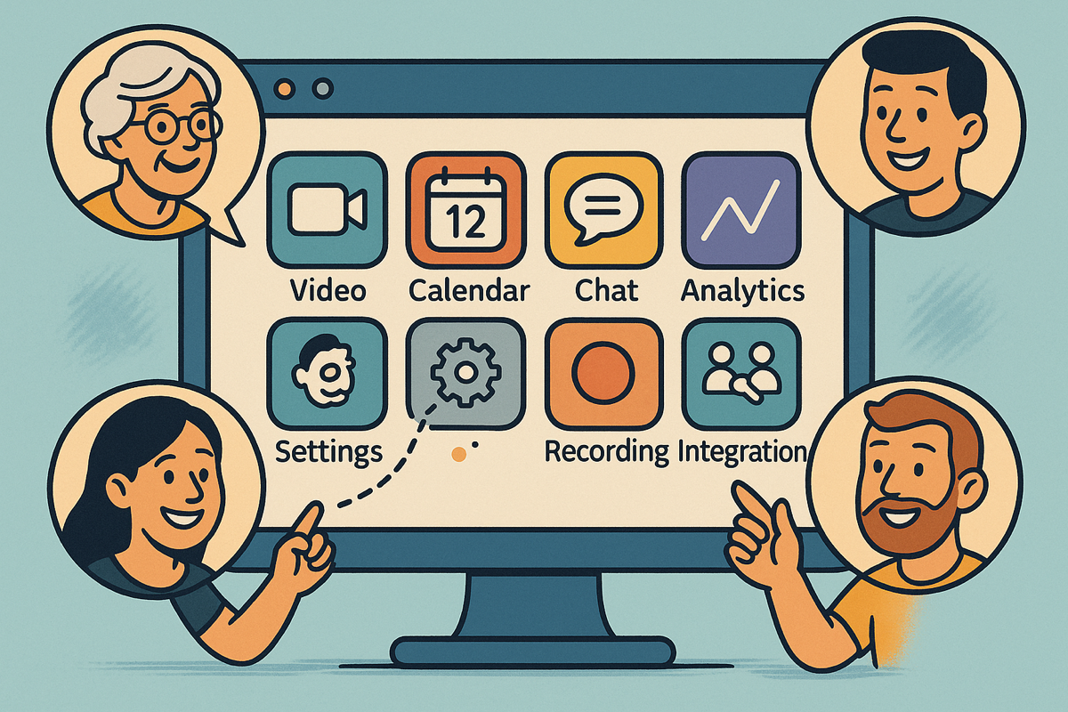
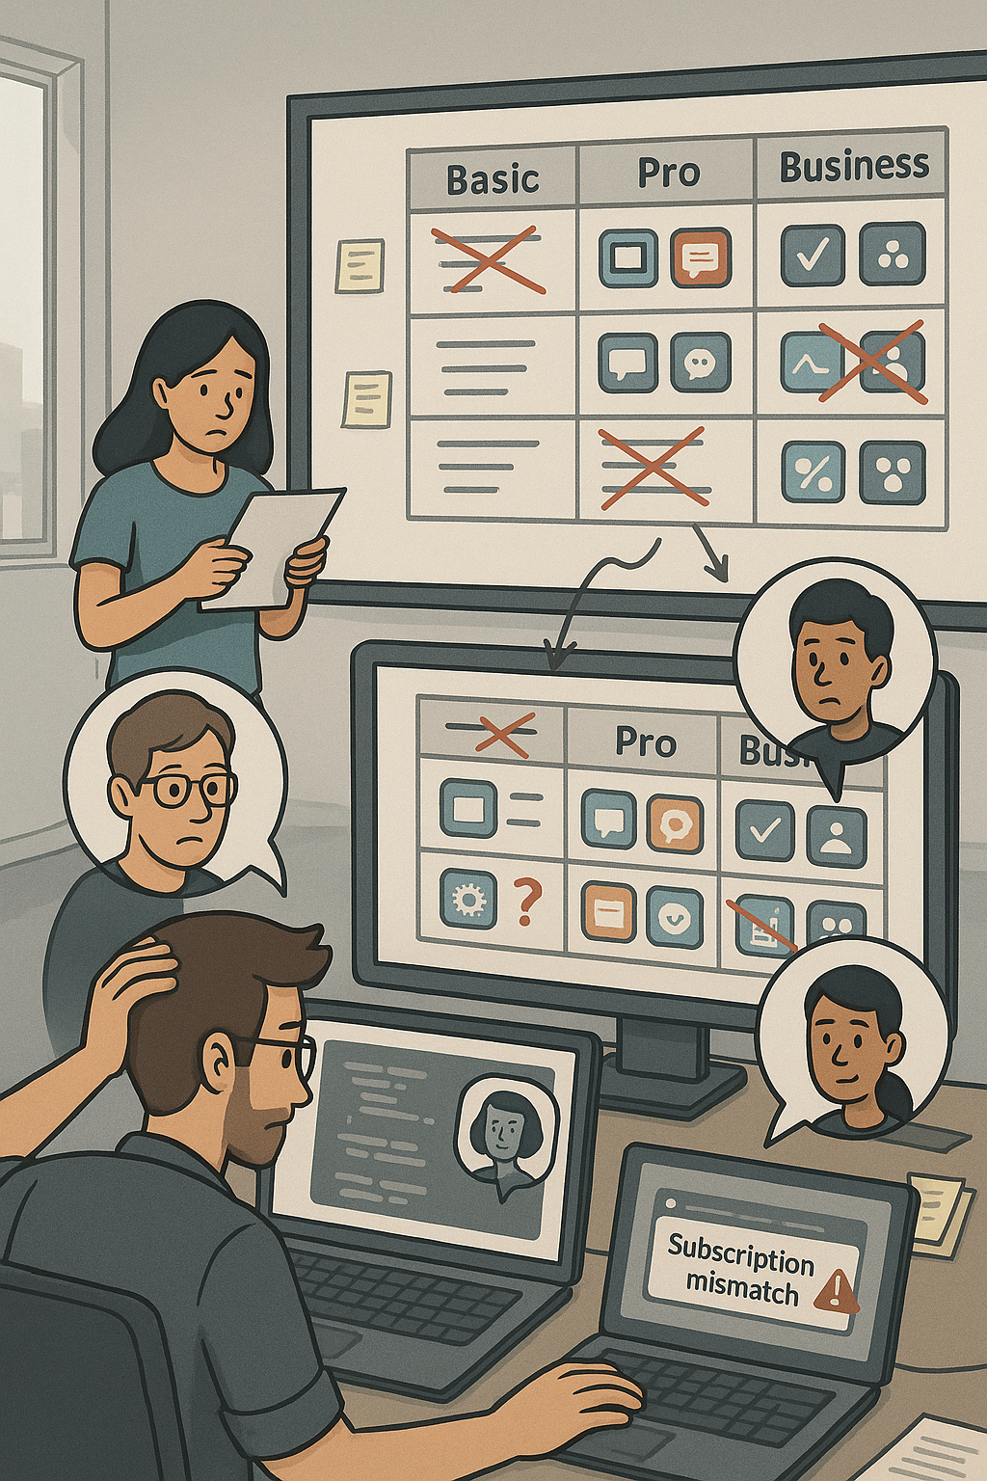



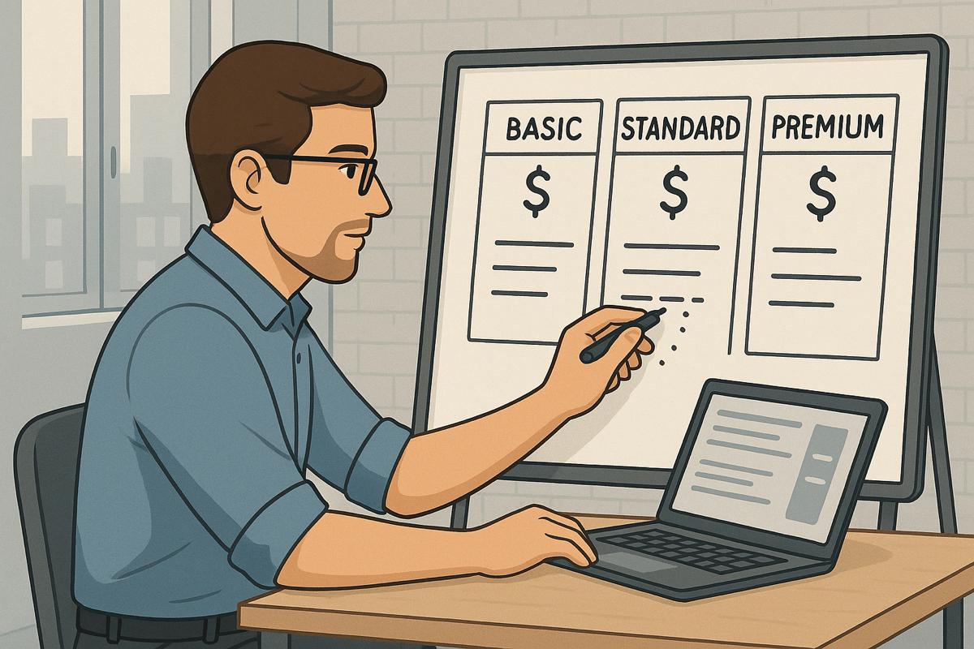
Teams
2
1
3
4

Slide 3




1
1
INTRODUCTION
2
PROPOSAL
3
USE CASE
4
CONCLUSIONS
2

Slide 4








User-oriented Pricings
García-Fernández, A., Parejo, J. A., & Ruiz-Cortés, A. (2024, May). Pricing4saas: towards a pricing model to drive the operation of saas.
In International Conference on Advanced Information Systems Engineering (pp. 47-54). Cham: Springer Nature Switzerland.
3
Notes:
Pricings include list of features
Features are distributed among plans
Plans determine the subset of features available by paying a certain Price
Plans can also impose strict or relaxed usage limits to some strategic features
Usuarlly, plans are designed to commit the needs of a certain group of users
Add-ons as extensions of plans for features that doesn’t exactly match any group of users defined by plans, or as a way of extending usage limits.
Pricings are structures that include a list of features, that are distributed among a set of plans, which determine the subset features that users will be able to access if they commit to pay the price. Moreover, plans can also impose strict or relaxed usage limits on some features, forcing users to upgrade their plan if they need to consume more resources.

Slide 5

User-oriented Pricings
García-Fernández, A., Parejo, J. A., & Ruiz-Cortés, A. (2024, May). Pricing4saas: towards a pricing model to drive the operation of saas.
In International Conference on Advanced Information Systems Engineering (pp. 47-54). Cham: Springer Nature Switzerland.
3
Notes:
Pricings are structures that include a list of features, that are distributed among a set of plans, which determine the subset features that users will be able to access if they commit to pay the price. Moreover, plans can also impose strict or relaxed usage limits on some features, forcing users to upgrade their plan if they need to consume more resources.

Slide 6




User-oriented Pricings
García-Fernández, A., Parejo, J. A., & Ruiz-Cortés, A. (2024, May). Pricing4saas: towards a pricing model to drive the operation of saas.
In International Conference on Advanced Information Systems Engineering (pp. 47-54). Cham: Springer Nature Switzerland.
3
Notes:
Pricings are structures that include a list of features, that are distributed among a set of plans, which determine the subset features that users will be able to access if they commit to pay the price. Moreover, plans can also impose strict or relaxed usage limits on some features, forcing users to upgrade their plan if they need to consume more resources.

Slide 7
User-oriented Pricings
García-Fernández, A., Parejo, J. A., & Ruiz-Cortés, A. (2024, May). Pricing4saas: towards a pricing model to drive the operation of saas.
In International Conference on Advanced Information Systems Engineering (pp. 47-54). Cham: Springer Nature Switzerland.
3
Notes:
Pricings are structures that include a list of features, that are distributed among a set of plans, which determine the subset features that users will be able to access if they commit to pay the price. Moreover, plans can also impose strict or relaxed usage limits on some features, forcing users to upgrade their plan if they need to consume more resources.

Slide 8



User-oriented Pricings
García-Fernández, A., Parejo, J. A., & Ruiz-Cortés, A. (2024, May). Pricing4saas: towards a pricing model to drive the operation of saas.
In International Conference on Advanced Information Systems Engineering (pp. 47-54). Cham: Springer Nature Switzerland.
3
Notes:
Pricings are structures that include a list of features, that are distributed among a set of plans, which determine the subset features that users will be able to access if they commit to pay the price. Moreover, plans can also impose strict or relaxed usage limits on some features, forcing users to upgrade their plan if they need to consume more resources.

Slide 9



How to Measure the Complexity of a Pricing?
Ⓢ(BASIC)
Ⓢ(BASIC, calls)
ICSOC’24
TSC’25?
Ⓢ(PRO)
Ⓢ(PRO, calls)
Ⓢ(BUSINESS)
Ⓢ(BUSINESS, calls)
3

Slide 10
Traditional DevOps life cyle
code
deploy
plan
Dev
Ops
build
release
operate
test
monitor
PROVIDER EVENTS (pe_{j})
pe_{1 (new plan)}
pe_{2 (new feature)}
pe_{3 (price change)}
2
pe_{j (feature reallocation)}
Notes:
Todos conocemos el ciclo DevOps original. Sin embargo, para sistemas SaaS que ofrecen planes de precios, éste se vuelve ineficiente y error-prone.
What would you say if I tell you that it becomes very unefficient when applied to SaaS with pricing models integrated?

Slide 11
Traditional DevOps life cyle
code
deploy
plan
Dev
Ops
build
release
operate
test
monitor
PROVIDER EVENTS (pe_{j})
pe_{1 (new plan)}
pe_{2 (new feature)}
pe_{3 (price change)}
2
pe_{j (feature reallocation)}
Notes:
¿Por qué? Porque incluso si el proveedor no desarrolla nuevas funcionalidades, cualquier cambio en el plan de precios —como restringir una feature en un plan existente o introducir un nuevo plan— activa un nuevo ciclo completo de DevOps.

Slide 12
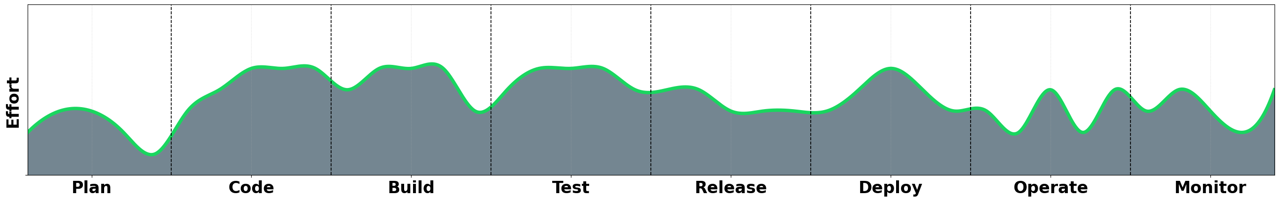
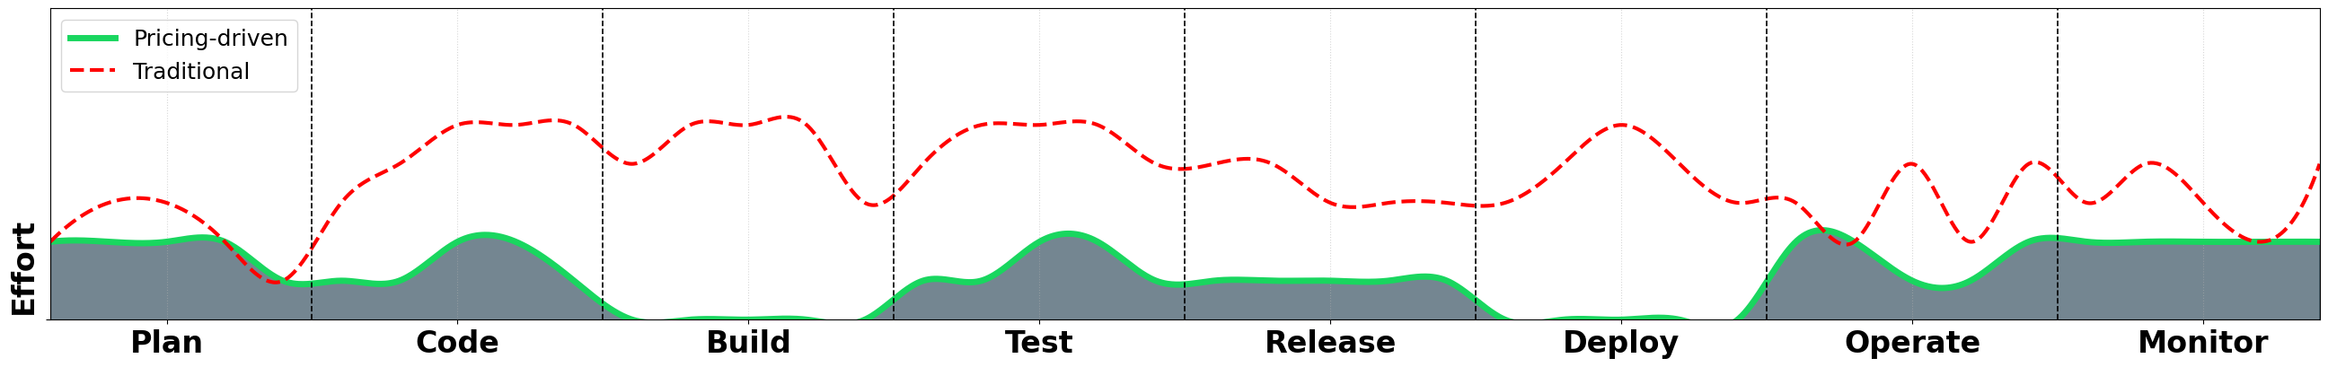
Traditional DevOps life cyle
code
deploy
plan
Dev
Ops
build
release
operate
test
monitor
2
Notes:
¿Por qué? Porque incluso si el proveedor no desarrolla nuevas funcionalidades, cualquier cambio en el plan de precios —como restringir una feature en un plan existente o introducir un nuevo plan— activa un nuevo ciclo completo de DevOps.

Slide 13


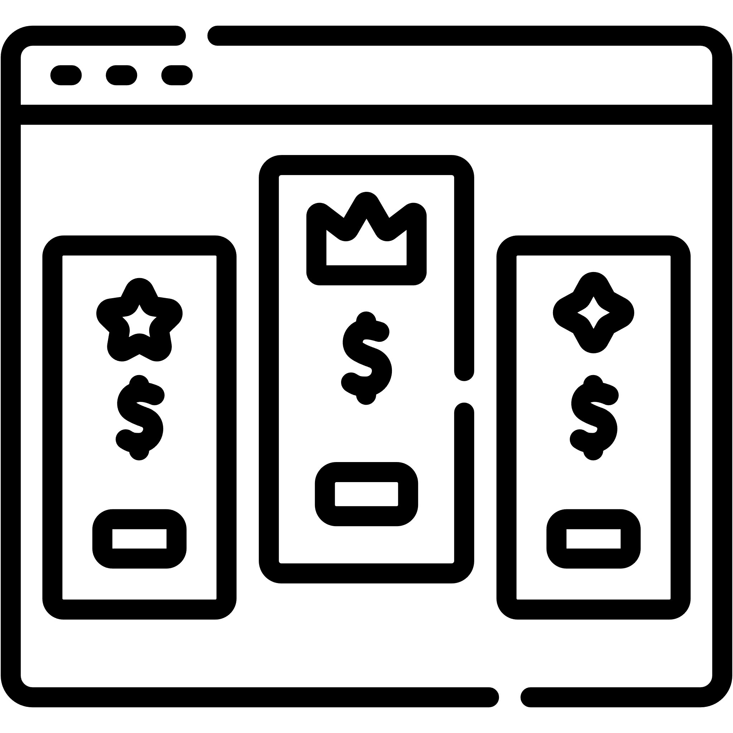

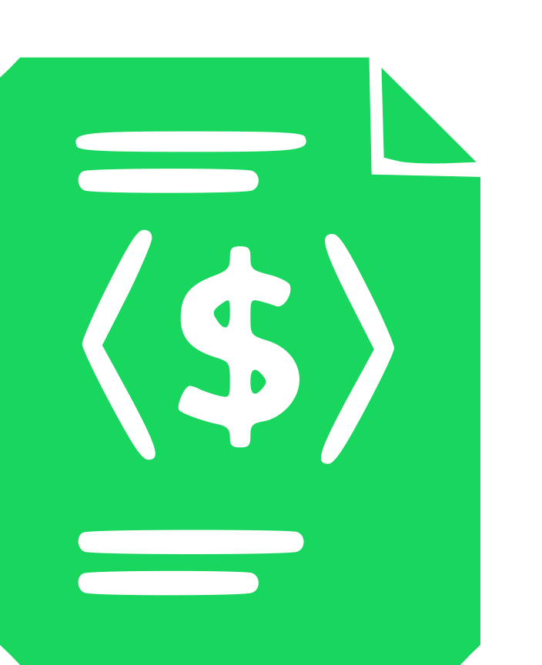



Pricing-driven Development and Operation of SaaS
code
deploy
build
operate
toggle
Ops
Dev
operate
plan
release
test
monitor
4
Notes:
En este contexto, proponemos en la tesis pricing-driven devops, un ciclo alternativo al original que gestiona este tipo de eventos de forma mucho más eficiente y directa, gracias a que considera tanto los pricings del servicio –así como las subscripciones de los usuarios del mismo– como elementos de primer nivel dentro del sistema.
Como vemos, en esta aproximación las fases “code” y “build” se sustituyen por la fase “toggle”, ya que no es necesario modificar el código del servicio para aplicar los cambios provocados por el evento. Además, la fase “deploy” desaparece, ya que las modificaciones se aplican en caliente, sin necesidad de redesplegar el sistema.
Sin embargo, como es de esperar, lograr este resultado no es tribial. (Aquí exponemos los 5 challenges del pricing-driven devops y a qué fases afecta):

Slide 14
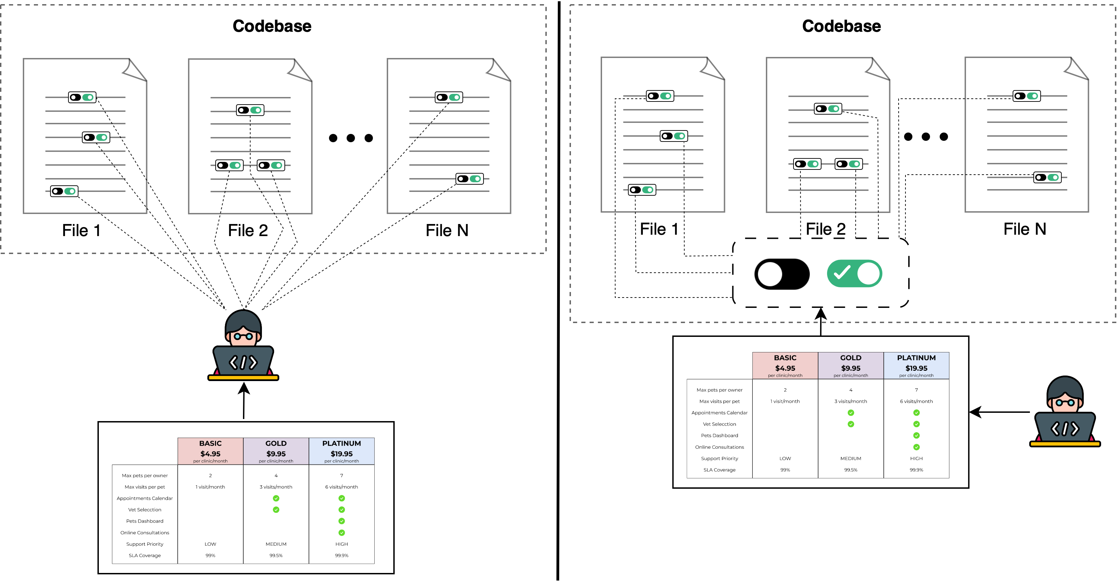
Pricing-driven Self-adaptation
code
deploy
build
operate
toggle
Ops
Dev
operate
plan
release
test
monitor
4
Notes:
En este contexto, proponemos en la tesis pricing-driven devops, un ciclo alternativo al original que gestiona este tipo de eventos de forma mucho más eficiente y directa, gracias a que considera tanto los pricings del servicio –así como las subscripciones de los usuarios del mismo– como elementos de primer nivel dentro del sistema.
Como vemos, en esta aproximación las fases “code” y “build” se sustituyen por la fase “toggle”, ya que no es necesario modificar el código del servicio para aplicar los cambios provocados por el evento. Además, la fase “deploy” desaparece, ya que las modificaciones se aplican en caliente, sin necesidad de redesplegar el sistema.
Sin embargo, como es de esperar, lograr este resultado no es tribial. (Aquí exponemos los 5 challenges del pricing-driven devops y a qué fases afecta):

Slide 15
Pricing-driven Self-adaptation
code
deploy
build
operate
toggle
Ops
Dev
operate
plan
release
test
monitor
4
Notes:
En este contexto, proponemos en la tesis pricing-driven devops, un ciclo alternativo al original que gestiona este tipo de eventos de forma mucho más eficiente y directa, gracias a que considera tanto los pricings del servicio –así como las subscripciones de los usuarios del mismo– como elementos de primer nivel dentro del sistema.
Como vemos, en esta aproximación las fases “code” y “build” se sustituyen por la fase “toggle”, ya que no es necesario modificar el código del servicio para aplicar los cambios provocados por el evento. Además, la fase “deploy” desaparece, ya que las modificaciones se aplican en caliente, sin necesidad de redesplegar el sistema.
Sin embargo, como es de esperar, lograr este resultado no es tribial. (Aquí exponemos los 5 challenges del pricing-driven devops y a qué fases afecta):

Slide 16
Traditional DevOps Life Cycle
code
deploy
plan
Dev
Ops
build
release
operate
test
monitor
PROVIDER EVENTS (pe_{j})
pe_{1 (new plan)}
pe_{2 (new feature)}
pe_{3 (price change)}
4
pe_{j (feature reallocation)}
Notes:
La idea aquí es presentar que:
Todos conocemos el ciclo DevOps tradicional.
El problema que tiene esta aproximación es que, en sistemas SaaS que tienen planes de precios, TODO tipo de cambios que surjan estas estructuras “lanza” un ciclo completo.
Esto no tiene sentido que sea así, pues por el simple hecho de hacer que una feature no esté disponible en el plan X, añadir un plan, etc; lanzar un ciclo completo de devops es ineficiente.

Slide 17
Traditional DevOps Life Cycle
code
deploy
plan
Dev
Ops
build
release
operate
test
monitor
PROVIDER EVENTS (pe_{j})
pe_{1 (new plan)}
pe_{2 (new feature)}
pe_{3 (price change)}
4
pe_{j (feature reallocation)}
Notes:
La idea aquí es presentar que:
Todos conocemos el ciclo DevOps tradicional.
El problema que tiene esta aproximación es que, en sistemas SaaS que tienen planes de precios, TODO tipo de cambios que surjan estas estructuras “lanza” un ciclo completo.
Esto no tiene sentido que sea así, pues por el simple hecho de hacer que una feature no esté disponible en el plan X, añadir un plan, etc; lanzar un ciclo completo de devops es ineficiente.

Slide 18
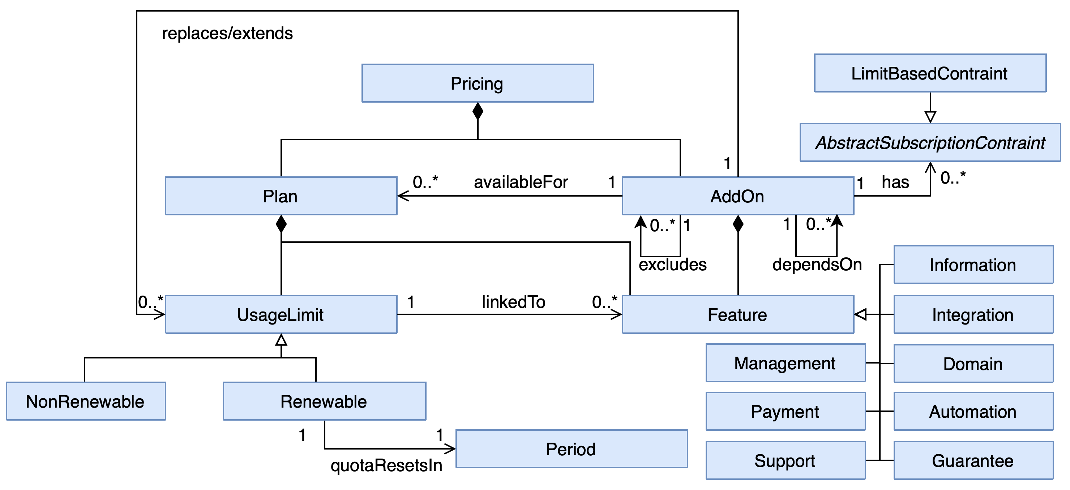
Pricing-driven Development and Operation of SaaS
toggle
Ops
Dev
operate
plan
release
test
monitor
iPricing
PROVIDER EVENTS (pe_{j})
pe_{1 (new plan)}
pe_{3 (price change)}
4
pe_{j (feature reallocation)}

Slide 19
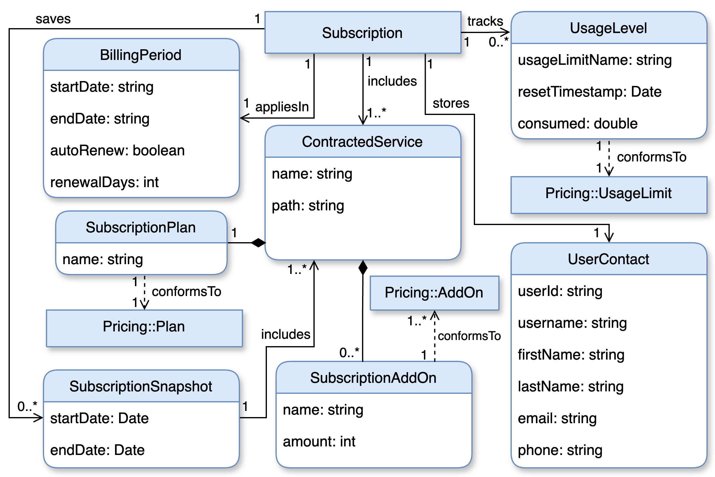
Pricing-driven Development and Operation of SaaS
toggle
Ops
Dev
operate
plan
release
test
monitor
iSubscription
PROVIDER EVENTS (pe_{j})
pe_{1 (new plan)}
pe_{3 (price change)}
4
pe_{j (feature reallocation)}
Notes:
¿Debo incluir esta info de las iSubscriptions? ¿O simplemente vender que aun no se ha definido esa parte?

Slide 20
Pricing-driven Self-adaptation
toggle
Ops
Dev
operate
plan
release
test
monitor
PROVIDER EVENTS (pe_{j})
pe_{1 (new plan)}
pe_{3 (price change)}
4
pe_{j (feature reallocation)}
Notes:
Pricing-driven Self-adaptation: Involucra a las nuevas fases “toggle” y “operate”. Su objetivo es diseñar soluciones (actualmente basadas en feature toggling) para lograr aplicar cambios en el plan de precios que tengan efecto directo en las configuraciones de los usuarios sin necesidad de tocar el código del sistema.

Slide 21
Pricing-driven Self-adaptation
toggle
Ops
Dev
operate
plan
release
test
monitor
PROVIDER EVENTS (pe_{j})
pe_{1 (new plan)}
pe_{3 (price change)}
4
pe_{j (feature reallocation)}
Notes:
Pricing-driven Self-adaptation: Involucra a las nuevas fases “toggle” y “operate”. Su objetivo es diseñar soluciones (actualmente basadas en feature toggling) para lograr aplicar cambios en el plan de precios que tengan efecto directo en las configuraciones de los usuarios sin necesidad de tocar el código del sistema.

Slide 22
Feature Toggles
5

Slide 23
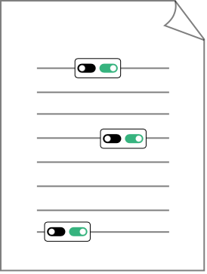
Anatomy of a feature toggle
SaaS Code File
5

Slide 24
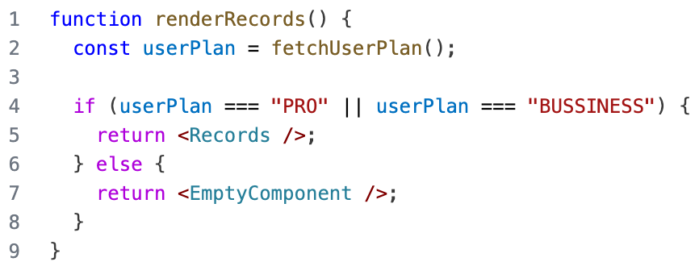
Anatomy of a feature toggle
Context
Rule
Feature
SaaS Code File
5

Slide 25
1
1
INTRODUCTION
2
PROPOSAL
3
USE CASE
4
CONCLUSIONS
6

Slide 26

7

Slide 27

Feature
Management
8

Slide 28

Feature
Management
Evaluation
Configuration
8
Notes:
De tal forma que si cambio la rule con la que se evalua la feature tb cambie el comportamiento
3. La rule es la misma, pero su evaluación es distinta en función del contexto, i.e. variables cuyo valor se determina en tiempo de ejecución, y pueden proceder de fuentes externas

Slide 29

Evaluation
Configuration
Feature
Evaluation
Feature
Management
8

Slide 30

Feature
Evaluation
Integration
Evaluation
Configuration
Feature
Management
8

Slide 31

Pricing-driven
Automation
Integration
$
Feature
Evaluation
Feature
Management
Evaluation
Configuration
8

Slide 32
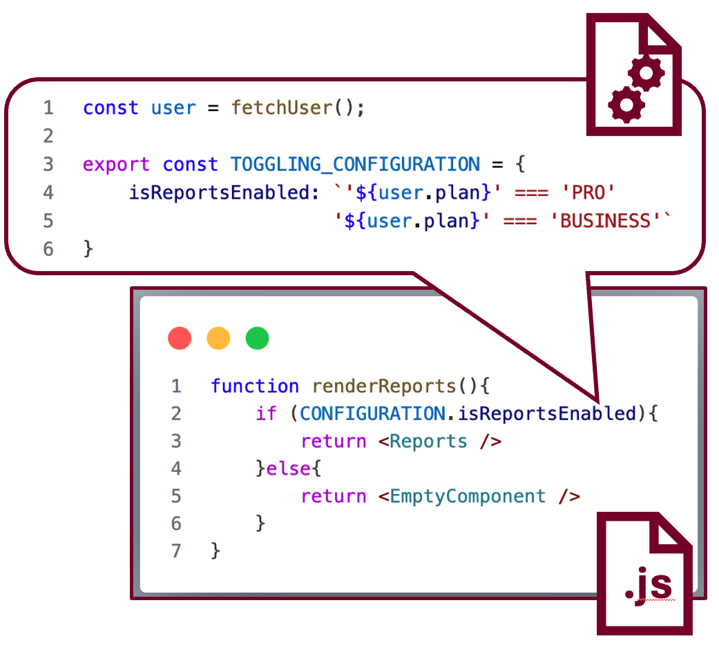
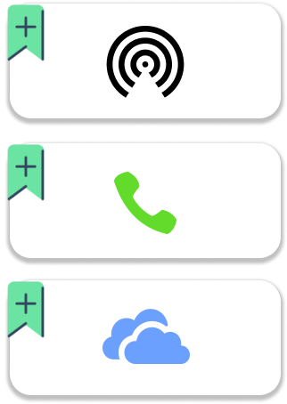
Feature Management
Feature
Management
1
2
1. Features CRUD Operations
4
2. Rules CRUD Operations
3. Feature Dependencies Management
4. Centralized Feature Management
Depends on
Excludes
8

Slide 33

Evaluation Configuration
Feature
Management
Evaluation
Configuration
1. Dynamic evaluation of features
2. Rules support boolean, numeric and string
values
3. Dynamic context aware evaluation
4. Custom attributes for evaluations
5. Compound rules
9
Notes:
De tal forma que si cambio la rule con la que se evalua la feature tb cambie el comportamiento
3. La rule es la misma, pero su evaluación es distinta en función del contexto, i.e. variables cuyo valor se determina en tiempo de ejecución, y pueden proceder de fuentes externas

Slide 34
Feature Evaluation
Evaluation
Configuration
Feature
Evaluation
1. Single feature evaluation
2. Multi-feature evaluation
Feature
Management
3. Support default values
4. Standardized boolean results
10

Slide 35
Integration
Feature
Evaluation
Integration
1. SDK Based
1.1 Server SDK
Evaluation
Configuration
1.2 Client SDK
2. API Based
2.1 Secure Communication
Feature
Management
11

Slide 36


Pricing-driven Automation
Pricing-driven
Automation
Integration
$
1. Pricing Model Support
2. Pricing-driven toggle generation
Feature
Evaluation
Feature
Management
3. Hot context change management
Evaluation
Configuration
12

Slide 37
Pricing-driven
Automation
Feature
Management
$
Integration
Evaluation
Configuration
Feature
Evaluation
8

Slide 38
1
1
INTRODUCTION
2
PROPOSAL
3
USE CASE
4
CONCLUSIONS
9

Slide 39






Previous analysis on the support of industry solutions to pricing-driven devops
4
18
18
feature toggling
tools
out of
3
categories
tools
can potentially support pricing-driven
self-adaptation
1
18
out of
tools
support pricing-driven self-adaptation
García-Fernández, A., Parejo, J. A., Cavero, F. J., & Ruiz-Cortés, A. (2024, December).
Racing the market: An industry support analysis for pricing-driven devops in SaaS.
In International Conference on Service-Oriented Computing (pp. 260-275).
10
Notes:
A lot of manual effort required: dado que muchas de las herramientas que ofrecen la tecnología necesaria para potencialmente gestionar la variabilidad, están orientadas a A/B testing, y solo permiten configurarlas manualmente desde la interfaz
Cannot perform multi-feature evaluations: which hinders performance in client environments.

Slide 40



Revisiting and Extending Literature Results with HORIZON
Togglz
Unleash
IMPOSSIBLE hot context change management
Features cannot be DELETED PROGRAMATICALLY
Pricing4SaaS
DevCycle
LaunchDarkly
Classified as CAPABLE
Rules must be configured MANUALLY
IMPROVE hot context change management
11

Slide 41
1
1
INTRODUCTION
2
PROPOSAL
3
USE CASE
4
CONCLUSIONS
12

Slide 42
Conclusions
DevCycle
Pricing-driven
Automation
Feature
Management
$
Unleash
Integration
Evaluation
Configuration
LaunchDarkly
Feature
Evaluation
13

Slide 43


HORIZON: a Classification and Comparison Framework for Pricing-driven Feature Toggling
Alejandro García-Fernández
(agarcia29@us.es)
Universidad de Sevilla, Seville, Spain
July 3rd, 2025

