Slide 1

Racing the Market: An Industry Support Analysis for
Pricing-Driven DevOps in SaaS
Alejandro García-Fernández, José Antonio Parejo, Francisco Javier Cavero, Antonio Ruiz-Cortés
Universidad de Sevilla, Seville, Spain
JCIS’25
09-11 September 2025
Notes:
Artículos largos y artículos ya publicados (relevantes): 15 minutos MÁXIMO de presentación + 5 minutos de discusión.
- 1ª tarjeta (color verde): quedan 5 minutos para alcanzar el tiempo máximo de presentación.
- 2ª tarjeta (color amarillo): quedan 2 minutos para alcanzar el tiempo máximo de presentación.
- 3ª tarjeta (color rojo): el tiempo máximo de presentación ha finalizado.

Slide 2

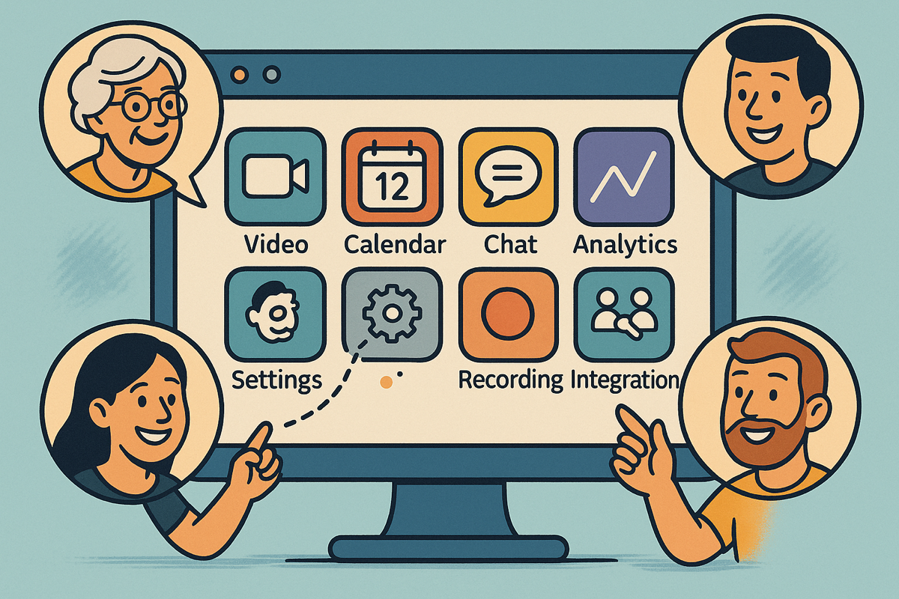
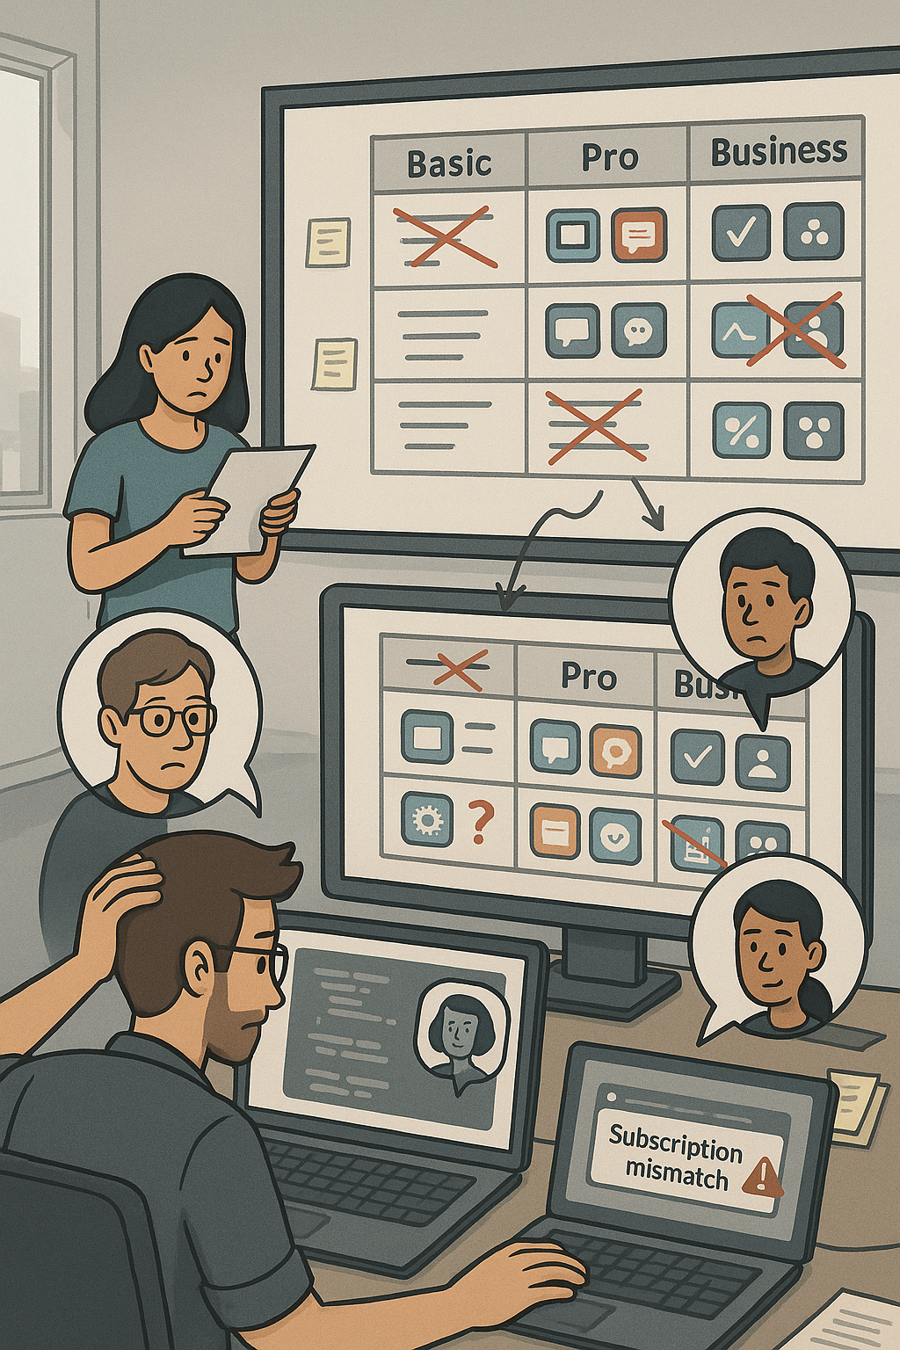



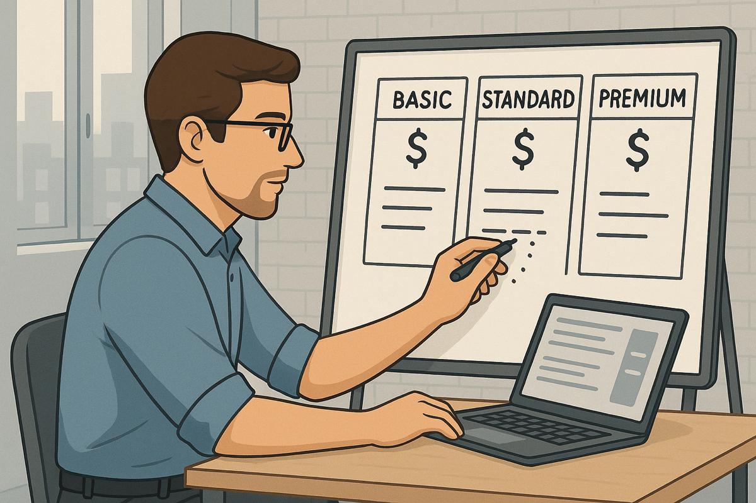
Teams
2
1
3
4
Notes:
But before we Delve into de details, let me tell you the story of John
Wouldn’t it be great for John to have a suite of tolos that can aware him in advance of any errors, warnings, and so on so that he can minimize the amount of these problems in production?

Slide 3
What is this about?
1.
Introduction
1.1
Pricings
1.2
Feature Toggles
1.3
Configuration and Evaluation Spaces
2.
Analysis of the Industry
3.
Conclusions & Future Work
3
Notes:
But let’s slow down a little bit. What is a pricing?

Slide 4








User-oriented Pricings
García-Fernández, A., Parejo, J. A., & Ruiz-Cortés, A. (2024, May). Pricing4saas: towards a pricing model to drive the operation of saas.
In International Conference on Advanced Information Systems Engineering (pp. 47-54). Cham: Springer Nature Switzerland.
4
Notes:
Pricings include list of features
Features are distributed among plans
Plans determine the subset of features available by paying a certain Price
Plans can also impose strict or relaxed usage limits to some strategic features
Usuarlly, plans are designed to commit the needs of a certain group of users
Add-ons as extensions of plans for features that doesn’t exactly match any group of users defined by plans, or as a way of extending usage limits.
Pricings are structures that include a list of features, that are distributed among a set of plans, which determine the subset features that users will be able to access if they commit to pay the price. Moreover, plans can also impose strict or relaxed usage limits on some features, forcing users to upgrade their plan if they need to consume more resources.

Slide 5

User-oriented Pricings
García-Fernández, A., Parejo, J. A., & Ruiz-Cortés, A. (2024, May). Pricing4saas: towards a pricing model to drive the operation of saas.
In International Conference on Advanced Information Systems Engineering (pp. 47-54). Cham: Springer Nature Switzerland.
4
Notes:
Pricings are structures that include a list of features, that are distributed among a set of plans, which determine the subset features that users will be able to access if they commit to pay the price. Moreover, plans can also impose strict or relaxed usage limits on some features, forcing users to upgrade their plan if they need to consume more resources.

Slide 6




User-oriented Pricings
García-Fernández, A., Parejo, J. A., & Ruiz-Cortés, A. (2024, May). Pricing4saas: towards a pricing model to drive the operation of saas.
In International Conference on Advanced Information Systems Engineering (pp. 47-54). Cham: Springer Nature Switzerland.
4
Notes:
Pricings are structures that include a list of features, that are distributed among a set of plans, which determine the subset features that users will be able to access if they commit to pay the price. Moreover, plans can also impose strict or relaxed usage limits on some features, forcing users to upgrade their plan if they need to consume more resources.

Slide 7
User-oriented Pricings
García-Fernández, A., Parejo, J. A., & Ruiz-Cortés, A. (2024, May). Pricing4saas: towards a pricing model to drive the operation of saas.
In International Conference on Advanced Information Systems Engineering (pp. 47-54). Cham: Springer Nature Switzerland.
4
Notes:
Pricings are structures that include a list of features, that are distributed among a set of plans, which determine the subset features that users will be able to access if they commit to pay the price. Moreover, plans can also impose strict or relaxed usage limits on some features, forcing users to upgrade their plan if they need to consume more resources.

Slide 8



User-oriented Pricings
García-Fernández, A., Parejo, J. A., & Ruiz-Cortés, A. (2024, May). Pricing4saas: towards a pricing model to drive the operation of saas.
In International Conference on Advanced Information Systems Engineering (pp. 47-54). Cham: Springer Nature Switzerland.
4
Notes:
Pricings are structures that include a list of features, that are distributed among a set of plans, which determine the subset features that users will be able to access if they commit to pay the price. Moreover, plans can also impose strict or relaxed usage limits on some features, forcing users to upgrade their plan if they need to consume more resources.

Slide 9



How to Measure the Complexity of a Pricing?
Ⓢ(BASIC)
Ⓢ(BASIC, calls)
ICSOC’24
TSC’25?
Ⓢ(PRO)
Ⓢ(PRO, calls)
Ⓢ(BUSINESS)
Ⓢ(BUSINESS, calls)
4

Slide 10
Configuration
Space
Ⓢ(BASIC)
Ⓢ(BASIC, calls)
TSC’25?
Ⓢ(PRO)
Ⓢ(PRO, calls)
Ⓢ(BUSINESS)
Ⓢ(BUSINESS, calls)
4
Notes:
El pricing es una forma compacta de representar el espacio de configuración del SaaS

Slide 11

Pricings’ Configuration Space
Ⓢ(BASIC)
Ⓢ(GOLD)
Ⓢ(PLAT.)
5

Slide 12
Pricings’ Configuration Space
Ⓢ(BASIC)
Ⓢ(BASIC, calls)
Ⓢ(BASIC, cloud storage)
Ⓢ(BASIC, calls, cloud storage)
Ⓢ(GOLD)
Ⓢ(GOLD, calls)
Ⓢ(GOLD, cloud storage)
Ⓢ(GOLD, calls, cloud storage)
Ⓢ(PLAT.)
CALLS
Ⓢ(PLAT., calls)
Ⓢ(PLAT., cloud storage)
Ⓢ(PLAT., calls, cloud storage)
CLOUD STORAGE
5

Slide 13





Operation of SaaS with Pricing
FEATURE TOGGLE
6
Notes:
To integrate pricing within applications, developers use feature toggles, a technique that allows modifying the behavior of a system without changing the code. At the end of the day, they are still Boolean conditions that use a specific attribute of each user, for example in the plan they have contracted, to determine whether or not they have access to the feature.

Slide 14
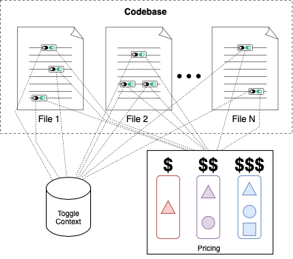
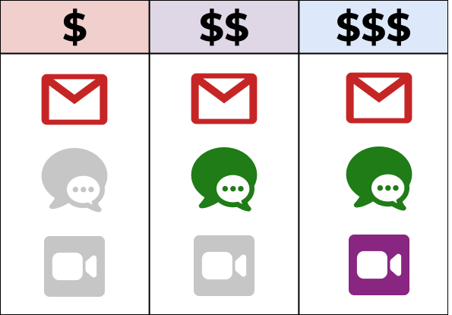
Feature Toggles
7
Notes:
In the SaaS code, feature toggles are if-then blocks that depend both on the restrictions imposed by the pricing (e.g. feature user is subscribed to the PRO plan?), and a external context, like the current user’s subscription or their use of a feature.
Unfortunately, the use of feature toggles also increases the complexity of managing the service, since they generate “one of the worst kinds of technical debt” [14] and transform testing into a combinatorial problem [12]

Slide 15

Feature Toggles
7
Notes:
In the SaaS code, feature toggles are if-then blocks that depend both on the restrictions imposed by the pricing (e.g. feature user is subscribed to the PRO plan?), and a external context, like the current user’s subscription or their use of a feature.
Unfortunately, the use of feature toggles also increases the complexity of managing the service, since they generate “one of the worst kinds of technical debt” [14] and transform testing into a combinatorial problem [12]

Slide 16
Feature Toggles
: Evaluation Space
8
evaluation space size
7
Notes:
The concept of pricing’s evaluation space that we introduce becomes crucial in this context. It is defined as the minimum set of feature toggles that have to be evaluated in order to operate all features governed by a pricing and translated into code. For example, here we have 8, but

Slide 17
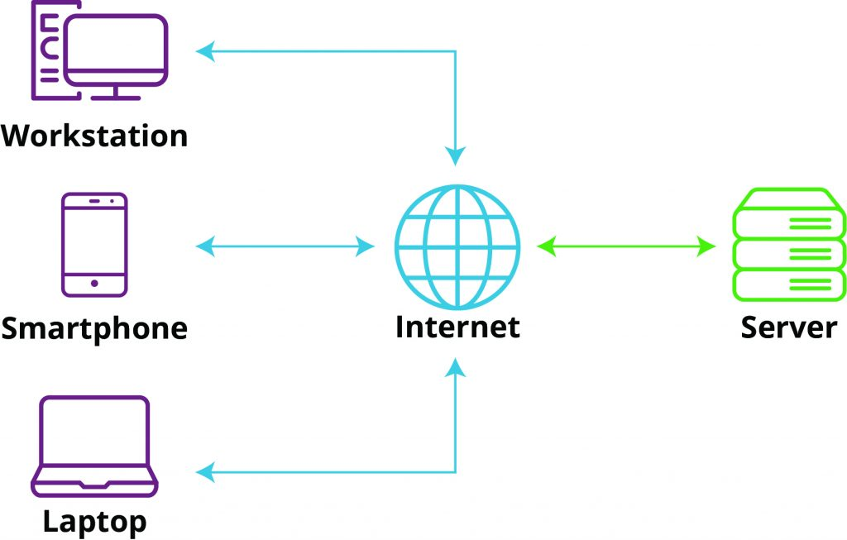
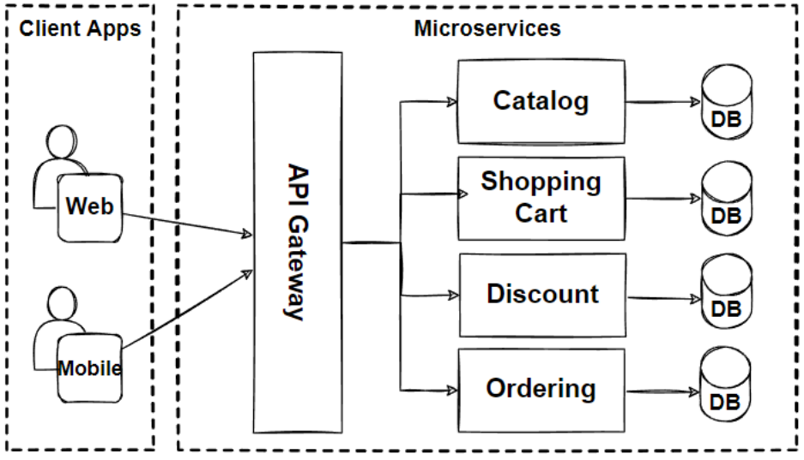
Feature Toggles
: Evaluation Space
8
8+
…
32
7
Notes:
But this may change regarding on the architecture employed. For example, suposing that all features of our imaginary pricing appear in every service of a microservice architecture, like the one shown here, with 4 services, the evaluation space increases to 32.

Slide 18
What is this about?
1.
Introduction
2.
Analysis of the Industry
3.
Conclusions & Future Work
8

Slide 19
Analysis of the Industry: Research Questions
1
How are pricings’ configuration and evaluation spaces evolving in modern SaaS?
2
Are current feature toggling tools appropriate for optimizing pricing-driven feature toggling?
3
Does current feature toggling tools’ underlying models provide enough expressiveness to represent real-world pricings?
9
Notes:
RQ1: How are pricings’ configuration and evaluation spaces evolv-
ing in modern SaaS? Given that in recent years SaaS pricing models have
incorporated new elements, such as add-ons, and modified their structure (in
terms of plans and features); this research question addresses several key as-
pects of pricing dynamics to uncover the trends in design and complexity of these
structures, thus identifying the challenges faced by SaaS providers to man-
age Pricing-driven Development and Operation of SaaS.
RQ2: Are feature toggling tools appropriate for optimizing pricing-
driven feature toggling?Given the dimensions of variability of SaaS pricings,
projected into their configuration and evaluation spaces, this research question
aims to identify whether a gap exists between the evolution of pricings and the
current industry tooling.

Slide 20
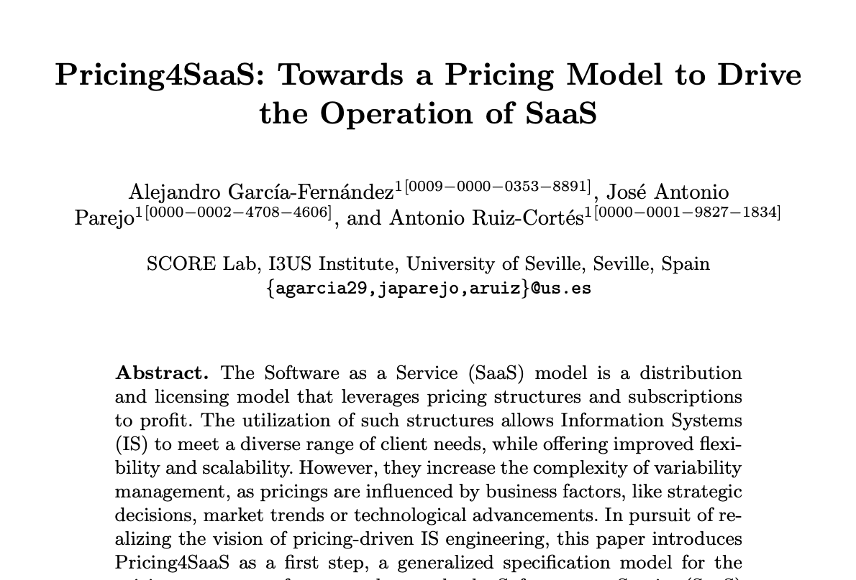










RQ₁: How are pricings’ configuration and evaluation spaces evolving in modern SaaS?
16
Available on webarchive
+4 years of trackable history
162
Clear list of features in
most snapshots
30
30 SaaS
10
Notes:
Para este punto me deben quedar 5 minutos, por lo que explicaré muy brevemente las dos validaciones. En la primera contaré como he construido el caso práctico sobre petclinic, y en la segunda que los alumnos de PSG2 han hecho uso de las librerías desarrolladas para el primer caso de uso para integrar planes de precios de forma dinámica dentro de sus proyectos de curso, lo que nos ha permitido identificar algunos puntos de mejora que fijo como trabajo futuro durante el doctorado (solo señalaré los principales).

Slide 21
RQ₁: How are pricings’ configuration and evaluation spaces evolving in modern SaaS?
16
Available on webarchive
+4 years of trackable history
162
Clear list of features in
most snapshots
30
30 SaaS
10
Notes:
Para este punto me deben quedar 5 minutos, por lo que explicaré muy brevemente las dos validaciones. En la primera contaré como he construido el caso práctico sobre petclinic, y en la segunda que los alumnos de PSG2 han hecho uso de las librerías desarrolladas para el primer caso de uso para integrar planes de precios de forma dinámica dentro de sus proyectos de curso, lo que nos ha permitido identificar algunos puntos de mejora que fijo como trabajo futuro durante el doctorado (solo señalaré los principales).

Slide 22
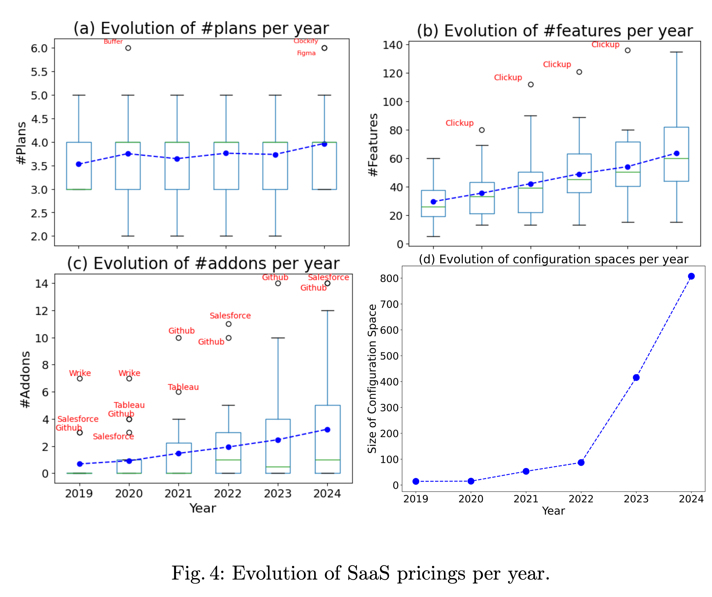
RQ₁: How are pricings’ configuration and evaluation spaces evolving in modern SaaS?
Evolution of the
configuration space
Evolution of the
evaluation space
11
Notes:
(1) Configuration spaces are experimenting an exponential rise due to the increase
in the number of add-ons.
GROWTH
(2) The increasing number of features is expanding the size of evaluation spaces,
making the management of SaaS pricings more challenging.
…
The Mann-WhitneyUtests,were conducted based
on the results of normality and homoscedasticity tests, to compare the number of
plans, features, and add-ons between 2019 and 2024.
The differences were statistically significant across all compared magnitudes

Slide 23
RQ₁: How are pricings’ configuration and evaluation spaces evolving in modern SaaS?
Evolution of the
configuration space
Evolution of the
evaluation space
Notes:
(1) Configuration spaces are experimenting an exponential rise due to the increase
in the number of add-ons.
(2) The increasing number of features is expanding the size of evaluation spaces,
making the management of SaaS pricings more challenging.
…
The Mann-WhitneyUtests,were conducted based
on the results of normality and homoscedasticity tests, to compare the number of
plans, features, and add-ons between 2019 and 2024.
The differences were statistically significant across all compared magnitudes

Slide 24
RQ₁: How are pricings’ configuration and evaluation spaces evolving in modern SaaS?
Evolution of the
configuration space
Evolution of the
evaluation space
Notes:
(1) Configuration spaces are experimenting an exponential rise due to the increase
in the number of add-ons.
(2) The increasing number of features is expanding the size of evaluation spaces,
making the management of SaaS pricings more challenging.
…
The Mann-WhitneyUtests,were conducted based
on the results of normality and homoscedasticity tests, to compare the number of
plans, features, and add-ons between 2019 and 2024.
The differences were statistically significant across all compared magnitudes

Slide 25
RQ₁: How are pricings’ configuration and evaluation spaces evolving in modern SaaS?
Evolution of the
configuration space
Evolution of the
evaluation space
Notes:
(1) Configuration spaces are experimenting an exponential rise due to the increase
in the number of add-ons.
(2) The increasing number of features is expanding the size of evaluation spaces,
making the management of SaaS pricings more challenging.
…
The Mann-WhitneyUtests,were conducted based
on the results of normality and homoscedasticity tests, to compare the number of
plans, features, and add-ons between 2019 and 2024.
The differences were statistically significant across all compared magnitudes

Slide 26
RQ₁: How are pricings’ configuration and evaluation spaces evolving in modern SaaS?
Evolution of the
configuration space
Evolution of the
evaluation space
Notes:
(1) Configuration spaces are experimenting an exponential rise due to the increase
in the number of add-ons.
(2) The increasing number of features is expanding the size of evaluation spaces,
making the management of SaaS pricings more challenging.
…
The Mann-WhitneyUtests,were conducted based
on the results of normality and homoscedasticity tests, to compare the number of
plans, features, and add-ons between 2019 and 2024.
The differences were statistically significant across all compared magnitudes

Slide 27

RQ₁: How are pricings’ configuration and evaluation spaces evolving in modern SaaS?
Evolution of the
configuration space
APPROVED
Evolution of the
evaluation space
Mann-Whitney U tests
12
Notes:
(1) Configuration spaces are experimenting an exponential rise due to the increase
in the number of add-ons.
(2) The increasing number of features is expanding the size of evaluation spaces,
making the management of SaaS pricings more challenging.
…
The Mann-WhitneyUtests,were conducted based
on the results of normality and homoscedasticity tests, to compare the number of
plans, features, and add-ons between 2019 and 2024.
The differences were statistically significant across all compared magnitudes

Slide 28




RQ₂: Are current feature toggling tools appropriate for optimizing pricing-driven feature toggling?
keyword
snowballing
5
21
alternativeto.net
“feature toggling tool”
“feature toggling library”
13
Notes:
Para este punto me deben quedar 5 minutos, por lo que explicaré muy brevemente las dos validaciones. En la primera contaré como he construido el caso práctico sobre petclinic, y en la segunda que los alumnos de PSG2 han hecho uso de las librerías desarrolladas para el primer caso de uso para integrar planes de precios de forma dinámica dentro de sus proyectos de curso, lo que nos ha permitido identificar algunos puntos de mejora que fijo como trabajo futuro durante el doctorado (solo señalaré los principales).

Slide 29
RQ₂: Are current feature toggling tools appropriate for optimizing pricing-driven feature toggling?
14
Notes:
L3: Pricing-aware evaluation. Automatically generate dynamic evaluation expressions for feature toggles from a serialized pricing. For instance, the evaluation shown in Fig. would be replaced by: userSubscription[“appointmentsCalendar”]

Slide 30


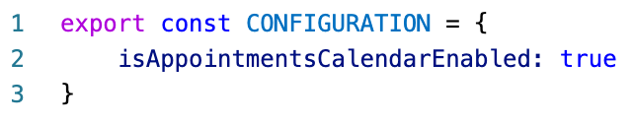
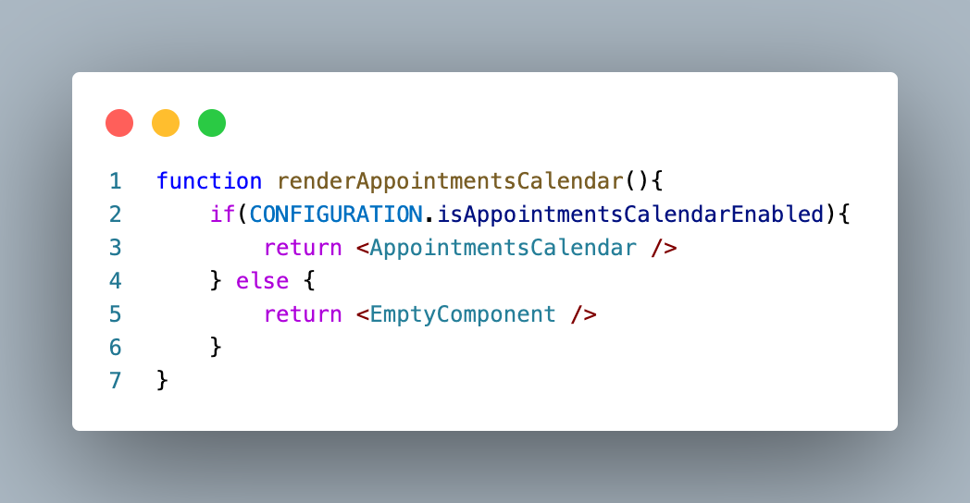
RQ₂: Are current feature toggling tools appropriate for optimizing pricing-driven feature toggling?
L1
.js
14
Notes:
L3: Pricing-aware evaluation. Automatically generate dynamic evaluation expressions for feature toggles from a serialized pricing. For instance, the evaluation shown in Fig. would be replaced by: userSubscription[“appointmentsCalendar”]

Slide 31
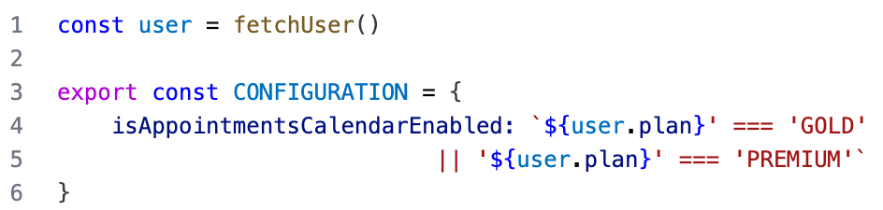
RQ₂: Are current feature toggling tools appropriate for optimizing pricing-driven feature toggling?
L2
L1
.js
14
Notes:
L3: Pricing-aware evaluation. Automatically generate dynamic evaluation expressions for feature toggles from a serialized pricing. For instance, the evaluation shown in Fig. would be replaced by: userSubscription[“appointmentsCalendar”]

Slide 32
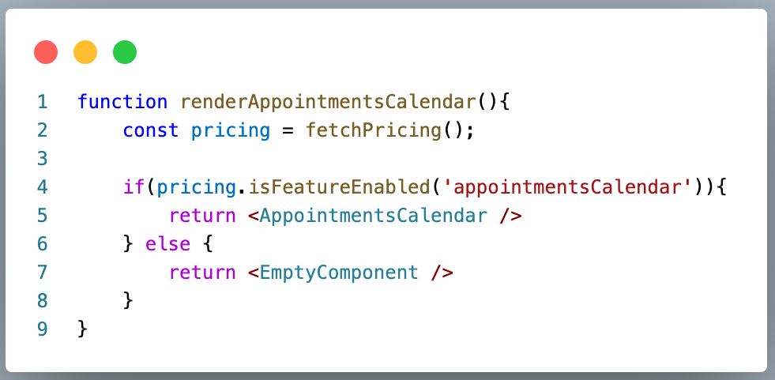
RQ₂: Are current feature toggling tools appropriate for optimizing pricing-driven feature toggling?
L3
L2
L1
.js
14
Notes:
L3: Pricing-aware evaluation. Automatically generate dynamic evaluation expressions for feature toggles from a serialized pricing. For instance, the evaluation shown in Fig. would be replaced by: userSubscription[“appointmentsCalendar”]

Slide 33
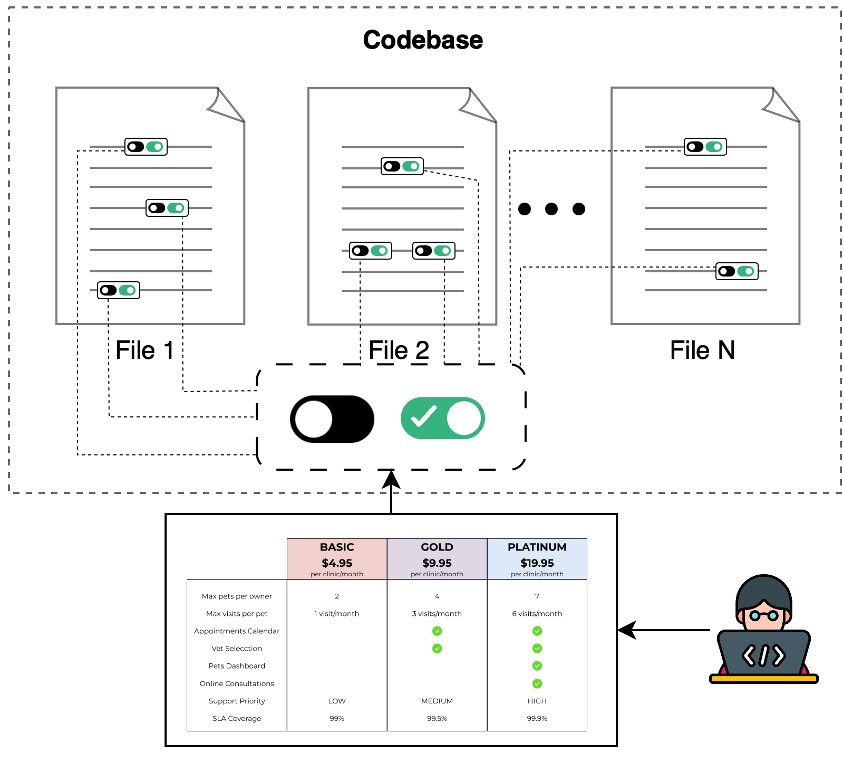
RQ₂: Are current feature toggling tools appropriate for optimizing pricing-driven feature toggling?
L3
L2
L1
.js
14
Notes:
L3: Pricing-aware evaluation. Automatically generate dynamic evaluation expressions for feature toggles from a serialized pricing. For instance, the evaluation shown in Fig. would be replaced by: userSubscription[“appointmentsCalendar”]

Slide 34
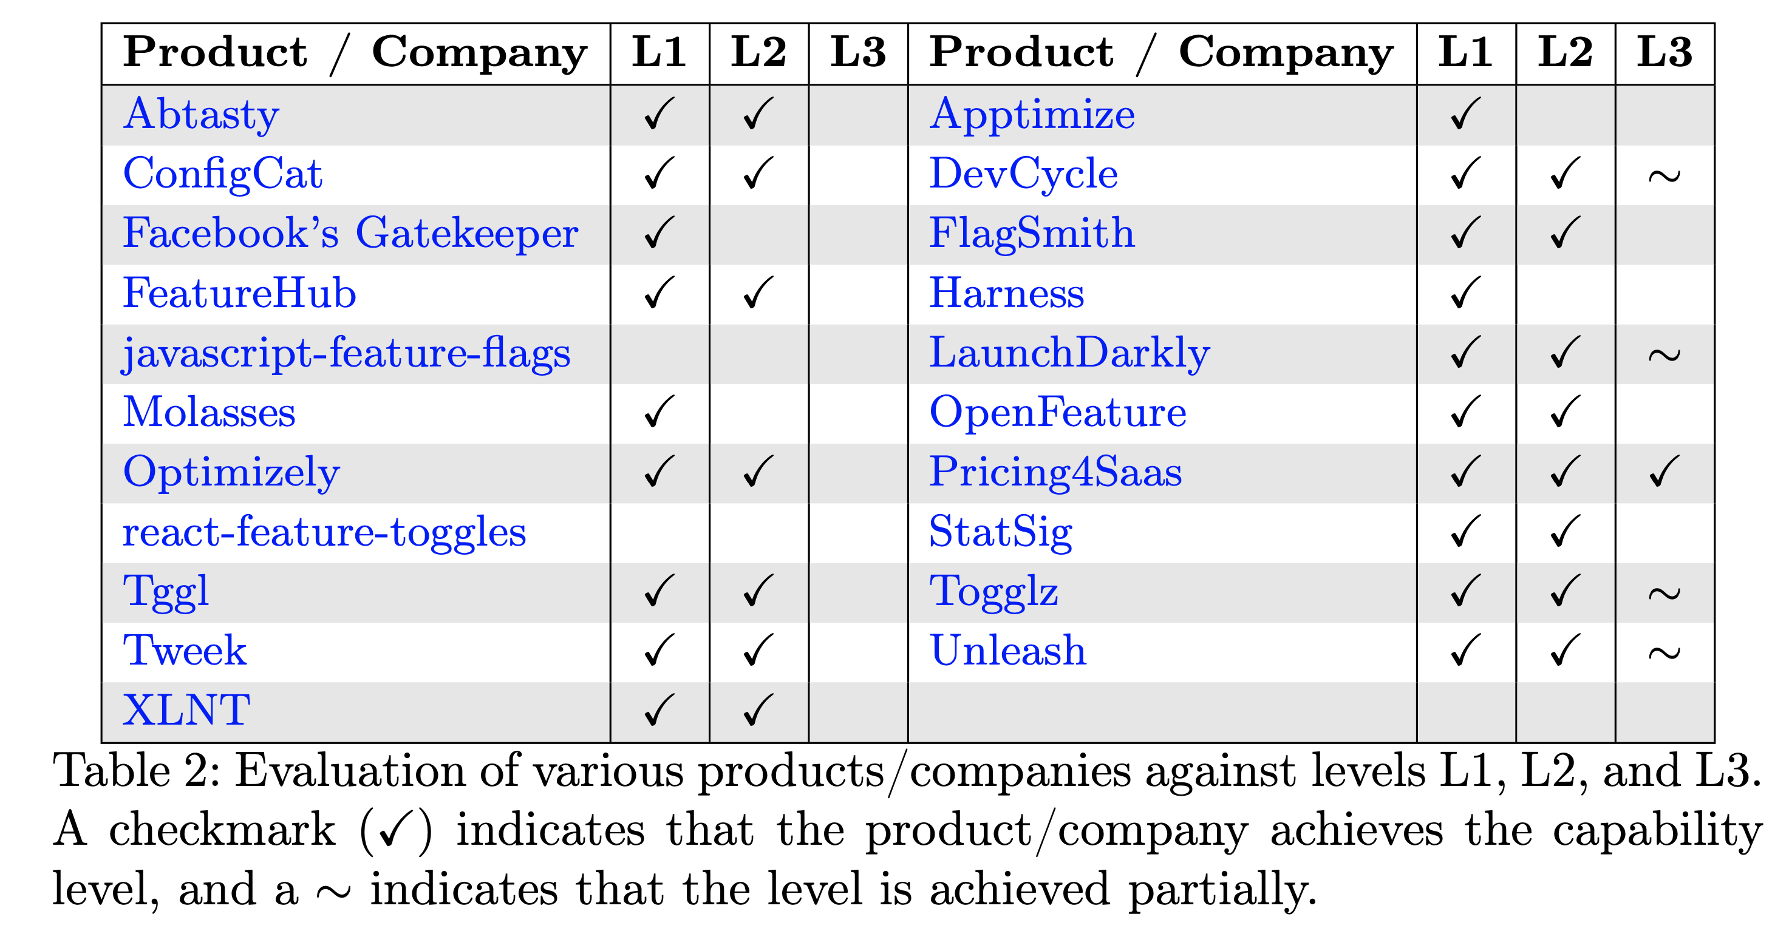
RQ₂: Are current feature toggling tools appropriate for optimizing pricing-driven feature toggling?
15
Notes:
(1) Only one of the feature toggling solutions currently supports the implementa-
tion of pricing-driven feature toggling.
(2) Only a small set of industrial solutions have the necessary elements to poten-
tially support pricing-driven feature toggling.

Slide 35
RQ₃: Does current feature toggling tools’ underlying models provide enough expressiveness to represent real-world pricings?
16
Notes:
(1) Only one of the feature toggling solutions currently supports the implementa-
tion of pricing-driven feature toggling.
(2) Only a small set of industrial solutions have the necessary elements to poten-
tially support pricing-driven feature toggling.

Slide 36
RQ₃: Does current feature toggling tools’ underlying models provide enough expressiveness to represent real-world pricings?
RQ₃: Does Pricing2Yaml provide enough expressiveness to represent real-world pricings?
16
Notes:
(1) Only one of the feature toggling solutions currently supports the implementa-
tion of pricing-driven feature toggling.
(2) Only a small set of industrial solutions have the necessary elements to poten-
tially support pricing-driven feature toggling.

Slide 37


RQ₃: Does Pricing2Yaml provide enough expressiveness to represent real world pricings?
01
Set prices as formulas
02
v3.0
Modeling of inter-addons constraints
03
Personalized subscription periods
17
Notes:
(1) Only one of the feature toggling solutions currently supports the implementa-
tion of pricing-driven feature toggling.
(2) Only a small set of industrial solutions have the necessary elements to poten-
tially support pricing-driven feature toggling.

Slide 38
What is this about?
1.
Introduction
2.
Analysis of the Industry
3.
Conclusions & Future Work
18

Slide 39
Conclusions
4
19
Notes:
BUSINESS DOMAIN/AREA

Slide 40

Pricing-driven Development & Operation of SaaS
20
Notes:
In this context, this is where the visión of pricing-driven Development and Operation of SaaS appears. It aims to reduce the time to market of derived from pricing-driven changes, as well as the risks associated with human intervention.
This approach involves moving from an error-prone imperative programming model to a declarative specification model in which, if the pricing is defined correctly, the application of its conditions in the codebase is, by definition, correct.

Slide 41
Traditional DevOps life cyle
code
deploy
plan
Dev
Ops
build
release
operate
test
monitor
PROVIDER EVENTS (pe_{j})
pe_{1 (new plan)}
pe_{2 (new feature)}
pe_{3 (price change)}
pe_{j (feature reallocation)}
21
Notes:
Todos conocemos el ciclo DevOps original. Sin embargo, para sistemas SaaS que ofrecen planes de precios, éste se vuelve ineficiente y error-prone.
What would you say if I tell you that it becomes very unefficient when applied to SaaS with pricing models integrated?

Slide 42
Traditional DevOps life cyle
code
deploy
plan
Dev
Ops
build
release
operate
test
monitor
PROVIDER EVENTS (pe_{j})
pe_{1 (new plan)}
pe_{2 (new feature)}
pe_{3 (price change)}
pe_{j (feature reallocation)}
21
Notes:
¿Por qué? Porque incluso si el proveedor no desarrolla nuevas funcionalidades, cualquier cambio en el plan de precios —como restringir una feature en un plan existente o introducir un nuevo plan— activa un nuevo ciclo completo de DevOps.

Slide 43
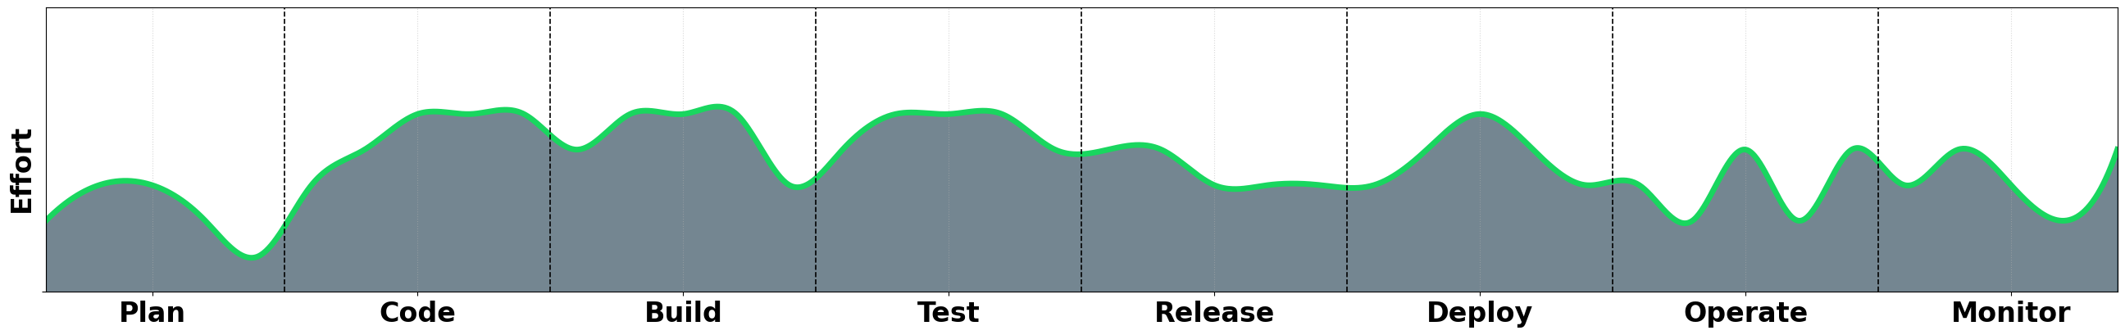
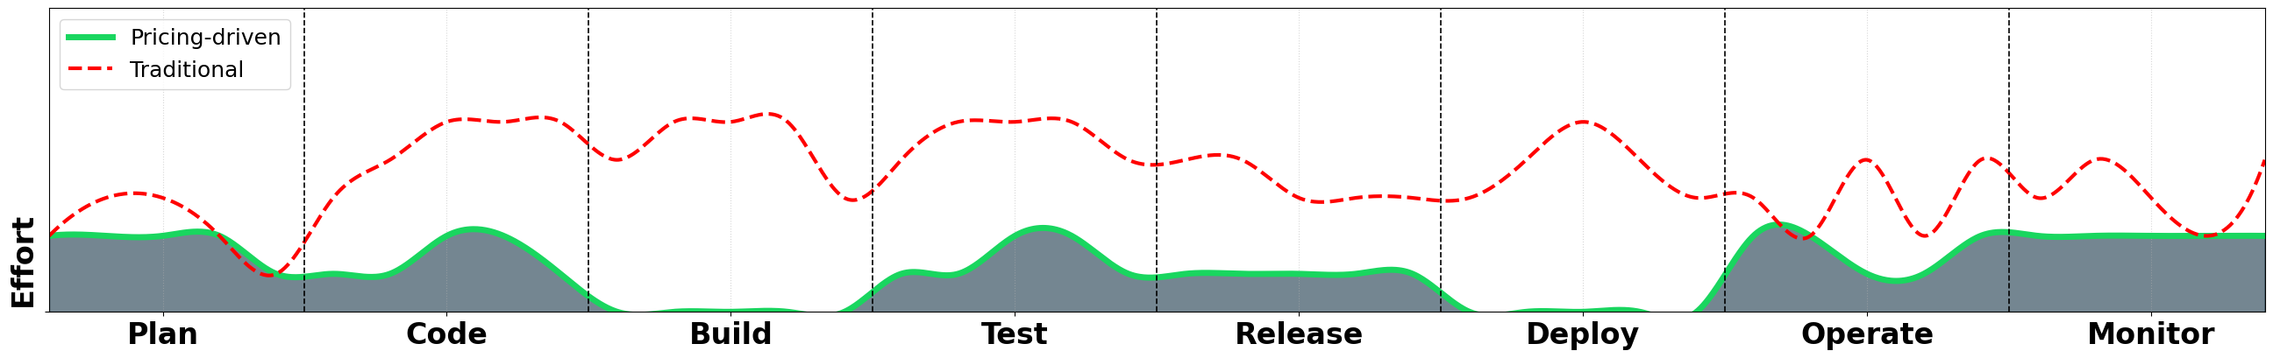
Traditional DevOps life cyle
code
deploy
plan
Dev
Ops
build
release
operate
test
monitor
21
Notes:
¿Por qué? Porque incluso si el proveedor no desarrolla nuevas funcionalidades, cualquier cambio en el plan de precios —como restringir una feature en un plan existente o introducir un nuevo plan— activa un nuevo ciclo completo de DevOps.

Slide 44


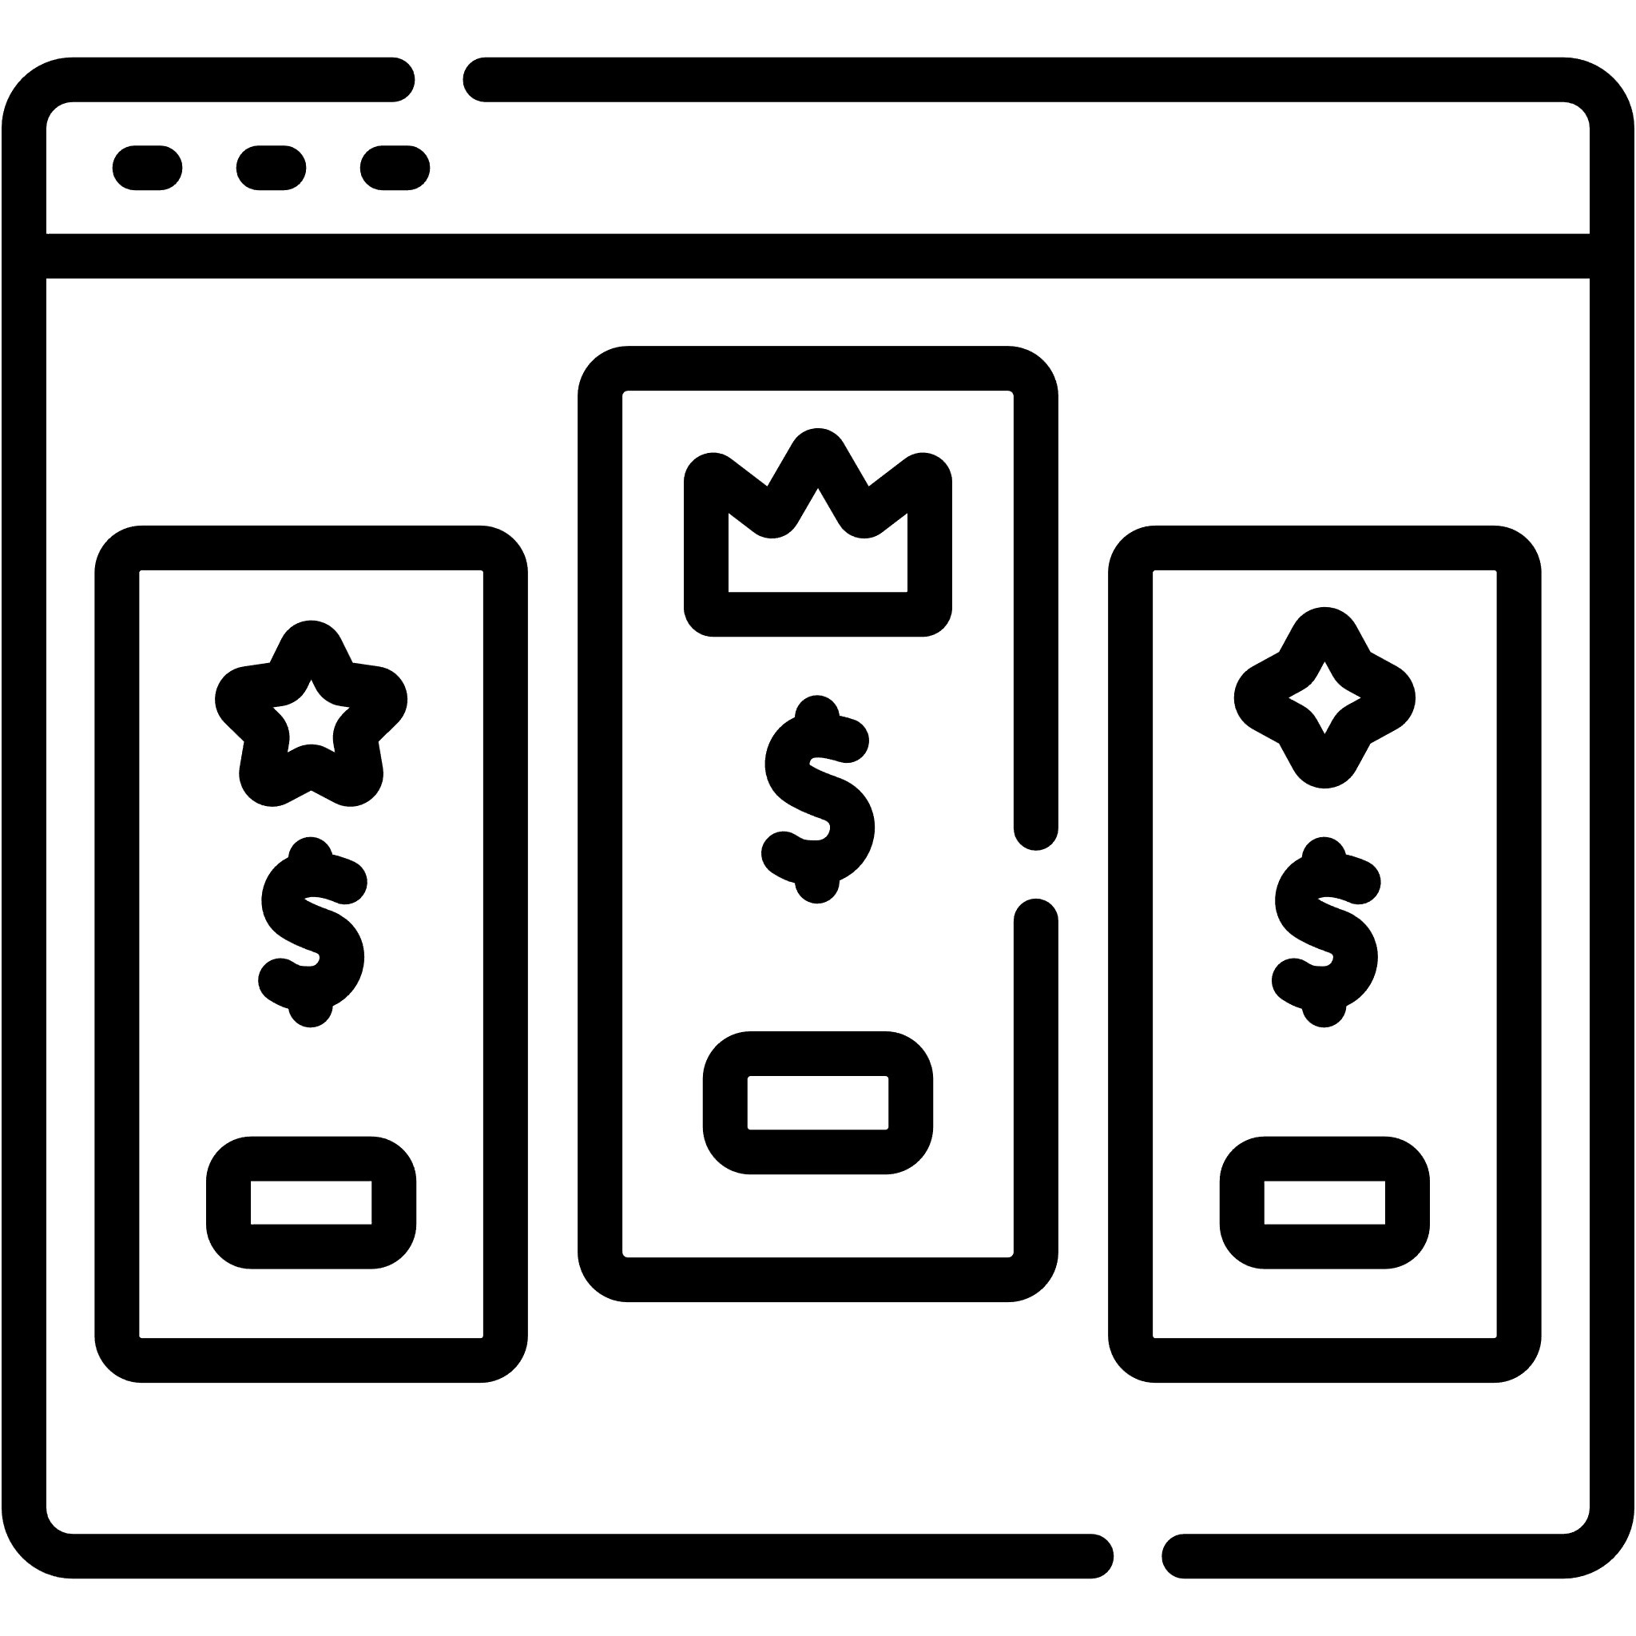

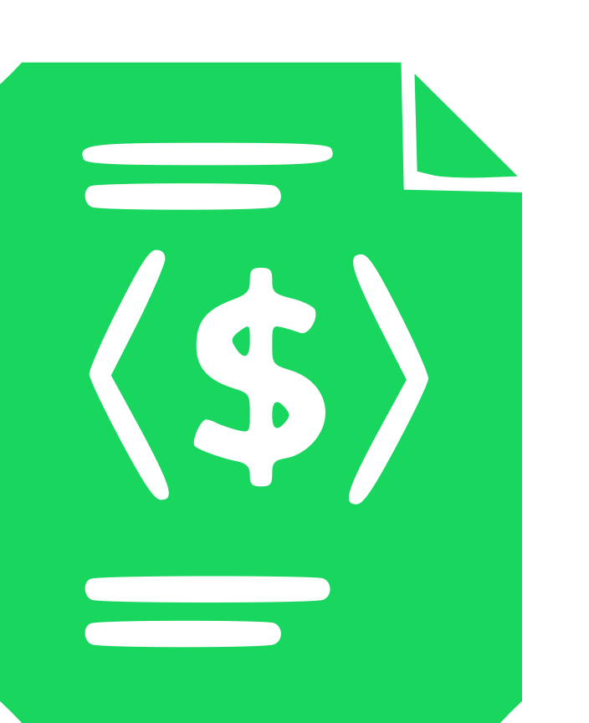





Pricing-driven Development and Operation of SaaS
code
deploy
build
toggle
operate
Dev
Ops
operate
plan
release
test
monitor
22
Notes:
En este contexto, proponemos en la tesis pricing-driven devops, un ciclo alternativo al original que gestiona este tipo de eventos de forma mucho más eficiente y directa, gracias a que considera tanto los pricings del servicio –así como las subscripciones de los usuarios del mismo– como elementos de primer nivel dentro del sistema.
Como vemos, en esta aproximación las fases “code” y “build” se sustituyen por la fase “toggle”, ya que no es necesario modificar el código del servicio para aplicar los cambios provocados por el evento. Además, la fase “deploy” desaparece, ya que las modificaciones se aplican en caliente, sin necesidad de redesplegar el sistema.
Sin embargo, como es de esperar, lograr este resultado no es tribial. (Aquí exponemos los 5 challenges del pricing-driven devops y a qué fases afecta):

Slide 45
Pricing-driven Development and Operation of SaaS
build
toggle
operate
Dev
Ops
operate
plan
release
test
monitor
22
Notes:
En este contexto, proponemos en la tesis pricing-driven devops, un ciclo alternativo al original que gestiona este tipo de eventos de forma mucho más eficiente y directa, gracias a que considera tanto los pricings del servicio –así como las subscripciones de los usuarios del mismo– como elementos de primer nivel dentro del sistema.
Como vemos, en esta aproximación las fases “code” y “build” se sustituyen por la fase “toggle”, ya que no es necesario modificar el código del servicio para aplicar los cambios provocados por el evento. Además, la fase “deploy” desaparece, ya que las modificaciones se aplican en caliente, sin necesidad de redesplegar el sistema.
Sin embargo, como es de esperar, lograr este resultado no es tribial. (Aquí exponemos los 5 challenges del pricing-driven devops y a qué fases afecta):

Slide 46

Racing the Market: An Industry Support Analysis for
Pricing-Driven DevOps in SaaS
Alejandro García-Fernández, José Antonio Parejo, Francisco Javier Cavero, Antonio Ruiz-Cortés
(agarcia29@us.es)
Universidad de Sevilla, Seville, Spain
JCIS’25
09-11 September 2025

Slide 47
Extra Slides
Notes:
Pricing & Subscription Modeling: Dado que los pricings y las subscripciones son los elementos esenciales que rigen este ciclo de pricing-driven devops –o más específicamente sus versiones orientadas a la máquina (iPricings y iSubscriptions)–, este challenge aborda el desafío de crear un lenguaje lo suficientemente expresivo como para poder representar los pricings de cualquier dominio, así como sus subscripciones.

Slide 48
Pricing-driven Development and Operation of SaaS
1. Pricing & Subscription Modeling
2. Pricing Design Methodologies
toggle
Dev
Ops
operate
plan
3. PRICING-DRIVEN SELF-ADAPTATION
release
4. Subscription Compliance Testing
test
monitor
5. Automated Analysis of Pricings
PROVIDER EVENTS (pe_{j})
pe_{1 (new plan)}
pe_{3 (price change)}
23
pe_{j (feature reallocation)}
Notes:
Pricing & Subscription Modeling: Dado que los pricings y las subscripciones son los elementos esenciales que rigen este ciclo de pricing-driven devops –o más específicamente sus versiones orientadas a la máquina (iPricings y iSubscriptions)–, este challenge aborda el desafío de crear un lenguaje lo suficientemente expresivo como para poder representar los pricings de cualquier dominio, así como sus subscripciones.

Slide 49
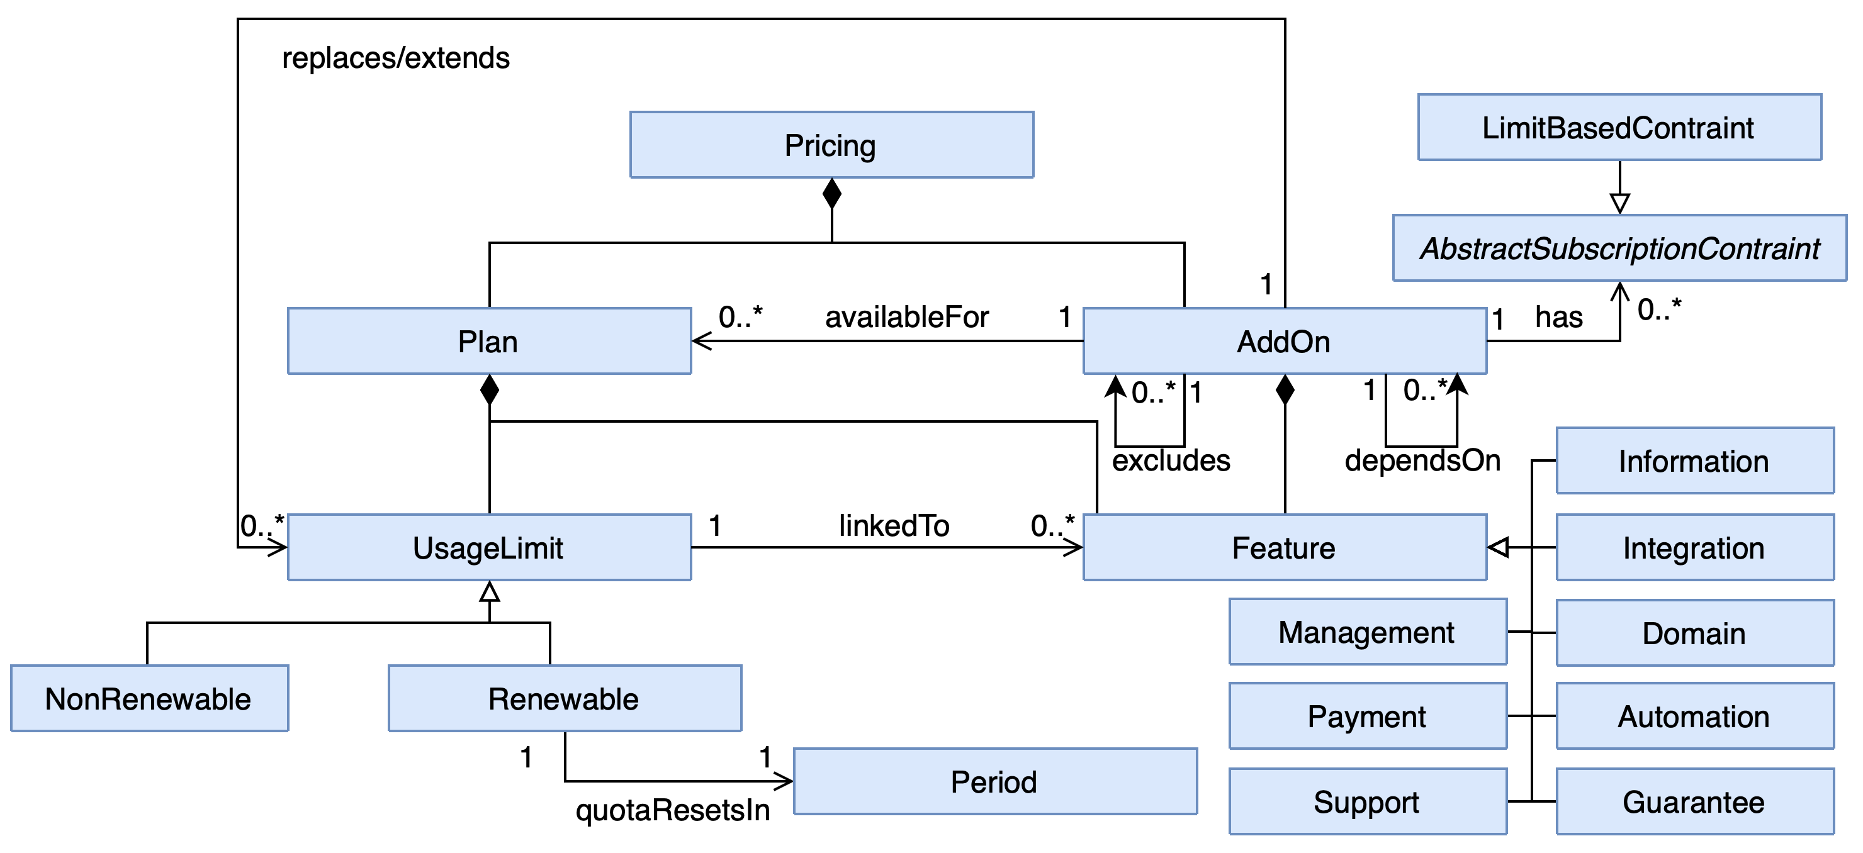
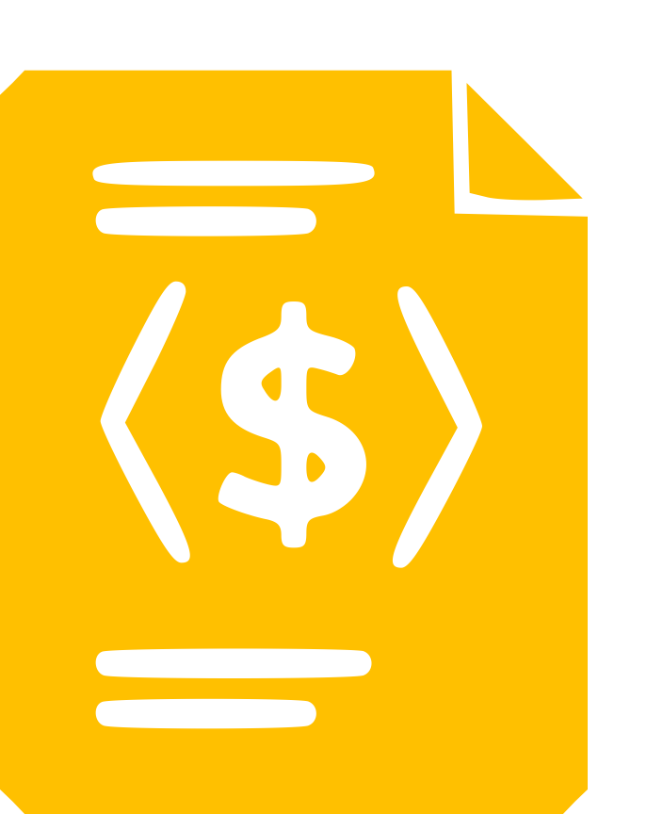

Pricing-driven Development and Operation of SaaS
1. Pricing & Subscription Modeling
2. Pricing Design Methodologies
toggle
Dev
Ops
operate
plan
3. PRICING-DRIVEN SELF-ADAPTATION
release
4. Subscription Compliance Testing
test
monitor
5. Automated Analysis of Pricings
iPricing
PROVIDER EVENTS (pe_{j})
pe_{1 (new plan)}
pe_{3 (price change)}
23
pe_{j (feature reallocation)}
Notes:
Pricing Design Methodologies: Se enmarca en la fase “plan”, e incluye todas aquellas contribuciones orientadas a definir metodologías para diseñar planes de precios que maximicen el valor percibido de cada configuración del sistema, con el objetivo de reducir las dummy configurations —es decir, aquellas combinaciones poco atractivas o irrelevantes para los usuarios.
Create generic models for pricings and subscriptions

Slide 50
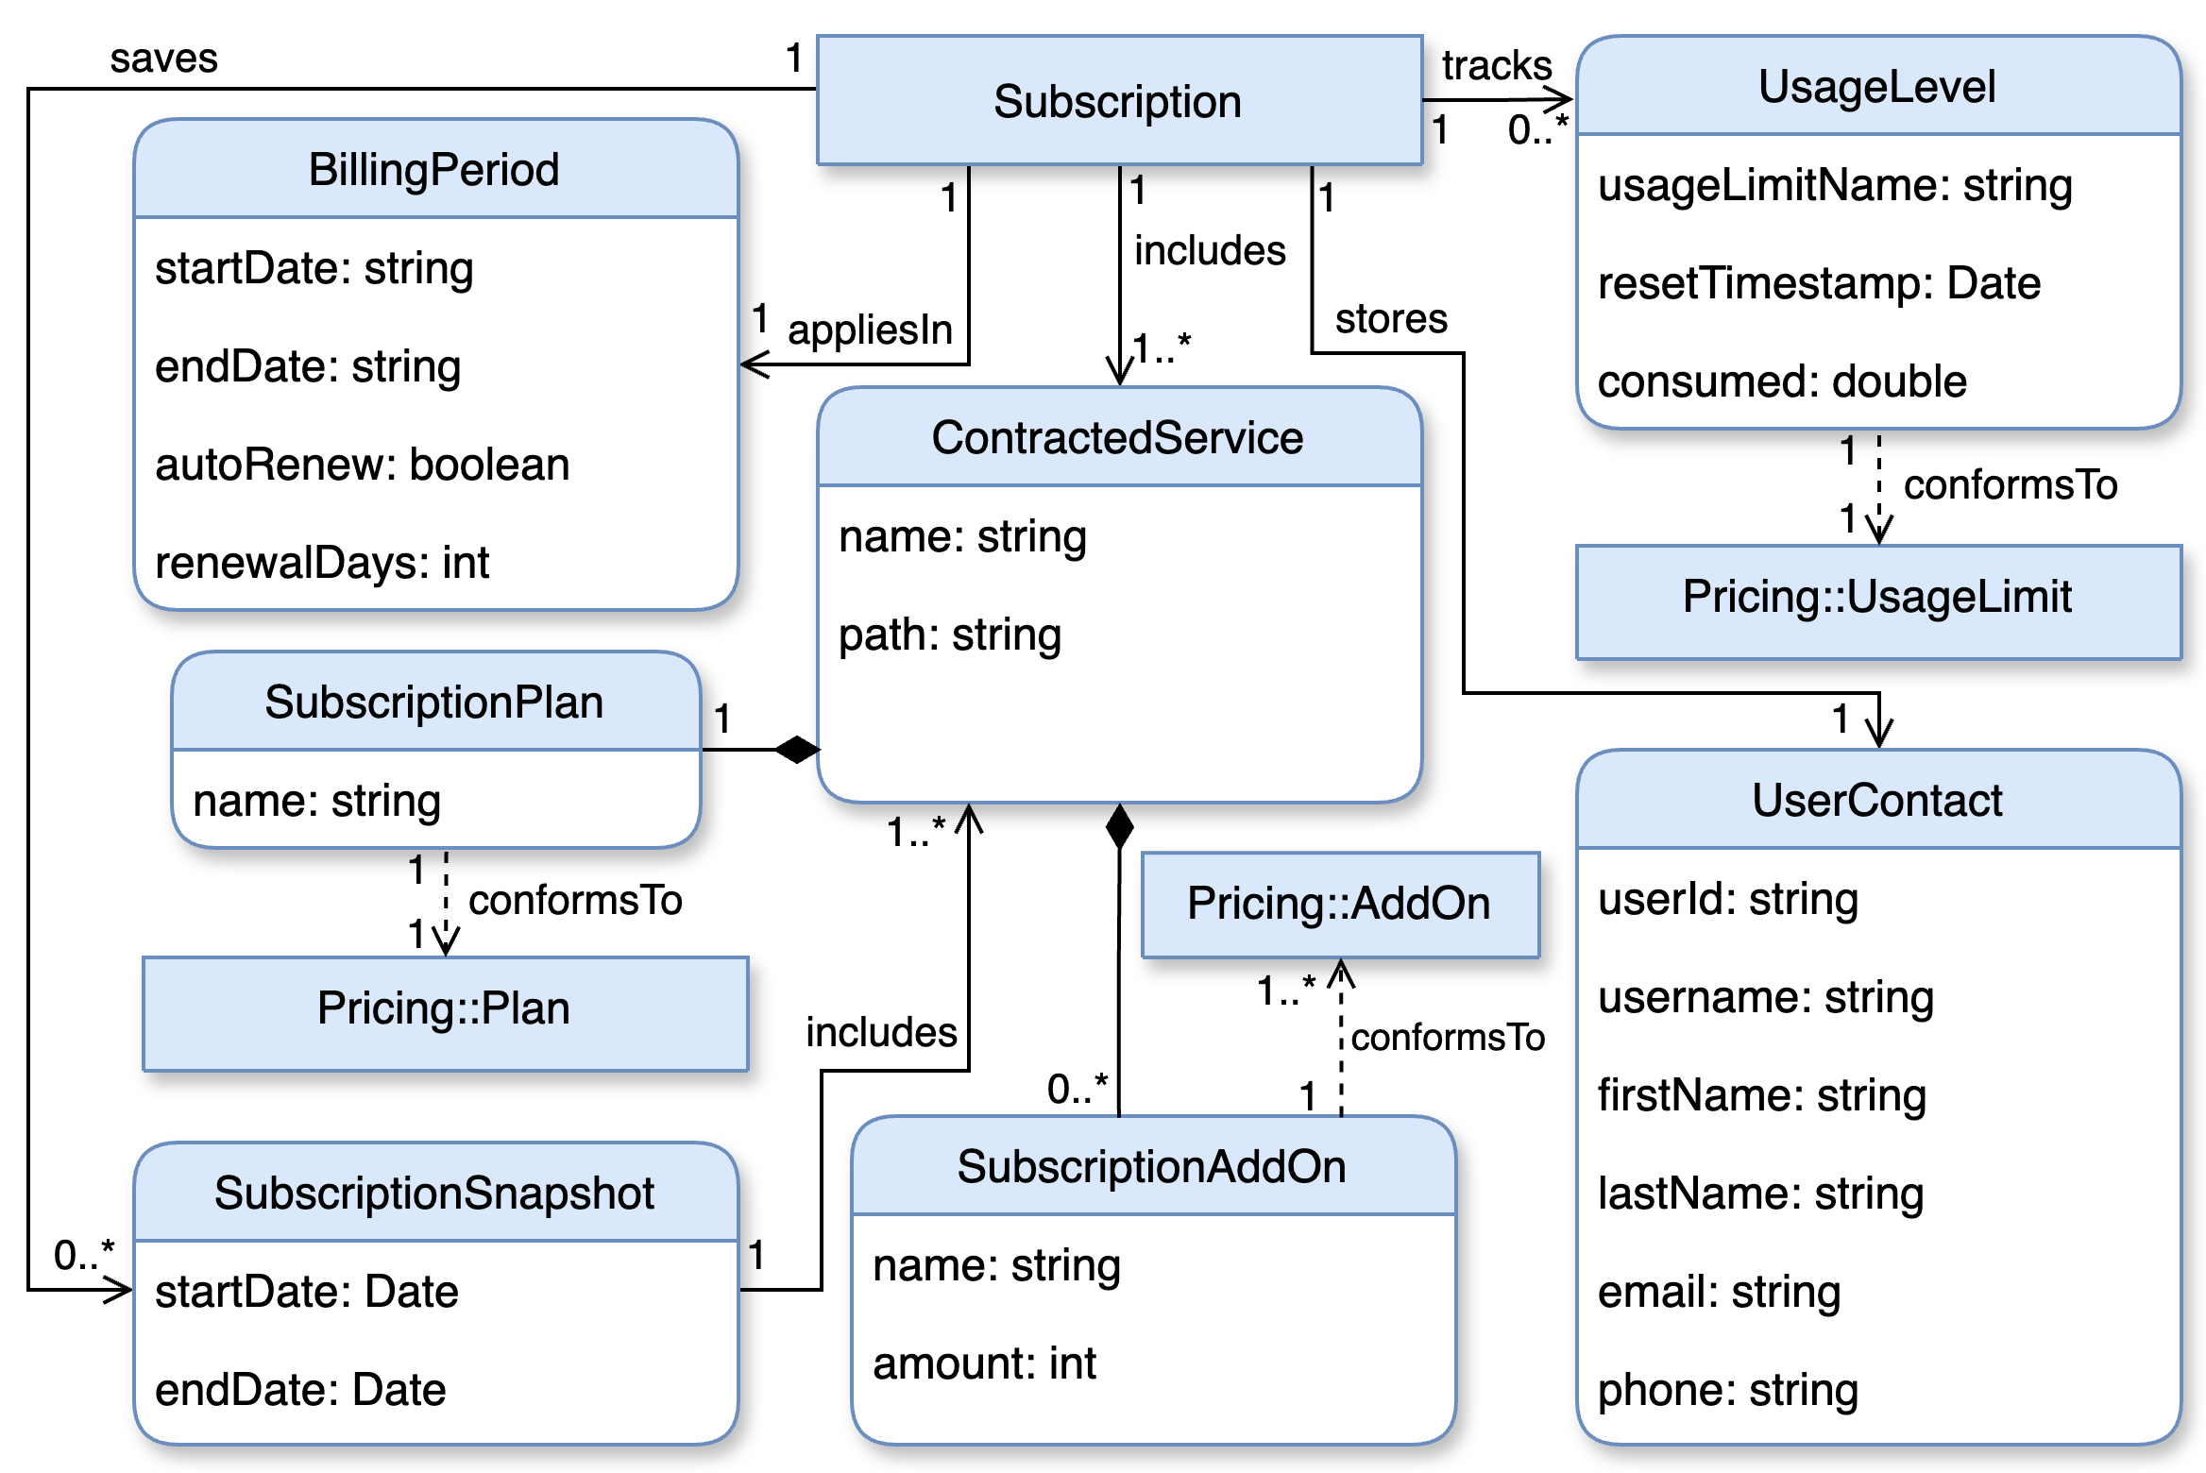
Pricing-driven Development and Operation of SaaS
1. Pricing & Subscription Modeling
2. Pricing Design Methodologies
toggle
Dev
Ops
operate
plan
3. PRICING-DRIVEN SELF-ADAPTATION
release
4. Subscription Compliance Testing
test
monitor
5. Automated Analysis of Pricings
iSubscription
PROVIDER EVENTS (pe_{j})
pe_{1 (new plan)}
pe_{3 (price change)}
23
pe_{j (feature reallocation)}
Notes:
Pricing Design Methodologies: Se enmarca en la fase “plan”, e incluye todas aquellas contribuciones orientadas a definir metodologías para diseñar planes de precios que maximicen el valor percibido de cada configuración del sistema, con el objetivo de reducir las dummy configurations —es decir, aquellas combinaciones poco atractivas o irrelevantes para los usuarios.

Slide 51
Pricing-driven Development and Operation of SaaS
1. Pricing & Subscription Modeling
2. Pricing Design Methodologies
toggle
Dev
Ops
operate
plan
3. PRICING-DRIVEN SELF-ADAPTATION
release
4. Subscription Compliance Testing
test
monitor
5. Automated Analysis of Pricings
PROVIDER EVENTS (pe_{j})
pe_{1 (new plan)}
pe_{3 (price change)}
23
pe_{j (feature reallocation)}
Notes:
Pricing Design Methodologies: Se enmarca en la fase “plan”, e incluye todas aquellas contribuciones orientadas a definir metodologías para diseñar planes de precios que maximicen el valor percibido de cada configuración del sistema, con el objetivo de reducir las dummy configurations —es decir, aquellas combinaciones poco atractivas o irrelevantes para los usuarios.

Slide 52

Pricing-driven Development and Operation of SaaS
1. Pricing & Subscription Modeling
2. Pricing Design Methodologies
3. PRICING-DRIVEN SELF-ADAPTATION
toggle
Dev
Ops
operate
plan
4. Subscription Compliance Testing
release
5. Automated Analysis of Pricings
test
monitor
PROVIDER EVENTS (pe_{j})
pe_{1 (new plan)}
pe_{3 (price change)}
23
pe_{j (feature reallocation)}
Notes:
Pricing Design Methodologies: Se enmarca en la fase “plan”, e incluye todas aquellas contribuciones orientadas a definir metodologías para diseñar planes de precios que maximicen el valor percibido de cada configuración del sistema, con el objetivo de reducir las dummy configurations —es decir, aquellas combinaciones poco atractivas o irrelevantes para los usuarios.

Slide 53
Pricing-driven Development and Operation of SaaS
1. Pricing & Subscription Modeling
2. Pricing Design Methodologies
toggle
Dev
Ops
operate
plan
3. PRICING-DRIVEN SELF-ADAPTATION
release
4. Subscription Compliance Testing
test
monitor
5. Automated Analysis of Pricings
PROVIDER EVENTS (pe_{j})
pe_{1 (new plan)}
pe_{3 (price change)}
23
pe_{j (feature reallocation)}
Notes:
Pricing Design Methodologies: Se enmarca en la fase “plan”, e incluye todas aquellas contribuciones orientadas a definir metodologías para diseñar planes de precios que maximicen el valor percibido de cada configuración del sistema, con el objetivo de reducir las dummy configurations —es decir, aquellas combinaciones poco atractivas o irrelevantes para los usuarios.

Slide 54
Pricing-driven Development and Operation of SaaS
1. Pricing & Subscription Modeling
2. Pricing Design Methodologies
toggle
Dev
Ops
operate
plan
3. PRICING-DRIVEN SELF-ADAPTATION
release
4. Subscription Compliance Testing
test
monitor
5. Automated Analysis of Pricings
PROVIDER EVENTS (pe_{j})
pe_{1 (new plan)}
pe_{3 (price change)}
23
pe_{j (feature reallocation)}
Notes:
Pricing Design Methodologies: Se enmarca en la fase “plan”, e incluye todas aquellas contribuciones orientadas a definir metodologías para diseñar planes de precios que maximicen el valor percibido de cada configuración del sistema, con el objetivo de reducir las dummy configurations —es decir, aquellas combinaciones poco atractivas o irrelevantes para los usuarios.

Slide 55

Pricing-driven Development and Operation of SaaS
1. Pricing & Subscription Modeling
2. Pricing Design Methodologies
toggle
Dev
Ops
operate
plan
Test Generator
3. PRICING-DRIVEN SELF-ADAPTATION
release
4. Subscription Compliance Testing
test
monitor
5. Automated Analysis of Pricings
PROVIDER EVENTS (pe_{j})
pe_{1 (new plan)}
pe_{3 (price change)}
23
pe_{j (feature reallocation)}
Notes:
Pricing Design Methodologies: Se enmarca en la fase “plan”, e incluye todas aquellas contribuciones orientadas a definir metodologías para diseñar planes de precios que maximicen el valor percibido de cada configuración del sistema, con el objetivo de reducir las dummy configurations —es decir, aquellas combinaciones poco atractivas o irrelevantes para los usuarios.

Slide 56



Pricing-driven Development and Operation of SaaS
1. Pricing & Subscription Modeling
2. Pricing Design Methodologies
toggle
Dev
Ops
operate
plan
3. PRICING-DRIVEN SELF-ADAPTATION
release
4. Subscription Compliance Testing
test
monitor
5. Automated Analysis of Pricings
PROVIDER EVENTS (pe_{j})
pe_{1 (new plan)}
pe_{3 (price change)}
23
pe_{j (feature reallocation)}
Notes:
Pricing Design Methodologies: Se enmarca en la fase “plan”, e incluye todas aquellas contribuciones orientadas a definir metodologías para diseñar planes de precios que maximicen el valor percibido de cada configuración del sistema, con el objetivo de reducir las dummy configurations —es decir, aquellas combinaciones poco atractivas o irrelevantes para los usuarios.

Slide 57
Pricing-driven Development and Operation of SaaS
code
deploy
build
operate
toggle
Ops
Dev
operate
plan
release
test
monitor
23
Notes:
En este contexto, proponemos en la tesis pricing-driven devops, un ciclo alternativo al original que gestiona este tipo de eventos de forma mucho más eficiente y directa, gracias a que considera tanto los pricings del servicio –así como las subscripciones de los usuarios del mismo– como elementos de primer nivel dentro del sistema.
Como vemos, en esta aproximación las fases “code” y “build” se sustituyen por la fase “toggle”, ya que no es necesario modificar el código del servicio para aplicar los cambios provocados por el evento. Además, la fase “deploy” desaparece, ya que las modificaciones se aplican en caliente, sin necesidad de redesplegar el sistema.
Sin embargo, como es de esperar, lograr este resultado no es tribial. (Aquí exponemos los 5 challenges del pricing-driven devops y a qué fases afecta):

