Slide 1



QoS meets Pricing
Francisco Javier Cavero López
José Antonio Parejo Maestre
Antonio Ruiz Cortés
Universidad de Sevilla, Seville, Spain
SCORE Lab - PhD Forum
04th April 2025

Slide 2


QoS-Aware Composition (QACO/QSWSC)
QACO
QACO
2/20
Notes:
"Muchos consideran el problema de QoS-aware service composition como algo del pasado, un tema que quedó enterrado en la literatura. Pero hoy estamos aquí para desafiar esa idea..."
"Porque, como en toda buena historia, algunas ideas no mueren… solo esperan el momento adecuado para regresar con más fuerza."

Slide 3

QoS-Aware Composition (QACO)
3/20
Notes:
Me, A Totally Eager Outsider (MATEO)

Slide 4





QoS-Aware Composition (QACO)
3/20

Slide 5
QoS-Aware Composition (QACO)
4
2
3
1
3/20

Slide 6
QoS-Aware Composition (QACO)
2
4
1
3
3/20

Slide 7
QoS-Aware Composition (QACO)
Composite Web Service (CWS)
T2: Book hotels
T1: Book flights
T4: Send invoice
T3: Get travel insurance
3/20

Slide 8








QoS-Aware Composition (QACO)
3/20

Slide 9
QoS-Aware Composition (QACO)
Composite Web Service (CWS)
Booking, Trivago
T2: Book hotels
Amadeus, TravelPerk
SendGrid, MailerSend
T1: Book flights
T4: Send invoice
Treppy, VisitorsCoverage
T3: Get travel insurance
Binding
Ⓑ(<T1,S1>, <T2,S3>, <T3,S5>, <T4,S7>)
3/20

Slide 10
QoS-Aware Composition (QACO)
Cost < 10€
Avail >= 99%
3/20

Slide 11
QoS-Aware Composition (QACO)
Composite Web Service (CWS)
Booking, Trivago
T2: Book hotels
Amadeus, TravelPerk
SendGrid, MailerSend
T1: Book flights
T4: Send invoice
Treppy, VisitorsCoverage
T3: Get travel insurance
Binding
Ⓑ(<T1,S1>, <T2,S3>, <T3,S5>, <T4,S7>)
3/20

Slide 12
QoS-Aware Composition (QACO)
Composite Web Service (CWS)
Booking, Trivago
T2: Book hotels
Amadeus, TravelPerk
SendGrid, MailerSend
T1: Book flights
T4: Send invoice
Treppy, VisitorsCoverage
T3: Get travel insurance
Binding
Space (BS)
Ⓑ(<T1,S1>, <T2,S3>, <T3,S5>, <T4,S7>)
, Ⓑ(<T1,S2>, <T2,S3>, <T3,S5>, <T4,S7>), … Ⓑ(<T1,S2>, <T2,S4>, <T3,S6>, <T4,S8>)
BS(CWS) = 16 bindings
3/20

Slide 13
QACO Servitization
Tasks (T)
Services (S)
Features (F)
Graph (G)
Demand (D)
Optimization (O)
?
QACO
Optimal bindings (OB)
CWS
Problem
QACO(CWS, Problem) = QACO(T, S, F, G, D, O) -> OB
6/20

Slide 14

QoS-Aware Composition (QACO)
Tasks
Services
Bindings
QoS features
Aggregations
Optimization
4/20

Slide 15
QACO Model
Tasks (T)
Candidate Services (S)
Features (F)
Graph (G)
Composite Web Service (CWS)
Optimal Bindings (OB)
Demand (D)
Global Constraints (GC)
Local Constraints (LC)
Binding Constraints (BC)
Aggregated Score (AS)
Optimization (O)
Binding Space (BS)
5/18

Slide 16
QACO Model
CWS
Tasks: {T1, T2, T3, T4}
Services: {{S1, S2}, {S3, S4}, {S5, S6}, {S7, S8}}
Features: {{S1_{COST}, S1_{AVAIL}, S1_{TIME}}, …, {S8_{COST}, S8_{AVAIL}, S8_{TIME}}}
Graph: T1->T2, T1->T3, T2->T4, T3->T4
Problem
Demand (D)
  GC: Ⓑ_{COST} < 50€
  LC: T1_{COST} <= 10€
  BC: provider(T1) = provider(T2),
Optimization (O): min_{COST}, max_{AVAIL}, min_{TIME}
T2: Book hotels
T1: Book flights
T4: Send invoice
T3: Get travel insurance
5/20

Slide 17
QACO Model
CWS
Tasks: {T1, T2, T3, T4}
Services: {{S1, S2}, {S3, S4}, {S5, S6}, {S7, S8}}
Features: {{S1_{COST}, S1_{AVAIL}, S1_{TIME}}, …, {S8_{COST}, S8_{AVAIL}, S8_{TIME}}}
Graph: T1->T2, T1->T3, T2->T4, T3->T4
Problem
Demand (D)
  GC: Ⓑ_{COST} < 50€
  LC: T1_{COST} <= 10€
  BC: provider(T1) = provider(T2),
Optimization (O): min_{COST}, max_{AVAIL}, min_{TIME}
T2: Book hotels
T1: Book flights
T4: Send invoice
T3: Get travel insurance
5/20

Slide 18
QACO Model
CWS
Tasks: {T1, T2, T3, T4}
Services: {{S1, S2}, {S3, S4}, {S5, S6}, {S7, S8}}
Features: {{S1_{COST}, S1_{AVAIL}, S1_{TIME}}, …, {S8_{COST}, S8_{AVAIL}, S8_{TIME}}}
Graph: T1->T2, T1->T3, T2->T4, T3->T4
Problem
Demand (D)
  GC: Ⓑ_{TIME} < 10sec
  LC: T1_{TIME} <= 1sec
  BC: provider(T1) != provider(T2),
Optimization (O): min_{TIME}
T2: Book hotels
T1: Book flights
T4: Send invoice
T3: Get travel insurance
5/20

Slide 19
QACO Model
CWS
T: T1, T2, T3, T4
S: S1, S2, S3, S4, S5, S6, S7, S8
F: Cost, Availability, Time
G: T1->T2, T1->T3, T2->T4, T3->T4
Problem
Demand (D)
  GC: B_coste < 50
  LC: T1_coste <= 10€
  BC: proveedor(T1) = proveedor(T2),
Optimization (O): minCost, maxAvail, minTime
T2: Book hotels
T1: Book flights
T4: Send invoice
T3: Get travel insurance
6/18

Slide 20
QACO Servitization
Tasks (T)
Services (S)
Features (F)
Graph (G)
Demand (D)
Optimization (O)
SOLVER
QACO model
Optimal bindings (OB)
CWS
Problem
QACO(CWS, Problem) = QACO(T, S, F, G, D, O) -> OB
6/20

Slide 21
QACO Servitization
Tasks (T)
Services (S)
Features (F)
Graph (G)
Demand (D)
Optimization (O)
SDK
SOLVER
SOLVER
QACO model
Optimal bindings (OB)
CWS
Problem
QACO(CWS, Problem) = QACO(T, S, F, G, D, O) -> OB
6/20

Slide 22
QACO Servitization
Tasks (T)
Services (S)
Features (F)
Graph (G)
Demand (D)
Optimization (O)
SDK
SOLVER
QACO model
API
Optimal bindings (OB)
CWS
Problem
QACO(CWS, Problem) = QACO(T, S, F, G, D, O) -> OB
6/20

Slide 23
QACO Servitization
Tasks (T)
Services (S)
Features (F)
Graph (G)
Demand (D)
Optimization (O)
SOLVER
API
QACO model
Optimal bindings (OB)
CWS
Problem
QACO(CWS, Problem) = QACO(T, S, F, G, D, O) -> OB
8/18

Slide 24
QACO Servitization
T
S
F
G
D
O
C
Optimal bindings
API
Aggregated score
QACO model
Binding space
QACO (T, S, F, G, D, O, C) -> AS, OB, BS
8/18

Slide 25

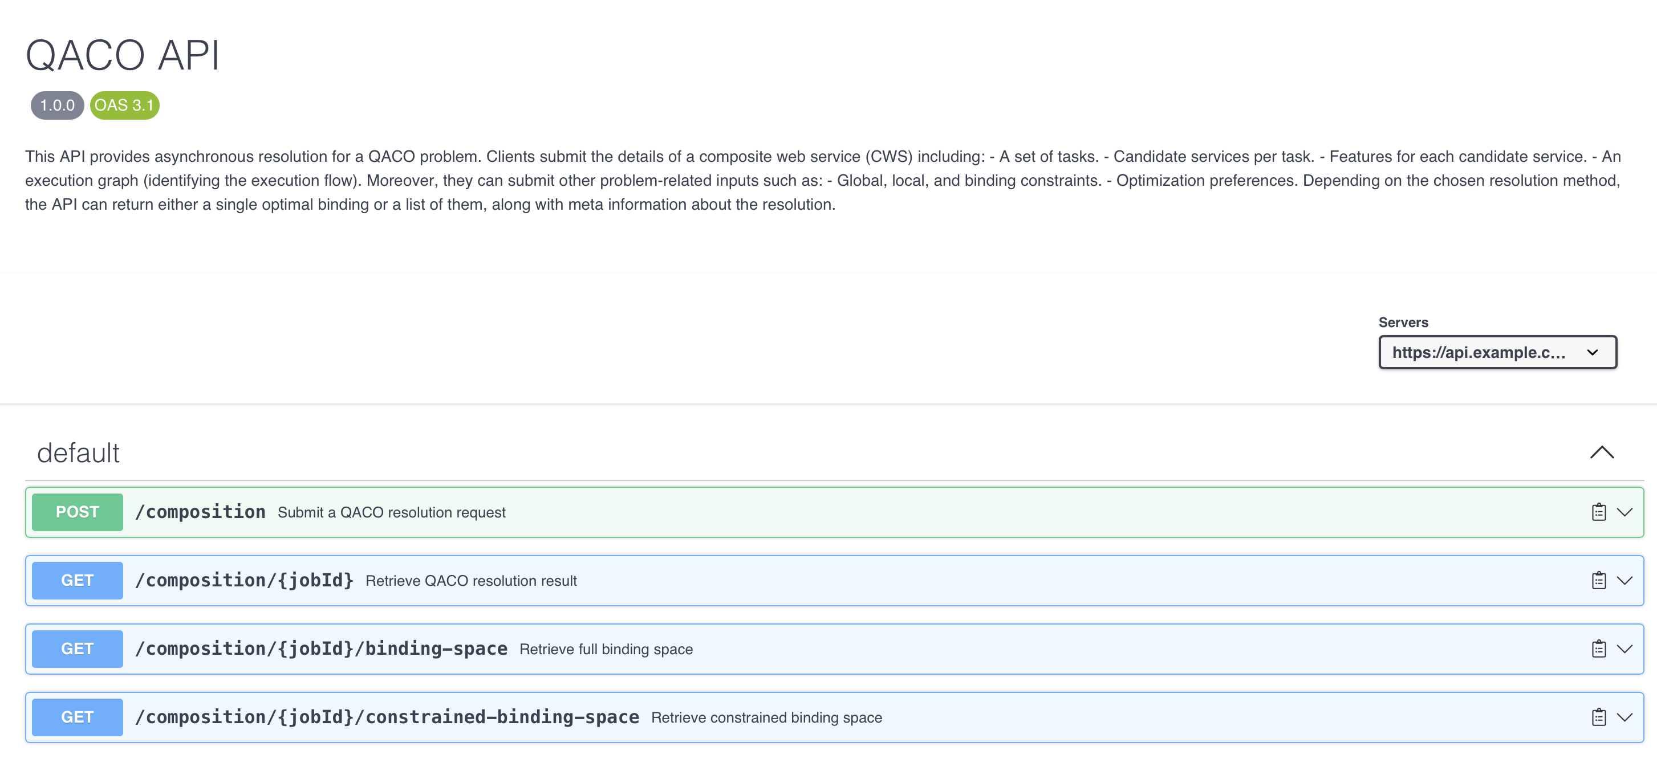
QACO Servitization
7/20

Slide 26
















QACO Limitations: Pricing
8/20

Slide 27
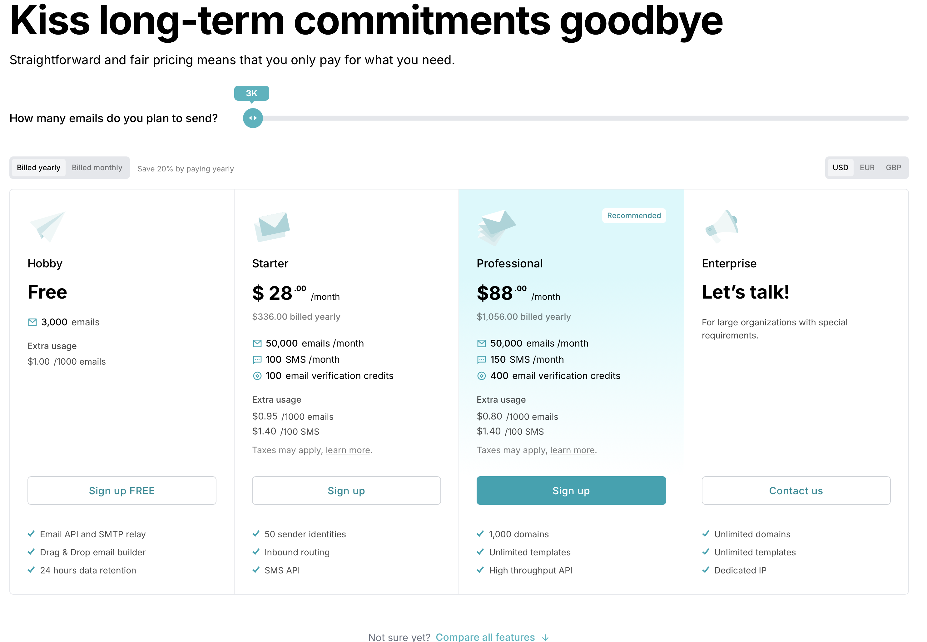
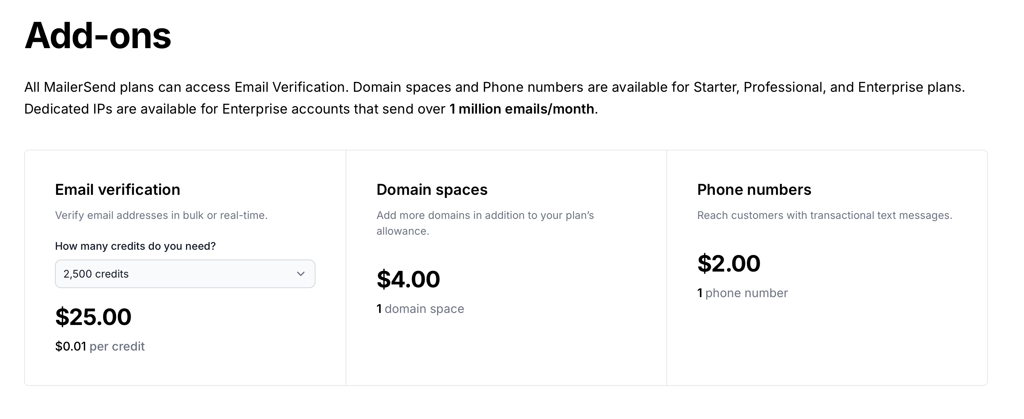
QACO Limitations: Mono-configuration vs multi-configuration
Configuration Space
73 configurations
https://www.mailersend.com/pricing
9/20

Slide 28
QoS and Pricing: Extra-functional features vs functional feautres
QoS = Extra-functional features
Pricing = Functional features + Extra-functional features
QoS ⊂ Pricing
10/20

Slide 29
QoS and Pricing
QoS ⊂ Pricing
10/20

Slide 30
QoS and Pricing
QACO
QoS-aware composition
11/20

Slide 31
QoS and Pricing
QACO
QoS-aware composition
PACO
Pricing-aware composition
11/20

Slide 32
QoS and Pricing
QACO
QoS-aware composition
PACO
Pricing-aware composition
12/20

Slide 33
Pricing-Aware Composition (PACO)
Booking, Trivago
T2: Book hotels
Amadeus, TravelPerk
SendGrid, MailerSend
T1: Book flights
T4: Send invoice
Treppy, VisitorsCoverage
T3: Get travel insurance
BS(CWS) = 16 bindings
13/20

Slide 34
Pricing-Aware Composition (PACO)
S1₁, S1_{2,} S1₃
S2₁, S2_{2,} S2₃
Booking, Trivago
S1₁, S1_{2,} S1₃
S2₁, S2_{2,} S2₃
S5₁, S5_{2,} S5₃
S6₁, S6_{2,} S6₃
T2: Book hotels
Amadeus, TravelPerk
SendGrid, MailerSend
T1: Book flights
S3₁, S3_{2,} S3₃
S4₁, S4_{2,} S4₃
T4: Send invoice
Treppy, VisitorsCoverage
T3: Get travel insurance
BS(CWS) = 16 bindings
Binding
Ⓑ(<T1,S1,S1₁>, <T2,S2,S2₃>, <T3,S4,S4₂>, <T4,S5,S5₃>)
13/20

Slide 35
Pricing-Aware Composition (PACO)
S1₁, S1_{2,} S1₃
S2₁, S2_{2,} S2₃
Booking, Trivago
S1₁, S1_{2,} S1₃
S2₁, S2_{2,} S2₃
S5₁, S5_{2,} S5₃
S6₁, S6_{2,} S6₃
T2: Book hotels
Amadeus, TravelPerk
SendGrid, MailerSend
T1: Book flights
S3₁, S3_{2,} S3₃
S4₁, S4_{2,} S4₃
T4: Send invoice
Treppy, VisitorsCoverage
T3: Get travel insurance
BS(CWS) = 16 bindings
BS(CWS) = 1296 bindings
Binding
Ⓑ(<T1,S1,S1₁>, <T2,S2,S2₃>, <T3,S4,S4₂>, <T4,S5,S5₃>)
13/20

Slide 36
Pricing-Aware Composition (PACO)
CWS
Tasks: {T1, T2, T3, T4}
Services: {{S1₁, S1₂, S1₃}, {S2₁ , S2₂, S2₃}, …, {S8₁, S8₂, S8₃}
Features: {{{S1_{1_COST}, S1_{1_AVAIL}, S1_{1_TIME}, S1_{1_QUOTA} , S1_{1_RATE}}, {S1_{2_COST}, S1_{2_AVAIL}, S1_{2_TIME} , S1_{2_QUOTA} , S1_{2_RATE}},…}, …,}
Graph: T1->T2, T1->T3, T2->T4, T3->T4
Problem
Demand (D)
  GC: Ⓑ_{QUOTA} > 100 req/s
  LC: T1_{COST} <= 10€
  BC: provider(T1) = provider(T2),
Optimization (O): min_{COST}, max_{AVAIL}, min_{TIME}, max_{QUOTA}, max_{RATE}
T2: Book hotels
T1: Book flights
T4: Send invoice
T3: Get travel insurance
14/20

Slide 37
Pricing-Aware Composition (PACO)
CWS
Tasks: {T4}
Services: {S1, S2}
Features: {{S1_{COST}, S1_{AVAIL}, S1_{TIME}}, {S2_{COST}, S2_{AVAIL}, S2_{TIME}}}
Graph: T4
Problem
Demand (D):
  Ⓑ_{QUOTA} < 200 €
Optimization (O): min_{COST}, max_{AVAIL}, min_{TIME}
QACO
S1: SendGrid, S2: MailerSend
T4: Send invoice
BS(T4) = 2 bindings
15/20

Slide 38
Pricing-Aware Composition (PACO)
CWS
Tasks: {T4}
Services: {{S1₁, S1₂, S1₃, …, S1₅₇ }, {S2₁, S2₂, S2₃, …, S2₇₃}}
Features: {{{S1_{1_COST}, S1_{1_AVAIL}, S1_{1_TIME}, S1_{1_QUOTA} , S1_{1_USERS}}, {S1_{2_COST}, S1_{2_AVAIL}, S1_{2_TIME} , S1_{2_QUOTA} , S1_{2_USERS}},…}, …,}
Graph: T4
Problem
Demand (D):
  Ⓑ_{QUOTA} < 200 €
  Ⓑ_{QUOTA} >= 100 mails
  Ⓑ_{USERS} > 10 users
Optimization (O): min_{COST}, max_{AVAIL}, min_{TIME}, max_{QUOTA}, max_{USERS}
PACO
57 configs
73 configs
S1: SendGrid, S2: MailerSend
T4: Send invoice
BS(T4) = 130 bindings
16/20

Slide 39
Pricing-Aware Composition (PACO)
PACO
QACO
57 configs
73 configs
S1: SendGrid, S2: MailerSend
S1: SendGrid, S2: MailerSend
T4: Send invoice
T4: Send invoice
BS(T4) = 2 bindings
BS(T4) = 130 bindings
15/20

Slide 40
37 SaaS Config Space (13568;11776;11268;10367;1896;1152;786;85;79;44;40;33;25;24;20;16;16;15;11;10;8;8;7;7;7;6;5;4;4;4;4;4;4;3;3;3;3)
Media: 1386.89189
Mediana: 11
Moda: 4
Trends in Industry Support for Pricing-Driven DevOps in SaaS (2025)

Slide 41
Pricing-Aware Composition (PACO)
Explosion in the binding space
Rates
Usage limits (quotas)
Family of problems
17/20

Slide 42
Future Work
01
02
PACO Definition
PACO Servitization
Formal definition of the problem
Revisit QACO model and its specification
03
04
PACO Solution
PACO Family
An implementation that can solve it
Explore all the problems that are part of it
18/20

Slide 43
Conclusions
A glimpse of the relevance of PACO
Abstraction and servitization
Future directions
19/20
Notes:
QACO no está muerto / PACO lo puede resucitar
Formalizar QACO de forma que sea replicable es un primer paso para unificar la investigación en este campo y habrá que hacer lo mismo con PACO
PACO no es un tipo nuevo sino el “padre” de QACO y el problema estaba “ahí”???

Slide 44


QoS meets Pricing
Francisco Javier Cavero López
(fcavero@us.es)
Universidad de Sevilla, Seville, Spain
QACO
SCORE Lab - PhD Forum
04th April 2025
PACO

Slide 45
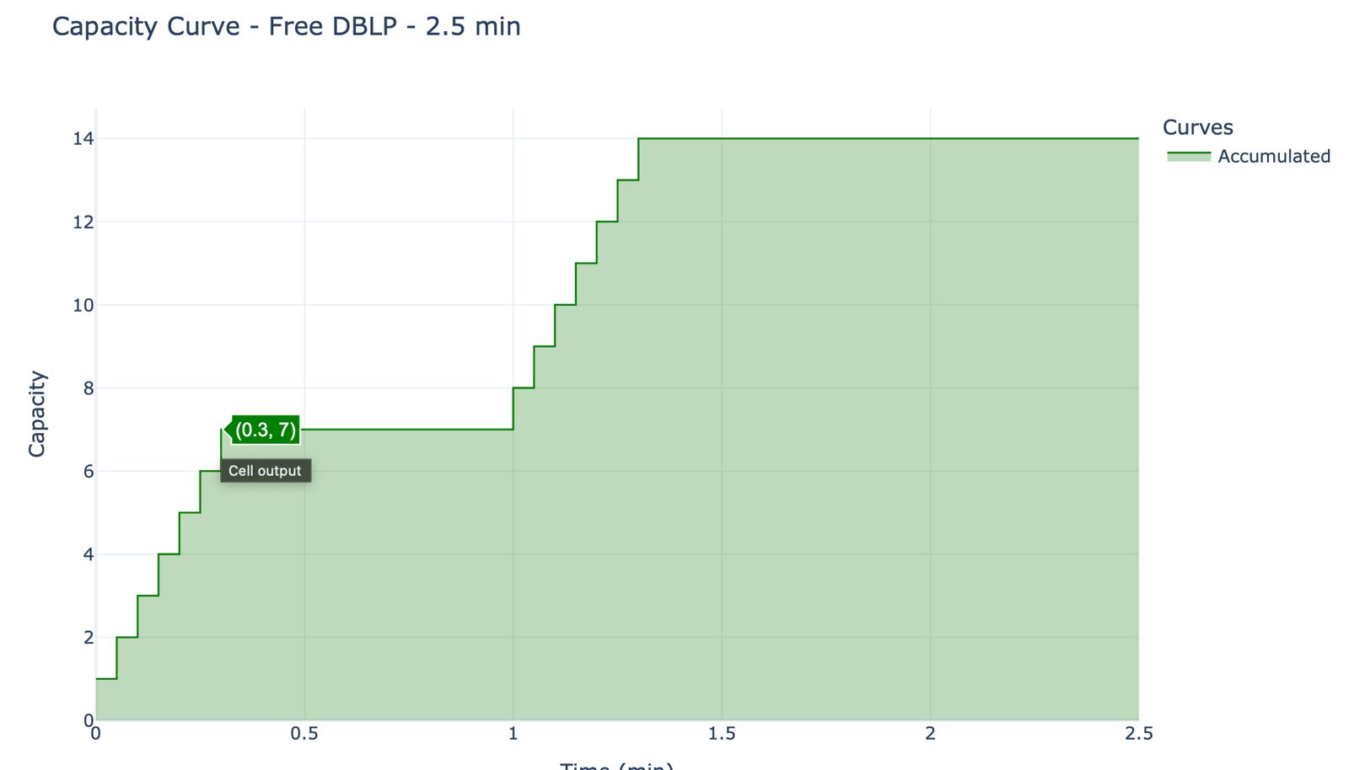
Capacity Analysis
Time (min)
1/5

Slide 46
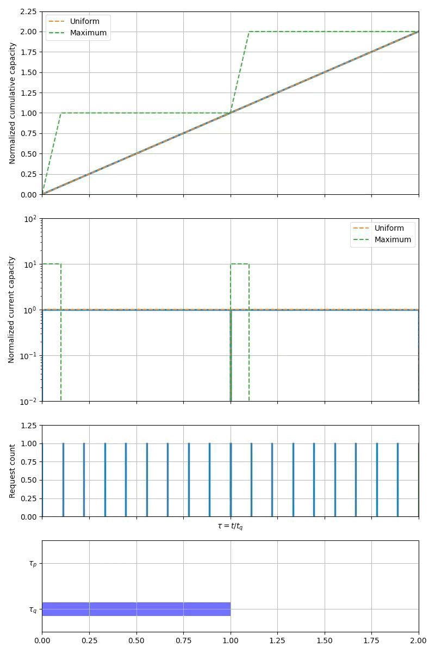
Capacity Curves
2/5

Slide 47
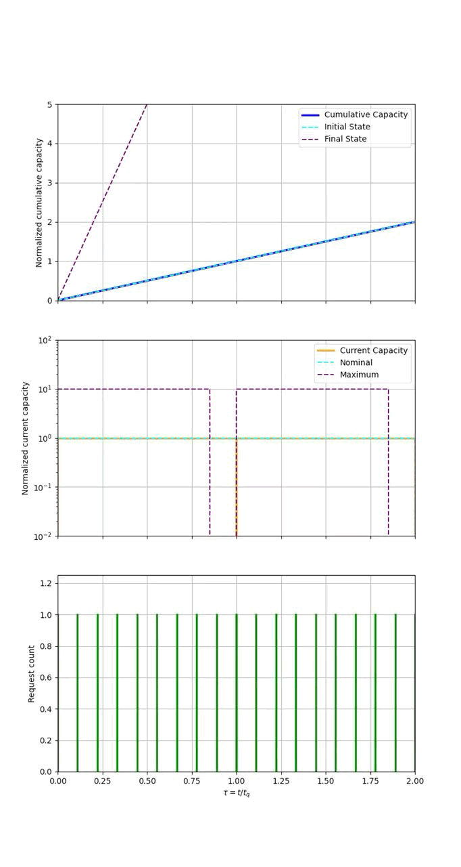
Capacity Curves with Overage
3/5

Slide 48
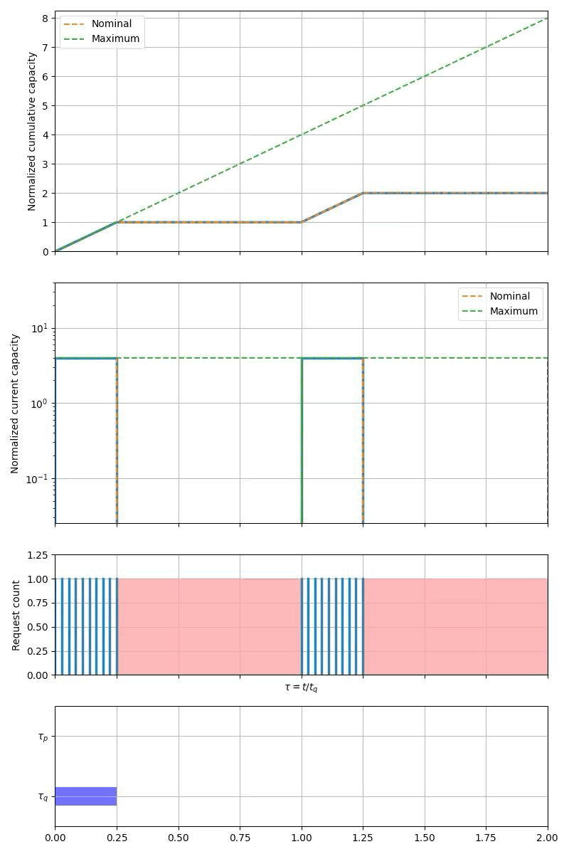
Combined Capacity Curves
4/5

Slide 49
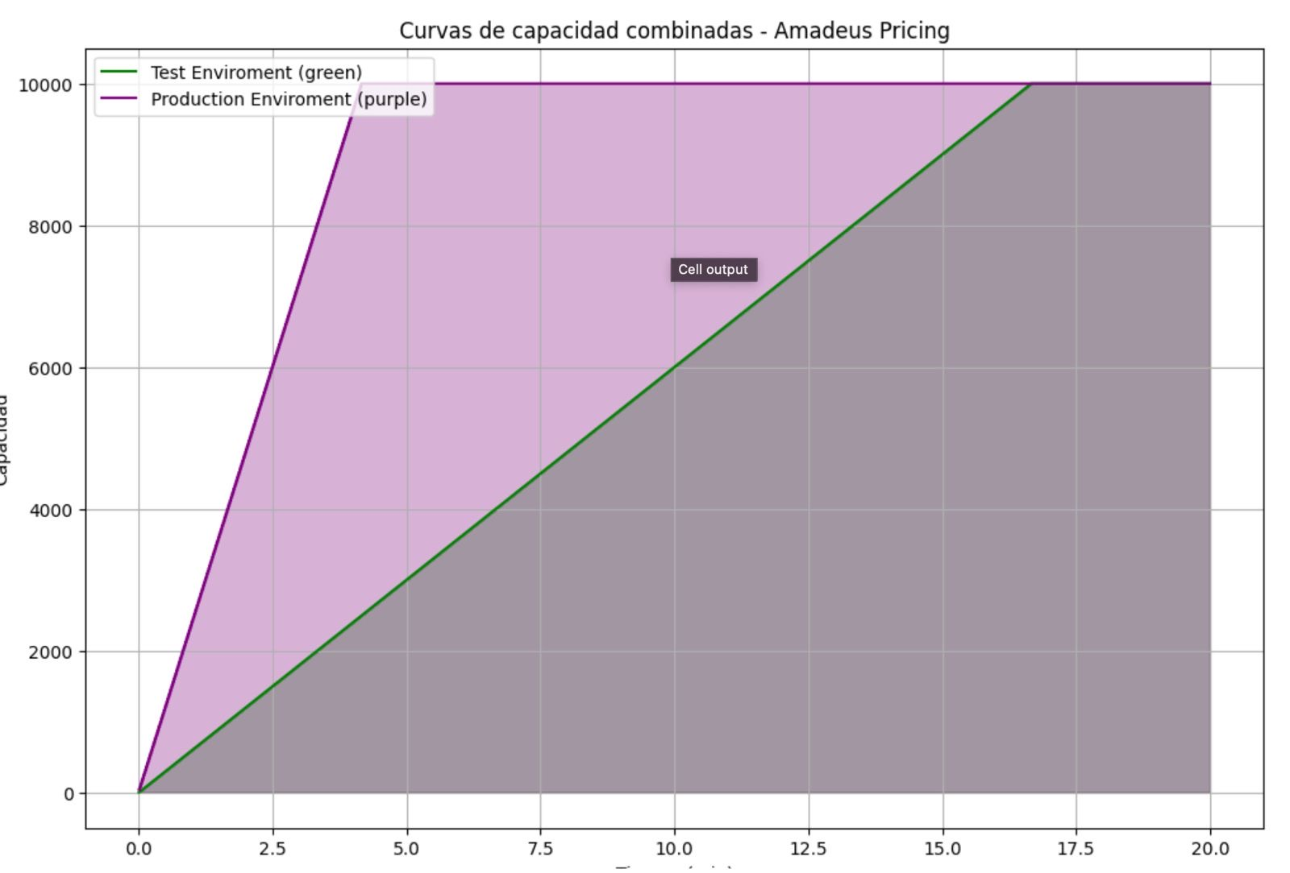
Combined Capacity Curves
Capacity
Time (min)
5/5

