Slide 1
ARKHAM TECHNICAL CHALLENGE // FORWARD DEPLOYED ENGINEER
CENACE Monclova LMP Analytics, Forecasting & Anomaly Detection
Market Physics, Machine Learning Benchmarking, and Operational Grid Telemetry
Candidate: Javier Diego-Fernández | Submission Date: Monday, November 9, 2026

Slide 2

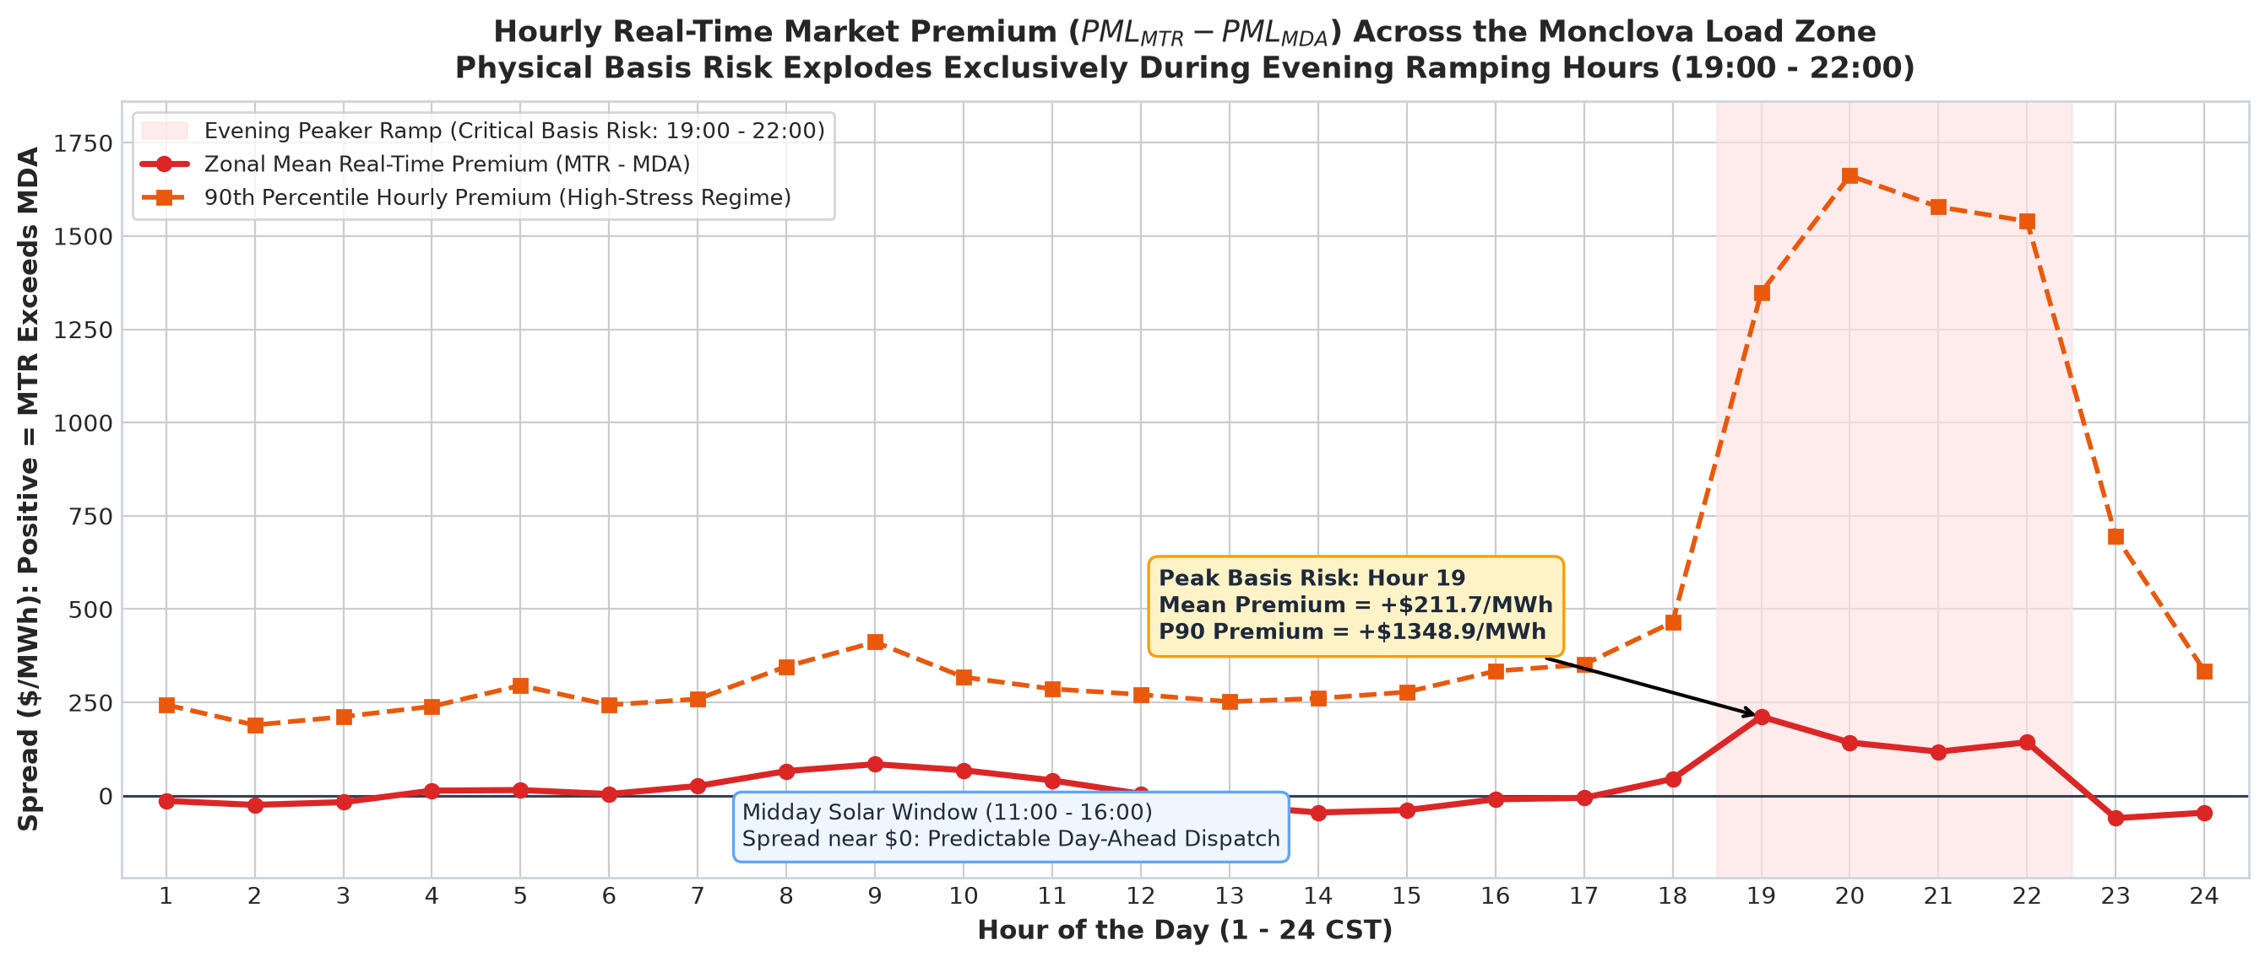

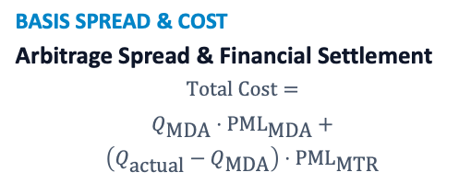
$$Typeequationhere.$$
WHOLESALE ELECTRICITY MARKET (MEM) & TWO-SETTLEMENT MECHANICS
The Fundamentals
CENACE (Independent System Operator): Operates Mexico's wholesale market auctions and enforces physical grid equilibrium through Security-Constrained Economic Dispatch (SCED).
MDA (DAY-AHEAD)
Committed Agreements – Day Before
Cleared 24h prior (10:00 AM D-1) to lock thermal unit commitment; acts as a financial hedge settling 85%–90% of physical volume.
MTR (REAL-TIME)
Small Fluctuations, Real-Time Deviations
Cleared in real-time intervals to balance physical variations (±10%–15%) caused by unexpected solar drops, wind fluctuations, and generator trips.
BASIS SPREAD & COST
Arbitrage Spread & Financial Settlement
$$\text{Total Cost}=$$
$$Q_{\text{MDA}}⋅{\text{PML}}_{\text{MDA}}+$$
$$\left(Q_{\text{actual}}−Q_{\text{MDA}}\right)⋅{\text{PML}}_{\text{MTR}}$$

Slide 3
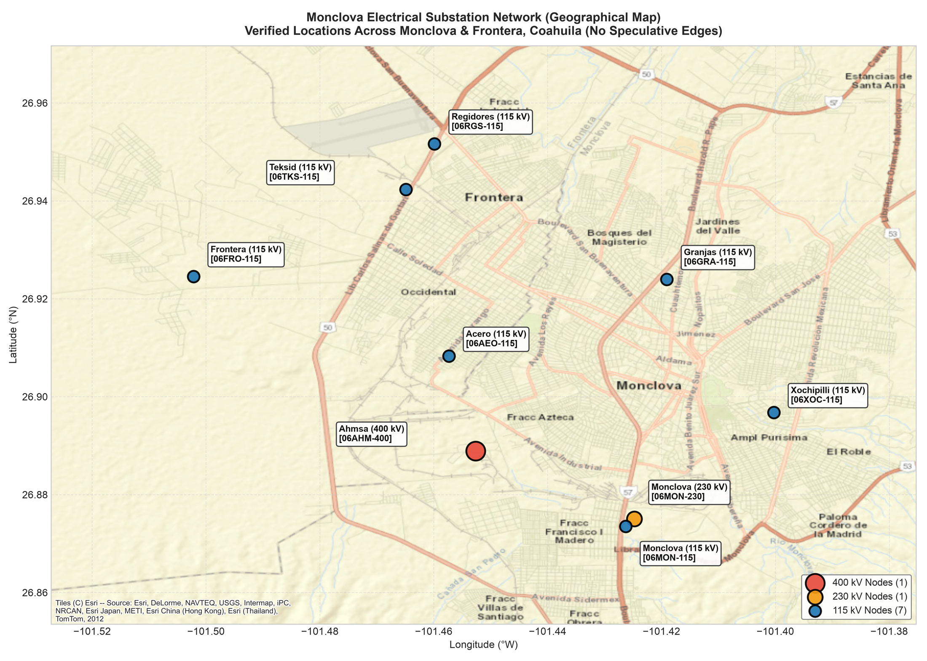
MONCLOVA ELECTRICAL TOPOLOGY // 'LA CAPITAL DEL ACERO'
Monclova Grid Geography & Substation Corridors
400 KV EXTRA-HIGH VOLTAGE
AHMSA Siderúrgica 2 (06AHM-400)
Dedicated bulk transmission intertie feeding electric arc furnace metallurgical steelmaking; heaviest industrial load point.
230 KV REGIONAL HUB
Monclova Regional Switchyard (06MON-230)
Primary regional step-down transmission hub co-located with 115 kV; transforms bulk power down into distribution.
115 KV SUBTRANSMISSION TIER
Teksid Foundry & 6 Distribution Nodes
Feeds Teksid Hierro's engine block casting foundry (06TKS-115) and 6 municipal step-down substations across the urban axis.
Arkham Technical Challenge // Javier Diego-Fernández 3 / 12

Slide 4
DATA ENGINEERING & MATHEMATICAL INTEGRITY
Production-Grade Ingestion & Validation Pipeline
STAGE 1
cenace_client
HTTP Resiliency
Rate Limiting: 0.35s politeness delay between queries.
Jitter Backoff: Exponential backoff with 5 retry limit.
Timeout Control: Deterministic 30s connection window.
STAGE 2
extractor
Temporal Chunking
Query Window: Automated 7-day API pagination.
Node Limits: Respects CENACE 20-node query ceiling.
Complete Span: 18 continuous months without dropped hours.
STAGE 3
validator
Ohm Additivity
Ohm Verification: PML == Energy + Losses + Congestion.
Precision Check: Numerical drift strictly < 0.001 MXN.
Zero Nulls: 100% deterministic timestamp alignment.
STAGE 4
parquet lake
Curated Storage
Storage Engine: Columnar Apache Parquet format.
Total Volume: 118,152 observations (3.8 MB total).
Query Speed: Sub-second SQL and DataFrame scan latency.
Arkham Technical Challenge // Javier Diego-Fernández 4 / 12

Slide 5
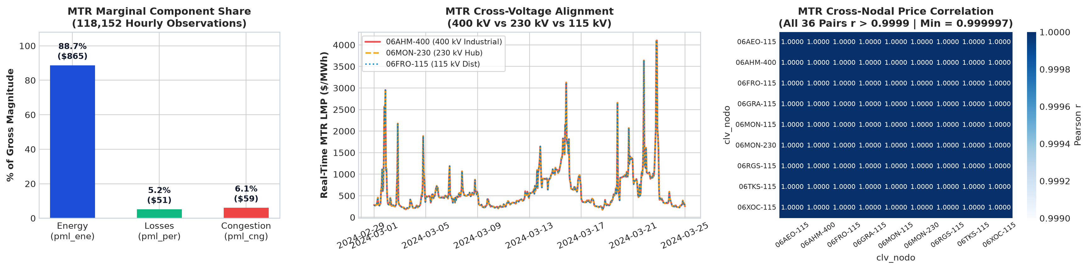
THE SINGLE UNIFIED MODEL PROOF // LATEX DECOMPOSITION
Market Physics & Spatial Price Coherence
$$PML={PML}_{energy}+{PML}_{losses}+{PML}_{congestion}$$
ENERGY DOMINANCE
Gross Magnitude Share
Energy (PML_energy): 88.7% ($864.84/MWh)
Losses & Congestion: Losses 5.2% | Congestion 6.1%
TRAJECTORY ALIGNMENT
Cross-Voltage Coherence
Spatial Divergence: Minimal ($2.52 zonal; $0.01 congestion median)
Pearson correlation: All 36 pairs r > 0.9999
SINGLE UNIFIED MODEL
Data-Rich Architecture
+800% Training Data: 118,152 vs 13,128 isolated rows
Equal Out-of-Sample MAE: $101.10/MWh (vs $101.04 separate)
MLOps Efficiency: -89% pipeline & monitoring overhead
Arkham Technical Challenge // Javier Diego-Fernández 5 / 12

Slide 6
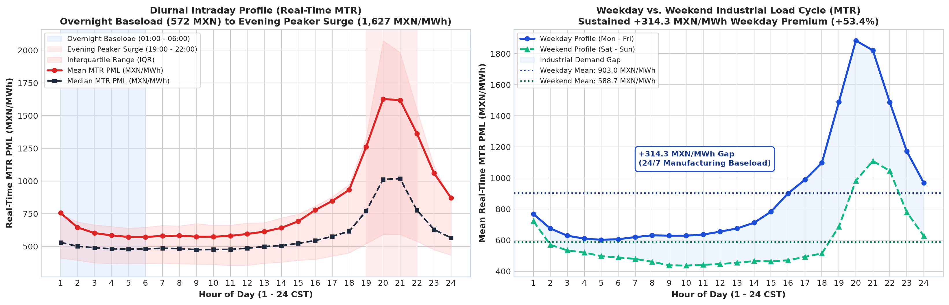
DIURNAL DISPATCH PROFILE & INDUSTRIAL DEMAND GAP
Temporal Dynamics & Industrial Load Cycles
Overnight Baseload Transitioning to Peak Scarcity ($1,627/MWh)
Real-time MTR prices hold flat overnight baseload ($572–$645/MWh, 01:00–06:00) before surging into evening peaker spikes (19:00–22:00) as solar declines.
+314.3 MXN/MWh Sustained Weekday Premium
24/7 heavy manufacturing baseload elevates weekday MTR prices (Mean: $903.0 MXN) well above weekends ($588.7 MXN), creating a +53.4% load premium.
Arkham Technical Challenge // Javier Diego-Fernández 6 / 12

Slide 7
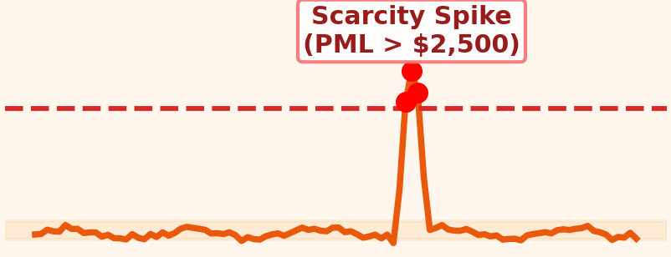
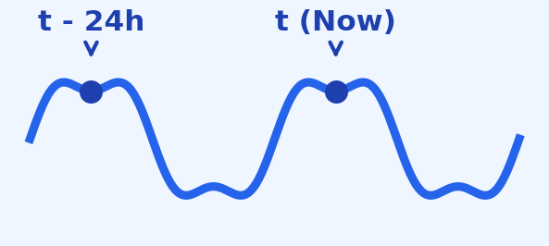
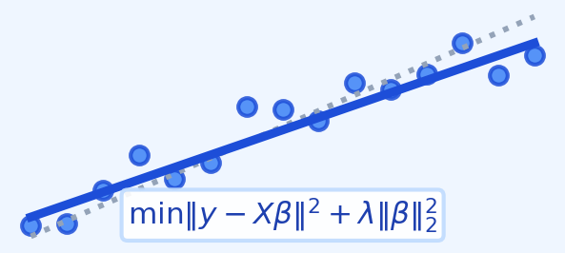
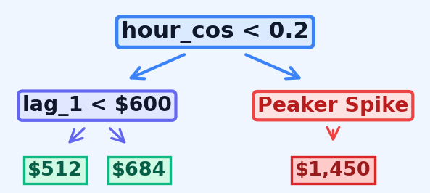
TRACK 1 FORECASTING (SARIMA, RIDGE, GBDT) & TRACK 2 ANOMALY DETECTION
Modeling Strategy & Evaluation Framework
TRACK 1: REAL-TIME MTR FORECASTING (3 ARCHITECTURES)
Linear Momentum Baselines vs Non-Linear L1 Tree Ensemble (2025 Test, N = 39,096)
TRACK 2: ANOMALY DETECTION
Regulatory Scarcity & Ohmic Loss Telemetry
SARIMA
Seasonal Time Series
RIDGE REGRESSION
Linear Regularized AR (L2)
HistGBDT (L1 MAE)
Tree Ensemble (Best)
Model Architecture: Calibrated threshold at MDA PML > $2,500/MWh (CENACE VOLL cap) & < $0 tail.
Physical Grounding: Captures 401 MDA scarcity alerts (91% in May–Jun '24) & 32.7x Ohmic line-heating surges (I²R).
Classical 1h benchmark fitting (1,0,1)×(1,0,1)24 per node. Models 24h seasonal wave but misses non-linear MTR shocks.
L2 linear autoregression (t-1...t-168): linear momentum tracker with 82.6% weight energy on lag_1 (β = +$772/MWh).
L1-loss gradient boosted trees. Resists scarcity outlier skew and branches dynamically on diurnal harmonics.
MAE: $134.22/MWh
WAPE: 17.7% | R²: 0.559
MAE: $142.65/MWh
WAPE: 18.8% | Prec: 57.4%
MAE: $101.10/MWh (BEST)
WAPE: 13.3% | Prec: 79.9%
401 MDA Alerts (3.1% Rate)
91% May–Jun '24 | -$53.4 Dec 25
EVALUATION METRIC RATIONALE: WHY EACH METRIC IS SELECTED FOR WHOLESALE POWER MARKETS
1. Mean Absolute Error (MAE - $/MWh)
Linear loss function directly proportional to financial imbalance dollars. Unlike quadratic RMSE, MAE avoids over-penalizing rare legitimate peaker spikes.
2. Weighted Absolute Percentage Error (WAPE - %)
Scale-independent percentage metric (sum |y - y_hat| / sum y). Normalizes error across seasonal price levels without division-by-zero risk in low-price hours.
3. Operational Precision (≤ $100/MWh Tolerance - %)
Commercial trading utility metric measuring the % of dispatch hours where error is within safe commercial bidding margins (79.9% HistGBDT L1 vs 57.4% Ridge).
Arkham Technical Challenge // Javier Diego-Fernández 7 / 12

Slide 8
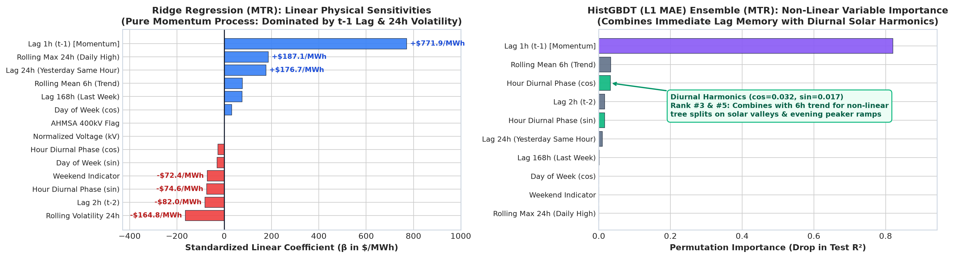
WHAT THE MODELS LEARN // STRUCTURAL GRID DYNAMICS & FEATURE WEIGHTS
Mechanistic Interpretation: Linear Weights vs Non-Linear Trees
RIDGE REGRESSION MECHANICS
Linear Momentum Persistence
Pure Autoregression: Ridge puts most of its weight on the last hour (+$771.9/MWh) and 24-hour highs (+$187.1/MWh).
Linear Blindness: Because weights simply add together, it cannot bend smoothly for midday solar dips or evening ramps.
HistGBDT (L1 MAE) MECHANICS
Thermodynamics & Diurnal Splits
Lag + Time of Day: Combines the 1-hour lag with 6-hour trend and hour of day (cos/sin) to reshape predictions across the day.
Spike-Resistant Learning: L1 tree splits adapt differently for solar valleys vs. evening peaks without letting rare spikes distort normal hours.
PHYSICAL TAKEAWAYS
MTR Grid Physics Implications
1-Hour Inertia Drives MTR: The latest cleared price (lag_1, 0.82 importance) drives almost all next-hour forecasting power.
Causal Alignment: Using 1-hour lags works cleanly at :45 for real-time MTR dispatch, whereas Day-Ahead (MDA) auctions require weather and fuel forecasts.
Arkham Technical Challenge // Javier Diego-Fernández 8 / 12

Slide 9
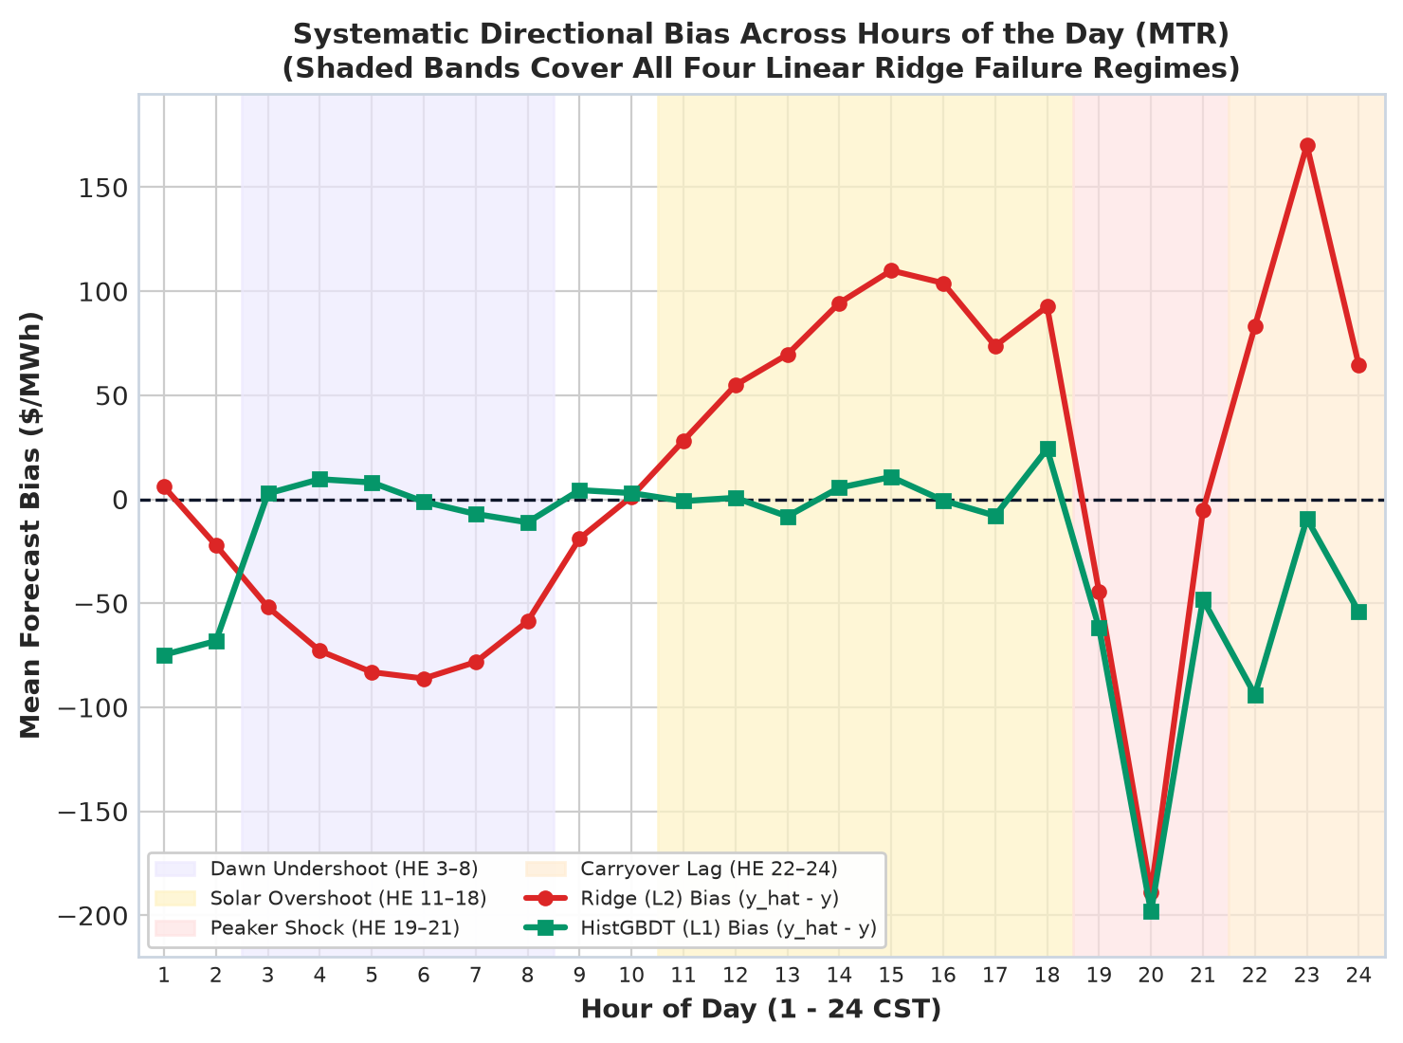
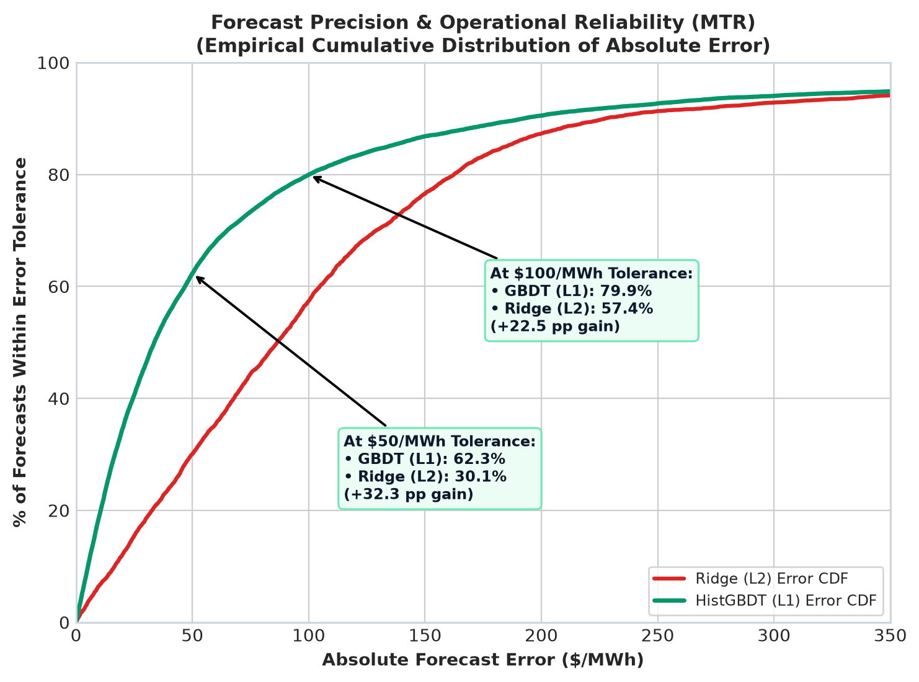
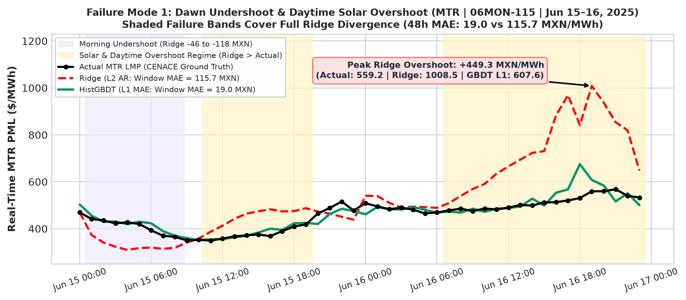
DIAGNOSTIC CASE STUDY // HYPERPLANE LIMITATIONS IN CONVEX GRID DISPATCH
Algorithmic Failure Modes of Linear Ridge
FAILURE MODE 1: SOLAR & DAYTIME OVERSHOOT
Inability to Bend Around Zero-Marginal-Cost Solar Generation
Straight-Line Solar Drift: Ridge relies on linear price momentum and cannot bend when solar generation flattens prices, overpredicting 11:00–18:00 by +$78/MWh on average.
Jun 15–16 Case Study: Over 48h, linear momentum drifts +$449.3/MWh high ($1,008.5 vs $559.2).
HistGBDT (L1) Precision: HistGBDT (L1) learns the daily solar shape automatically, keeping average midday and dawn bias near zero (< $3/MWh).
FAILURE MODE 2: DAWN/PEAKER ASYMMETRY & CDF
Regime Drift vs. Median-Aligned L1 Distributional Control
Daily Transition Failures: Ridge misses every turn in the daily curve — underpredicting dawn (-$72/MWh) and evening peaks (-$189/MWh), then lagging +$170/MWh too high at night (23:00).
Operational Reliability CDF: HistGBDT (L1) stays within the $100/MWh trading tolerance 80% of all test hours (vs only 57% for Ridge)
L1-Loss Plateau Stability: Training trees on L1 (median error) instead of L2 (squared error) stops rare scarcity spikes from distorting normal hours, cutting Jan freeze error from $167 to $99/MWh.
Arkham Technical Challenge // Javier Diego-Fernández 9 / 12

Slide 10
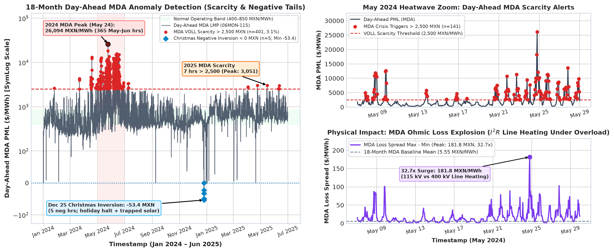
MAY 2024 ENERGY CRISIS, SCARCITY CAP & CHRISTMAS VALLEY
Physics Inspired Anomaly Detection (MDA)
SCARCITY PEAKS: $26,094 ('24) | $3,051 ('25)
401 MDA hrs > $2,500 (3.1%): 365 (91%) in May–Jun '24 + 7 in '25 ($26,222 zone max).
OHMIC LOSS SURGE: 32.7x Baseline Surge
MDA I²R spread jumped from $5.55 avg to $181.8/MWh (115 kV vs 400 kV; -$603.85 min).
CHRISTMAS VALLEY: -$53.4/MWh Inversion
5 hours inverted < $0 on Dec 25 holiday halt + trapped solar bottleneck (-$53.9 zone).
Arkham Technical Challenge // Javier Diego-Fernández 10 / 12

Slide 11
PRODUCTIONIZATION & ANALYST WORKFLOW // SCHEDULE, ALERTING & GOVERNANCE
3-Stage Decision Engine: Scheduling, Alerting & Audited ROI
STAGE 1 · DAY-AHEAD (MDA · D-1)
Lock 85–90% Supply Before Noon
Sizes D-1 bids vs. break-even ahead of CENACE's 12:00 CST gate.
• Pre-Noon Schedule: Delivers 10:15 CST daily P10–P90 bands vs. $1,250/MWh break-even & CSV export.
• Post-Auction Alerts: Sends 24h plant shift warnings when D-1 clears > $2,500 (Jun 11 HE 21: $3,012).
• Single Monclova View: One zone curve replaces 9 near-identical tabs (r > 0.9999); flags 06AHM-400 splits.
• Phase 2 Causal Feeds: Adds NOAA weather + Waha Hub gas prices before enabling automated D-1 ML bidding.
STAGE 2 · REAL-TIME (MTR · LIVE)
Hourly :45 Dispatch & Triage
Tracks live MTR − MDA spikes, 1–4h risks & immediate asset actions.
• Causal :45 Inference: HistGBDT (L1) predicts +1–4h MTR ($101.10 MAE; 79.9% ≤ $100) with Ridge fallback.
• Alert Triggers: Fires on > $2,500 VOLL, > 5x I²R line loss, or spread surges (Jun 10 HE 20: +$4,549).
• Plain-English Triage: Separates SIN scarcity (pml_cng = $0) from local bottlenecks & sizes $/hr risk.
• SCADA vs. D-7 Mode: Live utility SCADA (API lags 7 days) triggers 12 MW EAF cuts & 20 MWh BESS discharge.
STAGE 3 · SETTLEMENT (D+7 · MLOPS)
Prove Dollar ROI & Govern Drift
Audits finalized CENACE invoices, scores trust & shields weekly retrain.
• Jun 9–15 Audited ROI: Cut bill from MXN 5.59M to 4.76M — MXN 828.7k (-14.8%) saved via hedges, EAF & BESS.
• Trust by Time of Day: Highest precision in Morning Ramp (95.2% ≤ $100) & Solar (91.0%) vs. Peaks (58.5%).
• Retrain & Drift Guard: Retrains Mon 00:00 CST (8-wk window) + KS test (p < 0.01); excludes May '24 blackouts.
• Low-Friction Rollout: Launch automated morning Slack/email briefs first, wire SCADA, then open full console.
OPERATIONAL MANDATE
Export Pre-Noon Bids | 24h Plant Shift Advisories
OPERATIONAL MANDATE
:45 Live MTR Execution | BESS & EAF Override
OPERATIONAL MANDATE
MXN 828.7k (-14.8%) Saved | Mon 00:00 Retrain
Arkham Technical Challenge // Javier Diego-Fernández 11 / 12

Slide 12
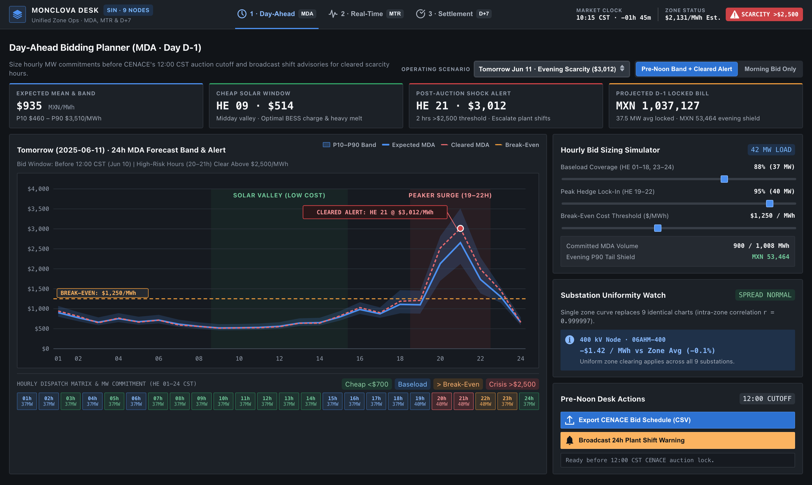
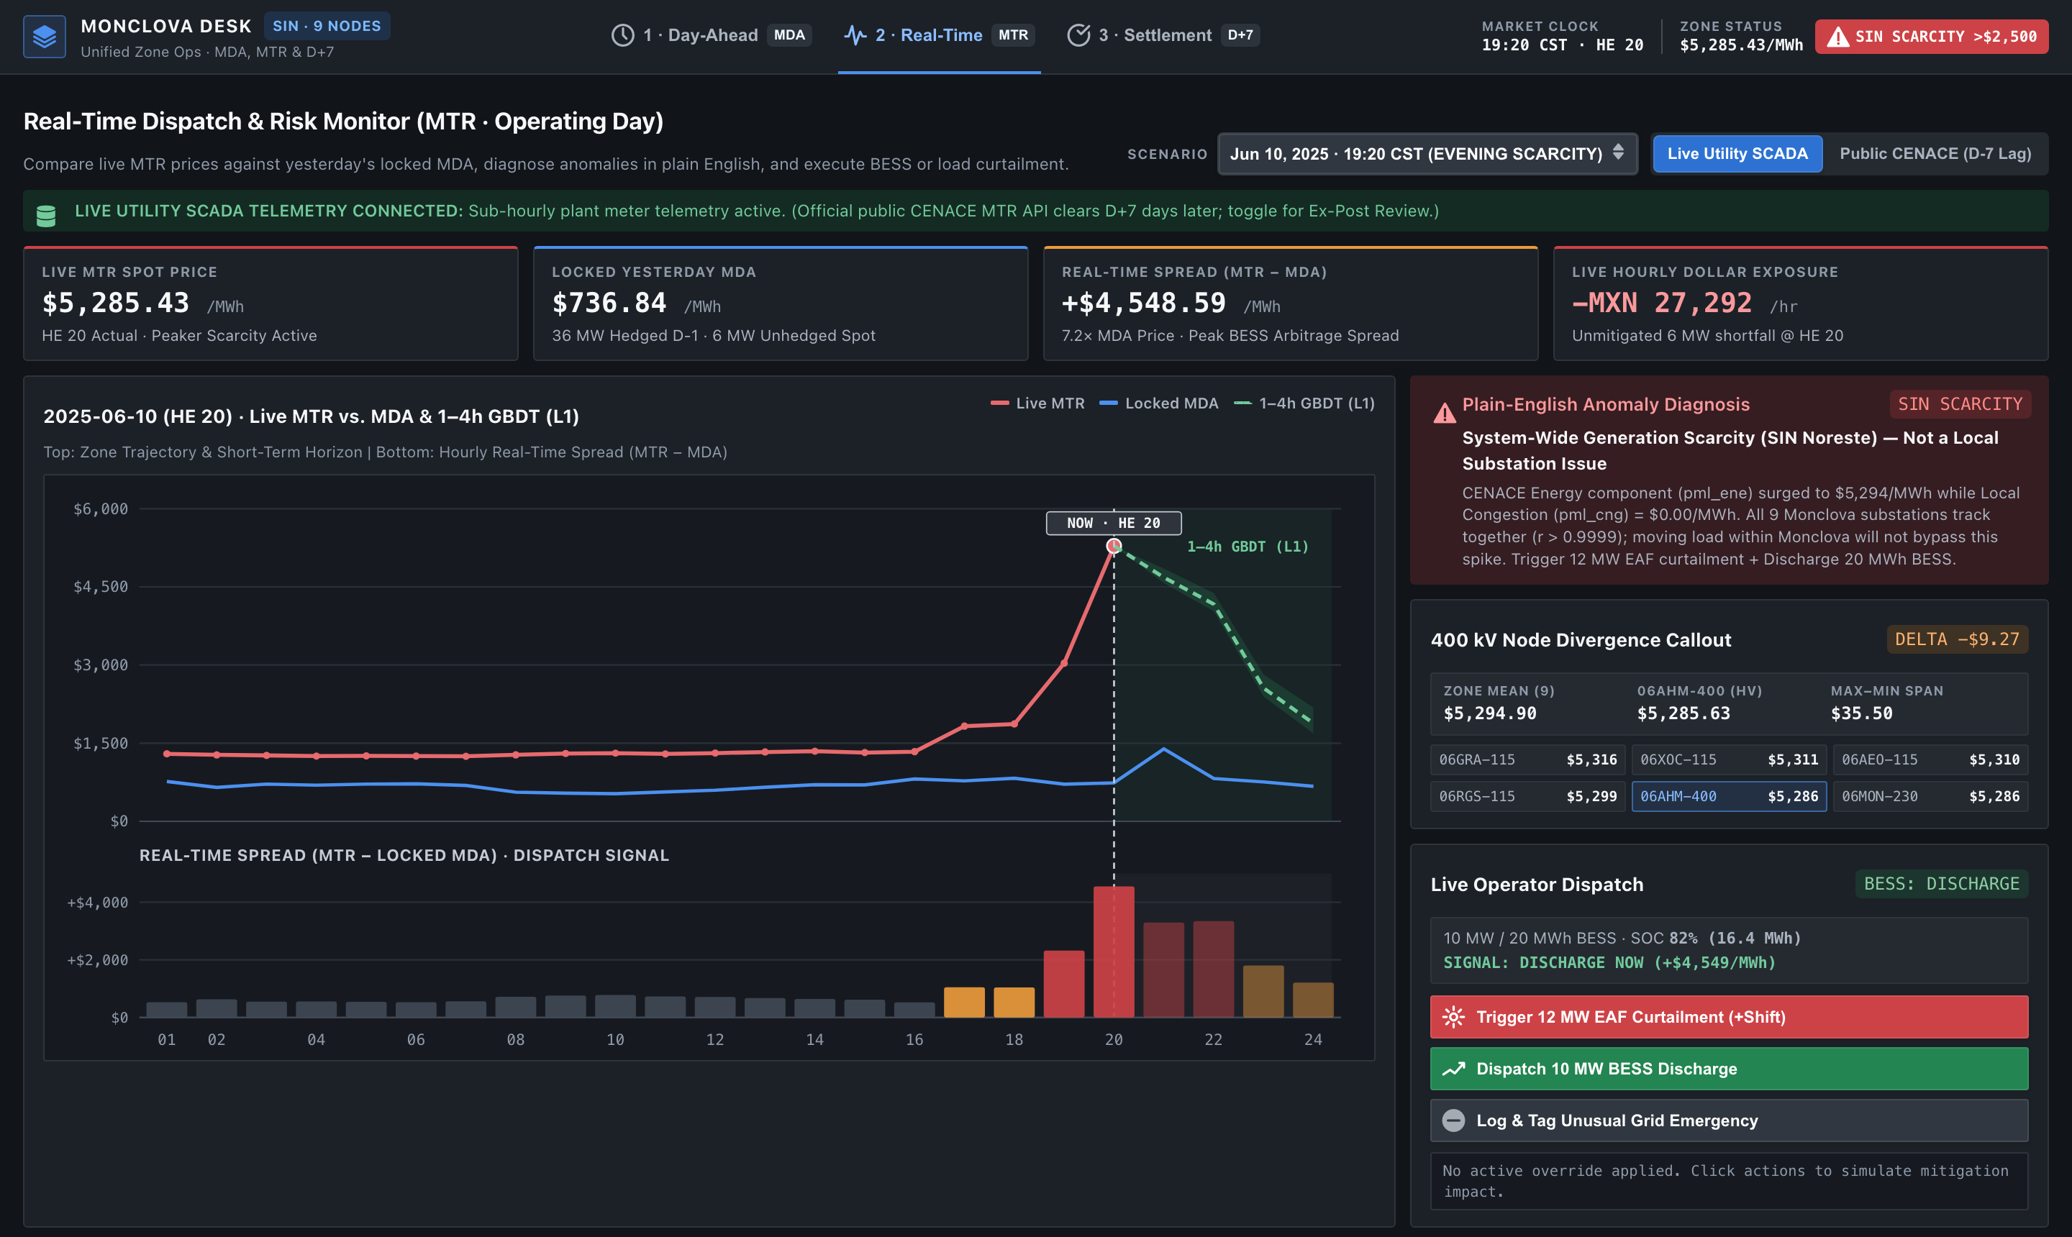
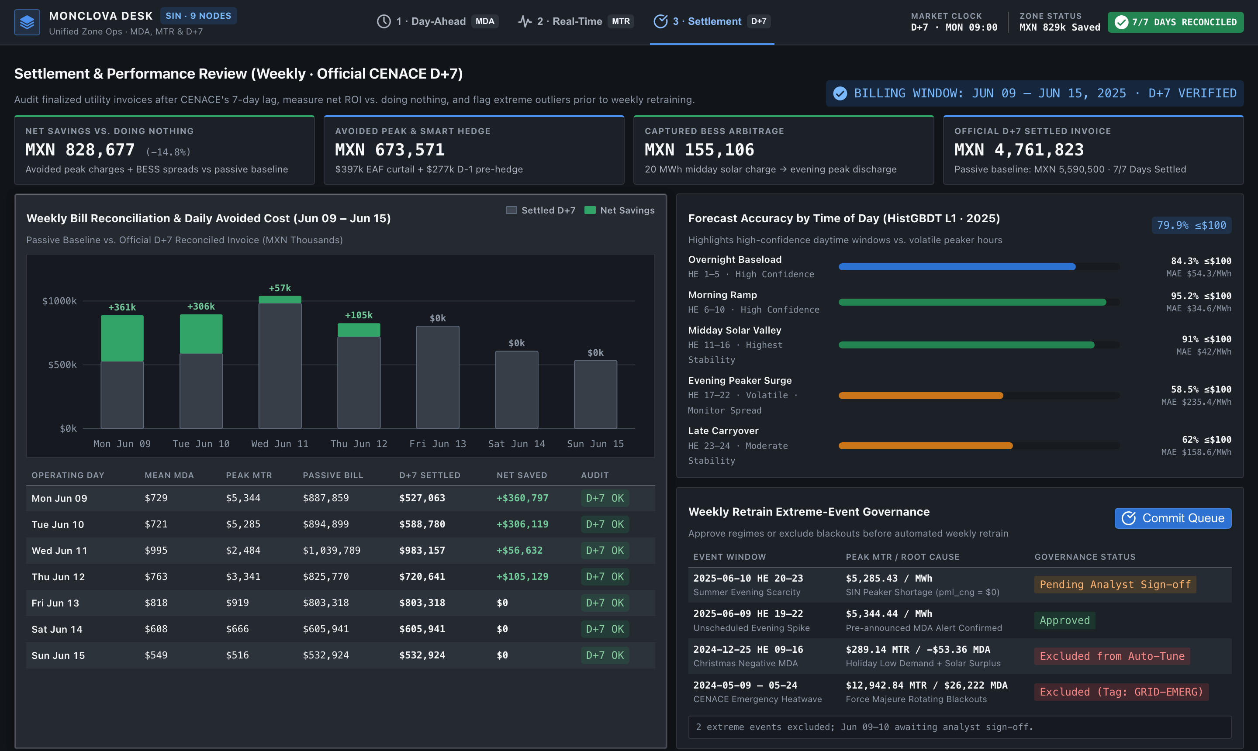
ANALYST CONSOLE PROTOTYPE // PALANTIR-INSPIRED WORKBENCH
Monclova Analyst Console: Plan Tomorrow, Manage Today & Verify Savings
TAB 1 · DAY-AHEAD PLANNER
Lock Tomorrow Before Noon
TAB 2 · REAL-TIME MONITOR
Live Operations & Alerts
▸ Chart: Tomorrow's 24h price outlook vs. break-even cost, flagging cheap solar & peak hours.
▸ Sliders: Test how much power to buy before noon and preview the projected daily bill.
▸ Actions: Download tomorrow's bid file and send an early warning to reschedule plant shifts.
▸ Chart: Live market price vs. yesterday's locked rate, next 4h outlook & extra cost/hr.
▸ Diagnosis: Explains in plain words if a spike hits the whole grid or one local line.
▸ Actions: Pause heavy furnaces, discharge the backup battery during peaks, or log alerts.
TAB 3 · BILLING & WEEKLY REVIEW
Saved: MXN 828,677 (-14.8%)
HOW THE ANALYST CONSOLE WORKS
Unified Daily Workflow
▸ Savings: Compares weekly bills vs. doing nothing, proving MXN 828.7k (-14.8%) saved.
▸ Reliability: Shows which hours forecasts get right cleanly (daytime) vs. volatile peaks.
▸ Review: Inspect major price spikes and approve or exclude blackout days from updates.
1. Morning-to-Night Workflow: Plan tomorrow's bids before noon (Tab 1), react to live price spikes during the day (Tab 2), and verify real savings each week (Tab 3).
2. One Curve Instead of 9 Charts: Since all 9 local substations move together, the screen stays clean with one curve and only flags the plant substation if it diverges.
3. Built for Real Market Timing: Connects to live plant meters during operating hours for fast action, then matches official CENACE invoices released a week later.
4. Always-On Alerts Bar: The top strip counts down to the daily bidding cutoff, shows the current zone price, and flashes immediately during extreme shortages.
Arkham Technical Challenge // Javier Diego-Fernández 12 / 12

