Slide 1

Project 1 Data Analytics Bootcamp August 6, 2024
Group 5:
Drew Billington
Javier Reyes Hernandez
Marukha Hussaini

Slide 2
Agenda / Structure
Intro & Setup
Analysis:
Drew
Marukha
Javier
Observations & Conclusion

Slide 3
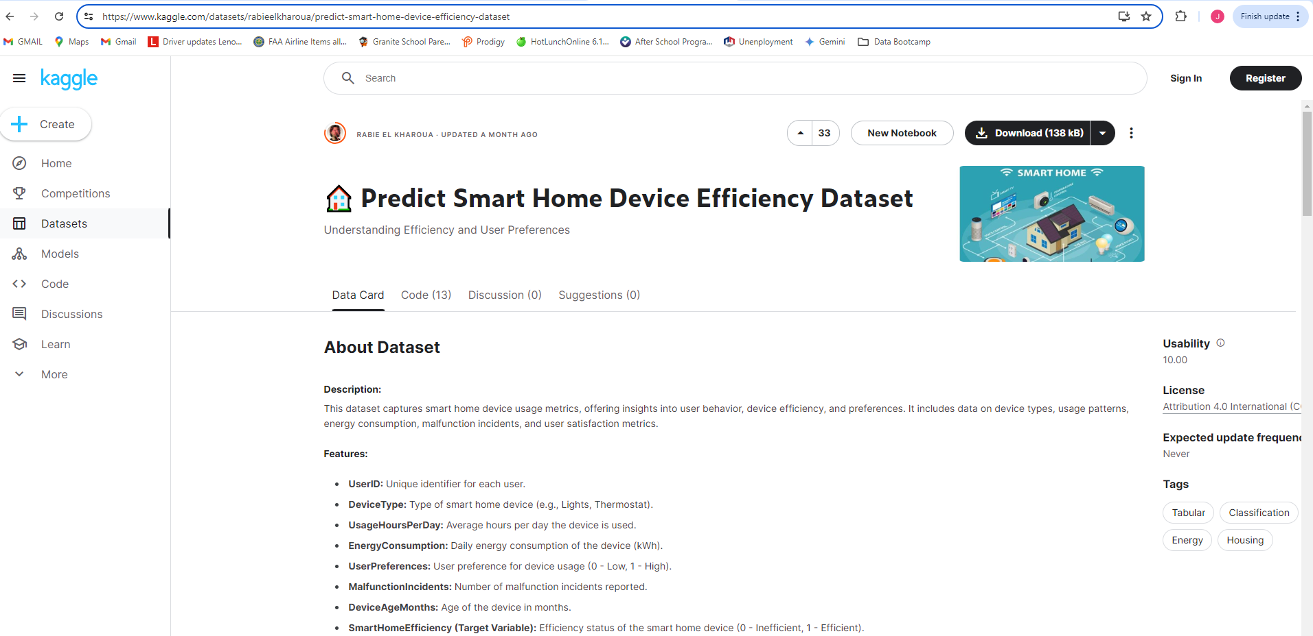
Intro - Dataset
kaggle – Predict Smart Home Device Efficiency Dataset
This dataset captures smart home device usage metrics, offering insights into user behavior, device efficiency, and preferences. It includes data on device types, usage patterns, energy consumption, malfunction incidents, and user satisfaction metrics.
Sizing: 8 column/datapoints; 5,403 rows
API…
Documentation read
Command line tool (CLI) & API
Result = did not complete via API
Explore other methods (ex CLI) for API data export

Slide 4
Intro – Dataset
Fields:
UserID: Unique identifier for each user.
DeviceType: Type of smart home device (e.g., Lights, Thermostat).
UsageHoursPerDay: Average hours per day the device is used.
EnergyConsumption: Daily energy consumption of the device (kWh).
UserPreferences: User preference for device usage (0 - Low, 1 - High).
MalfunctionIncidents: Number of malfunction incidents reported.
DeviceAgeMonths: Age of the device in months.
SmartHomeEfficiency (Target Variable): Efficiency
Additional field/datapoint added: EnergyConsumptionHR
EnergyConsumptionHR = EnergyConsumption / UsageHoursPerDay

Slide 5
Intro – Dataset work
Clean / check procedures:
.count(); drop NaN
.dtypes(); adjust as necessary
Duplicated values rows; drop duplicates
Duplicated values column; consolidate dup names
Clean CSV for go-forward data

Slide 6
Analysis – Overview
What kind of insights can we ascertain about Smart Home Device Efficiency and Usage?
What are the stats on usage hours & energy consumption? For each device type? How do they compare?
How does energy consumption vary by device type?
What is the relationship between device age and malfunction incidents?
How do user preferences impact energy consumption?
What is the distribution of smart home efficiency ratings among the devices?
What devices have higher energy consumption?

Slide 7
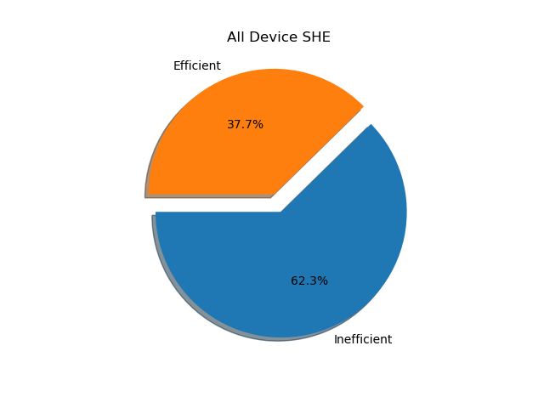
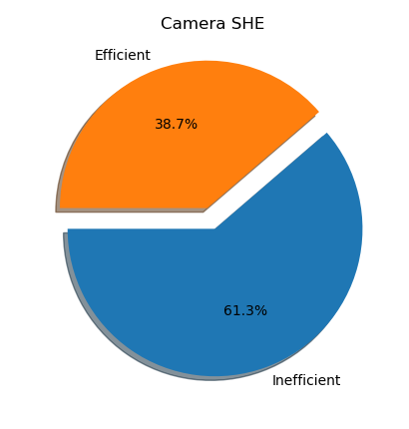
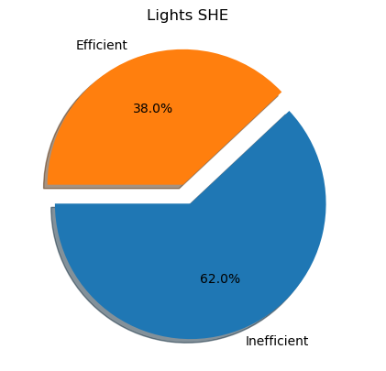

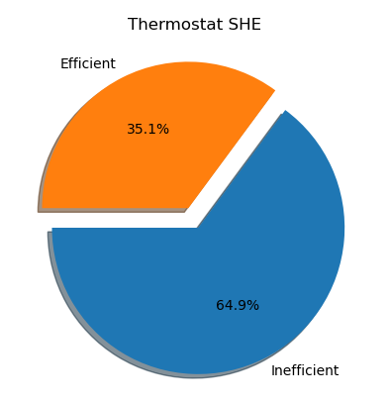
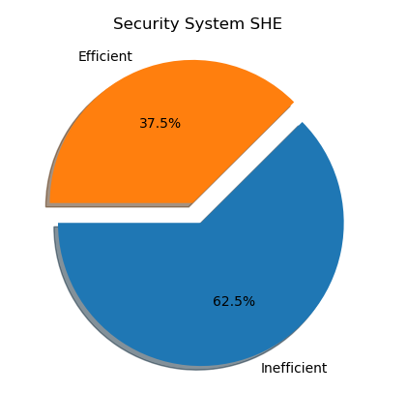
Analysis What is the distribution of smart home efficiency ratings among the devices?

Slide 8
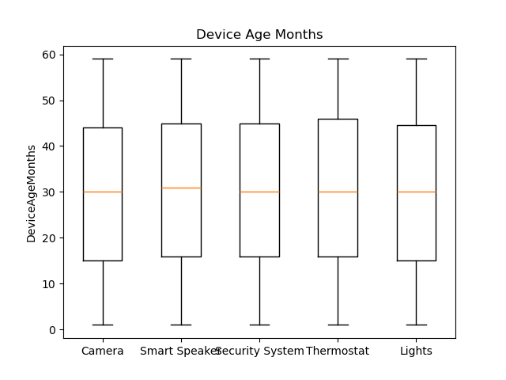
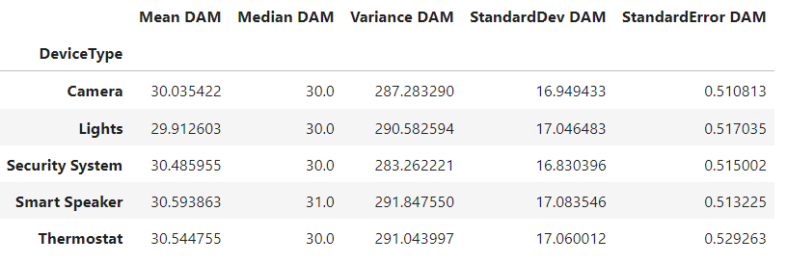
Analysis Device age months stats, per device

Slide 9
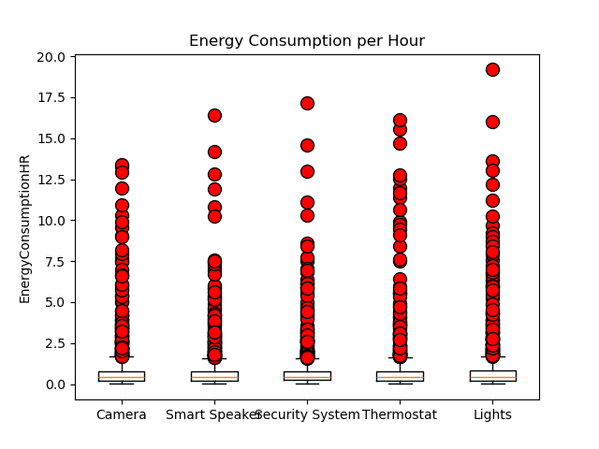
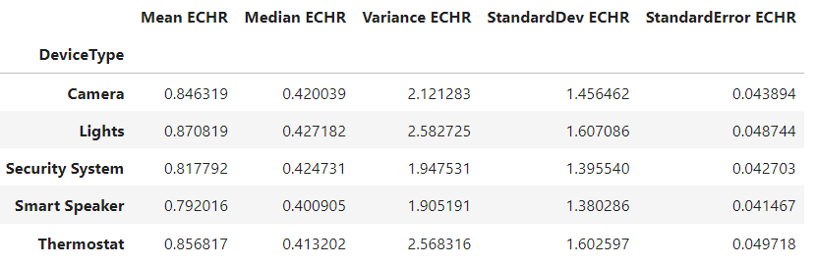
Analysis Energy consumption per hour stats, per device

Slide 10
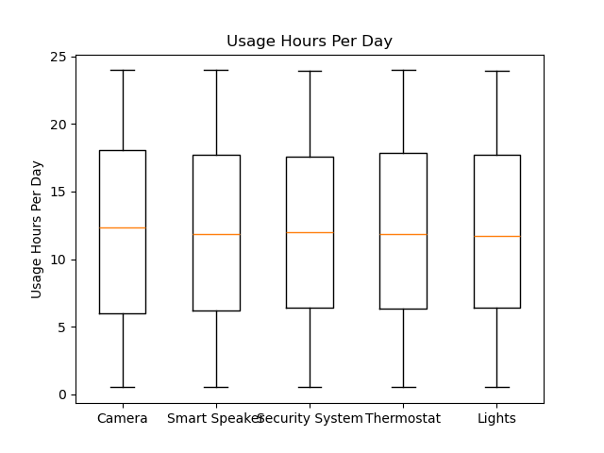
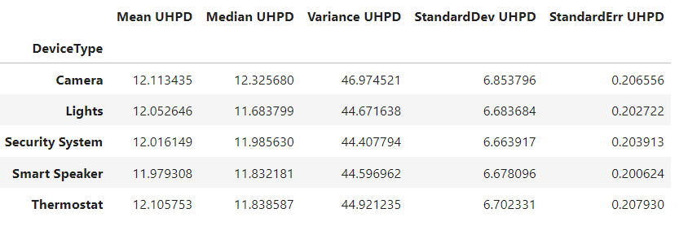
Analysis Usage Hours per day stats, per device

Slide 11
Analysis How does energy consumption vary by device type?
Placeholder Visual
Placeholder Visual
Placeholder Visual
Placeholder Visual

Slide 12
Analysis What are the average usage hours & energy consumption for each device type? How do they compare?

Slide 13
Analysis What is the relationship between device age and malfunction incidents?
Placeholder Visual
Placeholder Visual
Placeholder Visual
Placeholder Visual

Slide 14
Analysis How do user preferences impact energy consumption?
Placeholder Visual
Placeholder Visual
Placeholder Visual
Placeholder Visual

Slide 15
Analysis What devices have higher energy consumption?
Placeholder Visual
Placeholder Visual
Placeholder Visual
Placeholder Visual

Slide 16
Observations
Takeaway observations…
As a group, we were expecting (hoping?) for some more wild data that would show us “wow this device is way better/worse than others!”
Interestingly, device types and datapoints all led to similar conclusions == there is limited difference between device types, etc…
Key takeaway = Smart Home devices (per this dataset) are all pretty much the same…

Slide 17
Conclusion
General one liner summary
What we learned?
What we would do more of / next time?

Slide 18
FIN

