Slide 1
How to develop asynchronously, for real (or not)
Javier Molina
Software developer
Technical domain, Praetorians team

Slide 2
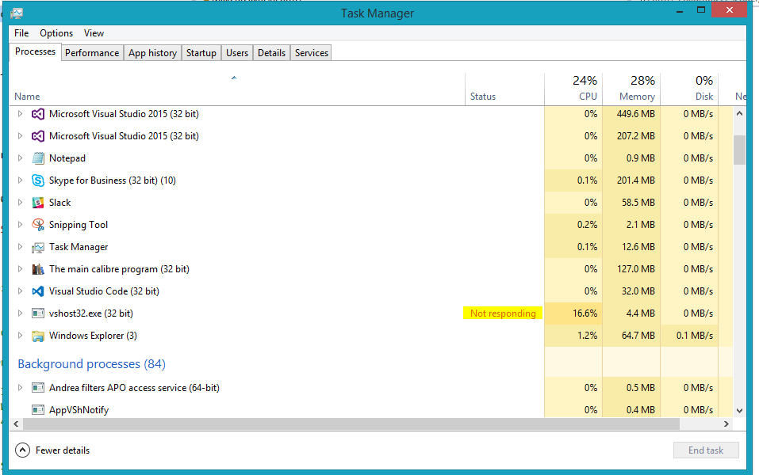
Why async programming?

Slide 3
Useful definitions
Something is asynchronous when you don’t have to stop and wait for it
Does not require a multithread environment. For example an IO operation.
Multithreading means multiple execution context in the application
Parallel computing means that multiple operations are carried out simultaneously.

Slide 4
Key Takeaways
Async/await
What it should returns?
Control flow
Some examples

Slide 5
async/await
Highlights
Syntax sugar for invoking and chaining Tasks.
Pros
Easy syntax
Allows update UI thread
Cons
More overhead than sync methods

Slide 6
async/await
What can be accomplished using async and await keywords
1. Writing an asynchronous code with a synchronous code structure.
2. In UI applications, the UI will be responsive during the asynchronous operation and will not be grayed out.
3. Exception handling can be done just similar to a synchronous code.

Slide 7
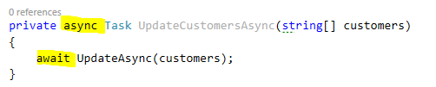
async/await
async
FALSE This method is asynchronous.
TRUE In this method we’ll call asynchronous methods
await
FALSE Program flow will be waiting until the method is completely executed.
TRUE Calling this method will return immediately the control to the caller, when method end, the execution will continue from that point.

Slide 8
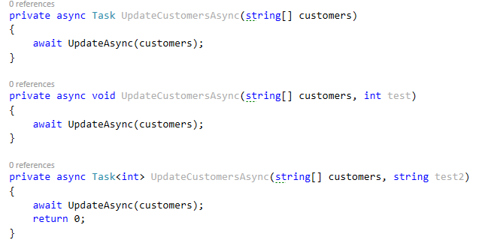
What should it returns?
Async methods can return the following types:
void
Task
Task<T>

Slide 9
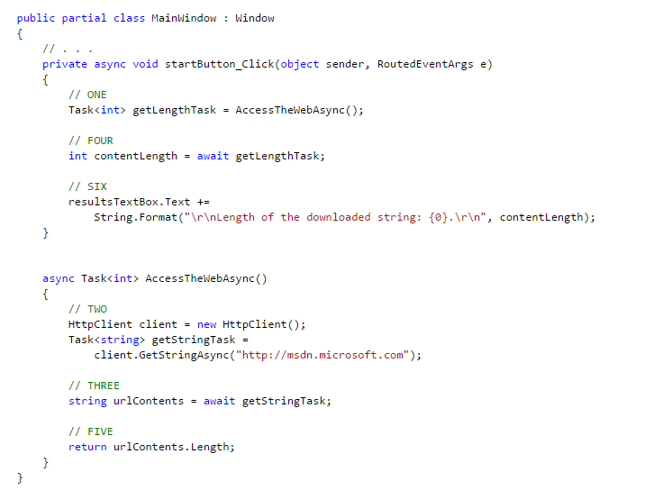
Control flow

Slide 10
Some examples

Slide 11
Thanks so much for your attendance

