Slide 1

Color Theory

Slide 2
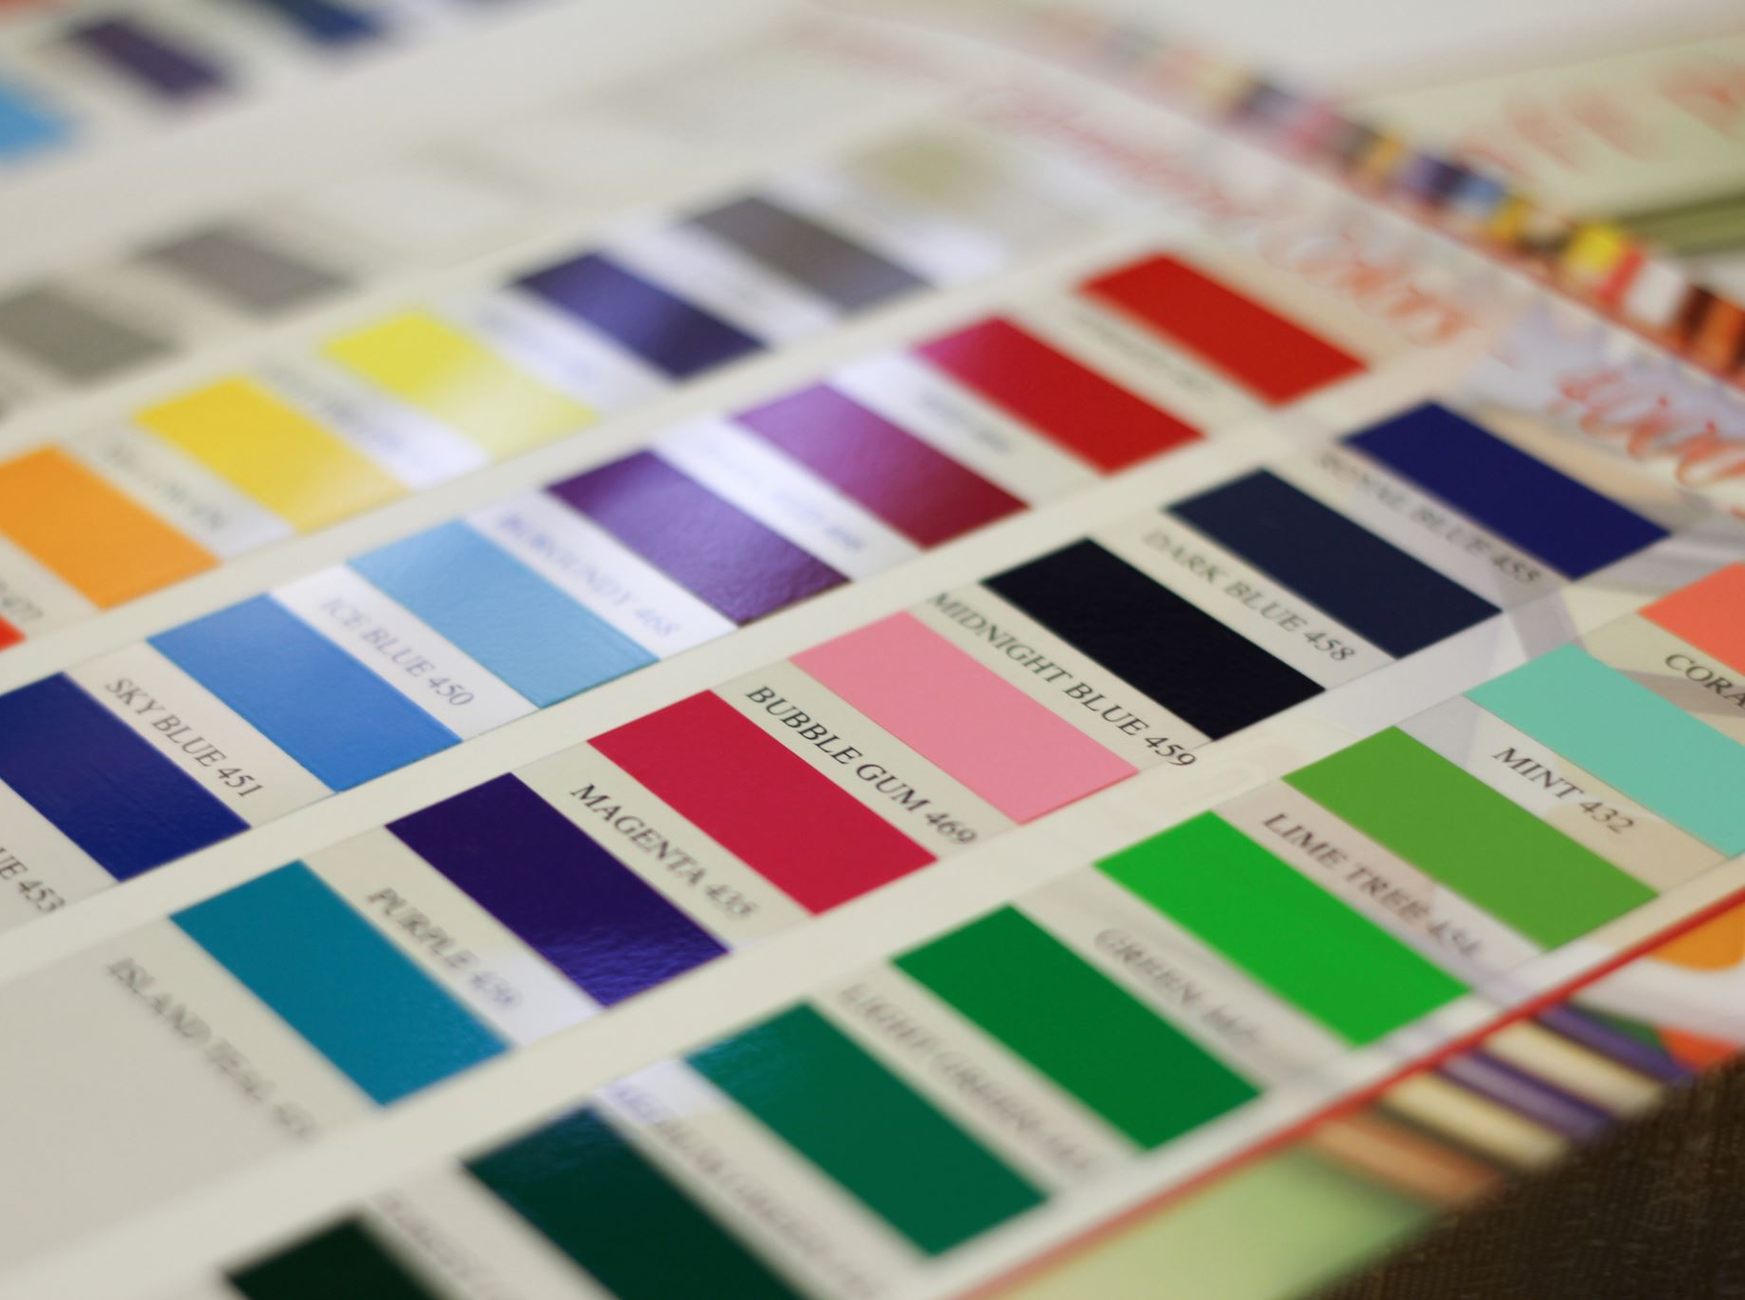

Index
What is color theory?
Hue , saturation and brightness
Types of colors
Contrast , vibration
Complementary and analogous colors
Color meanings

Slide 3

What Is Color Theory?
Color theory is the art and science of using color. It explains how humans perceive color (both physically and psychologically) and how colors mix, match, and contrast with one another.

Slide 4
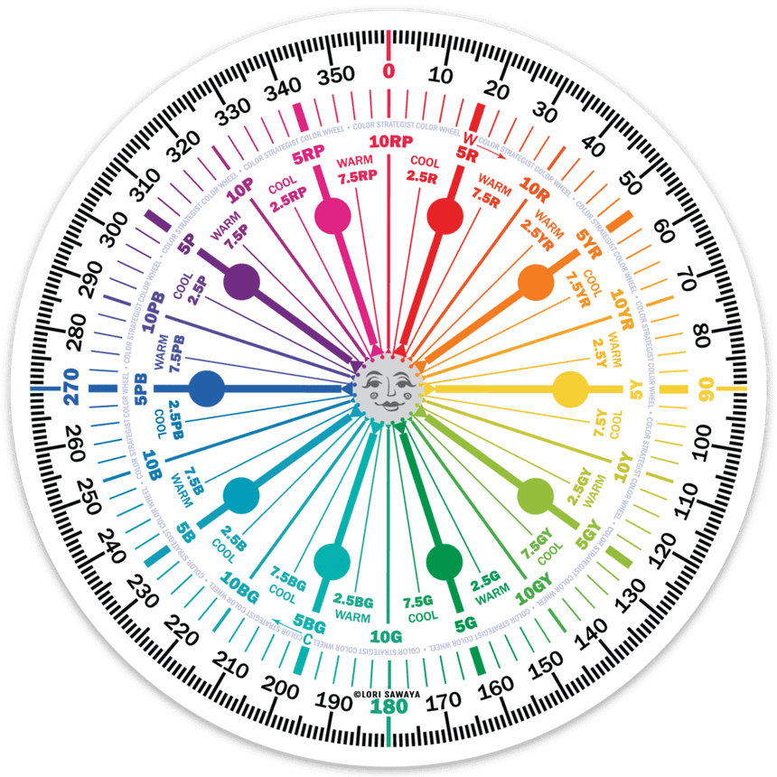
Hue , saturation and brightness
Hue is the fundamental property of color that determines its name, such as red, green, blue, yellow, or purple. It is the characteristic that allows us to distinguish one color from another. In other words, hue refers to the specific wavelength of light that is reflected or transmitted, which our eyes perceive as a particular color.

Slide 5
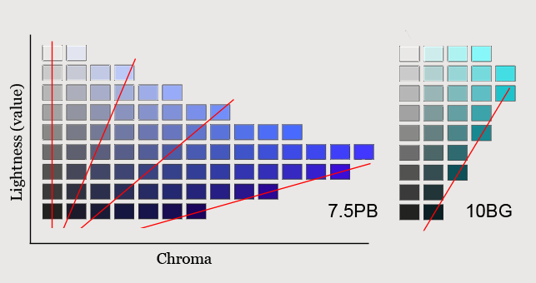
Hue , saturation and brightness
Brightness refers to the amount of white (or black) mixed into a color. It controls the overall lightness or darkness of a color. In the context of digital colors, brightness is often represented as a value between 0 (black) and 255 (white). A higher brightness value means a lighter color, while a lower value means a darker color

Slide 6
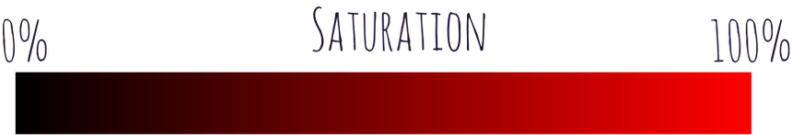
Hue , saturation and brightness
Saturation refers to the purity or intensity of a color. It measures how vibrant or muted a color appears. It measures how much gray is mixed into a color.
A saturation value of 0 indicates a shade of gray, while a value of 100% represents the most vivid, intense color possible.

Slide 7
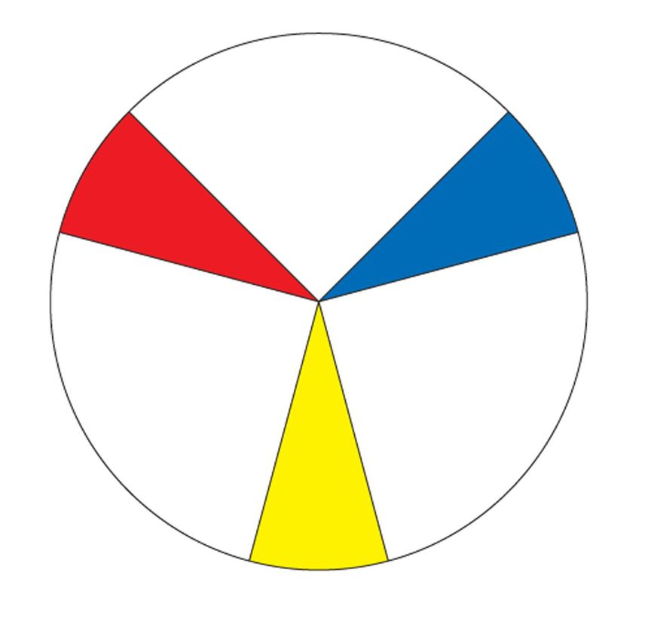
Primary colors (type of colors)
Primary colors are those that cant be obtained by mixing other colors.
There are three:
Blue
Red
Yellow
These colors are considered “pure” because they have no additional components and are the basis for the creation of other colors.

Slide 8

Secondary Colors (type of colors)
Seconday colors: They are those that we obtain after mixing two primary colors in equal parts.
Red + Blue = Violet
Red + Yellow = Orange
Blue + Yellow = Green

Slide 9
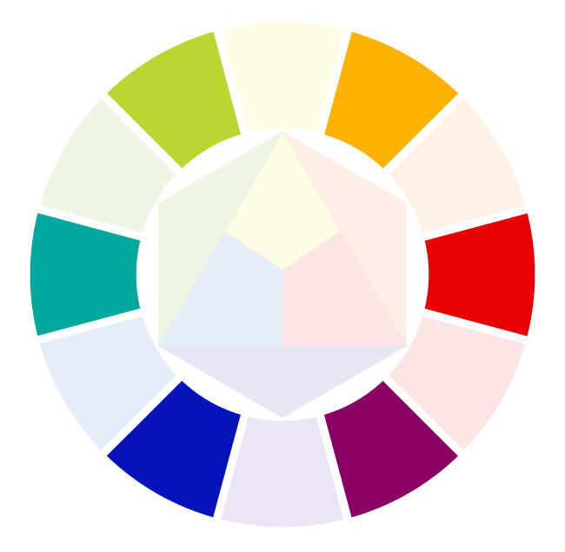
TertiaryColors (type of colors)
Tertiary colors: T
Yellow Orange
Red Orange
Red Violet
Blue Violet
Blue Green
Yellow Green

Slide 10

Color Contrast
Color contrast is important for highlighting interface elements and also for determining the overall color palette of a web site.Colors are divided into two groups:
Warm colors
Cool colors
In the example above, you can see how clearly yellow takes prominence over the blue. Likewise, the red takes the attention from the green, almost shrinking it.

Slide 11




Simultaneous Contrast
Simultaneous contrast is a color illusion that bends our perception of a color based on the sorrounding colors
Both center colors are the same

Slide 12



Vibration
The vibrancy of a color can evoke specific emotions and set a particular atmosphere. For instance, brighter hues often energize users and enhance their alertness, while darker shades create a more relaxing and tranquil vibe.For example in pc componentes web site the prizes are in red because they want to highlitght it

Slide 13
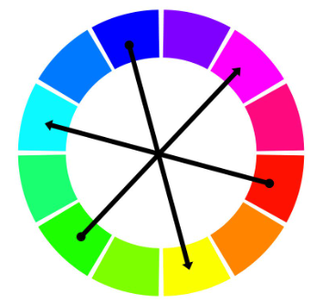
Complementary
Complemetary colors are a pair of colors on completly opposite sides of the color spectrum from each other, they can also be called oposite colors.

Slide 14
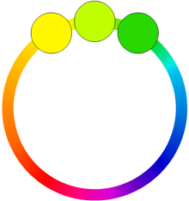
Analogous
Analogous colors are groups of colors that are next to each other on the color wheel. Red, orange, and red-orange are examples.

Slide 15

Color Meaning
The psychology of color is important to be able to convey the feelings and emotions that we want on our website. Although we must keep in mind that each color can be perceived differently in each culture, so we must know our audience.

Slide 16
The meaning of each color
Red: passion, physical energy
Yellow: happiness, creativity, mental stimulation
Blue: calmness, honesty, trust
Orange: spontaneity, adventure, dynamism
Green: growth, freshness, harmony
Purple: spirituality, imagination, mystery
Pink: unconditional love, sympathy, femininity
Brown: strength, dependability, warmth
Black: power, elegance, mystery, formality
White: purity, innocence, delicacy, cleanliness
White: purity, innocence, delicacy, cleanliness

Slide 17
References
Color Theory 101: A Complete Color Guide (2024) • Colors Explained
https://tonosatubrilloilu.blogspot.com
Web ui design best practices

