Slide 1

Venture Capital and Entrepreneurial Management
MGMT 264
Valuation Methodologies
Raphael (“Raffi”) Amit, PhD
The Marie and Joseph Melone Professor
The Wharton School
University of Pennsylvania
 (215) 898 7731
 amit@wharton.upenn.edu

Slide 2
Average US VC pre-money valuations
- Angel and Seed
Source: PitchBook
Notes:
Time to liquidity increases

Slide 3
Average US VC pre-money valuations
- Early Stage and Late Stage
Source: PitchBook
Notes:
Time to liquidity increases

Slide 4
Median Dilution Amounts—2015 vs. 2020
Source: WSGR Entrepreneurs Report Q3 2020
Stage Round | Median Pre-$ Value | Median Amount Raised | Dilution
Seed | $6.0M | $1.0M | 14%
Series A | $16.1M | $5.0M | 24%
Series B | $40.0M | $7.5M | 16%
Series C + | $102.9M | $16.0M | 13%
2015
Stage Round | Median Pre-$ Value | Median Amount Raised | Dilution
Seed | $6.9M | $2.0M | 22%
Series A | $27.8M | $5.9M | 18%
Series B | $98.0M | $18.2M | 16%
Series C + | $315.0M | $24.0M | 7%
Q3
2020
Notes:
Takeaway:
Pre-$ valuations and amounts raised have increased a lot in the last 5 years, per the WSGR data (sample size, >100 for 2014, smaller for Q3 2020).
Note the dilution in seed deals (seed deals EXCLUDE angel participants): 20+% dilution for a seed deal has become more commonplace, in large part because
(i) startups are waiting longer to take first money in, since it’s so cheap to organize and launch a company; and
(2) as a consequence, they are more developed and mature on their business plan, so able to command higher pre-money valuations; and
(3) investors are pumping more money into these seed rounds, which commands a higher percentage of the company.
Note: Per recent Wing VC information for the 10 years ended 2020, the median dilution amount for a seed financing was 26%!

Slide 5
Valuation of Start-up Companies
- A Comprehensive Perspective
WHY value startup companies?
HOW to value startup companies?
WHAT does valuation imply?
Investment
Fundraising
Stock Incentives
Taxes
Demand and Supply of Capital
“Prospect” of a Startup Company
Terms
Strategic Goals
Barriers for Next Round Financing…

Slide 6
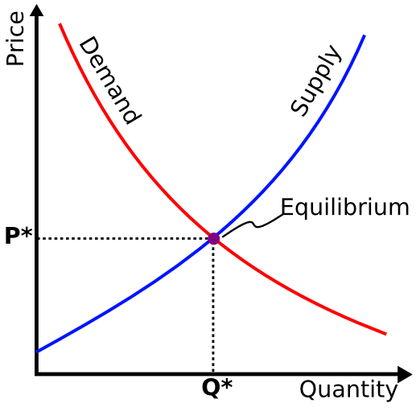
Valuation of Start-up Companies
- Important Premises
Premise 1: Company valuation is ultimately determined by market forces.

Slide 7
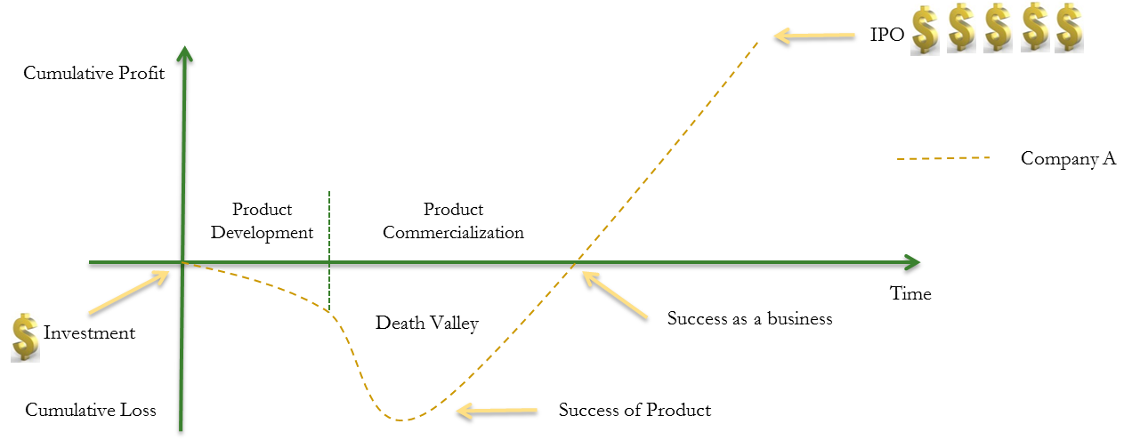
Valuation of Start-up Companies
- Important Premises
Premise 2: Cash Flow Trajectory

Slide 8
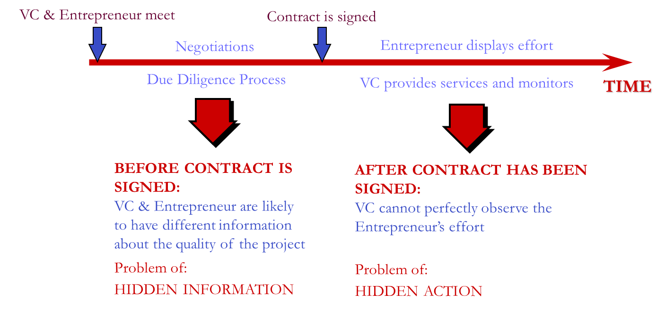
Valuation of Start-up Companies
- Important Premises
Premise 3: Information Asymmetry

Slide 9
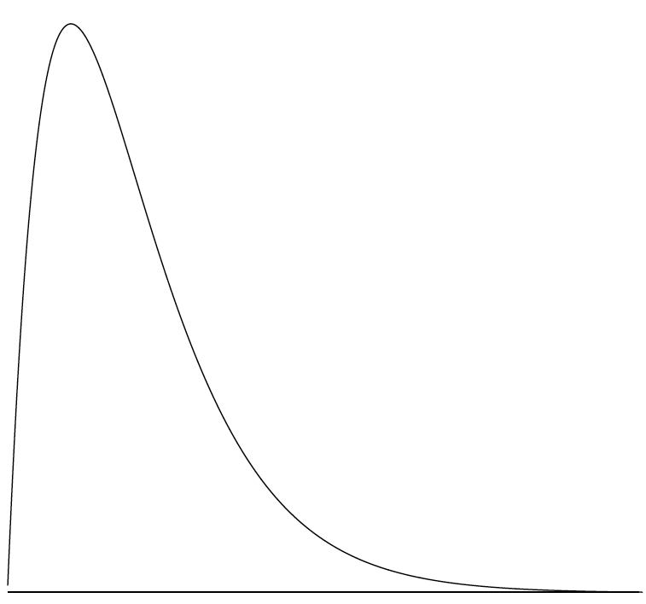




Valuation of Start-up Companies
- Important Premises
Premise 4: Risks
Failures
Mediocre Performers
Homerun
Frequency
Return
Source: Matt Oguz, TechCrunch.com
Notes:
Using the blackboard to show the probability function
Ask what are the main buckets of Risk faced by VC?
The Company
Management
Technology
Products
The Market for the Product
Customers’ willingness to buy
Competitors’ pace of imitation
The Industry Environment
Suppliers
Complementors
Barriers to entry
Technology
Regulations
The Public Financial Markets (Re: Exit)
And by default, the state of the M&A markets

Slide 10
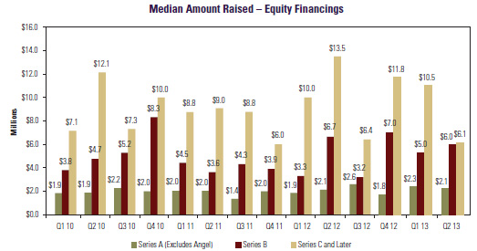

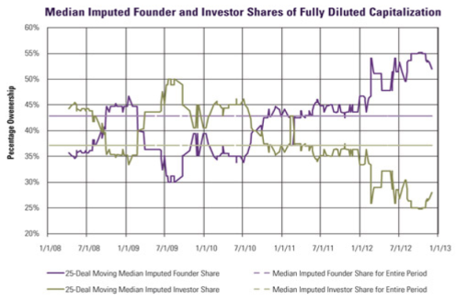
Valuation of Start-up Companies
- An Overview
Valuing Start-up Companies: Exogenous Factors
Market
Industry Norms
Gut Feeling and Art

Slide 11

Valuation of Start-up Companies
- An Overview
Valuing Start-up Companies: Methodologies
  Comparable Method
  Discounted Cash Flow Method
  The Venture Capital Method

Slide 12
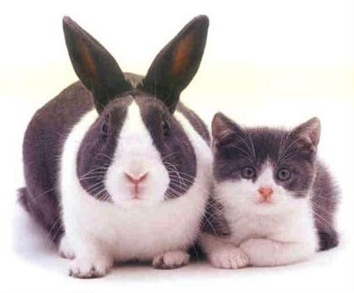
Valuation Methodologies
- Comparable Method
Comparable Method
  Step 1: Look for other firms with similar “value characteristics”
    Risk
    Growth rate
    Capital structure
    Size and timing of cash flows
  Step 2: Select an appropriate comparable
    P/E multiples
    EBIT & EBITDA multiples
    Revenue multiples
    Book value multiples

Slide 13
Valuation Methodologies
- Comparable Method
Challenges in valuing early stage private companies with comparable method
  Finding private or public firms with similar value attributes
  Selecting the multiples for a pre-revenue company
  Ascertaining valuations of the comparable firm if it is private

Slide 14

Valuation Methodologies
- Discounted Cash Flow (“DCF”) Method
Discounted Cash Flow
  Step 1: Calculate Cash Flow
  Step 2: Calculate Discount Rate
  Step 3: Calculate the Net Present Value
CF_{t} = EBIT_{t} * (1-ζ) + DEPR_{t} – CAPEX_{t} - ∆NWC_{t} + other_{t}
r = (D/V) * r_{d} * (1-ζ) + (E/V) * r_{e ,} where r_{e =} r_{f +} β * (r_{m} - r_{f})
NPV_{t} = [CF₁/(1+r)]+[CF₂/(1+r)²] +)]+[CF₃/(1+r)³]+…+ [(CF_{t} + TV_{t} /)/(1+r)^{t}],
where TV_{t}=[CF_{t} *(1+g)]/(r-g)

Slide 15
Valuation Methodologies
- Discounted Cash Flow (“DCF”) Method
Challenges in valuing early stage private companies
with DCF method
  Ascertaining the financial and cash flow projection of start-up companies
  Calculating the cost of capital (e.g. risk of early stage, illiquidity, market benchmark)
  Establishing reasonable assumptions

Slide 16
Valuation Methodologies
- The Venture Capital Method
Important factors for portfolio companies valuation
Most Important Factor | All | Stage |  | Industry |  | Fund Size
 |  | Early | Late | IT | Healthcare | Large | Small
Anticipated Exit | 46% | 38% | 58% | 34% | 50% | 45% | 47%
Comparable companies | 29% | 30% | 31% | 35% | 29% | 31% | 27%
Competitive pressure | 3% | 2% | 2% | 2% | 1% | 4% | 1%
Desired Ownership | 18% | 27% | 5% | 24% | 15% | 16% | 19%
Financial Metrics Used to Analyze Investments
Most Important Factor | All | Stage |  | Industry |  | Fund Size
 |  | Early | Late | IT | Healthcare | Large | Small
None | 9% | 17% | 1% | 13% | 7% | 9% | 10%
Cash-on-cash multiple | 63% | 56% | 71% | 57% | 72% | 65% | 61%
IRR | 42% | 26% | 60% | 33% | 42% | 40% | 42%
NPV | 22% | 12% | 21% | 16% | 29% | 24% | 21%
Source: Gompers et al, Working Paper(2016)

Slide 17

Valuation Methodologies
- The Venture Capital Method
The Venture Capital Method
  Commonly used in the venture capital community
  Consistent with the cash flow trajectory of venture capital backed start-ups
IPO
Cumulative Profit
Company A
Product Development
Product Commercialization
Time
Investment
Death Valley
Success as a business
Cumulative Loss
Success of Product

Slide 18

Valuation Methodologies
- The Venture Capital Method
The Venture Capital Method – An Example
  Institutional Venture Partners (together with other VCs) invested $80M in Snapchat in June 2013 at a pre-money valuation of $800M, which implies a 9.1% ownership at the time of investment.
  Assume that you are the partner at Institutional Venture Partner (IVP), you know that IVP requires 60% annualized compounded return from the deal. You also expect Snapchat to go public in 2018, which is 5 years after your investment.
  What should be the valuation of Snapchat at IPO in order to meet your return requirement?

Slide 19





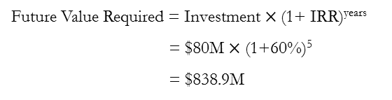
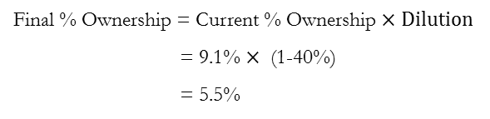
Valuation Methodologies
- The Venture Capital Method
The Venture Capital Method – An Example
Future Value Required by IVP
Final % Ownership of IVP
Future Value Required = Investment $×$(1+ IRR)^{years}
= $80M $×$ (1+60%)⁵
= $838.9M
Final % Ownership = Current % Ownership $×Dilution$
= 9.1% $×$ (1-40%)
= 5.5%
Required Value at IPO
Required Company Value at IPO = $\frac{Future Value Required}{Final \% Ownership}$ = $\frac{\text{\$}\text{838.9}\text{M}}{\text{5.5}\text{\% }}$ $≈\$15.3 Billion$
Comparable Internet Companies’ Value at IPO
$104 Billion
$24.5 Billion
$12.7 Billion
$7 Billion
$4.5 Billion
Notes:
Snap INC, (Snapchat) IPO March 3 2017 Priced at $17/share valuation at IPO: at the end on the first day of trading The stock closed at $24.48, giving the company a market value of $28.3bn This represent a 44% increase on day 1 (up from about $20B) for the price at which the company was listed.
July 29— 400 million shares from early investors PRICE $13.67 which is about $16 Billion market cap for Snap Inc.
August 14— 182 million shares from employees PRICE $12.6
August 14— 600 million shares from directors, founders, insiders
August 29— 20 million shares from early investors
On 9/14/2021 MKT cap $12.7 Billion p/share $71.3

Slide 20

Valuation Methodologies
- The Venture Capital Method
The Venture Capital Method - Basic Step
  Step 1: Estimate the terminal value of the firm in a future year (e.g. in the liquidity event)
    E.g., calculate using a multiple / comparable method
    Terminal Value = P/E * projected net income
  Step 2: Discount terminal value
    DTV = Terminal value / (1+target rate of return)^{years}
  Step 3: Calculate final % ownership
    Required final % ownership = investment / discounted terminal value

Slide 21
Valuation Methodologies
- The Venture Capital Method
An Example
  A VC considers an investment in MicroElectronics Corp. (MEC)
Fact Summary
Required Internal Rate of Return (IRR) of VC | 50%
Investment | $3.5 million
Term (Investment Horizon) | 5 years
Projected Net Income in Year 5 | $2.5 million
P/E in Year 5 | 15
Number of Shares Outstanding Before Financing | 1,000,000

Slide 22
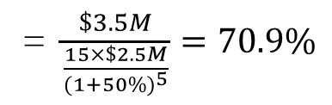
Valuation Methodologies
- The Venture Capital Method
MEC Example
  Pricing the transaction
    How much equity in MEC should the VC get in return for the cash investment?
Investment
Final Ownership Required =
Discounted Terminal Value
Investment
=$\frac{\$3.5M}{\frac{15×\$2.5M}{{(1+50\%)}^{5}}}=70.9\%$
=
P/E x (Terminal Net Income)
(1 + IRR)^{years}
Notes:
It would be good to write in this section the detailed calculations that are done on the blackboard
Done

Slide 23
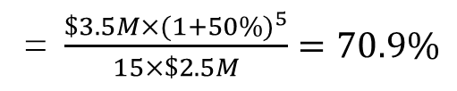
Valuation Methodologies
- The Venture Capital Method
MEC Example
  Pricing the transaction
    How much equity in MEC should the VC get in return for the cash investment?
Future Value of Investment
Final Ownership Required =
Terminal Value
Investment
x
(1 + IRR)^{years}
=$\frac{\$3.5M×{(1+50\%)}^{5}}{15×\$2.5M}=70.9\%$
=
P/E x (Terminal Net Income)
Notes:
It would be good to write in this section the detailed calculations that are done on the blackboard
$3.5 * 1.5**5 = $3.5 * 7.59375 = $26.578125
$26.578125/$37.5 = 70.875%

Slide 24




Valuation Methodologies
- The Venture Capital Method
MEC Example
  Computing shares to issue and share price
    How many new shares does MEC have to issue?
    At what price?
New Shares
% of Ownership Acquired =
New Shares + Old Shares
$$New Shares= \frac{\% of ownership}{1−(\% of ownership)}×Old Shares$$
$$=\frac{70.9\%}{1−70.9\%}×1M=2.4M$$
$$Share Price= \frac{Investment}{New Shares}$$
$$=\frac{\$3.5M}{2.4M}=\$1.4/share$$

Slide 25


Valuation Methodologies
- The Venture Capital Method
MEC Example
  Computing the implied valuation
    What is MEC’s post-money value?
    What is MEC’s pre-money value?
Post-Money Valuation$= \frac{Investment}{\% of Ownership Acquired}$
$=\frac{\$3.5M}{70.9\%}=\$4.9M$
Pre-Money Valuation = Post-Money Valuation – New Investment
= $4.9M-$3.5M = $1.4M

Slide 26
Valuation Methodologies
- Visualization of the Series A Financing of MEC
VC required IRR: 50%
Amount of investment: $3.5m
Term of investment: 5 years
Projected net income: $2.5m
P/E multiple: 15x
Outstanding shares: 1,000,000
Value in 5 Years = $2.5m x 15 = $37.5m
Management and Employees: 29%
VCs: 71%
discount rate = 50%
Net income
$2.5m
P/E multiple
15x
$3.5m
Today
Year 5

Slide 27
Valuation Methodologies
- The Venture Capital Method
Basic Steps
  Step 4: Anticipate and Calculate Dilution
IPO
Cumulative Profit
Product Development
Product Commercialization
Company A
Company B
Time
Investment
Death Valley
Success as a business
Cumulative Loss
Investment
Success of Product

Slide 28
Valuation Methodologies
- The Venture Capital Method
Basic Steps
  Step 4a: Anticipate and Calculate Dilution
    E.g., size of future stock option plan, next rounds of financings
    % of Dilution in round T= Required final % of ownership of investors in round T using Step 1-3
  Step 4b: Calculate retention ratio
    Formula 1: retention ratio = 100% - cumulative % of dilution in the future
    *Formula 2: retention ratio = 1/(1+% of dilution in round T)/(1+% of dilution in round T-1)/…….
  Step 4c: Calculate required current % ownership
    Required current % ownership = Required final % of ownership / retention ratio

Slide 29



Valuation Methodologies
- An Illustration of Dilution Formulas
Formula 1: Retention ratio =
100% - cumulative % of future dilution
Formula 2: Retention ratio =
1/(1+% of dilution in round T)/…
If the company issues new shares to new investors (or management) which enable them to hold 20% at liquidity
If the company issues additional 20% new shares to new investors (or management) before liquidity
80%
1 (=$\frac{1}{1+20\%}=83.3\%)$
20%
0.2 ($=\frac{20\%}{1+20\%}=16.7\%)$
Present Value
Terminal Value
Present Value
Terminal Value
Retention Ratio = 1-20%=80%
Retention Ratio = $\frac{1}{1+20\%}=83.3\%$

Slide 30
Valuation Methodologies
- The Venture Capital Method
An Example
  A VC considers an investment in MicroElectronics Corp. (MEC)
Fact Summary
Required Internal Rate of Return (IRR) of VC | 50%
Investment | $3.5 million
Term (Investment Horizon) | 5 years
Projected Net Income in Year 5 | $2.5 million
P/E in Year 5 | 15
Number of Shares Outstanding Before Financing | 1,000,000

Slide 31
Valuation Methodologies
- The Venture Capital Method
MEC Example
  Multiple Round of Financings
Fact Summary
Round | Year (Investment Horizon) | Investment | IRR
1 | 0 (5 years) | $1.5 million | 50%
2 | 2 (3 years) | $1.0 million | 40%
3 | 4 (1 years) | $1.0 million | 25%
Retention Ratio = 1 – (Total of Future Final % of Ownership)

Slide 32
Valuation Methodologies
- The Venture Capital Method
Items | Investor
 | Round I | Round II | Round III
Final % Ownership
Retention Ratio
Current % Ownership
New Shares Issued
Share Price
(1.5⁵*$1.5m) / (15*$2.5m) = 30.4%
(1.4³*$1m) / (15*$2.5m) = 7.3%
(1.25¹*$1m) / (15*$2.5m) = 3.3%
1-(7.3%+3.3%)=89.3%
1-3.3%=96.7%
100%
30.4% / 89.3% = 34%
(in year 1)
7.3% / 96.7% = 7.6%
(in year 3)
3.3%
(in year 5)
[34% / (1-34%)] * 1,000,000 = 515,151
[7.6% / (1-7.6%)] * 1,515,151 = 124, 623
[3.3% / (1-3.3%)] * 1,639,774 = 55,959
$1.5m / 515,151 = $2.91
$1m / 124,623 = $8.02
$1m / 55,959 = $17.87
Notes: The Retention ratio quantifies the expected dilutive effect of future financing rounds.

Slide 33
Valuation Methodologies
- The Venture Capital Method
Scenario | Final % Ownership of Investors | Final % Ownership of Founders | Value for Founders
One Round
Three Rounds
Difference
(1.5⁵*$3.5m) / (15*$2.5m) = 70.9%
29.1%
$2.5m*15*29.1% = $10.92m
41%*
59%
$2.5m*15*59% = $22.13m
$22.13m-$10.92m = $2.5m*15*29.9% = $11.21m**
29.9%
29.9%
*Final % Ownership of Investors (declining IRR):
(515,151+124,623 + 55,959) / (1,000,000 + 515,151 + 124,623+ 55,959) = (695,733/ 1,695,733)= 41%
**Difference in Value:
The difference in the value of the founders’ holdings, 29.9% of the $37.5m terminal valuation, is $11.21 million. This extra value is accounted for by the lower discount rate in later rounds, as well as by the reduced opportunity cost for VC investors.

Slide 34
Valuation Methodologies
- The Venture Capital Method
Items | Investor
 | Round I | Round II | Round III
Final % Ownership
Retention Ratio
Current % Ownership
New Shares Issued
Share Price
(1.5⁵*1.5m) / (15*2.5m) = 30.4%
(1.5³*1m) / (15*2.5m) = 9%
(1.5¹*1m) / (15*2.5m) = 4%
1—(9%+4%)=87%
1-4%=96%
100%
30.4% / 87% = 34.9% (in year 1)
9% / 96% = 9.4% (in year 3)
4%
(in year 5)
[34.9% / (1-34.9%)] * 1,000,000 = 536,424
[9.4% / (1-9.4%)] * 1,536,424 = 158, 940
[4% / (1-4%)] * 1,695,364 = 70,640
$1.5m / 536,424 = $2.80
$1m / 158,940 = $6.29
$1m / 70,640 = $14.16
Note: The Retention ratio quantifies the expected dilutive effect of future financing rounds.

Slide 35
Valuation Methodologies
- The Venture Capital Method
Scenario | Final % Ownership of Investors | Final % Ownership of Founders | Value for Founders
Three Rounds (Declining IRR)
Three Rounds (Constant IRR)
Difference
41%
59%
$2.5m*15*59% = $22.125m
43%*
57%
$2.5m*15*57% = $21.375m
$22.125m-$21.375m
= $0.75m**
2%
2%
*Final % Ownership of Investors:
(536,424 + 158, 940 + 70,640) / (1,000,000 + 536,424 + 158, 940 + 70,640) = (766,004/ 1,766,004)= 43%

Slide 36
Valuation Methodologies
- The Venture Capital Method
Scenario | Final % Ownership of Investors | Final % Ownership of Founders | Value for Founders
One Round
Three Rounds (Constant IRR)
Difference
(1.5⁵*$3.5m) / (15*$2.5m) = 70.9%
29.1%
$2.5m*15*29.1% = $10.92m
43%*
57%
$2.5m*15*57% = $21.375m
$21.375m – $10.92m
= $10.46m
27.9%
27.9%
*Final % Ownership of Investors at liquidity
(536,424 + 158, 940 + 70,640) / (1,000,000 + 536,424 + 158, 940 + 70,640) = (766,004/ 1,766,004)= 43%

Slide 37
Valuation Methodologies
- The Venture Capital Method - Liquidity event at the end of Year 6
Items | Investor
 | Round I | Round II | Round III
Final % Ownership
Retention Ratio
Current % Ownership
New Shares Issued
Share Price
(1.5⁵*$1.5m) / (15*$2.5m) = 30.4%
(1.7⁴*$1m) / (15*$2.5m) = 22.3%
(1.7²*$1m) / (15*$2.5m) = 7.7%
100 - (22.3%+7.7%)= 70%
100% -7.7%=92.3%
100%
30.4% / 70% = 43.4% (in year 1)
22.3% / 92.3% =24.2%
(in the beginning of year 3)
7.7%
(in the beginning of year 5)
[43.4 %/ (100%-43.4%)] * 1,000,000 = 766,784
[24.2% / (100%-24.2%)] * 1,766,784 = 564,066
[7.7% / (100%-7.7%)] * 2,330,850 = 194,448
$1.5m / 766,784 = $1.96
$1m / 564,066 = $1.77
$1m / 194,448 = $5.14
Notes: The Retention ratio quantifies the expected dilutive effect of future financing rounds.
Investor ownership at Liquidity: (766,784+ 564,066+194,448)/(1,000,000 + 766,784+ 564,066+194,448) = 60%

Slide 38
Valuation Methodologies
- The Venture Capital Method
Scenario | Final % Ownership of Investors | Final % Ownership of Founders | Value for Founders
Three Rounds (Declining IRR)
Three Rounds (Increasing IRR)
Difference
41%
59%
$2.5m*15*59% = $22.125m
60%*
40%
$2.5m*15*40% = $15.00m
$22.125m-$15.00m
= $7.13
19%
19%
*Final % Ownership of Investors:
(766,784+ 564,066+194,448)/(1,000,000 + 766,784+ 564,066+194,448) = 60%

Slide 39
Valuation Methodologies
- The Venture Capital Method
Scenario | Final % Ownership of Investors | Final % Ownership of Founders | Value for Founders
One Round
Three Rounds (Increasing IRR)
Difference
(1.5⁵*$3.5m) / (15*$2.5m) = 70.9%
29.1%
$2.5m*15*29.1% = $10.92m
60%*
40%
$2.5m*15*40% = $15.00m
$15.00m – $10.92m
= $4.08m
10.9%
27.9%
*Final % Ownership at Liquidity of Investors 3 rounds increasing IRR:
(766,784+ 564,066+194,448)/(1,000,000 + 766,784+ 564,066+194,448) = 60%

Slide 40
Valuation Methodologies
- The Venture Capital Method
Follow-on Investments --- Exercising the Preemptive Right
  Assuming the first round investor decides to buy pro-rata shares in the second and third round to maintain his/her current % of ownership
First Round Investor
Current % of Ownership: 34%
First Round Investor
Pro-rata shares to buy =
34% * 124,623 = 42,372
@ $8.02 / share
First Round Investor
Pro-rata shares to buy =
34% * 55,959 = 19,026
@ $17.87 / share
Year 0
Year 1
Year 2
Year 3
Year 4
Year 5
First Round
Investment: $1.5M
New Share Issued: 515,151
Share Price: $2.91/share
Second Round
Investment: $1M
New Share Issued: 124,623
Share Price: $8.02/share
Third Round
Investment: $1M
New Share Issued: 55,959
Share Price: $17.87/share

Slide 41
Valuation Methodologies
- The Venture Capital Method
Follow-on Investments
  Assuming the first round investor (as well as second round investor) did not anticipate the future dilutions and would like to maintain its ownership in the company.
Items | Investor
 | Round I | Round II | Round III
Final % Ownership | (1.5⁵*$1.5m) / (15*$2.5m) = 30.4% | (1.4³*$1m) / (15*$2.5m) = 7.3% | (1.25¹*$1m) / (15*$2.5m) = 3.3%
New Shares Issued | [30.4% / (1-30.4%)] * 1,000,000 = 436,266 | [7.3% / (1-7.3%)] * 1,436,266 = 113, 394 | [3.3% / (1-3.3%)] * 1,549,659 = 53,437
Share Price | $1.5m / 436,266 = $3.44 | $1m / 113, 394 = $8.82 | $1m / 53,437 = $18.71
$ 1.5 M
$ 0.3 M=113,394*30.4%*$8.82/share
$ 0.3 M=53,437*30.4%*$18.71/share
Liquidity Value
= $11.4M
=$2.5M*15*30.4%
IRR=46.2%
Year 0
Year 1
Year 2
Year 3
Year 4
Year 5

Slide 42
Valuation Methodologies
- The Venture Capital Method
Sensitivity Analysis
  The valuation of the company is sensitive to the assumptions on the exit value, which is determined by the P/E ratio and net income at the time of the liquidity event.
  Example of MEC:
    Investment=$1.5M
    IRR=50%
    Time to Liquidity: 5 years
    Dilution=10%
    Projected Net Income: $2.5M
% of NI Realized | P/E Ratio
 | 10 | 15 | 20 | 25 | 30 | 35 | 40
70% | $0.6M | $1.6M | $2.6M | $3.7M | $4.7M | $5.8M | $6.8M
80% | $0.9M | $2.1M | $3.2M | $4.4M | $5.6M | $6.8M | $8.0M
90% | $1.2M | $2.5M | $3.8M | $5.2M | $6.5M | $7.8M | $9.2M
100% | $1.5M | $2.9M | $4.4M | $5.9M | $7.4M | $8.9M | $10.4M
110% | $1.8M | $3.4M | $5.0M | $6.6M | $8.3M | $9.9M | $11.5M
120% | $2.1M | $3.8M | $5.6M | $7.4M | $9.2M | $10.9M | $12.7M
130% | $2.4M | $4.3M | $6.2M | $8.1M | $10.1M | $12.0M | $13.9M
* Numbers in the table are pre-money valuation

Slide 43
Valuation Methodologies
- The Venture Capital Method
Sensitivity Analysis
  The valuation of the company is sensitive to the assumptions on the exit value as well as the time to liquidity.
  Example of MEC:
    Investment=$1.5M
    IRR=50%
    Dilution=10%
    Projected Net Income:
    $2.5M
Time to Liquidity | P/E Ratio
 | 10 | 15 | 20 | 25 | 30 | 35 | 40
3 | $5.2M | $8.5M | $11.8M | $15.2M | $18.5M | $21.8M | $25.2M
4 | $2.9M | $5.2M | $7.4M | $9.6M | $11.8M | $14.1M | $16.3M
5 | $1.5M | $2.9M | $4.4M | $5.9M | $7.4M | $8.9M | $10.4M
6 | $0.5M | $1.5M | $2.5M | $3.4M | $4.4M | $5.4M | $6.4M
7 | N/A | $0.5M | $1.1M | $1.8M | $2.5M | $3.1M | $3.8M
* Numbers in the table are pre-money valuation

Slide 44
Valuation Methodologies
- The Venture Capital Method
Sensitivity Analysis
  The rate of return of investors is sensitive to the assumptions on the exit value, which is determined by the P/E ratio and net income at the time of the liquidity event.
  Example of MEC:
    Investment=$1.5M
    Time to Liquidity: 5 years
    Dilution=10%
    Projected Net Income: $2.5M
    Pre-money Valuation: $2.9M
% of NI Realized | P/E Ratio
 | 10 | 15 | 20 | 25 | 30 | 35 | 40
70% | 29% | 40% | 48% | 55% | 60% | 65% | 70%
80% | 32% | 43% | 52% | 59% | 65% | 70% | 75%
90% | 35% | 47% | 56% | 63% | 69% | 74% | 79%
100% | 38% | 50% | 59% | 66% | 72% | 78% | 83%
110% | 41% | 53% | 62% | 69% | 76% | 81% | 86%
120% | 43% | 56% | 65% | 72% | 79% | 84% | 89%
130% | 46% | 58% | 67% | 75% | 82% | 87% | 92%
* Numbers in the table are realized rate of return

Slide 45


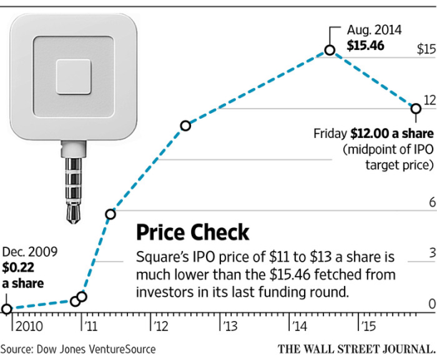
Valuation Methodologies
- The Venture Capital Method
Some caveats on VC method
  Suffer from the drawbacks of comparable method and DCF
  The assumptions are based on the investor’s perspective on the prospect of the venture.
Investors with distinct profiles view the same company very differently (Square)
Investors even debate with themselves
Marked down the value of its stake in Snapchat by 25% in September 2015
Marked up the value of its stake in Snapchat by 14.65% in October 2015
Notes:
Square

Slide 46
Valuation Methodologies
- The Venture Capital Method
Some caveats on VC method
  Be conservative in making the assumptions (e.g., exit value and dilution)
  Sensitivity analysis is critical
    Enables you to find your “comfort zone” and “line in the sand”
    Helps you to quantify the implication of valuation change
  Once you articulate your assumptions behind the valuation, you should try to manage the risk with other terms

Slide 47
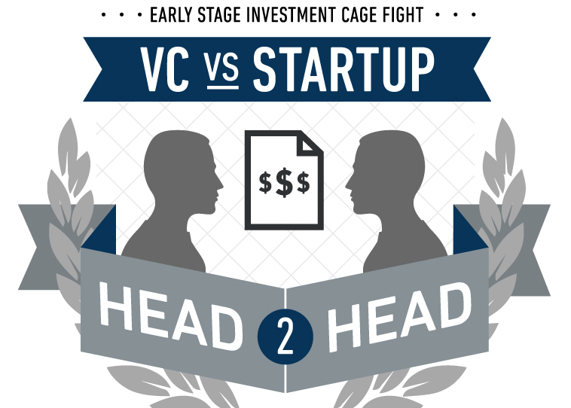
Takeaway
Different Valuation Methodologies
  Comparable Method
  Discounted Cash Flow Method
  The Venture Capital Method
The Venture Capital Method
  Retention Ratio and Dilution
  One Round vs. Multiple Rounds of Fundraising
  Follow-on Investment and Pro-rata Shares
  Sensitivity Analysis
Caveats
Next Class: Problem Set

Slide 48

Your Questions?

