Slide 1
About Python

Slide 2
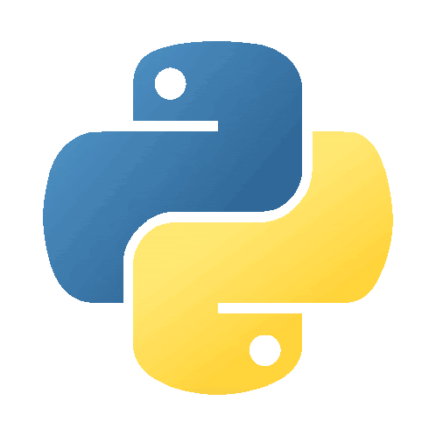
Brief History of Python
The Origin (1989): Created by Guido van Rossum at CWI in the Netherlands. It started as a "hobby programming project" to keep him occupied during the Christmas week.
The Name: It isn’t named after the snake! Van Rossum was a big fan of the British comedy troupe Monty Python’s Flying Circus.
Source: https://www.geeksforgeeks.org/python/history-of-python/

Slide 3
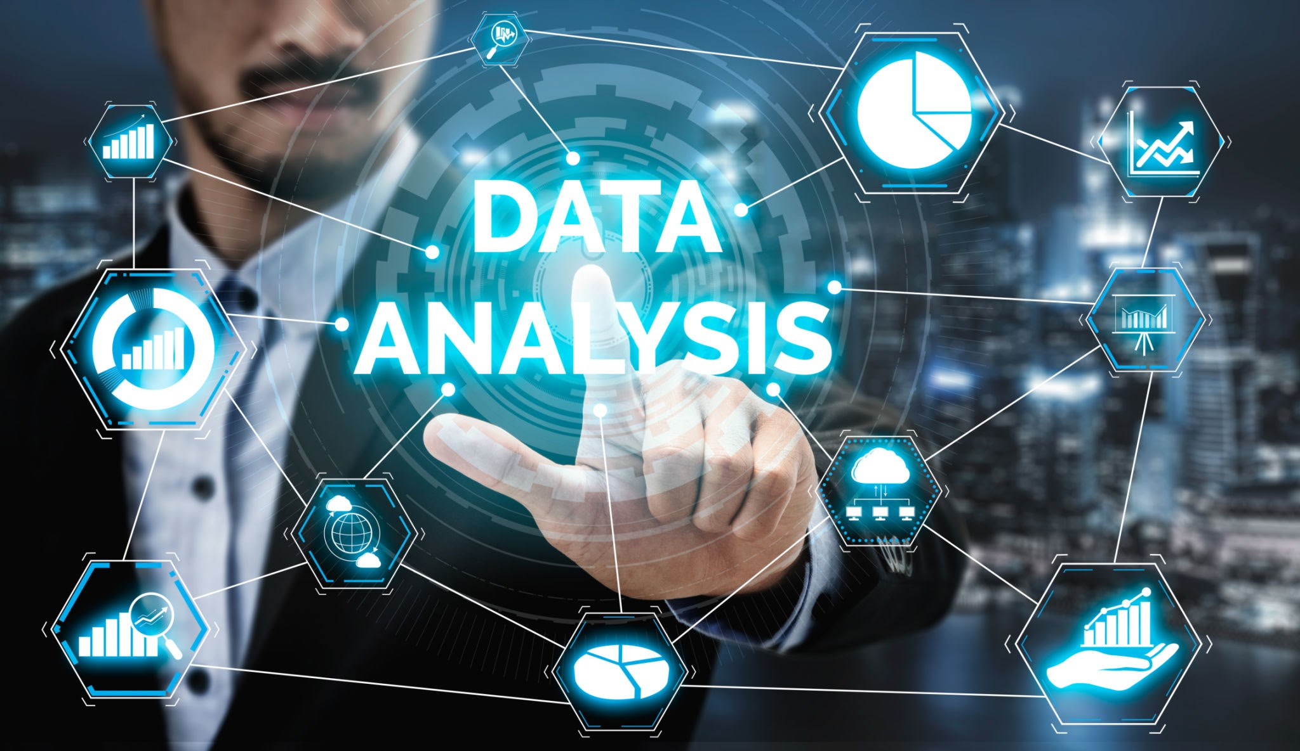
Python Use Cases
Python’s versatility is its greatest strength. It is a popular language for these fields:
Data Science & Analysis: Using libraries like Pandas and NumPy to process massive datasets and find trends.
Artificial Intelligence (AI): The backbone of Machine Learning and Deep Learning (via TensorFlow and PyTorch).
Web Development: Powering the "back-end" of major websites like Instagram, Pinterest, and Dropbox using frameworks like Django and Flask.
Automation & Scripting: Automating repetitive tasks—like moving files, scraping data from websites, or sending batch emails.
Scientific Computing: Heavily used in biology, physics, and astronomy for complex simulations.
Software Testing: Used to write automated test scripts to ensure other software works correctly before release.

Slide 4
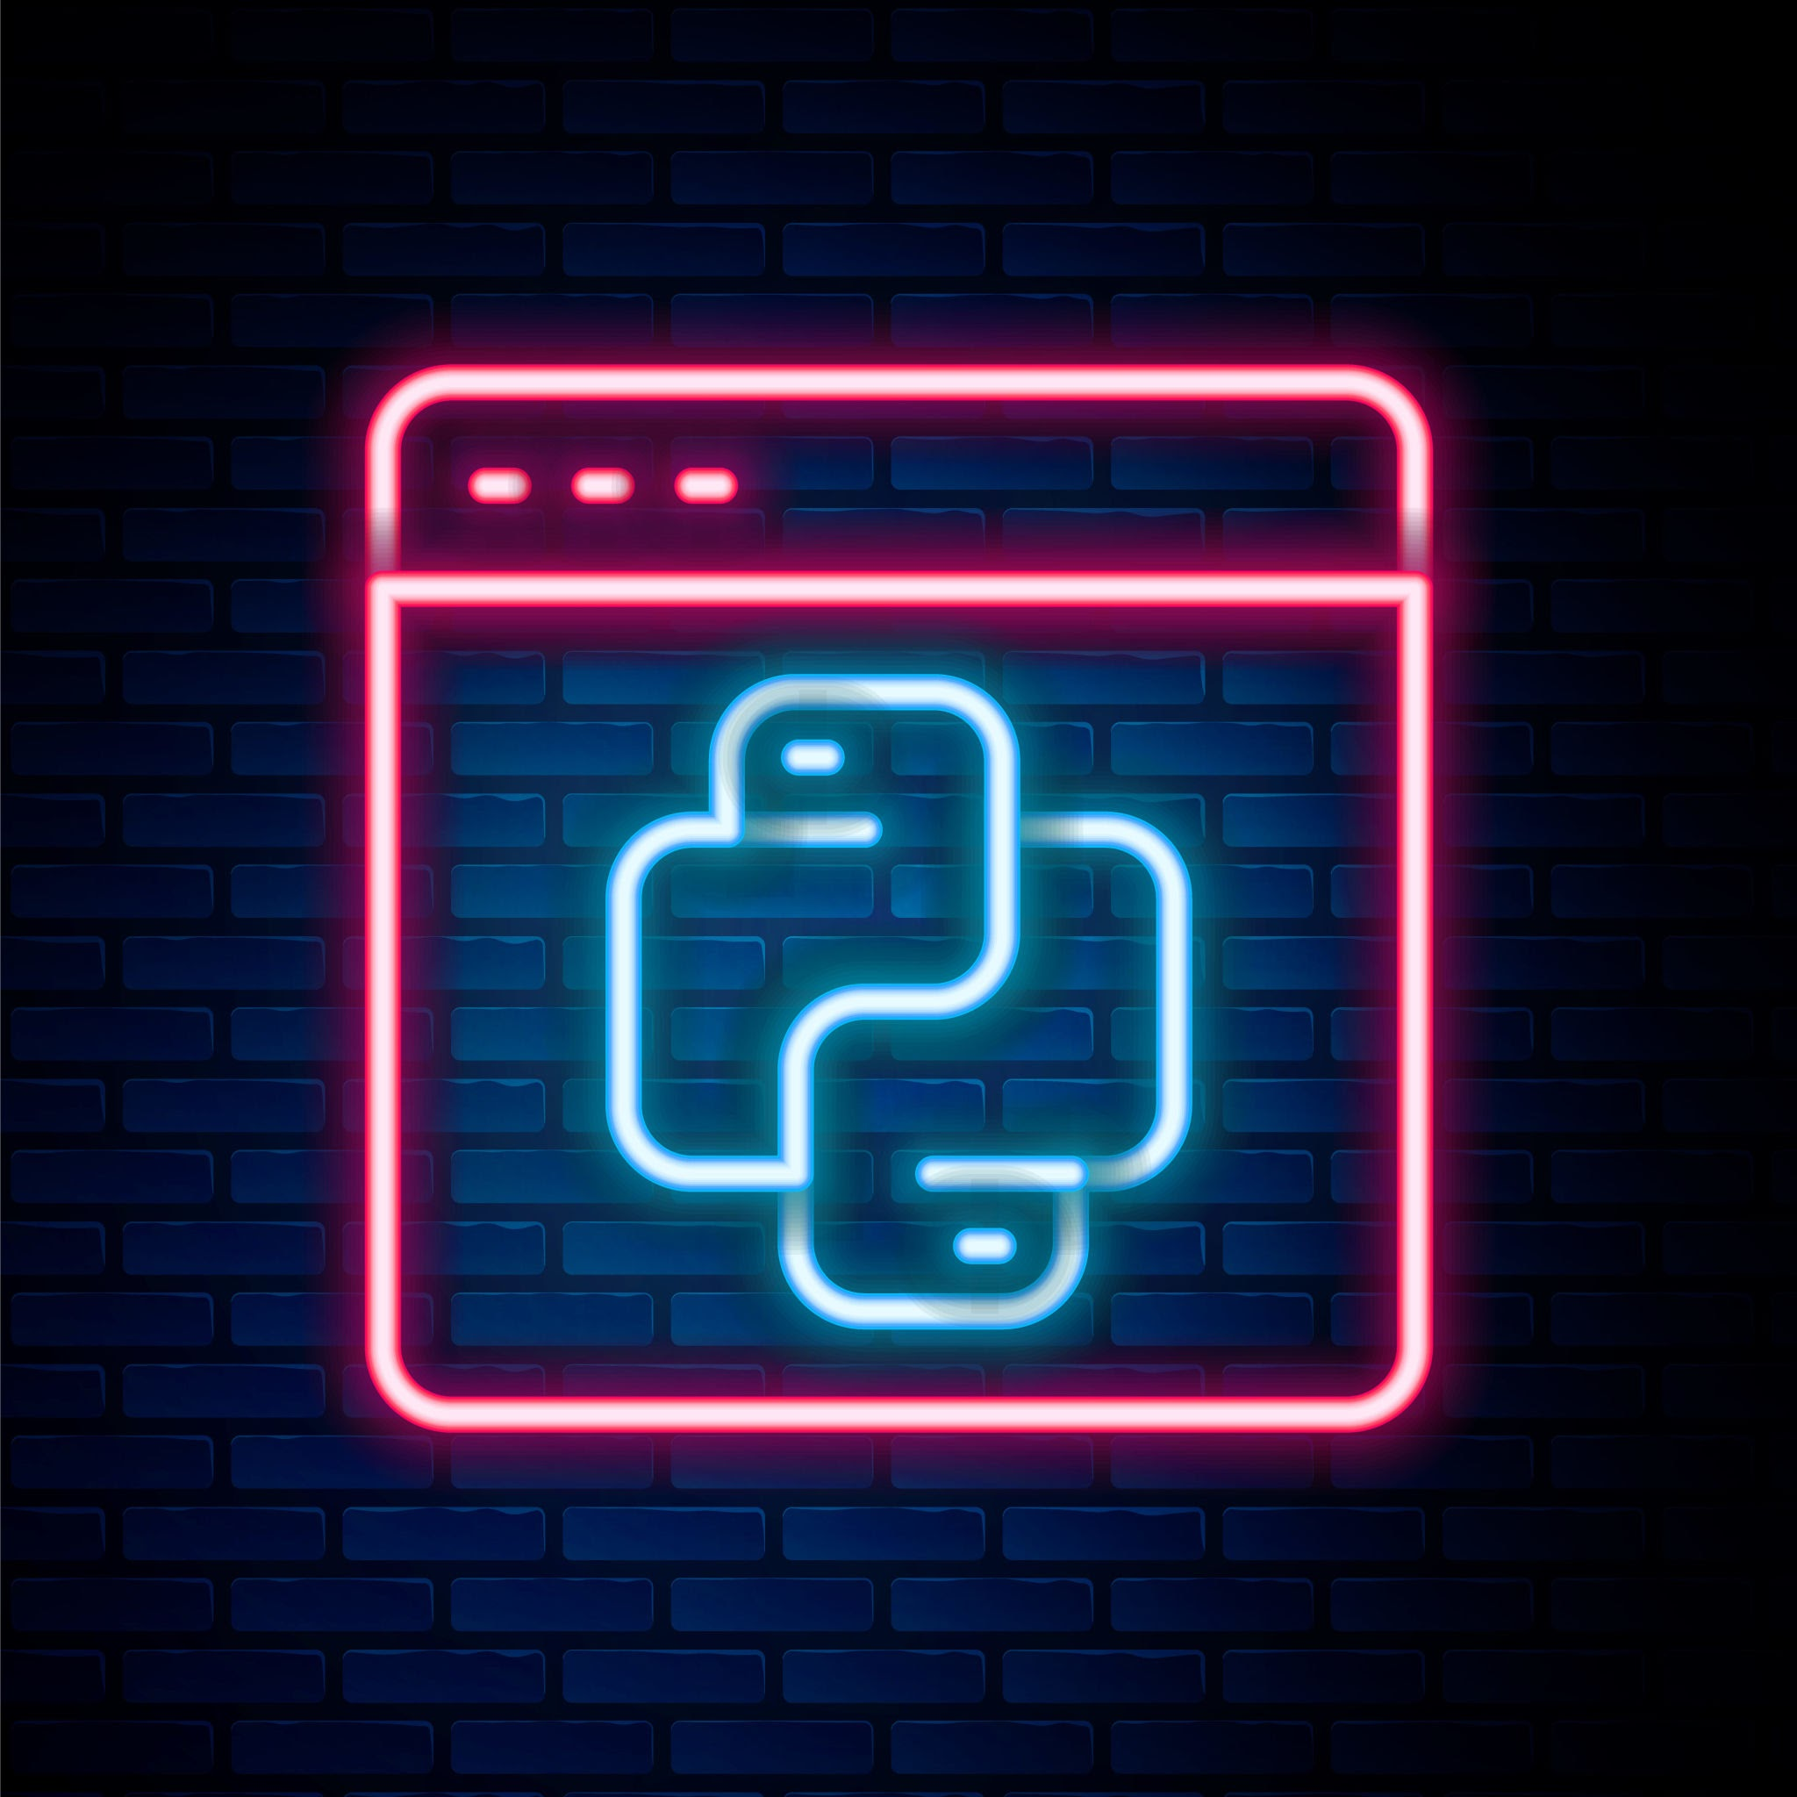
Course Content
Phase 1: Foundations of Logic – Explore Python’s history, set up your environment (VS Code), and master core basics like variables, data types, and if/else control flow.
Phase 2: Power & Efficiency – Transition from simple scripts to dynamic programs using Loops (for/while), Functions (DRY principle), and essential Data Structures like Lists and Dictionaries.
Phase 3: The Professional Bridge – Learn to interact with the real world by managing File I/O, handling errors with try/except, and expanding capabilities via pip and external libraries.
Phase 4: Capstone Project – Synthesize your skills by building a functional application, such as a CLI Task Manager, an API-driven Weather Checker, or an Automated File Organizer.
Learning Outcome – Move from "Hello World" to writing clean, professional-grade Python code capable of automation, data handling, and solving complex problems.

