Slide 1
Input and Output with Python

Slide 2
Introduction to Basic I/O
The Concept of Flow: Every program needs a way to communicate with the user.
Input: Getting data from the user into the program.
Output: Displaying results or messages from the program to the user.
The Python Standard Library: These functions are built-in and ready to use without extra setup.

Slide 3




The print() Function
Purpose: Sends data to the console (screen).
Example: print("Hello, World!")
Printing Variables: You can pass variables directly into the function.
Multiple Arguments: Use commas to print multiple items; Python adds a space between them by default.
Example: print("Age:", 25)

Slide 4



Formatting Your Output
The end Parameter: Control what happens at the end of a print statement (defaults to a newline \n).
Example: print("Hello", end=" ")
String Concatenation: Using the + operator to join strings.
F-Strings (Formatted String Literals): The modern, readable way to include variables.
Example: print(f"User: {name}")

Slide 5


Getting User Input with input()
Purpose: Pauses program execution and waits for the user to type something.
Code Example:
variable = input(“Prompt message: “)
The "String" Trap: Crucial Point—The input() function always returns a string (text), even if the user types a number.

Slide 6
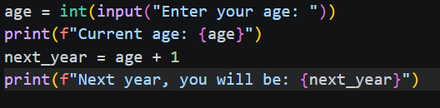
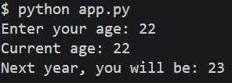
Data Type Conversion
The Problem: You cannot do math on a string.
The Solution: Type Casting.
Common Conversion Functions:
int(): Converts text to an integer (whole number).
float(): Converts text to a decimal number.
Example Code:
```
age = int(input(“Enter your age: “))
next_year = age + 1
```

Slide 7
Best Practices & Common Errors
Clear Prompts: Always tell the user exactly what you need (e.g., "Enter your weight in kg:").
ValueError: What happens when a user types "Apple" instead of "25" during an int() conversion?
Summary:
print() is for talking.
input() is for listening.
int()/float() are for translating.

Slide 8
Putting It All Together (Example)
Step 1: Prompt for a name (Input).
Step 2: Prompt for a numeric value (Input + Casting).
Step 3: Calculate a result (Logic).
Step 4: Display the final message (Formatted Output).

