Slide 1
Python Naming Conventions

Slide 2
Introduction to Clean & Flexible Code
The Goal: Writing code that isn't just functional, but readable and adaptable.
Two Pillars:
Naming Conventions: How we talk to other humans (and our future selves).
Dynamic Typing: How Python manages data behind the scenes.

Slide 3
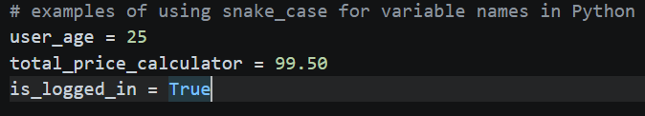
Naming Variables with Snake Case
The Standard: Python uses snake_case for variable and function names (defined in PEP 8).
The Rule: All letters are lowercase, and words are separated by underscores _.
Why "Snake" Case? The underscores look like a belly-crawling snake connecting the words.
Examples:

Slide 4
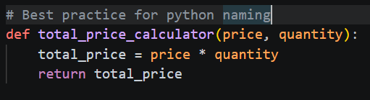
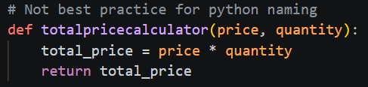
Why Conventions Matter
Readability: totalpricecalculator is harder to read than total_price_calculator.
Consistency: When everyone follows the same rules, jumping into a new project is easier.
What to Avoid:
CamelCase: userAge (Common in Java/JavaScript).
PascalCase: UserAge (Used for Classes in Python, not variables).
Kebab-Case: user-age (Used in CSS; results in an error in Python).

Slide 5
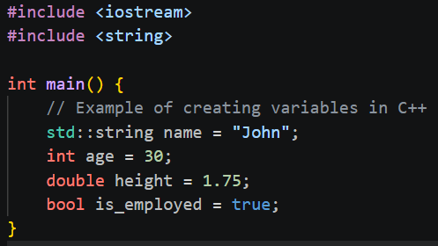
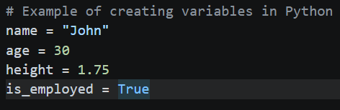
Understanding Dynamic Typing
Static vs. Dynamic:
Static (C++/Java): You must declare the type upfront. "This box only holds integers."
Dynamic (Python): The type is determined at runtime based on the value assigned. "This box holds whatever you put in it."
The Mechanism: Variables in Python are like labels pointing to objects in memory, rather than fixed containers.

Slide 6
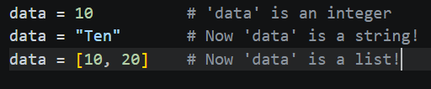
The "Type Swapping" Feature
Flexibility in Action: You can reassign a variable to a completely different data type without errors.
Benefit: Fast prototyping and less "boilerplate" code.

Slide 7
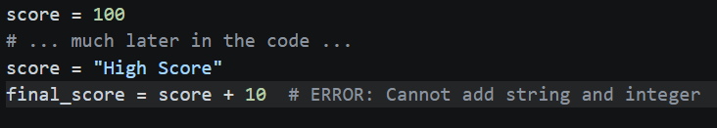
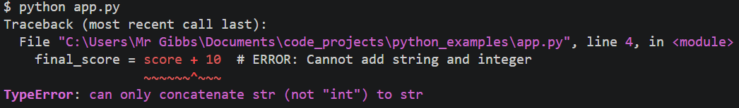
The "With Great Power..." Warning
The Risk of Dynamic Typing: Since Python doesn't stop you from changing types, you can accidentally break your logic.
Best Practice: Avoid reusing the same variable name for different types of data within the same script.
Example of a Bug:

Slide 8
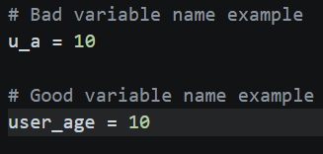
Summary & Best Practices
Use Snake Case: Keep it lowercase and underscored for variables.
Be Descriptive: u_a is bad; user_age is good.
Be Mindful of Types: Just because you can change a variable's type doesn't mean you should.
Use type(): If you're ever unsure what type a variable is currently "holding," check it!

Slide 9
Quick Check
Which of these follow Python's naming conventions?
PlayerScore
player_score
playerScore
playerscore
Is Python Statically or Dynamically typed?

