Slide 1
Python Basic Arithmetic and String Concatentation

Slide 2
Introduction to Operators
The Concept: Operators are special symbols that carry out arithmetic or logical computations.
The Goal: Today we look at how Python acts as a powerful calculator and a "text gluer."
Two Categories:
Arithmetic Operators: For numbers (int and float).
String Concatenation: For joining text (str).

Slide 3
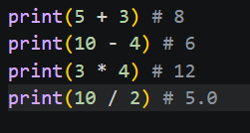
Basic Arithmetic (The Big Four)
Addition (+): Adds values on either side.
5 + 3 -> 8
Subtraction (-): Subtracts right operand from left.
10 - 4 -> 6
Multiplication (*): Multiplies values.
3 * 4 -> 12
Division (/): Divides left operand by right.
Note: In Python, division always returns a float.
10 / 2 -> 5.0

Slide 4
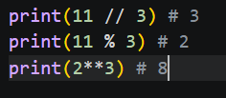
Advanced Math Operators
Floor Division (//): Divides and rounds down to the nearest whole number.
11 // 3 -> 3
Modulo (%): Returns the remainder of a division.
11 % 3 -> 2 (Because 3 goes into 11 three times with 2 left over).
Exponentiation (**): Raises the first number to the power of the second.
2 ** 3 -> 8 (2 X 2 X 2)

Slide 5


Order of Operations (PEMDAS)
Python follows standard mathematical rules:
Parentheses ()
Exponents **
Multiplication/ Division * / // %
Addition/ Subtraction + -
Example: (2 + 3) * 4 results in 20, whereas 2 + 3 * 4 results in 14.

Slide 6
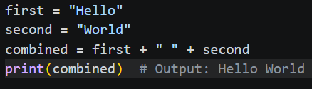

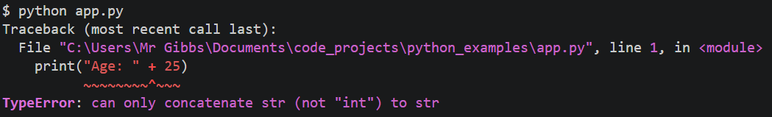
String Concatenation
Definition: Using the plus operator (+) to join two or more strings together.
Critical Rule: You cannot "add" a number to a string directly.

Slide 7
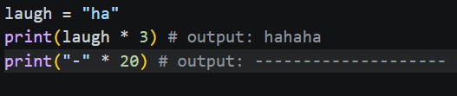
Overloading the Multiplier
String Repetition: In Python, you can use the * operator with a string and an integer to repeat text.
Use Case: Creating visual dividers in console output (e.g., print("-" * 20)).

Slide 8
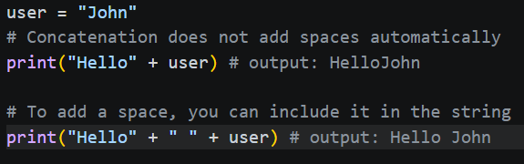

Common Pitfalls & Tips
The Space Issue: Concatenation doesn't add spaces automatically. You must include them (e.g., "Hello" + " " + "User").
Type Errors: Remember to use str() when mixing numbers into your strings.
Floating Point Precision: Sometimes math like 0.1 + 0.2 results in 0.30000000000000004 due to how computers store decimals!

Slide 9
Interactive Practice
What are the results of these expressions?
10 // 4
7 % 2
"Go " * 2 + "Team!"
10 + 2 * 5

Slide 10
Putting It All Together (Example)
Project Preview – The Personal Finance Tracker
Step 1: Capture the Identity (Input)
Ask the user for their name and store it as a String.
Step 2: Gather the Data (Casting)
Collect numeric values and convert them from Strings to Integers or Floats.
Step 3: Perform the Calculation (Logic)
Use Arithmetic Operators to find the balance and a Boolean to check status.
Step 4: Report the Findings (Formatted Output)
Combine text and variables using Concatenation and type conversion.

