Slide 1
Python Strings: slicing, modification, formatting, escaping

Slide 2
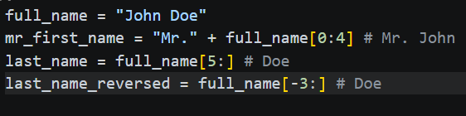
Introduction to String Slicing
Concept: Extracting a "substring" from a larger string using indices.
Syntax: string[start:end:step]
Start: Starting index (inclusive).
End: Ending index (exclusive).
Step: The "stride" or jump between characters.
Key Examples:
s[0:5] – Get first 5 characters.
s[5:] – Get everything from index 5 to the end.
s[-3:] – Get the last three characters.

Slide 3
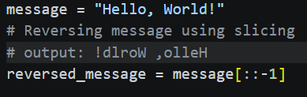
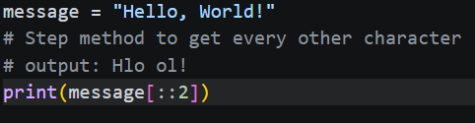
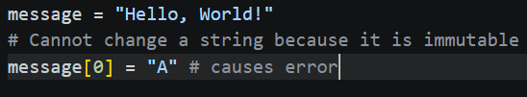
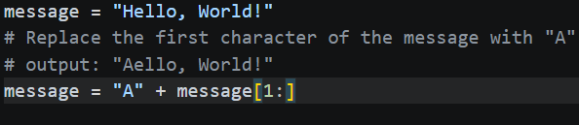
Advanced Slicing & Immutability
The "Step" Parameter:
s[::2] – Every second character.
s[::-1] – Pro-tip: The easiest way to reverse a string in Python.
Crucial Note: Strings are immutable.
Slicing does not change the original string; it creates a new one.
Correction: You cannot do s[0] = 'A'. You must slice and concatenate to "change" a string.

Slide 4
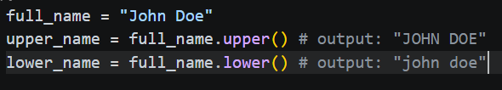
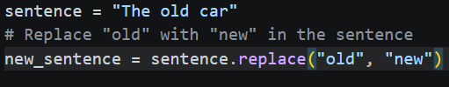
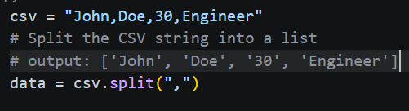
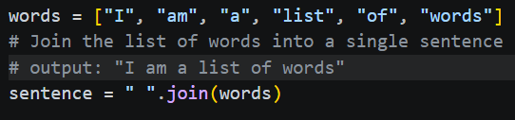
Modifying Strings (Built-in Methods)
Case Adjustments:
.upper() / .lower() – Change case entirely.
.strip() – Removes whitespace from start and end.
Search and Replace:
.replace("old", "new") – Replaces occurrences of a substring.
Splitting and Joining:
.split(",") – Turns a string into a list based on a delimiter.
" ".join(list) – Merges a list into a single string.

Slide 5
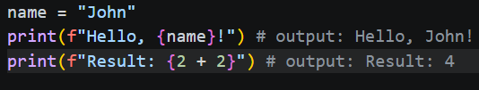
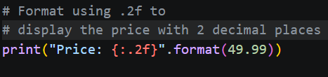

String Formatting (The Modern Way)
f-Strings (Formatted String Literals): The preferred method since Python 3.6.
Syntax: f"Hello, {name}!"
Supports expressions: f"Result: {2 + 2}"
The .format() Method:
"Price: {:.2f}".format(19.99) – Useful for padding and alignment.
Legacy % Operator:
Avoid using in new code, but be aware of it for legacy projects.

Slide 6
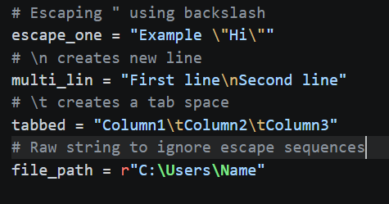
Escape Characters
The Problem: How do you put a quote inside a string? Or a new line?
The Solution: The backslash (\) escape character.
Common Sequences:
\' and \" – Single and double quotes.
\n – New line (line break).
\t – Horizontal tab.
\\ – Literal backslash.
Raw Strings: Use r"C:\Users\Name" to ignore escape sequences (essential for file paths and Regex).

Slide 7
Summary & Best Practices
Efficiency: Use f-strings for readability and speed.
Safety: Always remember strings are immutable; reassignment is necessary.
Cleanliness: Use .strip() when handling user input to avoid hidden space errors.
Readability: Don't over-complicate slices. If a slice is too complex, consider a loop or a descriptive function.

