Slide 1
Python String Methods

Slide 2
Introduction to String Methods
What are Methods? Functions that "belong" to an object. In Python, everything is an object, including strings.
Syntax: string_variable.method_name(arguments)
The Immutability Rule: Methods never modify the original string. They always return a new string with the changes applied.

Slide 3
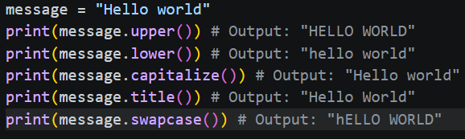
Case Modification
These methods are essential for normalizing data (e.g., checking "Yes" vs "yes").
.upper() / .lower(): Converts all characters to uppercase or lowercase.
.capitalize(): Capitalizes only the first character of the string.
.title(): Capitalizes the first character of every word.
.swapcase(): Flips lowercase to upper and vice versa.

Slide 4
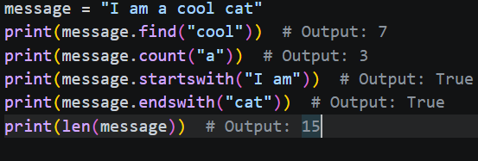
Searching, Inspection, Length
.find(sub): Returns the index of the first occurrence of a substring (returns -1 if not found).
.count(sub): Counts how many times a substring appears.
.startswith(prefix) / .endswith(suffix): Returns a Boolean (True/False). Very useful for file extensions or URL checking.
len(): Returns the length of a string

Slide 5




Cleaning and Padding
Essential for preparing user input or formatting console output.
.strip(): Removes leading and trailing whitespace (including \n and \t).
Also available as .lstrip() (left) and .rstrip() (right).
.replace(old, new): Swaps all occurrences of a substring with another.
.zfill(width): Adds zeros to the beginning of a string until it reaches a specific length (great for ID numbers).
.center(width, char): Centers the string within a padding of specified characters.

Slide 6
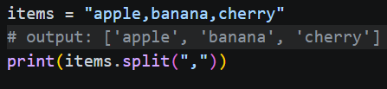

Splitting and Joining
The most powerful methods for converting between strings and lists.
.split(separator): Breaks a string into a list based on the separator.
.join(iterable): The inverse of split. It joins elements of a list into one string using the string as a connector.

Slide 7
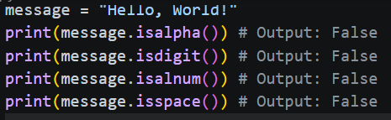
Boolean "Is" Methods
Used to validate the type of data contained within a string.
Method | Returns True if…
.isalpha() | All characters are letters.
.isdigit() | All characters are numbers.
.isalnum() | String is a mix of letters and numbers (no symbols).
.isspace() | String contains only whitespace.

Slide 8
Practical Best Practices
Method Chaining: You can perform multiple operations in one line:
clean_name = user_input.strip().title()
Performance: .join() is significantly faster than using + in a loop when building large strings.
Validation: Always use .lower() or .upper() when comparing strings to make your code case-insensitive.

