Slide 1
Python if, elif, else statements

Slide 2
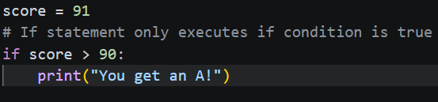
The if Statement
The Foundation: The if statement executes a block of code only if a specific condition is met.
Syntax:
Start with the if keyword.
Follow with a condition and a colon :.
Indentation: The code to run must be indented (usually 4 spaces).

Slide 3
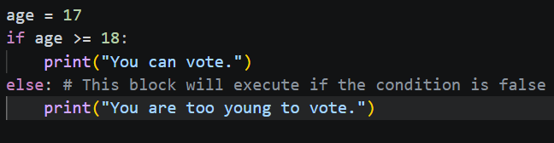
The else Statement
The "Otherwise" Clause: Provides an alternative path when the if condition is False.
Rules:
It has no condition of its own.
There can only be one else per if block.
It always comes at the very end.

Slide 4
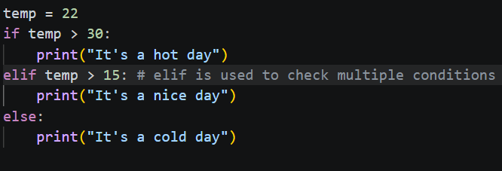
The elif Statement
Checking Multiple Options: Short for "else if." It allows you to check a new condition if the previous ones were False.
Flexibility: You can have as many elif blocks as you need between the if and the else.
Efficiency: Python stops checking once it finds the first True condition.

Slide 5
Putting It All Together (Example)
Goal: Categorize a numeric movie rating into a descriptive label.
The Execution Steps:
Input Data: Accept user input and assign it to a variable rating
Primary Check (if): Check if rating is >= 9.0 (Label: "Excellent").
Secondary Check (elif): Check if rating is >= 7.0 (Label: "Good").
Final Fallback (else): Categorize everything else as "Average/Poor".
Output: Print the resulting category.
How do you think the logic would change if we swapped the order and checked for >= 7.0 before checking for >= 9.0?

