Slide 1
Python For Loops

Slide 2
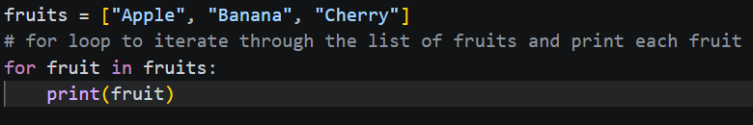
Iterating Over Sequences
A for loop is used to repeat a block of code for every item in a sequence (like a list or a string) or a specific range of numbers.
The Concept: Python "steps through" a collection one item at a time, assigning the current item to a variable.
Common Targets: Lists, Strings, and Tuples.
Syntax:
for item in sequence:
Indented code runs once for every "item."

Slide 3
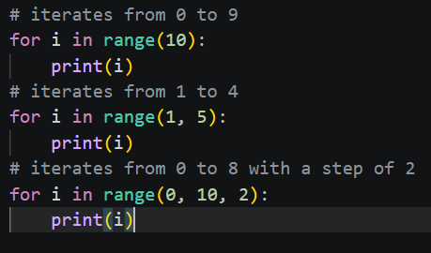
The range() Function
Generating Numbers: Used when you want to repeat an action a specific number of times.
The Parameters: range(start, stop, step)
Start: Beginning value (default is 0).
Stop: The loop ends before reaching this number (exclusive).
Step: How much to increment by (default is 1).
Example: range(1, 5) generates: 1, 2, 3, 4.

Slide 4
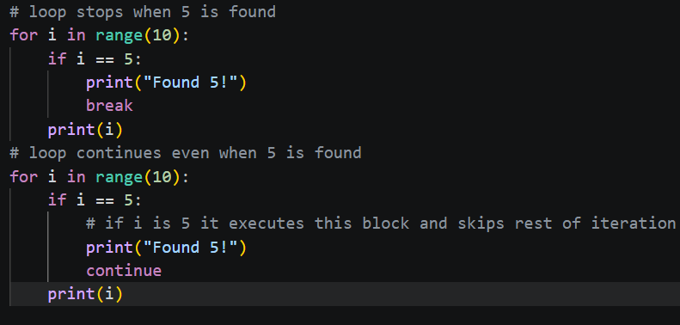
Loop Control (Break and Continue)
break: Stops the loop entirely, even if the sequence isn't finished.
continue: Skips the rest of the current iteration and jumps to the next item in the sequence.
Why use them? To handle unexpected data or stop once a specific goal is achieved.

Slide 5
Putting It All Together (Example)
Goal: Print only the even numbers between 1 and 10, but stop the loop if we hit the number 8.
The Execution Steps:
Create Range: Use range(1, 11) to include numbers up to 10.
Filter (Comparison): Inside the loop, use if num % 2 == 0 to identify even numbers.
Interrupt (Break): Add an if num == 8 check to trigger a break.
Display: Print the numbers that pass the filters.
Do you think a for loop or a while loop would be more efficient if you didn't know exactly how many times you needed to repeat the task?

