Slide 1
Python Loop Control

Slide 2
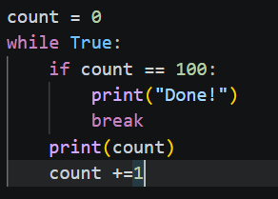
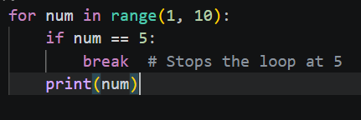
The break Statement
Loop control statements change the execution flow from its normal sequence. They allow you to exit a loop early, skip certain parts, or handle empty code blocks gracefully.
The "Emergency Exit": Immediately terminates the loop, regardless of the condition or sequence.
Flow: Execution jumps to the very first line of code after the loop block.
Common Use: Stopping a search once an item is found or exiting an infinite while True loop.

Slide 3
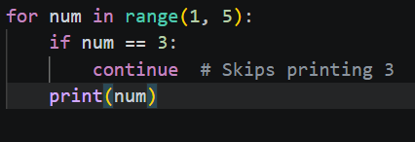
The continue Statement
The "Skip" Button: Stops the current iteration and jumps immediately to the top of the loop for the next cycle.
Flow: It skips the remaining code inside the loop for the current item only.
Common Use: Filtering out unwanted data (e.g., skipping negative numbers in a calculation).

Slide 4

The pass Statement
The "Placeholder": Does absolutely nothing. It is a null operation.
Why use it? Python syntax requires an indented block after statements like if or for. If you aren't ready to write the code yet, pass prevents a syntax error.
Common Use: Creating minimal classes or functions, or "todo" markers in your logic.

Slide 5
Putting It All Together (Example)
Goal: Process a list of numbers: print the squares of positive numbers, skip zeros, and stop if a negative number is found.
The Execution Steps:
Iterate: Use a for loop to go through a list like [2, 0, 4, -1, 5].
Handle Zeros (continue): If the number is 0, use continue to skip to the next number.
Handle Negatives (break): If the number is < 0, use break to stop the entire process.
Handle Positives: If neither of the above is true, print the square of the number.
Future Proofing (pass): Add an else block with pass just in case you want to add "end of list" logic later.
In a massive dataset, why might using break be better for performance than letting a loop finish naturally?

