Slide 1
Python Lists

Slide 2
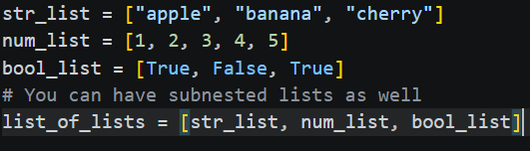
Introduction to Lists
Python lists are the "Swiss Army Knife" of data structures. Whether you're tracking a grocery list or processing thousands of data points, understanding how lists store and access data is foundational to your coding journey.
What is a List? A built-in Python data type used to store multiple items in a single variable.
Syntax: Defined using square brackets [] with items separated by commas.
Key Characteristics:
Ordered: They maintain the sequence in which elements are added.
Changeable (Mutable): You can add, remove, or modify items after creation.
Allows Duplicates: Since every item has a specific place, the same value can appear multiple times.

Slide 3
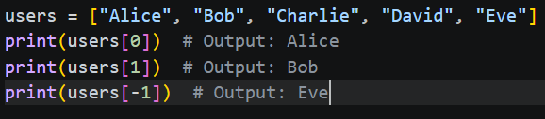
Indexing — Finding Your Data
The Concept: Every item in a list has a "position number" called an index.
Zero-Based Indexing: Python starts counting at 0, not 1.
Positive vs. Negative Indexing:
Positive: list[0] accesses the first item.
Negative: list[-1] accesses the last item (useful when you don't know the list length).

Slide 4
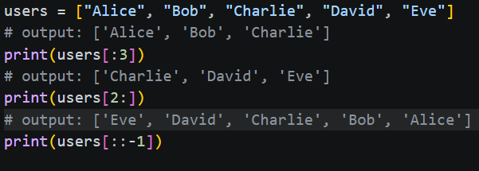
Slicing — Extracting a Range
The Syntax: list[start:stop:step]
How it Works:
Start: The index where the slice begins (inclusive).
Stop: The index where the slice ends (exclusive—it stops just before this index).
Step: (Optional) Determines the increment between each index (e.g., a step of 2 skips every other item).
Common Shortcuts:
[:3] — Get everything from the beginning to index 2.
[2:] — Get everything from index 2 to the end.
[::-1] — A clever trick to reverse the entire list.

Slide 5
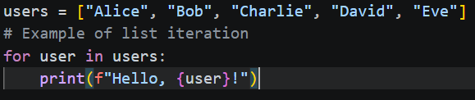
Iterating with For Loops
The Concept: A for loop allows you to "visit" each item in a list one by one to perform an action.
Sample Syntax:
```
for item in my_list:
# Do something with item
```
Why use it?
Automation: Apply the same logic to 10 items or 10,000 items without extra code.
Readability: Pythonic loops read almost like English sentences.
The enumerate() Function: If you need both the index and the value while looping, use enumerate(my_list).

Slide 6

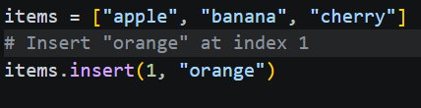
Adding Items to Python List
Adding to the End
append(item): Adds one item to the end of the list.
Adding at a Specific Position
insert(index, item): Places an item at a specific index.
Use 0 for the beginning: my_list.insert(0, "new_item").
Items at and after the index are shifted to the right.

Slide 7
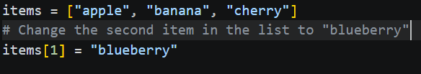
Update Item in Python List
To update an item in a Python list you must use indexing to accomplish this
Use the assignment operator (=). REMEMBER, Python uses zero-based indexing, meaning the first item is at index 0

Slide 8

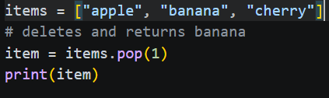
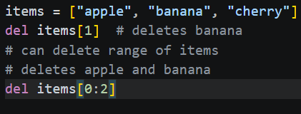

Removing Item From Python List
Python provides several built-in tools depending on whether you know the value or the position of the item.
Method | Action | Example
remove(val) | Deletes the first occurrence of val | list.remove(“apple”)
pop(idx) | Deletes and returns item at idx | item = list.pop(1)
del list[idx] | Deletes item or slice at idx | del list [0:2]
clear() | Empties entire list | list.clear()

Slide 9
Putting It All Together
The Goal: Manage a list of "Top 5 Innovations" by updating an entry and extracting the top 3 for a summary report.
Execution Steps:
Initialize: Create a list of 5 strings representing modern innovations.
Update: Use indexing to replace the 4th item (index 3) with a more recent breakthrough.
Extract: Use slicing to create a new sub-list containing only the "Top 3" items.
Process: Use a for loop to print each of the Top 3 items in a numbered list format.

