Slide 1
Python Tuples and Sets

Slide 2

Tuples — The Immutable Collection
What is a Tuple? A collection that is ordered but unchangeable (immutable).
Syntax: Defined using parentheses ().
When to use them:
Data Integrity: Use a tuple for data that should not change (e.g., GPS coordinates, RGB color codes, or a birthday).
Performance: Tuples are slightly faster than lists because their size is fixed in memory.
Dictionary Keys: Because they are immutable, tuples can be used as keys in a dictionary (lists cannot).

Slide 3
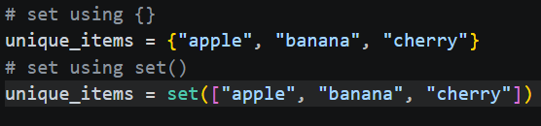
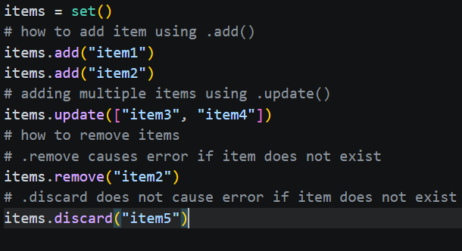
Sets — The Unique Collection
What is a Set? A collection that is unordered, unindexed, and contains no duplicate elements.
Syntax: Defined using curly braces {}.
When to use them:
Removing Duplicates: Easily turn a list with repeats into a collection of unique items.
Membership Testing: Checking if an item exists in a set is much faster than in a list.
Mathematical Operations: Perform unions, intersections, and differences between groups of data.

Slide 4
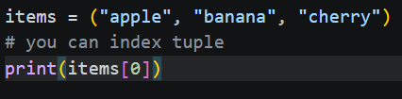
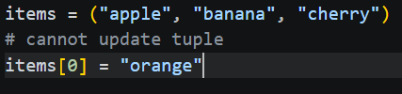
Accessing Items (The Comparison)
Accessing data works differently for Tuples and Sets because one is ordered and the other is not.
Accessing Tuple Items
Method: Since Tuples are ordered, you access items exactly like lists using indexing and slicing.
Immutability Rule: You can read my_tuple[0], but you cannot assign to it (e.g., my_tuple[0] = "New" will raise a TypeError).
Example: point = (10, 20); x = point[0]

Slide 5
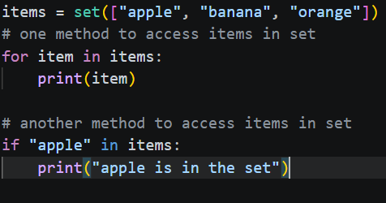
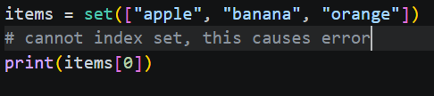
Accessing Items (The Comparison) Continued…
Accessing data works differently for Tuples and Sets because one is ordered and the other is not.
Accessing Set Items
The Restriction: Sets are unordered, meaning they have no index. You cannot use my_set[0].
The Solution:
Looping: Use a for loop to go through the whole collection.
Membership Check: Use the in keyword to see if a specific value exists.
Example: if "Admin" in user_roles: print("Access Granted")

Slide 6
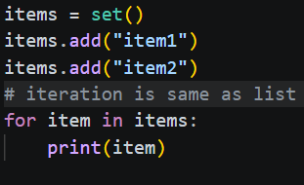
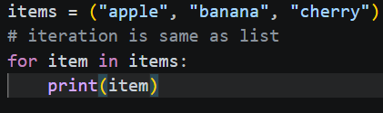
Iterating Through Tuples and Sets
The Approach: Both use the same for item in collection: syntax as lists.
The Key Difference:
Tuples: Iteration happens in a predictable, fixed order.
Sets: Since sets are unordered, the items might appear in a different order every time you run the loop.
The Rule of Thumb: If the sequence of your items matters during the loop, use a Tuple. If you only care that each item is processed once, a Set is fine.

Slide 7
Putting It All Together
The Goal: Securely store a location's fixed coordinates (Tuple) and filter a list of visitor IDs to find unique attendees (Set).
Execution Steps:
Define Constants: Store a "Home Base" location in a tuple so it cannot be accidentally modified.
Filter Data: Take a list of visitor IDs (which contains duplicates) and convert it into a set to get unique visitors.
Iterate and Report: Loop through both collections to print a summary of the location and the unique IDs present.

