Slide 1
Python Dictionaries

Slide 2
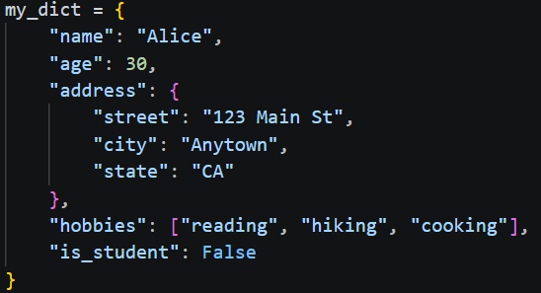
What is a Dictionary?
The Definition: A collection of data stored as Key-Value pairs.
The Real-World Link: Much like a physical dictionary where you look up a word (key) to find its definition (value).
Syntax: Uses curly braces {} with colons separating keys and values.
my_dict = {"key": "value"}
Uniqueness: Keys must be unique (you can't have two identical entries in a phonebook), but values can be anything.

Slide 3
Anatomy of a Dictionary
The Key: The unique identifier (usually a string or integer). Think of it as a "label."
The Value: The data associated with that label (can be lists, numbers, strings, or even other dictionaries).
Mapping: Dictionaries are "mapped" collections, meaning they don't rely on order/index (like lists) but on the relationship between the key and value.

Slide 4
Real-World Use Cases
User Profiles: Mapping a username to account_settings.
Inventory Management: Mapping a product_id to stock_quantity.
Digital Menus: Mapping dish_name to price.
Geographic Data: Mapping city_name to coordinates.

Slide 5
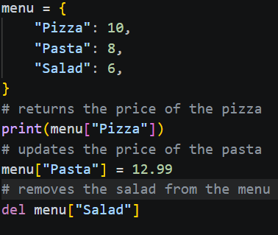
Common Dictionary Operations
Accessing: menu["Pizza"] returns the price.
Adding/Updating: menu["Pasta"] = 12.99 (adds a new item or changes an existing one).
Deleting: del menu["Pizza"] removes the entry.
Methods:
.keys() — Get all labels.
.values() — Get all data points.
.items() — Get both as pairs.

Slide 6
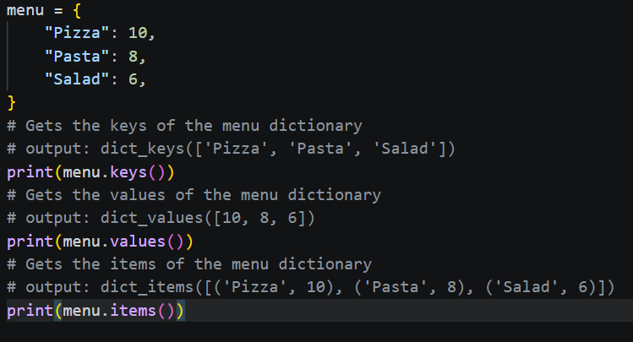
Common Dictionary Operations Continued…
Methods:
.keys() — Get all labels.
.values() — Get all data points.
.items() — Get both as pairs.

Slide 7
Putting It All Together
The Goal: Create a digital "Contact Card" system to manage employee information.
Steps to Complete the Example:
Initialize the Map: Use {} to define your core entity. Choose clear, descriptive keys (e.g., "name" instead of "n").
Retrieve Data: Use square brackets [] to call a key. Note: If the key doesn't exist, Python will throw an error.
Modify the State: Update the dictionary as information changes in real-time. This demonstrates the mutability of dictionaries.
Expand the Data: Add new fields (like email) without needing to redefine the entire structure.
Display: Use the .items() method in a loop to cleanly print the "Real-world mapping" for the user.

