Slide 1
Python functions def keyword and DRY

Slide 2
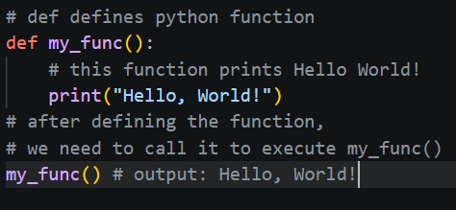
Introduction to the def Keyword
The def keyword is the foundation of modular programming in Python. It is used to define a function, allowing you to bundle a specific set of instructions into a single, reusable unit.
Syntax Anatomy:
def: The keyword that signals the start of a function definition.
Function Name: A unique identifier (usually snake_case).
Parameters: Inputs defined inside parentheses ().
The Colon :: Signals the start of the indented code block.
The "Why": Functions allow you to write code once and execute it anywhere by simply calling the name.

Slide 3
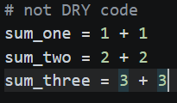
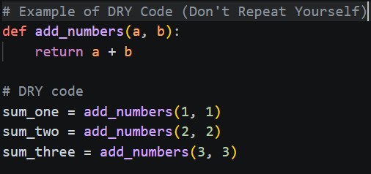
Understanding the DRY Principle
DRY stands for Don't Repeat Yourself. It is a core philosophy in software engineering aimed at reducing the repetition of information.
The Problem: Copy-pasting the same logic in multiple places makes code hard to maintain. If you find a bug, you have to fix it in every single spot.
The Solution: Abstraction. By moving repetitive logic into a function (using def), you create a single "source of truth."
Benefits:
Maintainability: Change the logic in one place, and it updates everywhere.
Readability: Code becomes cleaner and easier for others to follow.
Efficiency: Saves time and reduces the likelihood of "copy-paste" errors.

Slide 4
Putting It All Together – The "DRY" Transformation
To truly understand how def enables DRY, let’s look at a practical example of converting repetitive code into a streamlined function.
The Scenario: Calculating Sales Tax
Imagine you need to calculate the total price (price + 7% tax) for several different items.
Summary of Steps to Accomplish DRY:
Spot the Pattern: Look for lines of code that perform the same calculation or task.
Extract the Logic: Move that code into a def block.
Parameterize: Identify what changes (the inputs) and make them function parameters.
Replace: Swap out the repetitive manual code with your new function calls.
Starting Code:
```
item1_total = 100 + (100 * 0.07)
item2_total = 250 + (250 * 0.07)
item3_total = 15 + (15 * 0.07)
```

