Slide 1
Python functions, return value, global vs local scope

Slide 2
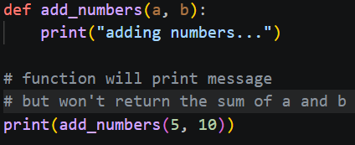
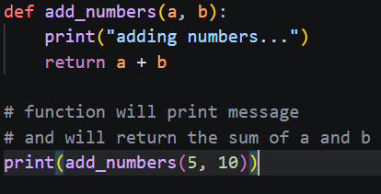
Introduction to Return Values
The Concept: Functions aren't just "doers"; they are "providers."
The return Keyword: Used to send a result back to the caller.
Termination: A function stops immediately once a return statement is executed.
Default Behavior: If no return is specified, Python implicitly returns None.

Slide 3
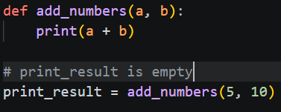
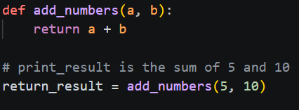
Why Use Return Instead of Print?
Print is for Humans: It shows a value on the console but doesn't store it.
Return is for Code: It allows the output of one function to be saved in a variable or passed into another function.

Slide 4
Understanding Scope (The "Where")
Definition: Scope determines which parts of your program can "see" or access specific variables.
The "Lego" Analogy: Variables inside a box (function) can't be seen from outside the box unless they are passed out.
The Two Main Levels:
Global Scope: Defined at the top level of the script.
Local Scope: Defined inside a function.

Slide 5
Global vs. Local Scope
Global Variables:
Accessible from anywhere in the code.
Persist as long as the program is running.
Local Variables:
Created when the function is called; destroyed when it finishes.
Shadowing: A local variable can have the same name as a global variable without affecting it.

Slide 6
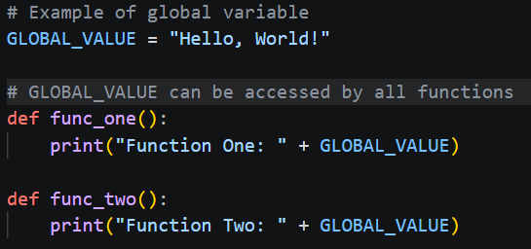
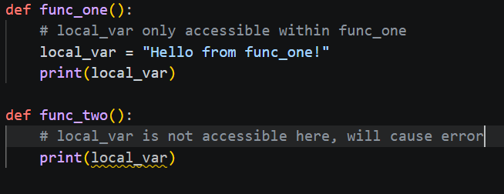
Global vs. Local Scope Example

Slide 7
Putting It All Together
The Goal: Calculate a final price after tax using both scopes and a return value.
Steps to Complete the Logic:
Define the Global: Set TAX_RATE outside the function so any future functions (like a shipping calculator) can also use it.
Create the Local Logic: Inside calculate_total, create the tax_amount variable. Note: You cannot access tax_amount outside this function!
Ship the Result: Use return total to "export" the calculation result.
Capture the Data: Call the function and assign it to a new variable (final_bill) so the data isn't lost.
Verify: Print the final variable to ensure the flow from Global -> Local -> Return worked correctly.

