Slide 1
Python Reading and Writing to .txt and .csv files

Slide 2
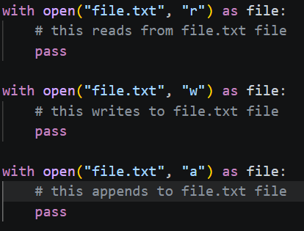
Introduction to File Handling
The "Persistence" Concept: Variables disappear when a program stops; files allow data to live on your hard drive.
The open() Function: The gateway to any file.
The Context Manager (with): The modern standard. It ensures a file is properly closed even if your code crashes.
with open("file.txt", "r") as file:
Modes: * 'r': Read (default)
'w': Write (overwrites existing content)
'a': Append (adds to the end)

Slide 3
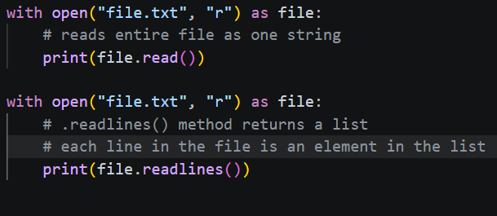
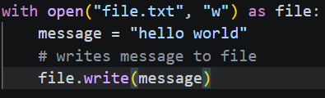
Working with Plain Text (.txt)
Reading:
.read(): Gets the whole file as one giant string.
.readlines(): Turns each line into an item in a list.
Writing:
.write(): Sends a string directly into the file.
Use Case: Log files, simple notes, or configuration settings.

Slide 4
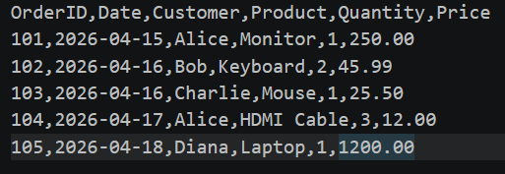
Working with Structured Data (.csv)
What is a CSV?: "Comma Separated Values"—essentially a simplified spreadsheet.
The csv Module: Python’s built-in tool for parsing these files.
Reader vs. DictReader:
csv.reader: Treats rows as lists.
csv.DictReader: Treats rows as Dictionaries (using the header as keys).

Slide 5
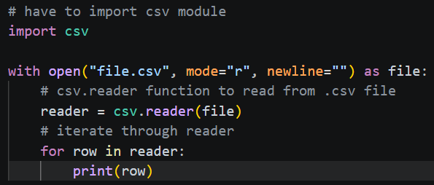
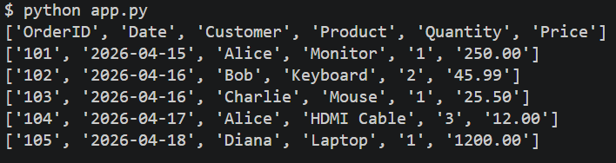
Working with Structured Data (.csv) Continued…

Slide 6
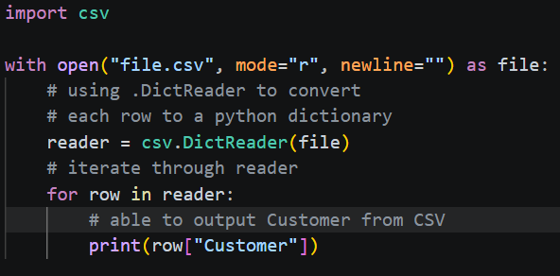
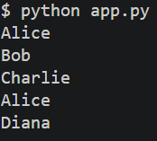
Working with Structured Data (.csv) Continued…

Slide 7
Writing to .csv Files
What is a CSV?: "Comma Separated Values"—essentially a simplified spreadsheet.
The csv Module: Python’s built-in tool for parsing these files.
Writer, DictWrier, writerows, writerow, writeheader:
csv.writer: Writes data to .csv file, use when data is structured as rows
csv.DictWriter: Writes data to .csv file, use when data is a list of dictionaries with matching keys
writer.writerows: Writes all rows at once
writer.writerow: Writes a single row
writer.writeheader: Writes the first row (headers), useful when working with csv.DictWriter

Slide 8
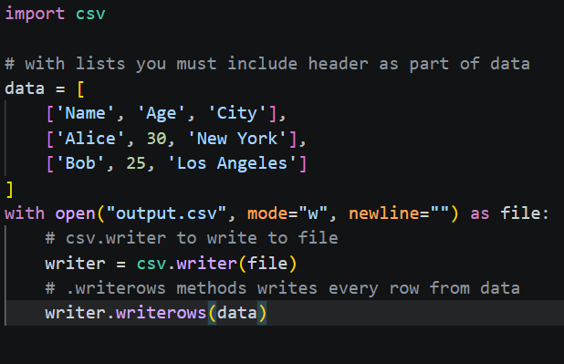

Writing to .csv Files Continued…

Slide 9
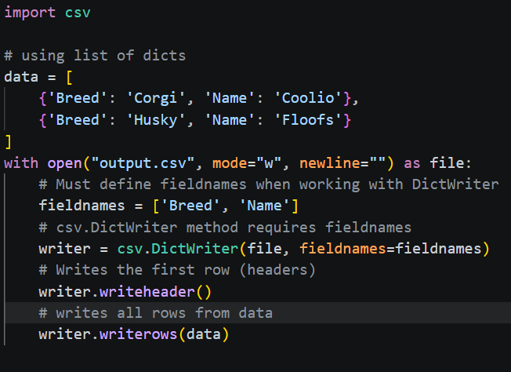
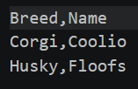
Writing to .csv Files Continued…

Slide 10
Common Pitfalls
The "Overwrite" Trap: Opening a file in 'w' mode deletes everything inside it immediately. Use 'a' if you want to keep old data.
The Newline Issue: When writing CSVs, use newline='' in the open() function to prevent blank lines between rows on Windows.
File Paths: Ensure the file is in the same folder as your script, or provide the full file path.

Slide 11
Putting It All Together
The Goal: Read a list of names from a text file and save them into a structured CSV file with a "Status" column.
Steps to Complete the Example:
Extract Data: Use a with block to open your source .txt file. Use .strip() to clean up the hidden \n (newline) characters.
Import Tools: Remember to import csv at the very top; it's not a global keyword like print.
Prepare the Destination: Open the .csv file in 'w' (write) mode. Define your header row first so the columns are labeled.
The Loop & Write: Use a for loop to iterate through your list of names. For every name, use writer.writerow() to pass a list representing one row.
Verify the Output: Open your folder. You should see a new roster.csv file that can be opened in Excel or Google Sheets.

