Slide 1
Python Context Managers

Slide 2
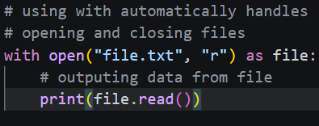
What is a Context Manager?
The Concept: A way to manage resources efficiently—specifically, ensuring that "setup" and "teardown" happen automatically.
The Problem: In programming, we often open things (files, database connections, network sockets) but forget to close them, leading to memory leaks or corrupted data.
The Solution: The with statement guarantees that a resource is cleaned up the moment you are done with it, even if your code runs into an error.

Slide 3
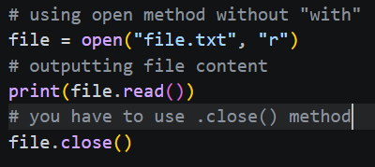
Why Not Just Use close()?
Manual Risk: If you use file.open() and file.close(), and an error occurs between those lines, the file stays open indefinitely.
The "Safety Net": The with statement acts like a structured try...finally block.
Readable Code: It reduces boilerplate code, making your scripts look cleaner and more professional.

Slide 4
How It Works (Behind the Scenes)
The Protocol: For an object to work with with, it must have two special "magic methods":
__enter__: Runs when the with block starts (Setup).
__exit__: Runs when the with block finishes (Teardown/Cleanup).
Scope: Any variable defined inside the with block is still accessible after the block ends, but the resource (the file itself) is closed and inaccessible for further reading/writing.

Slide 5
Real-World Applications
File Handling: The most common use case (reading/writing .txt, .csv, etc.).
Database Connections: Opening a connection to a database and ensuring it disconnects properly.
Thread Locks: Preventing multiple parts of a program from changing the same data at once.
Temporary Settings: Changing a decimal precision or environment variable for just one specific task.

Slide 6
Putting It All Together
The Goal: Safely write multiple lines to a log file and prove that the file is closed automatically.
Steps to Complete the Example:
Invoke the Manager: Start with with open(...). Use the as keyword to give the file a name (log_file) you can use inside the block.
Indent for Safety: All code that needs the file must be indented. This is the "protected" area where the resource is active.
Execute the Logic: Write your data or perform your calculations. You don't need to worry about log_file.close().
Exit the Context: Simply un-indent your next line of code. Python will immediately trigger the __exit__ method.
Test the State: Use the .closed attribute to verify that Python did the "teardown" for you. This confirms your code is resource-efficient and crash-proof.

