Slide 1
Python Exception Handling

Slide 2

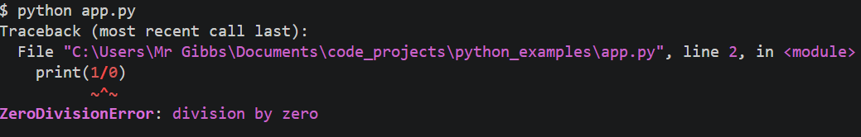
What is an Exception?
The Definition: An "Exception" is an error that occurs during the execution of a program (Runtime).
Crash vs. Control: Without handling, an error triggers a "Traceback" and stops the program immediately. With handling, the program can "catch" the error and keep running.
Common Types:
ValueError: Wrong type of data (e.g., trying to turn "abc" into an integer).
ZeroDivisionError: Dividing by zero.
FileNotFoundError: Trying to open a file that doesn't exist.

Slide 3
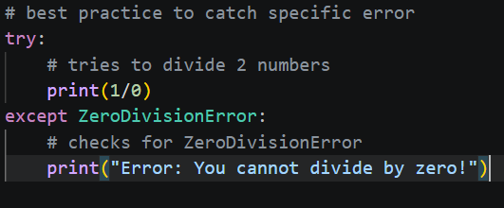
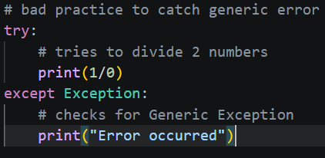
The try/except Syntax
The try Block: You place the code that might fail here. Python "tries" to run it.
The except Block: This code runs only if an error occurs in the try block. It is your safety net.
Specific vs. General: It is best practice to catch specific errors (e.g., except ValueError) rather than all errors (except Exception), so you don't accidentally hide bugs you didn't expect.

Slide 4
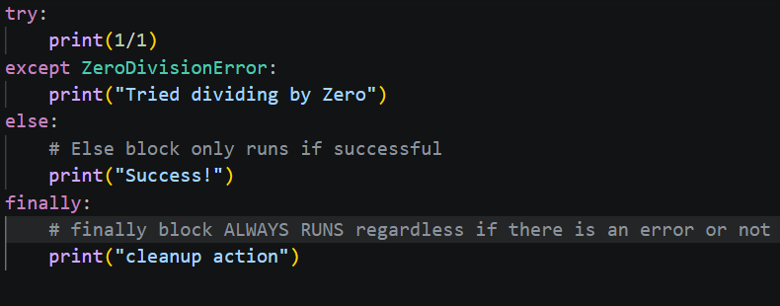
Expanding the Block (else and finally)
The else Block: Runs only if no errors occurred in the try block. Useful for code that should only happen if the previous step was successful.
The finally Block: Runs no matter what, whether an error happened or not. Perfect for cleanup tasks (like closing a file or database).

Slide 5
Real-World Scenarios
User Input: Validating that a user entered a number instead of text.
Web Requests: Handling cases where a website is down or the internet disconnects.
File Operations: Gracefully telling a user a file is missing instead of the program disappearing.
Calculations: Preventing "Division by Zero" errors in financial apps.

Slide 6
Putting It All Together
The Goal: Create a robust "Division Calculator" that handles bad user input and prevents the program from crashing.
Steps to Complete the Example:
Identify Hazards: Recognize that input() and division are "dangerous" operations that depend on user behavior.
Wrap in Try: Place the dangerous logic inside the try block.
Target Specific Errors: Add an except ValueError to catch text-to-number issues and a except ZeroDivisionError for math issues.
Reward Success: Use the else block to display the result. This keeps the try block focused only on the code that might break.
Clean Up: Use finally to print a closing message, ensuring the user knows the process has ended, regardless of the outcome.

