Slide 1
Python built in modules

Slide 2
Introduction to Python Modules
What is a Module?
A file containing Python definitions and statements (functions, variables, classes).
Why use Modules?
Code reusability and organization.
Access to complex logic without writing it from scratch.
The "Standard Library": Python comes with a "batteries included" philosophy, meaning many powerful modules are pre-installed.

Slide 3
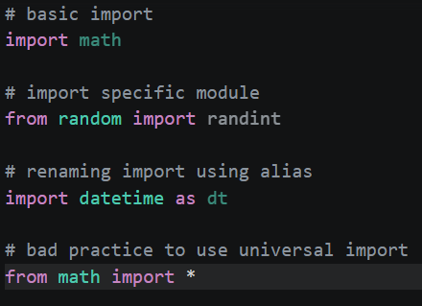
Syntax Variations for Importing
Basic Import: import math (Access via math.pi)
Specific Import: from random import randint (Access via randint())
Aliasing: import datetime as dt (Access via dt.datetime.now())
Universal (Discouraged): from math import * (Can lead to naming conflicts).

Slide 4
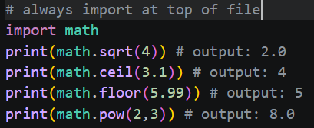
The math Module
Purpose: Provides mathematical constants and functions for floating-point math.
Key Functions:
math.sqrt(x): Returns the square root of x.
math.ceil(x) / math.floor(x): Rounding up or down to the nearest integer.
math.pow(x, y): Raises x to the power of y.
Constants:
math.pi (pi)
math.e (e)

Slide 5
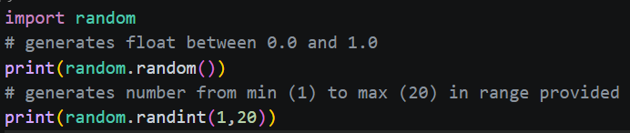
The random Module
Purpose: Used for generating pseudo-random numbers and making random selections.
Common Methods:
random.random(): Returns a float between 0.0 and 1.0.
random.randint(a, b): Returns a random integer between a and b (inclusive).
random.choice(sequence): Picks a random element from a list or tuple.
random.shuffle(list): Reorders a list in place.

Slide 6
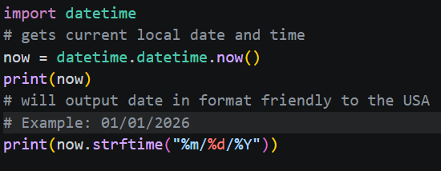
The datetime Module
Purpose: Supplies classes for manipulating dates and times.
Core Components:
datetime.datetime.now(): Gets the current local date and time.
datetime.date: Handles Year, Month, and Day.
Formatting:
strftime(): Converts a date object into a readable string (e.g., "2026-04-20").

Slide 7
Putting It All Together
Goal: Create a "Lucky Circle" script that calculates the area of a circle with a random radius and timestamps the result.
Steps to Accomplish:
Import the tools: Bring in math for pi, random for the radius, and datetime for the log.
Generate data: Use random.randint() to pick a radius between 1 and 10.
Perform calculation: Use math.pi and the exponent operator (or math.pow) to find the area (Area = pi X r^2).
Get current time: Use datetime.now() to mark when the calculation happened.
Output results: Print the radius, the calculated area, and the timestamp.

