Slide 1
Managing 3rd party Python libraries with pip

Slide 2
Why Look Beyond the Standard Library?
The "Batteries Included" Philosophy: Python comes with great built-in tools (e.g., math, datetime).
The Reality of Modern Dev: You shouldn't reinvent the wheel.
Community Power: Access to over 400,000+ projects on the Python Package Index (PyPI).
Key Benefits:
Speed up development.
Access specialized tools (AI, Web, Data Science).
Benefit from battle-tested code.

Slide 3
What is a Package?
Definition: A collection of Python modules bundled together.
Library vs. Framework:
Library: A collection of tools you call (e.g., Requests).
Framework: A structure that calls your code (e.g., Django).
Common Examples:
Pandas: Data manipulation.
Flask: Web development.
Pytest: Testing.

Slide 4

Meet pip: The Python Package Manager
What is it? The standard tool for installing and managing additional libraries.
Recursive Acronym: "Pip Installs Packages."
How it works: pip connects to PyPI, downloads the code, and handles dependencies.

Slide 5

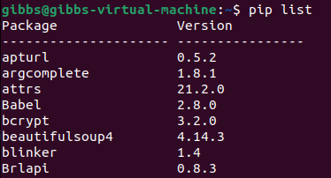
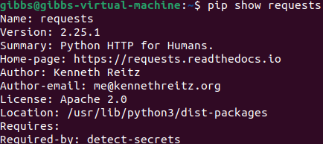
Essential pip Commands
Installing: pip install requests
Upgrading: pip install --upgrade requests
Uninstalling: pip uninstall requests
Listing Installed Packages: pip list
Checking Details: pip show requests

Slide 6
Managing Dependencies with requirements.txt
The Problem: How do you share your project's needs with others?
The Solution: A simple text file listing all required packages and their versions.
Key Commands:
Generate: pip freeze > requirements.txt
Install from file: pip install -r requirements.txt
Best Practice: Always include this file in your Git repositories.

Slide 7
Virtual Environments (The "Why")
The Conflict: Project A needs Version 1.0 of a library; Project B needs Version 2.0.
The Risk: Installing everything "globally" leads to "Dependency Hell."
The Fix: Virtual Environments (venv).
Isolated "sandboxes" for each project.
Keeps the global Python installation clean.

Slide 8


Working with venv
Creation: python -m venv .venv
Activation:
Windows: .venv\Scripts\activate
Mac/Linux: source .venv/bin/activate
Deactivation: Simply type deactivate.
Workflow: Create venv -> Activate -> pip Install.

Slide 9
Safety & Best Practices
Check the Source: Only install packages you trust.
Check Maintenance: Is the package updated recently? (Look at GitHub/PyPI).
Use Version Pinning: In requirements.txt, use requests==2.28.1 to prevent breaking changes.
Read the Docs: Most popular packages have extensive documentation on ReadTheDocs.

Slide 10
Summary & Resources
Recap:
pip is your gateway to the Python ecosystem.
PyPI is the warehouse.
Virtual environments are non-negotiable for professional work.
Resources:
PyPI.org
Official Pip Documentation
"Awesome Python" (curated list of top-tier packages)

