Slide 1
Organizing Python Projects

Slide 2
Why Stop Using Single Files?
The "Spaghetti Code" Problem: Large files become difficult to read and debug.
Collaboration: Multiple team members can’t easily work on one file simultaneously.
Reusability: Hard to use a specific function in a new project if it’s buried in a 2,000-line script.
Maintainability: Logical separation makes it easier to find and fix bugs.

Slide 3
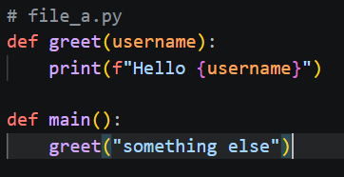
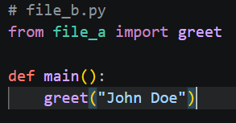
The Building Blocks: Modules
What is a Module? Any .py file is a module.
The import Statement: How we access code from other files.
Example:
file_a.py contains a function greet().
file_b.py uses import file_a to call file_a.greet().
Namespace Protection: Modules prevent naming conflicts (two files can both have a function named main()).

Slide 4
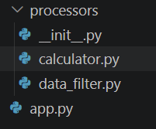
Grouping Modules: Packages
What is a Package? A directory containing multiple Python modules.
The __init__.py File: * Tells Python to treat the directory as a package.
Can be empty or used for initialization code.
Example Folder Structure:

Slide 5


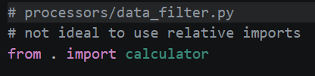
Navigation with Imports
Absolute Imports: Specifying the full path from the project root.
Relative Imports: Using dots to navigate based on current file location.
Best Practice: Use absolute imports whenever possible for clarity.

Slide 6
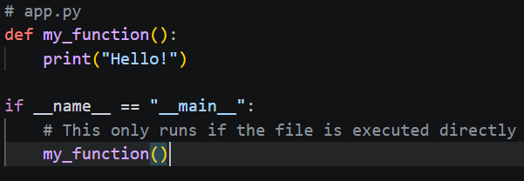
The if __name__ == "__main__": Idiom
The Problem: Importing a file executes all code inside it immediately.
The Solution: Use the "Main Guard" to prevent script logic from running during an import.
Benefit: Allows a file to be used both as a reusable module and a standalone script.

Slide 7
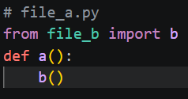
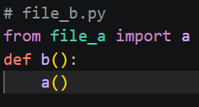
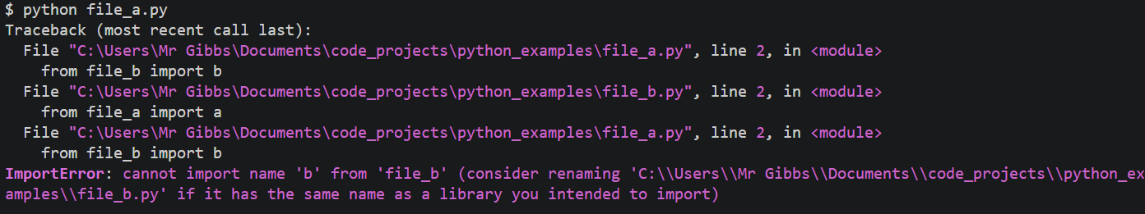
Circular Imports (The Trap)
What happens: File A imports File B, and File B imports File A.
The Result: ImportError or AttributeError.
How to Avoid It:
Redesign the architecture (move shared code to a third file).
Use "Local Imports" (importing inside a function rather than at the top).
Keep dependencies "downward" (High-level modules import low-level modules, not vice versa).

Slide 8
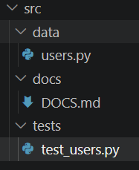
Common Project Patterns
The Flat Layout: (Small projects) All files in one folder.
The src Layout: (Professional/Large projects) Code lives in a src/ subdirectory to separate it from config files.
Standard Folders:
tests/: For your unit tests.
docs/: For documentation.
data/: For input/output files.

Slide 9
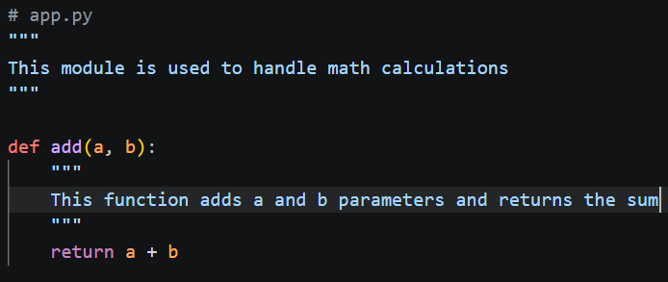
Best Practices for Clean Projects
One Responsibility: Each file should do one thing (e.g., database.py only handles DB logic).
Consistent Naming: Use snake_case for file names.
Keep it Shallow: Avoid nesting folders 5-6 layers deep.
Docstrings: Always document the purpose of a module at the very top of the file.

Slide 10
Recap:
Use Modules for logic separation.
Use Packages for organizational hierarchy.
Use Main Guards to keep imports clean.
Next Steps:
Refactor a "giant" script into three modules.
Experiment with moving utility functions into a utils/ package.

