Slide 1

OpenShift con ejemplos
Meetup Linux-Malaga 2017-06-16
@javilinux

Slide 2
WIFI
Plataforma Voluntariado
ju19hi12SE19L
http://192.168.0.100

Slide 3
DISCLAIMER
Todo el contenido de la presentación es de índole personal y no representa las opiniones de Red Hat

Slide 4
Agenda
Introduccion OpenShift
Entorno
Workshop

Slide 5
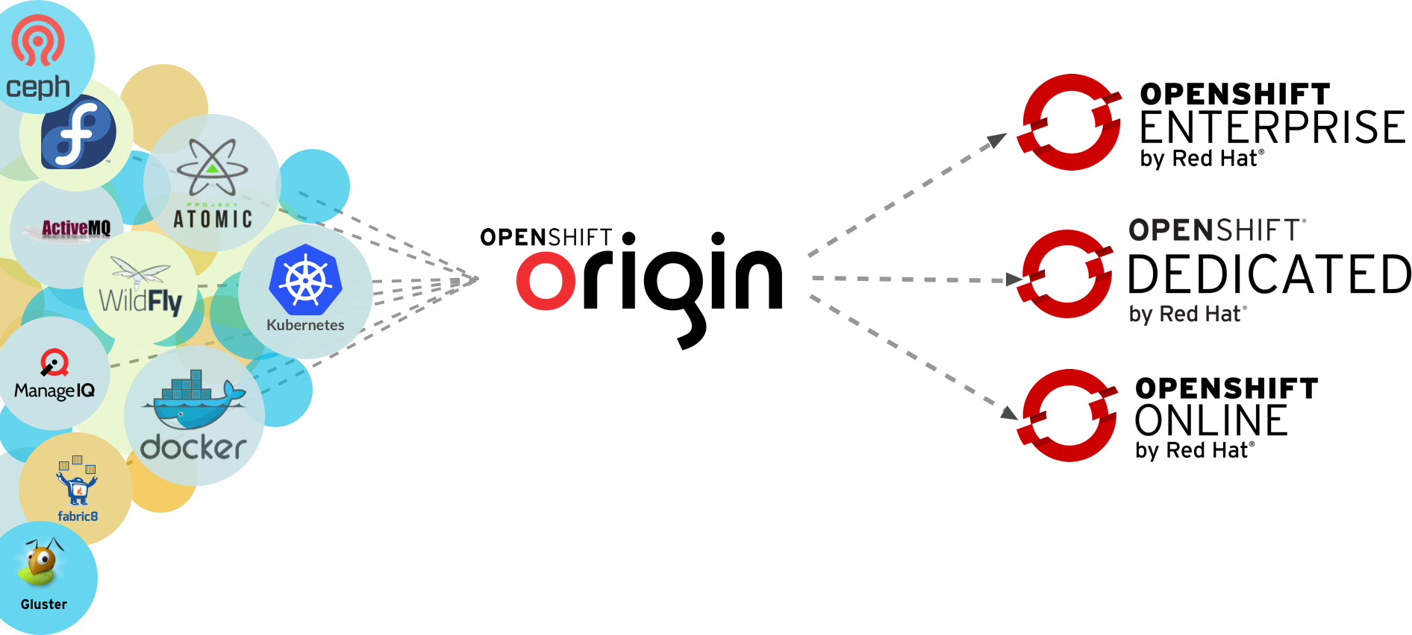
Community Powered Innovation
Notes:
OpenShift Origin is the open source community project that drives OpenShift development
But Origin combines a number of best-of-breed upstream projects including Docker, Kubernetes, Project Atomic and more.
Red Hat is a leading contributor to these these upstream projects that deliver the core infrastructure capabilities for OpenShift
OpenShift Online is our Public PaaS service offering at openshift.com
OpenShift Enterprise is our Private PaaS software solution for running your own PaaS

Slide 6











Openshift 3.1 - Open Source Components
Logging with EFK
Metrics
Installation
Notes:
OpenShift Origin is the open source community project that drives OpenShift development
But Origin combines a number of best-of-breed upstream projects including Docker, Kubernetes, Project Atomic and more.
Red Hat is a leading contributor to these these upstream projects that deliver the core infrastructure capabilities for OpenShift
OpenShift Online is our Public PaaS service offering at openshift.com
OpenShift Enterprise is our Private PaaS software solution for running your own PaaS

Slide 7
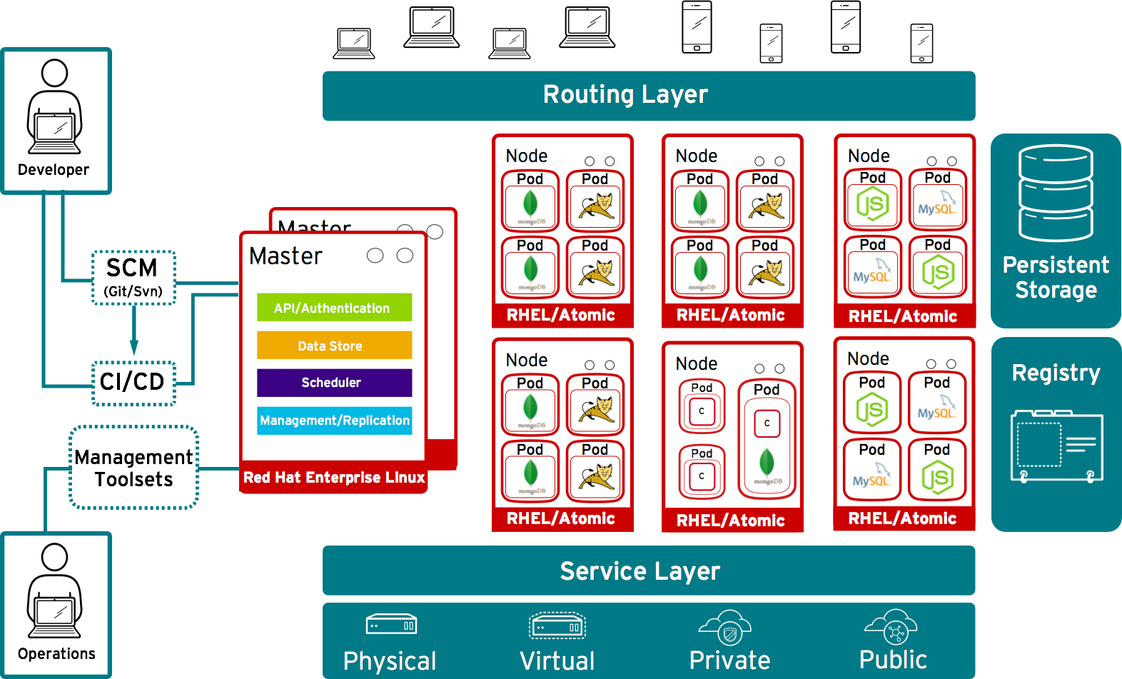
10,000ft View
Notes:
This is a high level architecture diagram of the OpenShift 3 platform. In this presentation we are going to review each of the major components and discuss how they work together.

Slide 8
ENTORNO LOCAL

Slide 9
Minishift
VM con OpenShift Origin “Containerized”
Sólo necesita un hypervisor instalado:
  Mac OS X: xhyve (default) / VirtualBox / VMware Fusion
  GNU/Linux: KVM (default) / VirtualBox
  Windows: Hyper-V (default) / VirtualBox
https://luzbel.github.io/Cuaderno-de-bitacora/misc/guia-minishift-en-w10/
https://docs.openshift.org/latest/minishift/getting-started/installing.html

Slide 10
OC CLUSTER UP
OpenShift Origin “Containerized” directamente en el equipo.
Requiere docker instalado.
  INSECURE_REGISTRY='--insecure-registry 172.30.0.0/16'

Slide 11
OC CLUSTER UP PRIVATE REGISTRY
Entrada en el /ect/hosts (o equivalente):
  192.168.0.100 registry.linux-malaga.org
Editar docker.conf (o equivalente):
  ADD_REGISTRY='--add-registry registry.linux-malaga.org:5000'
  INSECURE_REGISTRY='--insecure-registry registry.linux-malaga.org:5000 --insecure-registry 172.30.0.0/16'
oc cluster up –version='latest'

Slide 12
WORKSHOP
http://kubernetesbyexample.com/

Slide 13
https://learn.openshift.com/
https://www.openshift.com/promotions/ebook.html
https://www.openshift.com/promotions/for-developers.html
https://www.openshift.com/promotions/devops-with-openshift.html
http://www.openshift.com
http://www.openshift.org
http://blog.openshift.com
https://github.com/openshift/
https://github.com/openshift-evangelists/

Slide 14
Gracias!

