Slide 1
One Health Microbial Seminar Mediation analysis: Lin, L., Yi, X., Liu, H. et al. The airway microbiome mediates the interaction between environmental exposure and respiratory health in humans. Nat Med 29, 1750–1759 (2023).
Javier Mancilla Galindo
MSc Epidemiology
12 April 2024

Slide 2
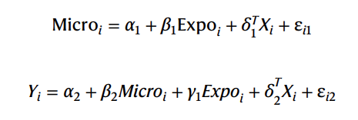

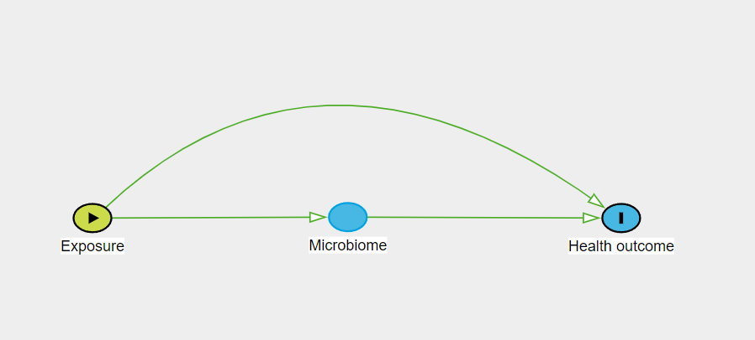
Formulas provided in the paper for mediation analyses:

Slide 3
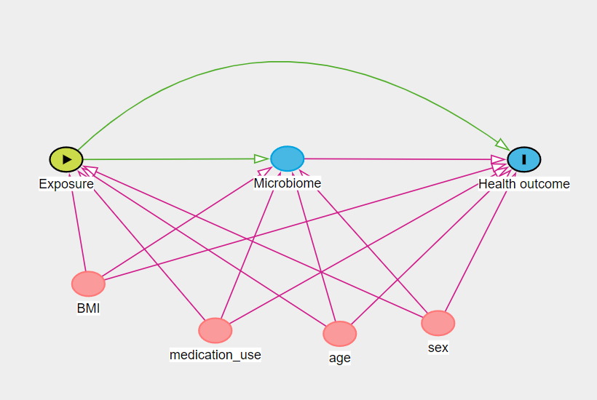
No problem estimating β₁
However, second equation is
especially problematic
if assumptions are not true…
Provided assumptions in DAG are true

Slide 4
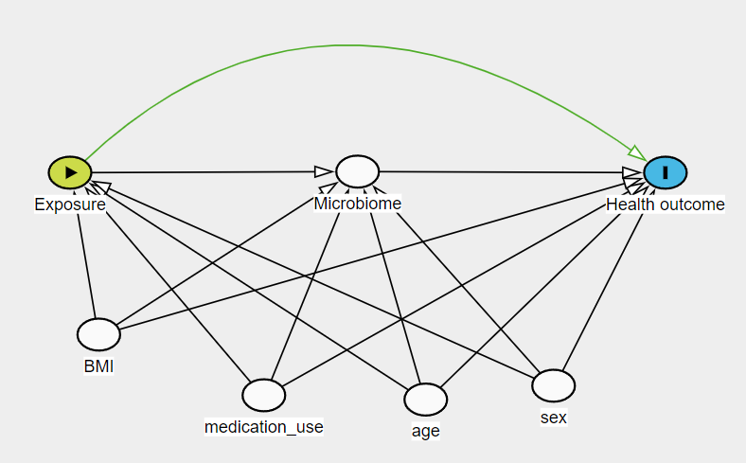
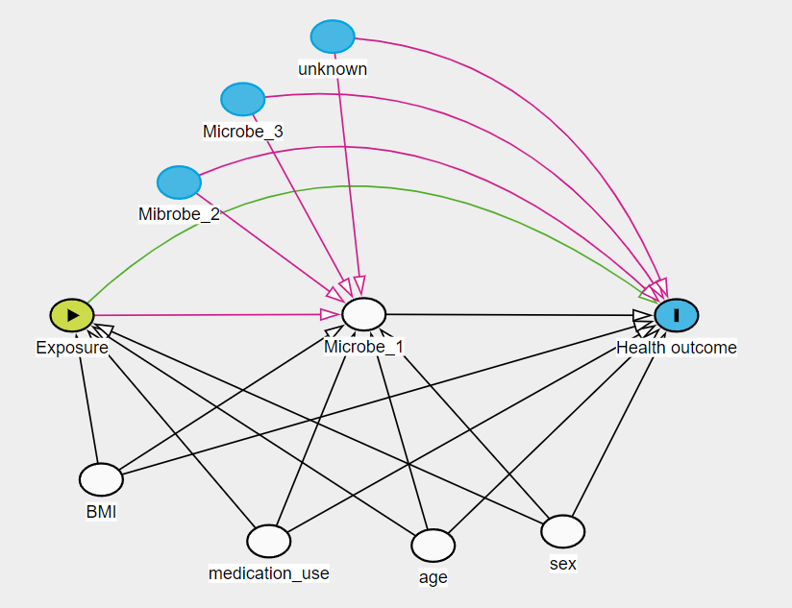
Can only estimate γ₁ if there are no (unmeasured) exposure or mediator-outcome confounders
But what if there were…
Notes:
Code for recreation of the last DAG in dagitty.net:
dag {
"Health outcome" [outcome,pos="0.245,0.280"]
BMI [adjusted,pos="-1.483,1.072"]
Exposure [exposure,pos="-1.571,0.280"]
Mibrobe_2 [pos="-1.249,-0.361"]
Microbe_1 [adjusted,pos="-0.694,0.275"]
Microbe_3 [pos="-1.058,-0.763"]
age [adjusted,pos="-0.486,1.390"]
medication_use [adjusted,pos="-0.980,1.369"]
sex [adjusted,pos="-0.096,1.322"]
unknown [pos="-0.788,-1.065"]
BMI -> "Health outcome"
BMI -> Exposure
BMI -> Microbe_1
Exposure -> "Health outcome" [pos="-0.778,-0.909"]
Exposure -> Microbe_1
Mibrobe_2 -> "Health outcome" [pos="-0.512,-0.856"]
Mibrobe_2 -> Microbe_1
Microbe_1 -> "Health outcome"
Microbe_3 -> "Health outcome" [pos="-0.239,-0.914"]
Microbe_3 -> Microbe_1
age -> "Health outcome"
age -> Exposure
age -> Microbe_1
medication_use -> "Health outcome"
medication_use -> Exposure
medication_use -> Microbe_1
sex -> "Health outcome"
sex -> Exposure
sex -> Microbe_1
unknown -> "Health outcome" [pos="-0.070,-0.966"]
unknown -> Microbe_1
}

Slide 5
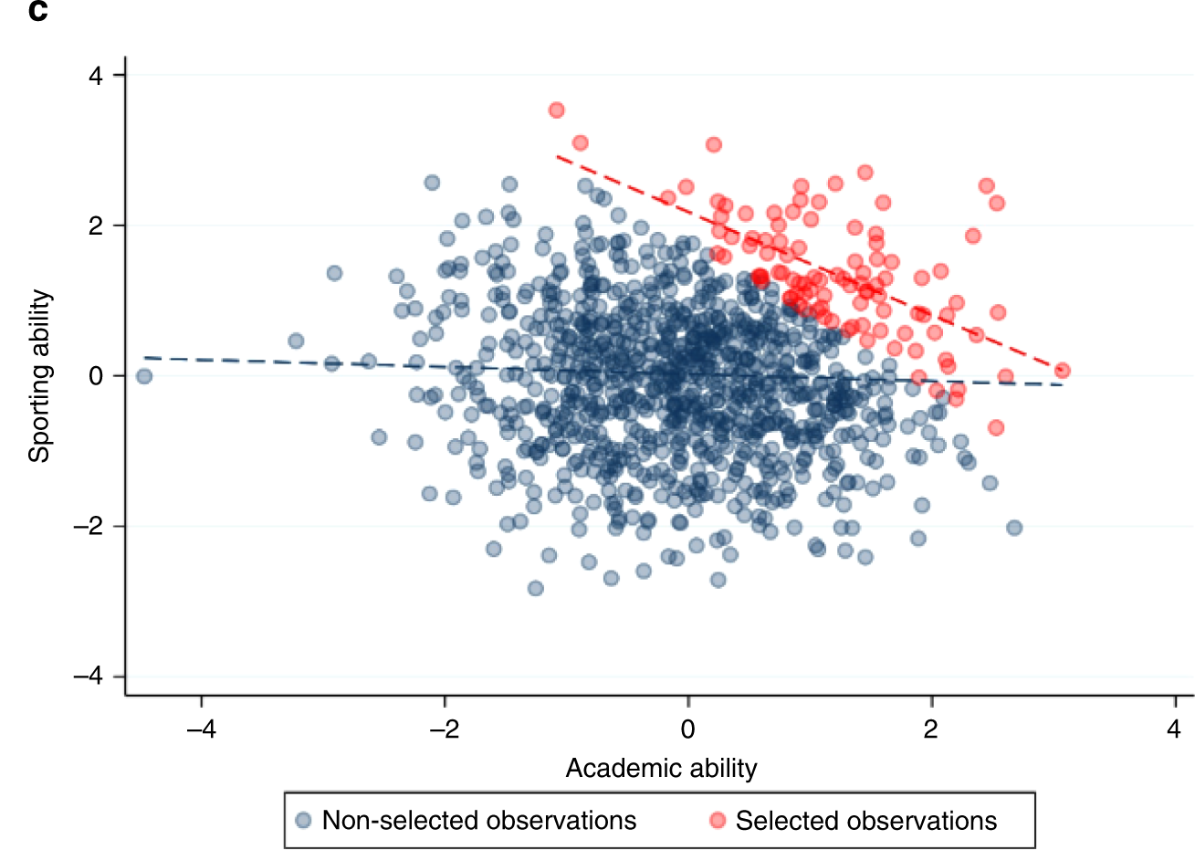
Collider stratification: example
Selection (conditioning): Prestigious schools
Griffith, G.J., Morris, T.T., Tudball, M.J. et al. Nat Commun. 2020;11:5749
Notes:
Extract from the article by Griffith et al.: The magnitude of this distortion can be large, inducing associations that do not exist in the general population or attenuating, inflating or reversing the sign of existing associations¹⁶ Furthermore, when attempting to draw causal inferences from ascertained datasets, such effects may not even be valid within the dataset itself (i.e. lack of internal validity) (Box 1). This is because associations induced by collider bias are properties of the sample, rather than the individuals that comprise it, so the associations estimated using the sample will not be a reliable indication of the individual level causal effects. Collider bias, therefore, causes associations to fail to generalise beyond the sample and for causal inferences to be inaccurate even within the sample. It is this second characteristic which distinguishes collider bias within the more general concept of selection bias. Selection bias can occur when there are effect modifiers that are distributed differently in the sample than in the population, thus causing effects to differ between the two. However, while this limits the generalisability of causal effects on the population, those effects are valid within the sample.

Slide 6
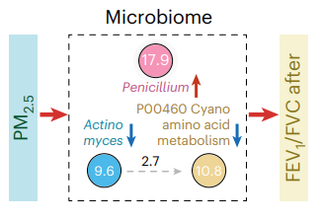
The proportion mediated can only take values between 0 and 1 (0 to 100%).
However, these look exagerately high for single microbial features!
I wouldn’t be surprised if adding all PM would give >>> 100%.
Counterintuitive that mediators can be both positive and negatively associated with the outcome…
Shouldn’t a mediator have the same directionality of effect as the exposure to be a mediator of its effect?

Slide 7
Supplementary Table 3 reports the proportion mediated of those features concluded to be important after accounting for FDR.
I selected the forward proportion mediated, only for smoking (even after excluding those concluded to be reverse mediation).
With n=36 estimates, the total sum of proportion mediation was 383.6% for smoking!!!
Notes:
For PM2.5 this was 224.3%

Slide 8
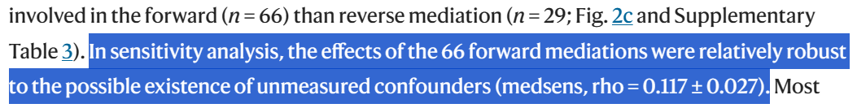
Sensitivity Analysis
Mean and SD?
Extracts from tutorial paper on mediation sensitivity analysis:
“A higher ρ value indicates less sensitivity to unmeasured pre-treatment confounders”
“ρ value is 0.1, indicating that the true ACME would not be significantly different from zero if there exist an unobserved confounder that causes a small correlation between errors for the mediator and the outcome models.”
Chi WE. et al. Frontiers in Education. 2022;7:886722

Slide 9
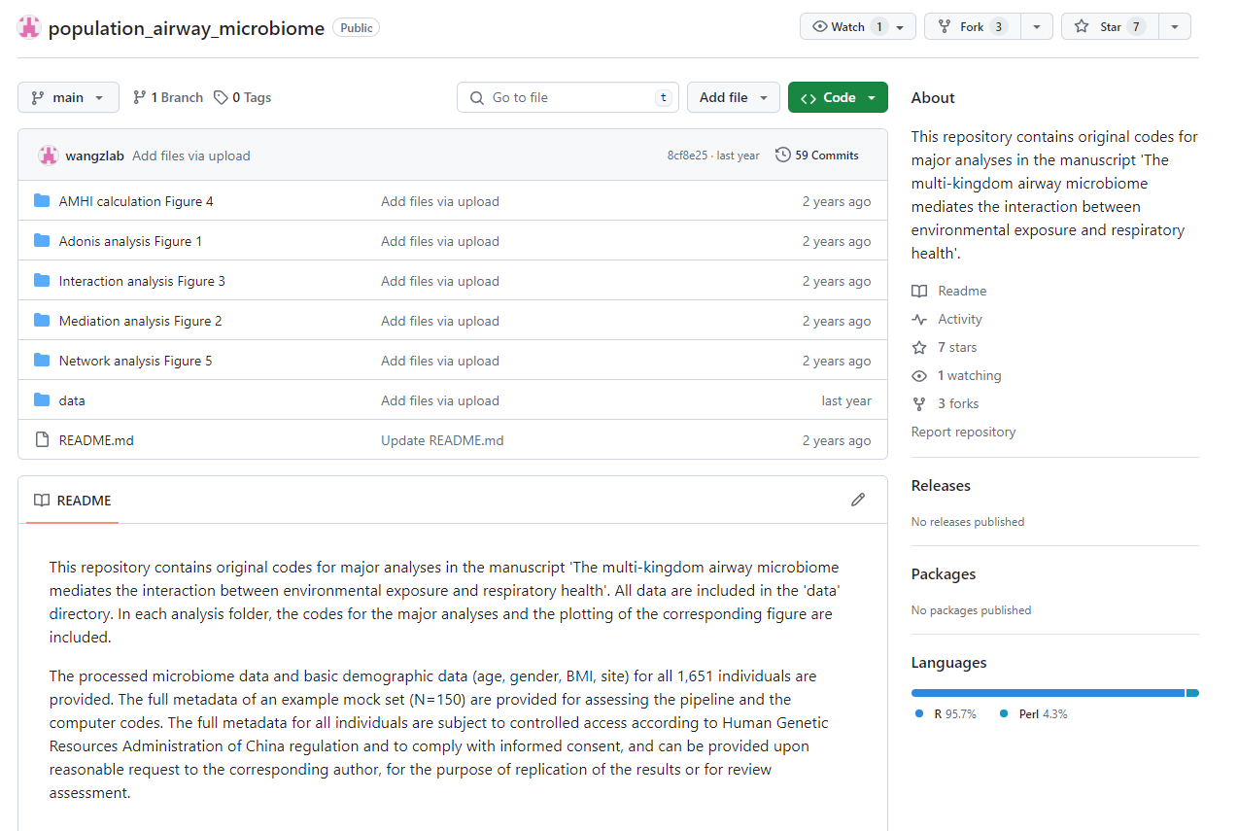

Good thing the authors provided some code and sample data (150 individuals) to reproduce analyses. Perhaps we can gain some insight from it.
https://github.com/wangzlab/population_airway_microbiome

Slide 10
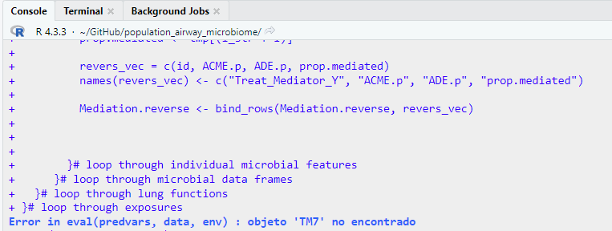


Code not reproducible
https://tinyurl.com/BPWRcourse
But I was still able to retrieve 64 results from code that ran before aborting.
Biofuel → Microbial feature → FEV1/FVC
Direction | N | Sum proportion mediated
Positive value | 36 | 103%
Negative value | 28 | -47%

Slide 11

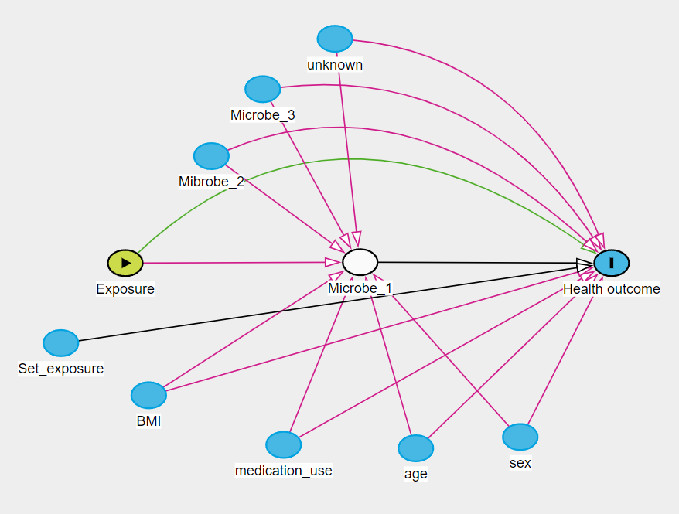
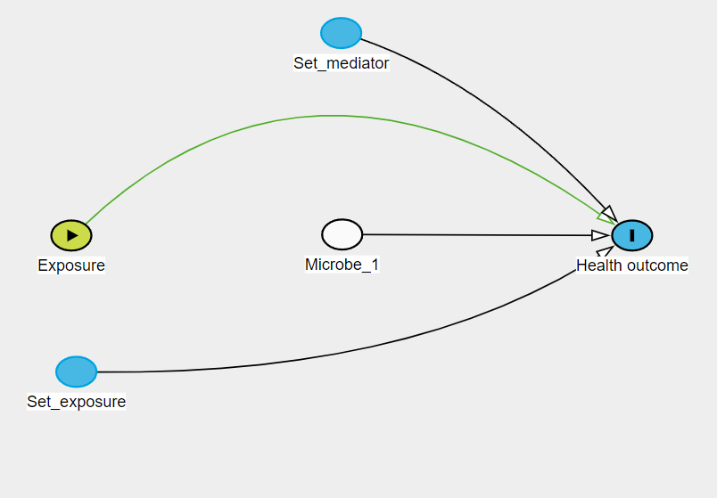

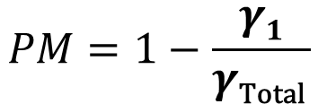
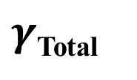
Solutions
Inverse probability weighting
$γ$_{Total}
$$PM=1−\frac{γ1}{γ\text{Total} }$$
$$\frac{β2}{γ\text{Total} }$$
or

Slide 12
Solutions
Inverse probability weighting
But how can we specify such complex propensity score models with so many potential mediator-outcome confounders??
Perhaps using “broader” microbiome definitions would allow this
Richness, abundance, etc. (continuous mediators challenging, but can be done)
Clusters
Airway Microbiome Health Index

Slide 13
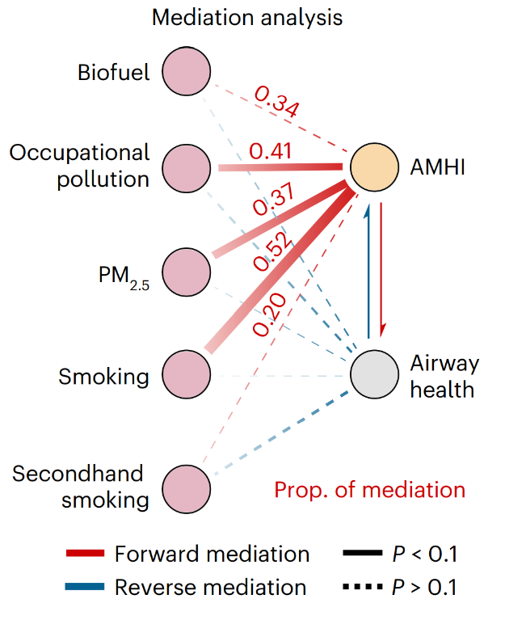
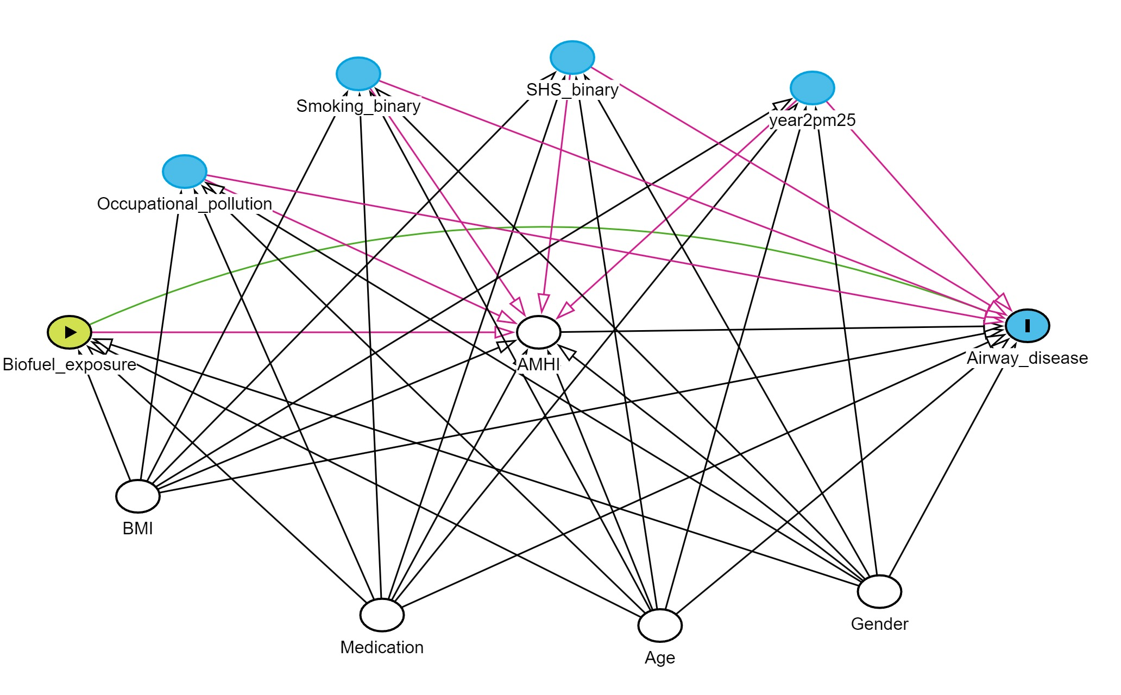
Airway Microbiome Health Index
Authors are assuming no correlation between exposures and no confounding
Notes:
dag {
AHMI [adjusted,pos="-0.702,0.802"]
Age [adjusted,pos="-0.486,1.390"]
Airway_disease [outcome,pos="0.167,0.789"]
BMI [adjusted,pos="-1.414,1.131"]
Biofuel_exposure [exposure,pos="-1.535,0.802"]
Gender [adjusted,pos="-0.096,1.322"]
Medication [adjusted,pos="-0.980,1.369"]
Occupational_pollution [pos="-1.331,0.480"]
SHS_binary [pos="-0.642,0.251"]
Smoking_binary [pos="-1.022,0.284"]
year2pm25 [pos="-0.215,0.312"]
AHMI -> Airway_disease
Age -> AHMI
Age -> Airway_disease
Age -> Biofuel_exposure
Age -> Occupational_pollution
Age -> SHS_binary
Age -> Smoking_binary
Age -> year2pm25
BMI -> AHMI
BMI -> Airway_disease
BMI -> Biofuel_exposure
BMI -> Occupational_pollution
BMI -> SHS_binary
BMI -> Smoking_binary
BMI -> year2pm25
Biofuel_exposure -> AHMI
Biofuel_exposure -> Airway_disease [pos="-0.731,0.401"]
Gender -> AHMI
Gender -> Airway_disease
Gender -> Biofuel_exposure
Gender -> Occupational_pollution
Gender -> SHS_binary
Gender -> Smoking_binary
Gender -> year2pm25
Medication -> AHMI
Medication -> Airway_disease
Medication -> Biofuel_exposure
Medication -> Occupational_pollution
Medication -> SHS_binary
Medication -> Smoking_binary
Medication -> year2pm25
Occupational_pollution -> AHMI
Occupational_pollution -> Airway_disease
SHS_binary -> AHMI
SHS_binary -> Airway_disease
Smoking_binary -> AHMI
Smoking_binary -> Airway_disease
year2pm25 -> AHMI
year2pm25 -> Airway_disease
}

Slide 14
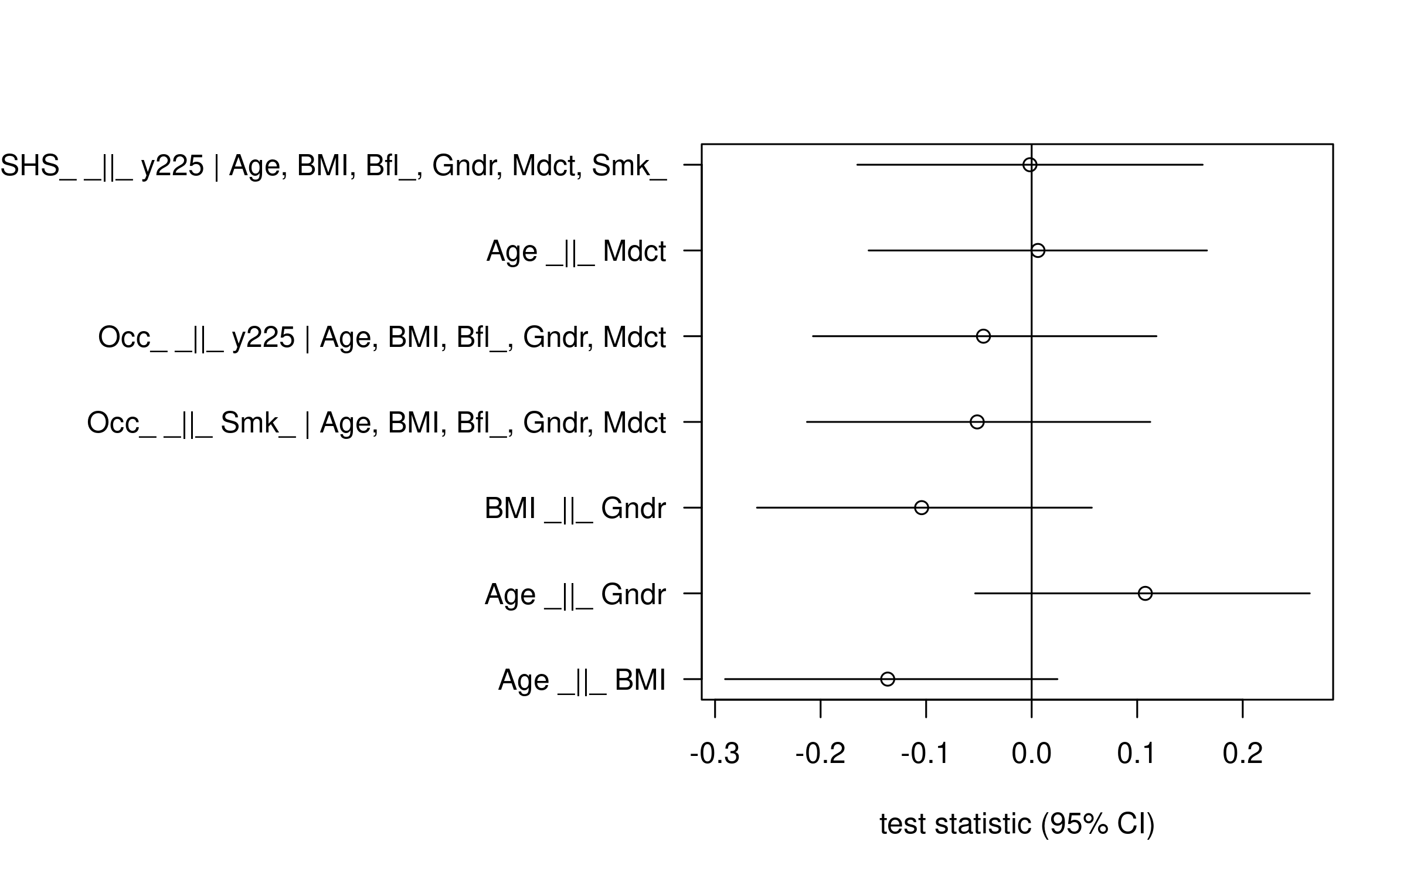
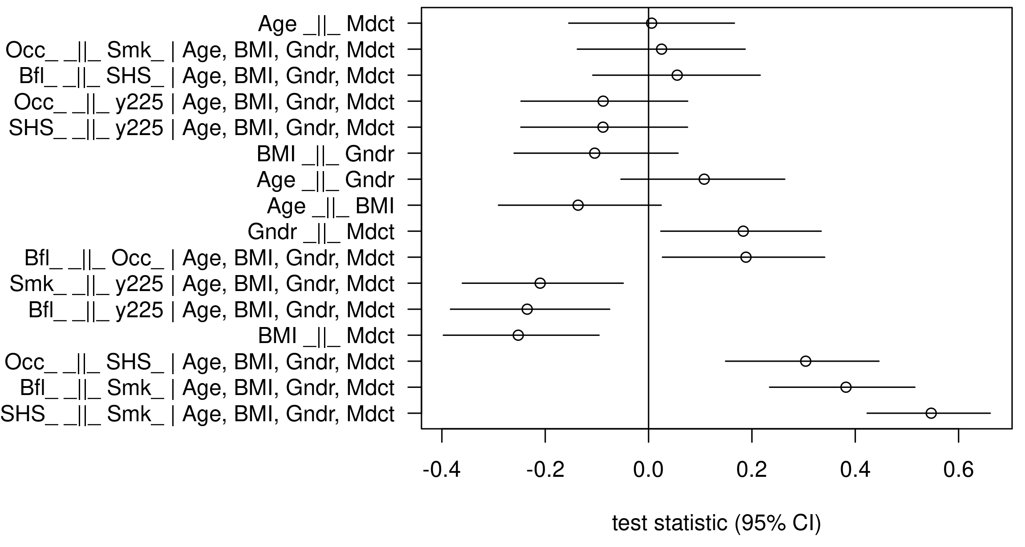
Reanalysis with sample data and IPW
npCBPS
Updating DAG to meet conditional independencies assumption:
Ankan A. et al. Current Protocols. 2021;1:e45
Notes:
Non-Parametric Covariate Balancing Propensity Score (npCBPS)

Slide 15
Reanalysis with sample data and IPW
Updating DAG to meet conditional independencies assumption:
Ankan A. et al. Current Protocols. 2021;1:e45
Notes:
dag {
AMHI [adjusted,pos="-0.702,0.802"]
Age [adjusted,pos="-0.486,1.390"]
Airway_disease [outcome,pos="0.167,0.789"]
BMI [adjusted,pos="-1.414,1.131"]
Biofuel_exposure [exposure,pos="-1.535,0.802"]
Gender [adjusted,pos="-0.096,1.322"]
Medication [adjusted,pos="-0.980,1.369"]
Occupational_pollution [pos="-1.331,0.480"]
SHS_binary [pos="-0.642,0.251"]
Smoking_binary [pos="-1.022,0.284"]
year2pm25 [pos="-0.215,0.312"]
AMHI -> Airway_disease
Age -> AMHI
Age -> Airway_disease
Age -> Biofuel_exposure
Age -> Occupational_pollution
Age -> SHS_binary
Age -> Smoking_binary
Age -> year2pm25
BMI -> AMHI
BMI -> Airway_disease
BMI -> Biofuel_exposure
BMI -> Medication
BMI -> Occupational_pollution
BMI -> SHS_binary
BMI -> Smoking_binary
BMI -> year2pm25
Biofuel_exposure -> AMHI
Biofuel_exposure -> Airway_disease [pos="-0.731,0.401"]
Biofuel_exposure -> SHS_binary
Biofuel_exposure -> Smoking_binary
Biofuel_exposure -> year2pm25
Gender -> AMHI
Gender -> Airway_disease
Gender -> Biofuel_exposure
Gender -> Medication
Gender -> Occupational_pollution
Gender -> SHS_binary
Gender -> Smoking_binary
Gender -> year2pm25
Medication -> AMHI
Medication -> Airway_disease
Medication -> Biofuel_exposure
Medication -> Occupational_pollution
Medication -> SHS_binary
Medication -> Smoking_binary
Medication -> year2pm25
Occupational_pollution -> AMHI
Occupational_pollution -> Airway_disease
Occupational_pollution -> Biofuel_exposure
Occupational_pollution -> SHS_binary
SHS_binary -> AMHI
SHS_binary -> Airway_disease
Smoking_binary -> AMHI
Smoking_binary -> Airway_disease
Smoking_binary -> SHS_binary
Smoking_binary -> year2pm25
year2pm25 -> AMHI
year2pm25 -> Airway_disease
}

Slide 16
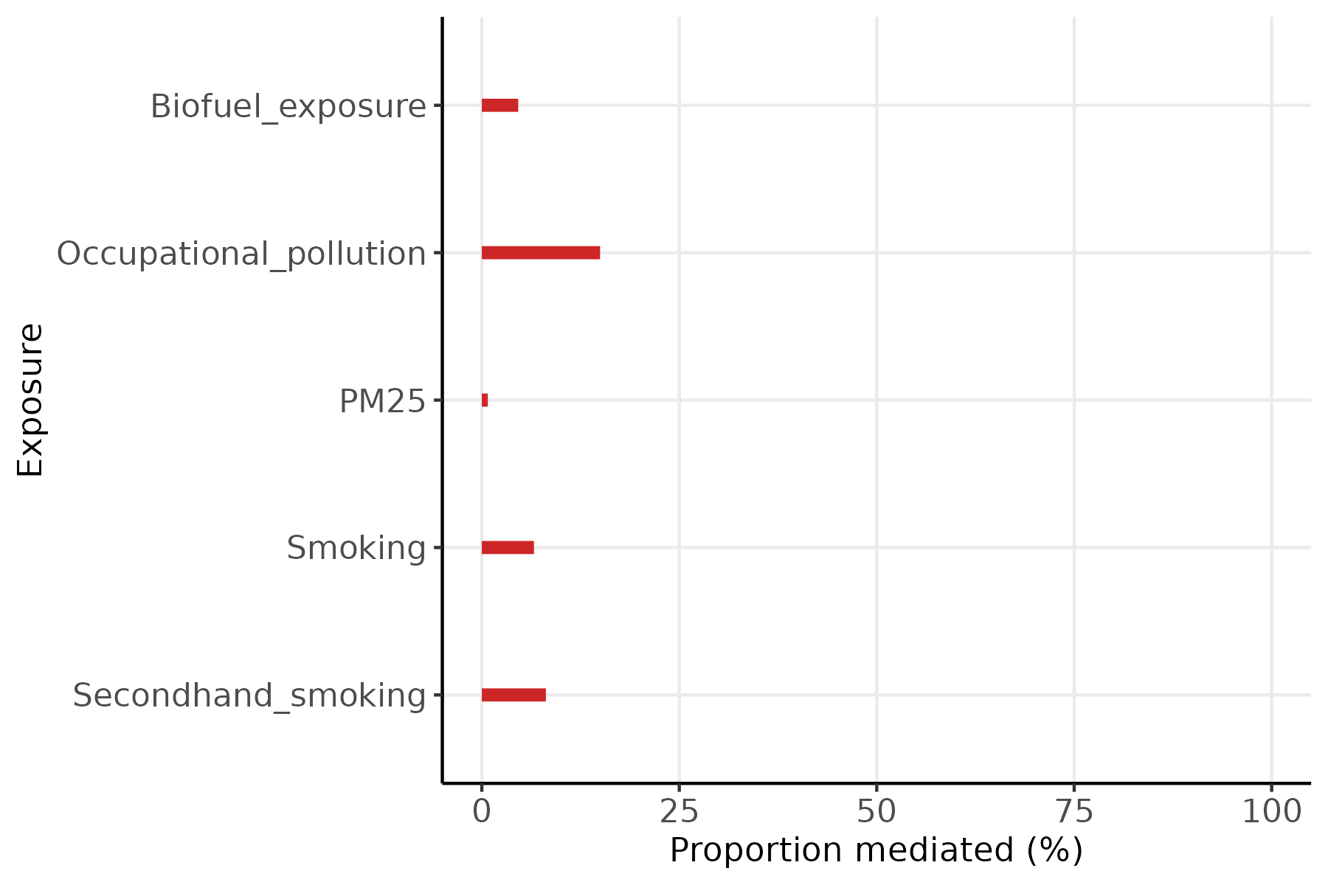
Bootstrap 95%CI of Proportion Mediated

Slide 17
Conclusions
Summing the PM largely exceeds 100%, which is biologically not possible.
Such problem is likely due to biased estimates caused by mediator collider stratification and not accounting for mediator-outcome confounding.
Using the AMHI could partially solve problems of looking at individual microbial features. Nonetheless, estimates in the paper are likely biased as shown in the DAG in slide 13.

Slide 18
Conclusions
By updating the assumptions in DAG to match the correlation structure of the dataset with current knowledge of hypothetical relationships, I was able to identify minimal adjustment sets for every exposure-outcome relationship.
To overcome shared exposure-outcome and mediator-outcome confounding, I used IPW to mediate a continuous outcome through npCBPS.
Bootstrap 95% confidence intervals show that estimates in the figure of the paper are exaggeratedly high, and all include 0.

Slide 19
Limitations
Reanalysis done in a subset. Thus, results could change when applied in the complete dataset.
When applied in the complete dataset, models should account for the effect of geographical region.
Only forward mediation assumed to be of interest in these reanalyses. Thus, I did not model reverse mediation.

