Slide 1
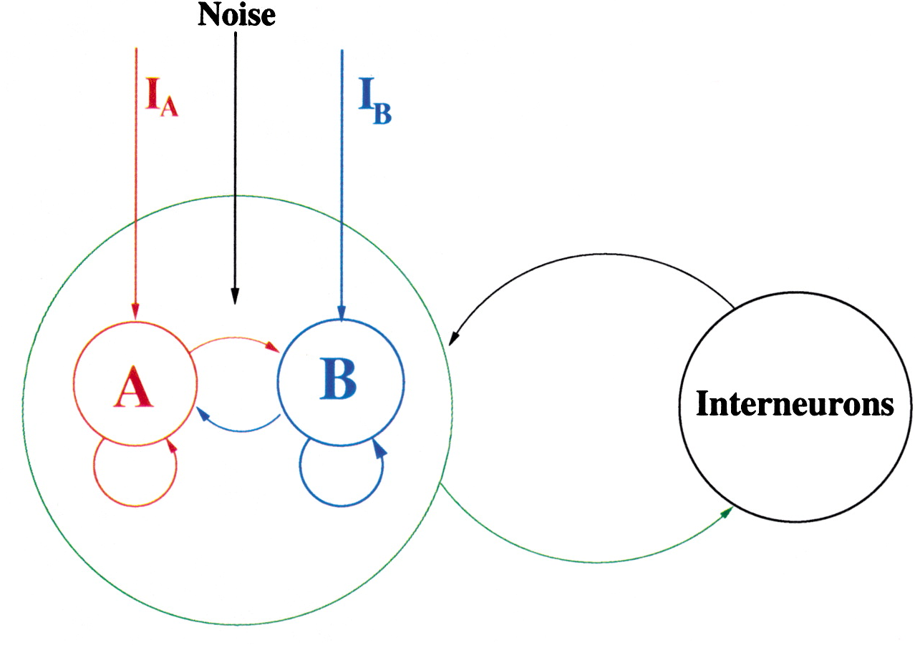
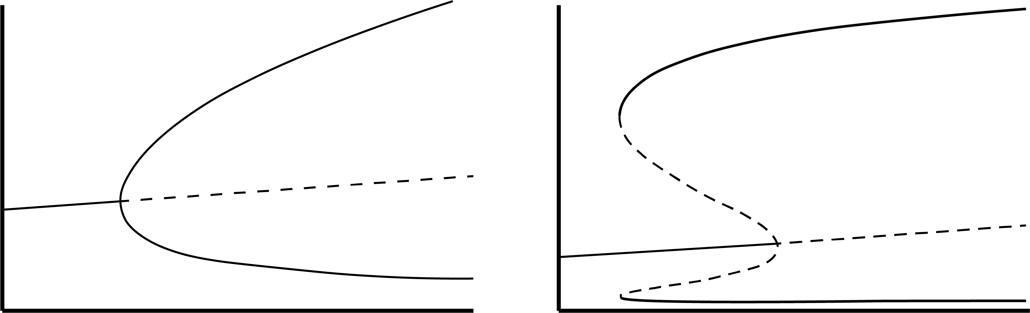
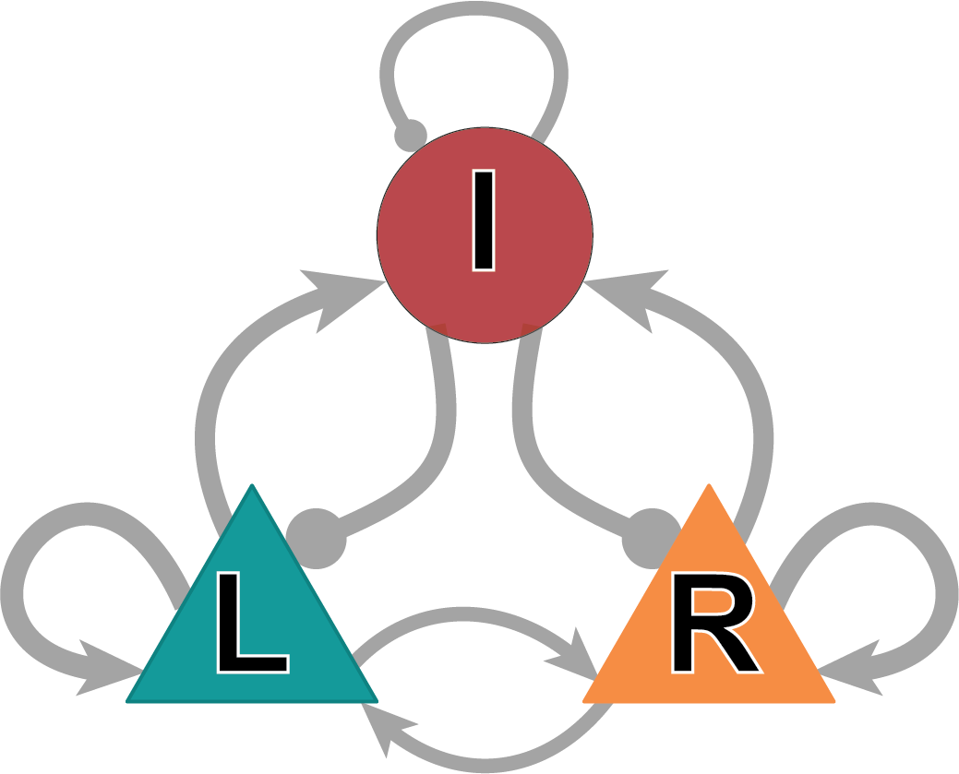
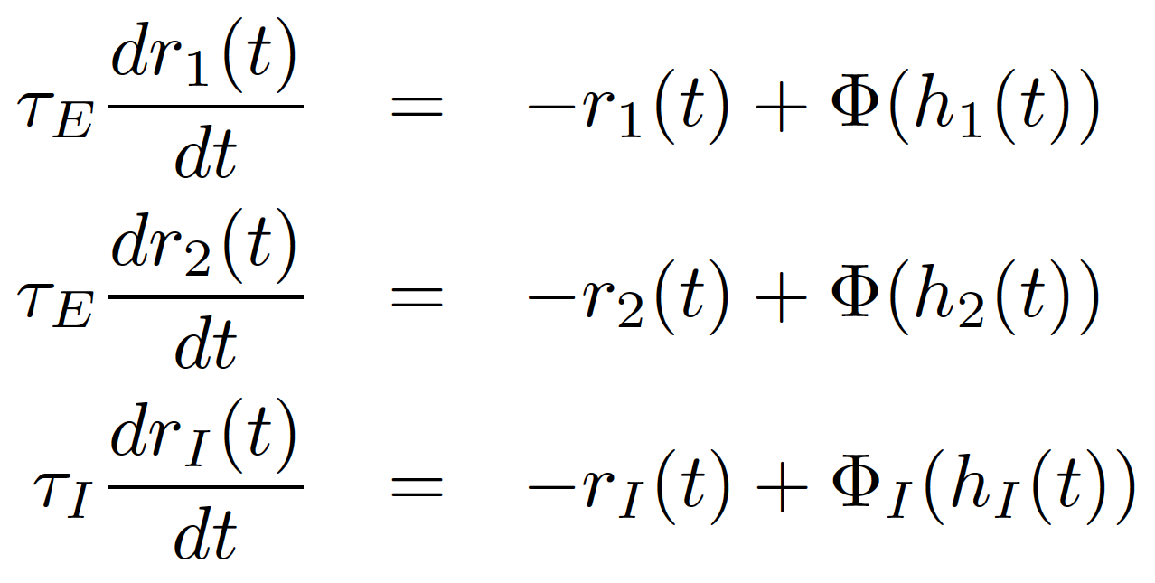
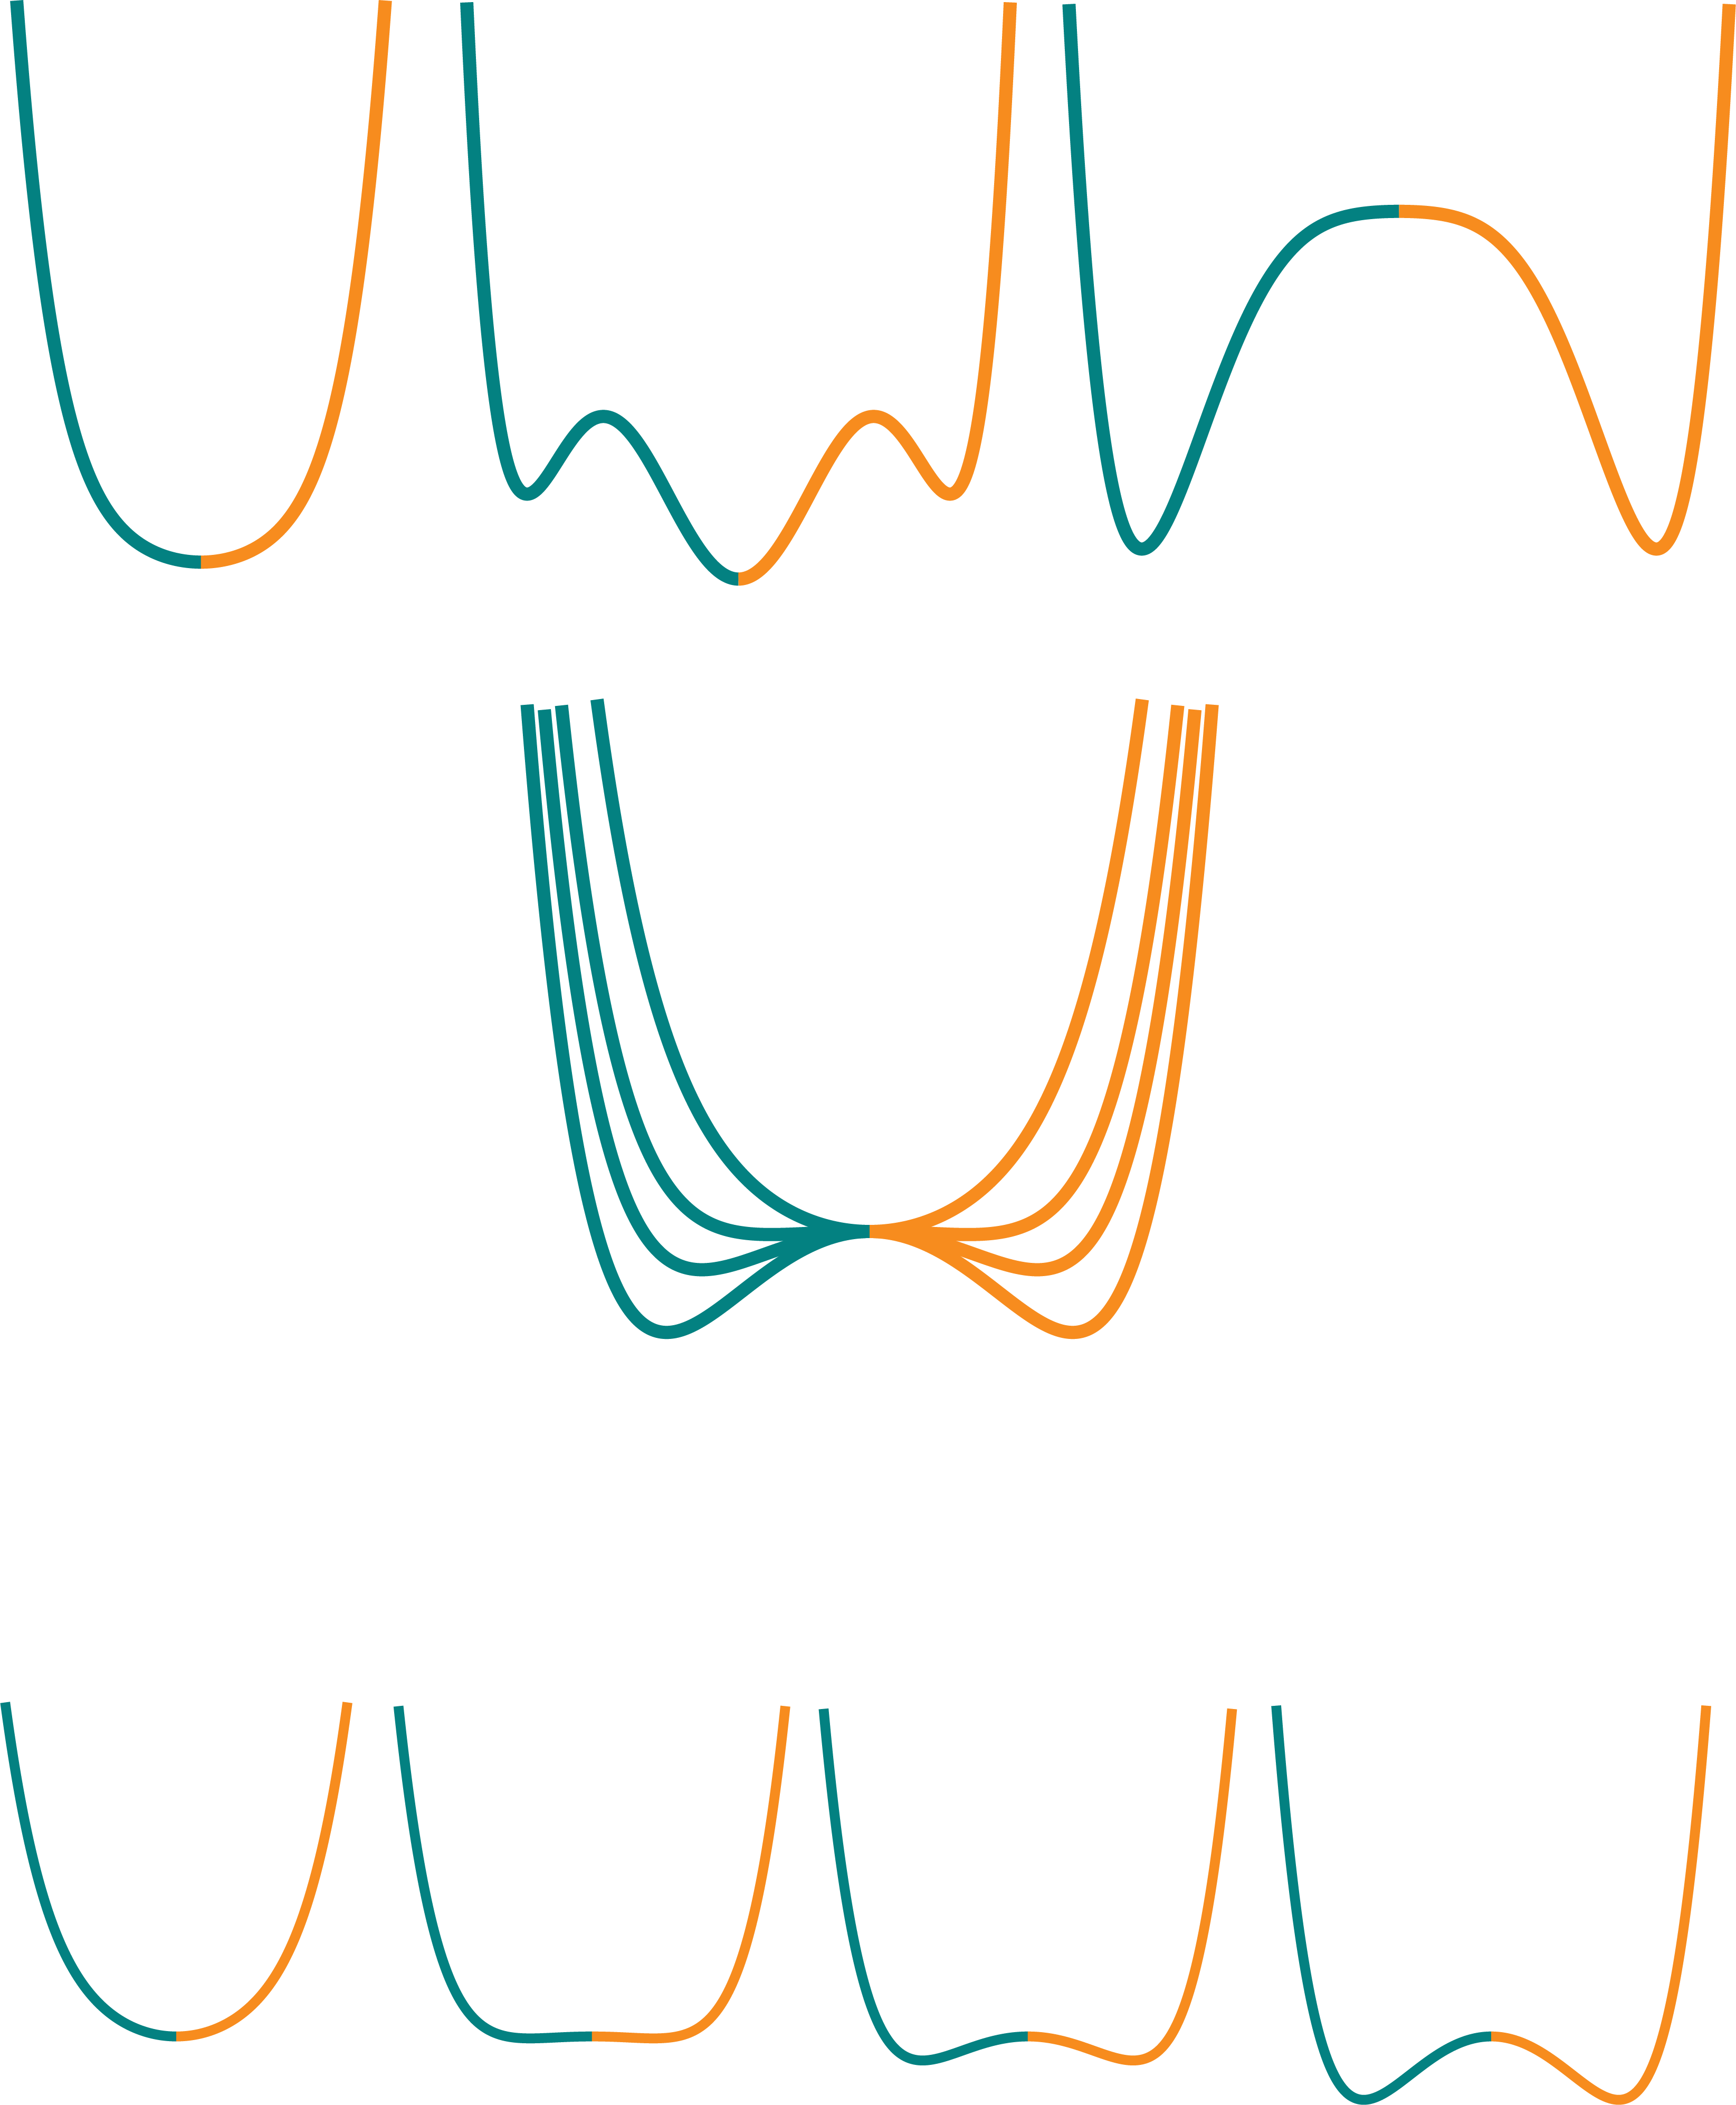
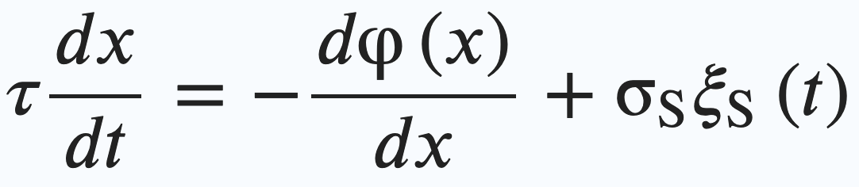


Short-term Memory models: attractor dynamics
Population Rate r_{R}
Right stim.
Left stim.
I_{L}
I_{R}
Unspecific excitatory input I_{ext}
$x\left(t\right)=r_{R}(t)−$ $r_{L}(t)$
Single state
Exc. Input I_{ext}
0
Multi-stability
winner-take-all
$x=r_{R}−$ $r_{L}$
Wong & Wang ‘06; Roxin & Ledberg ’08; Prat-Ortega et al 2021

Slide 2
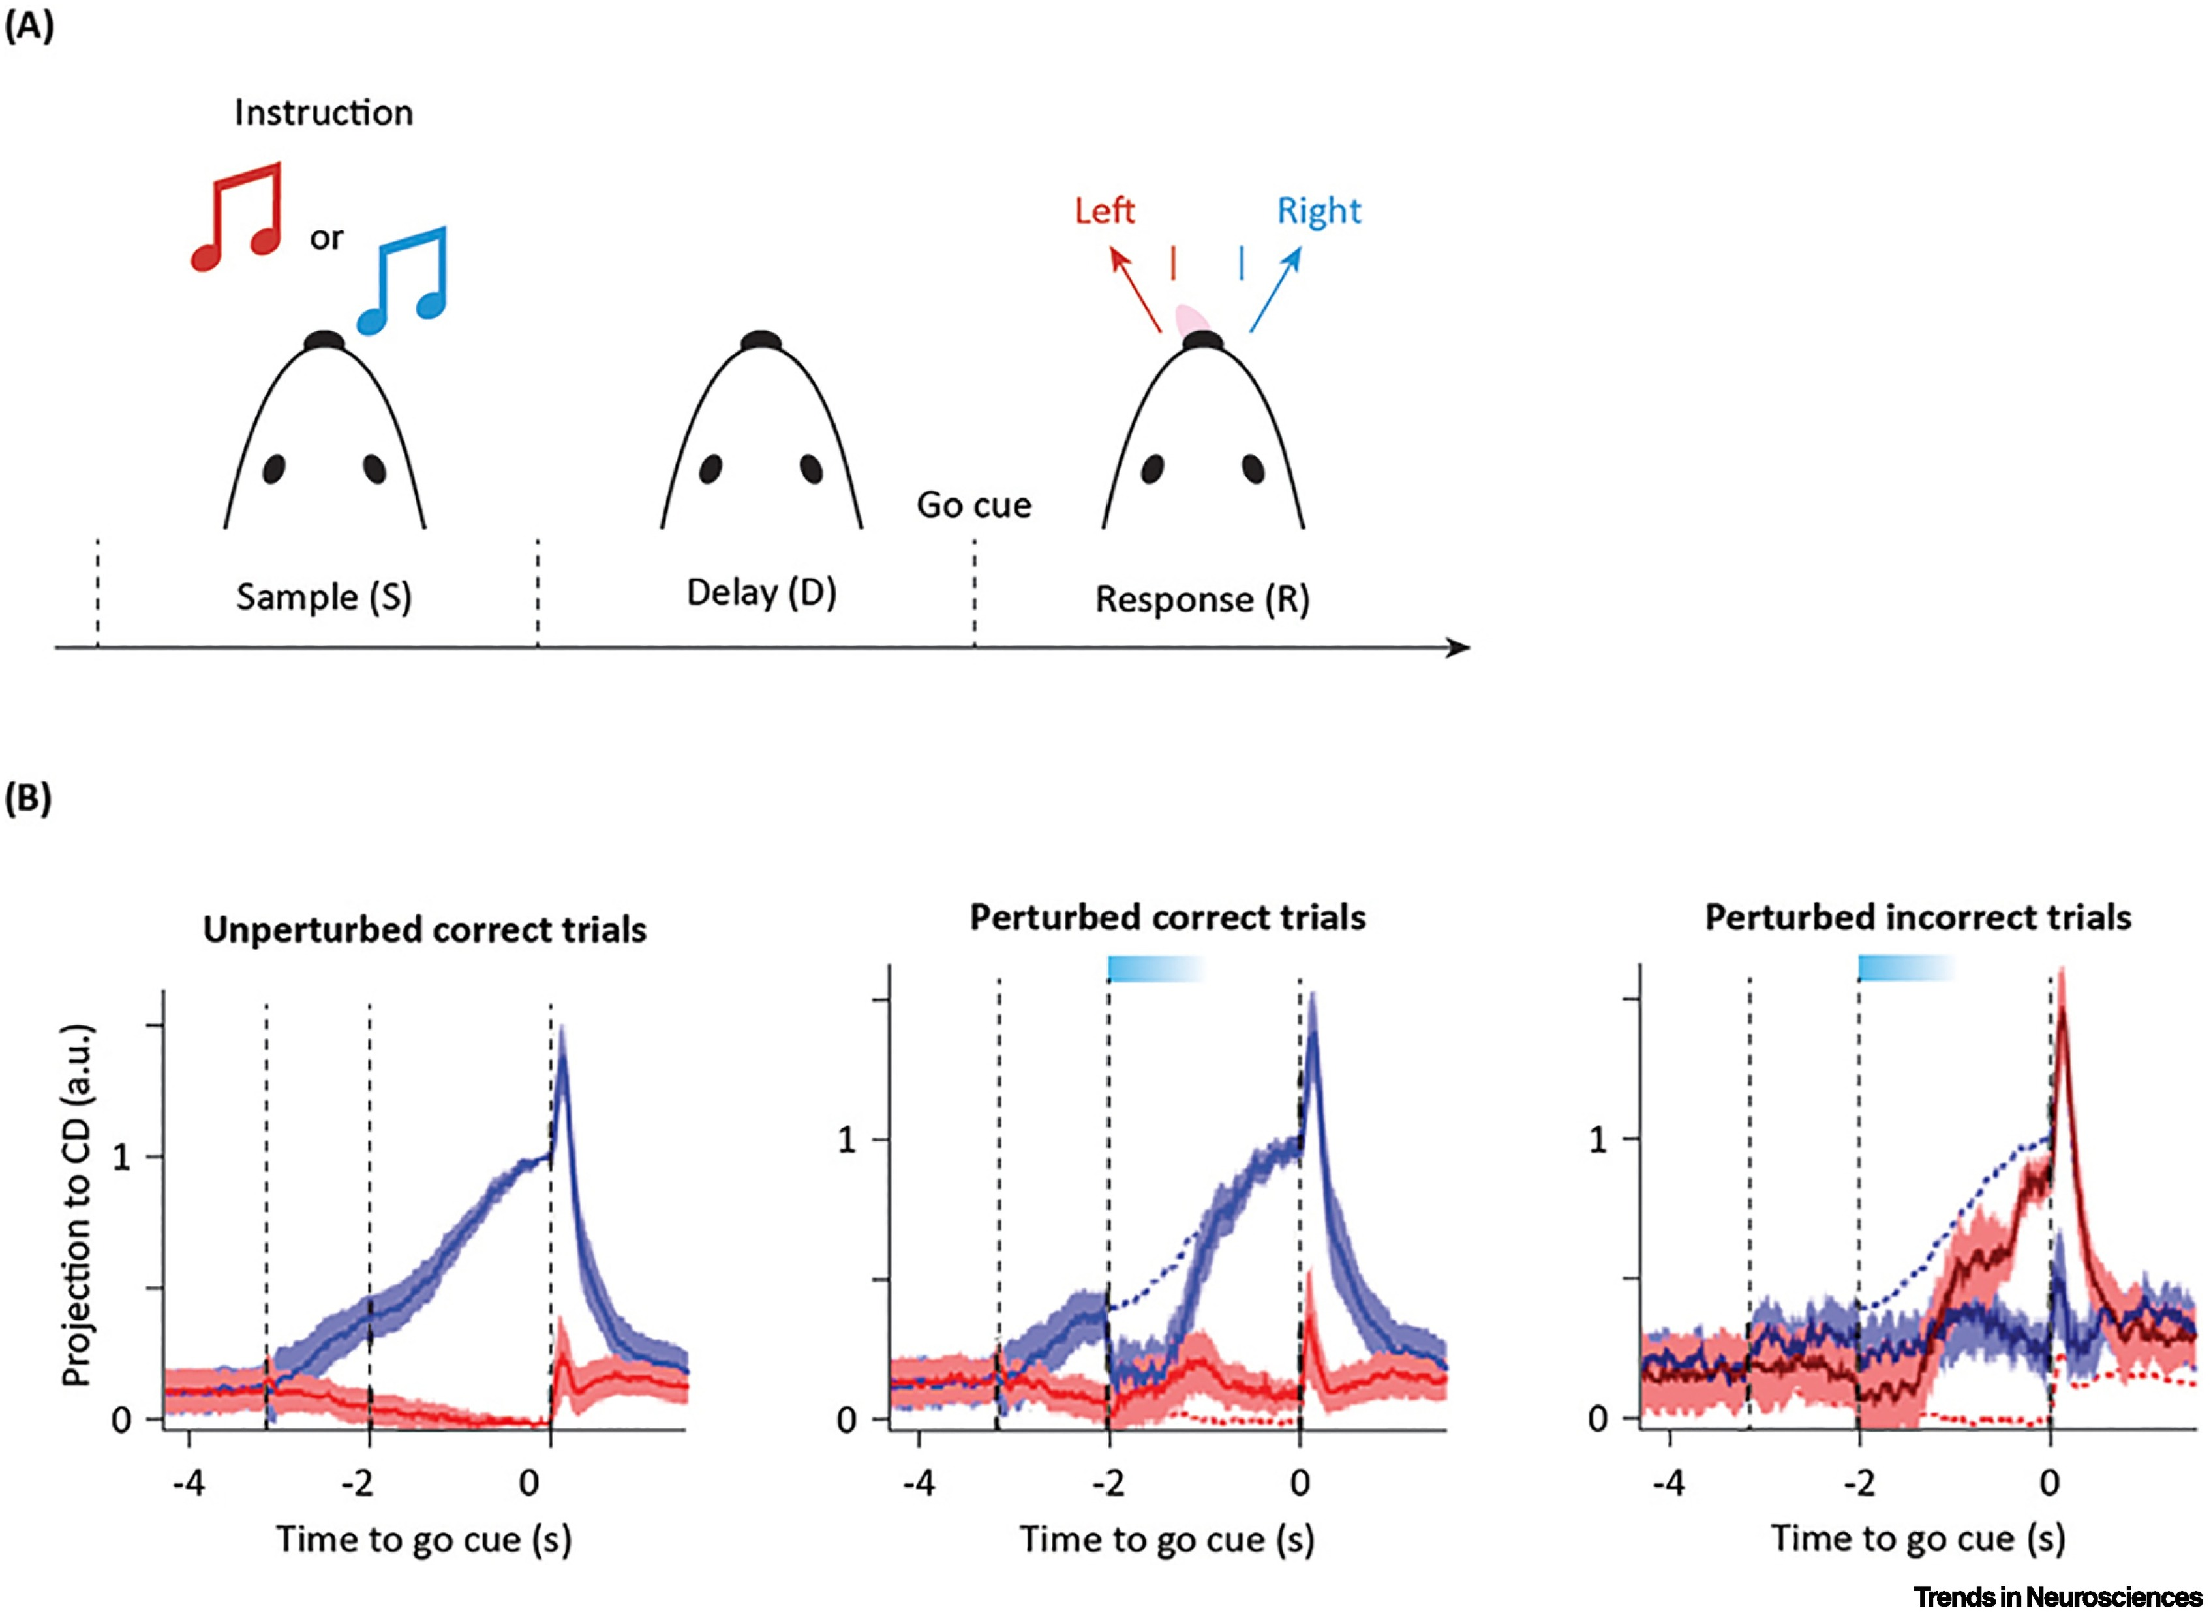
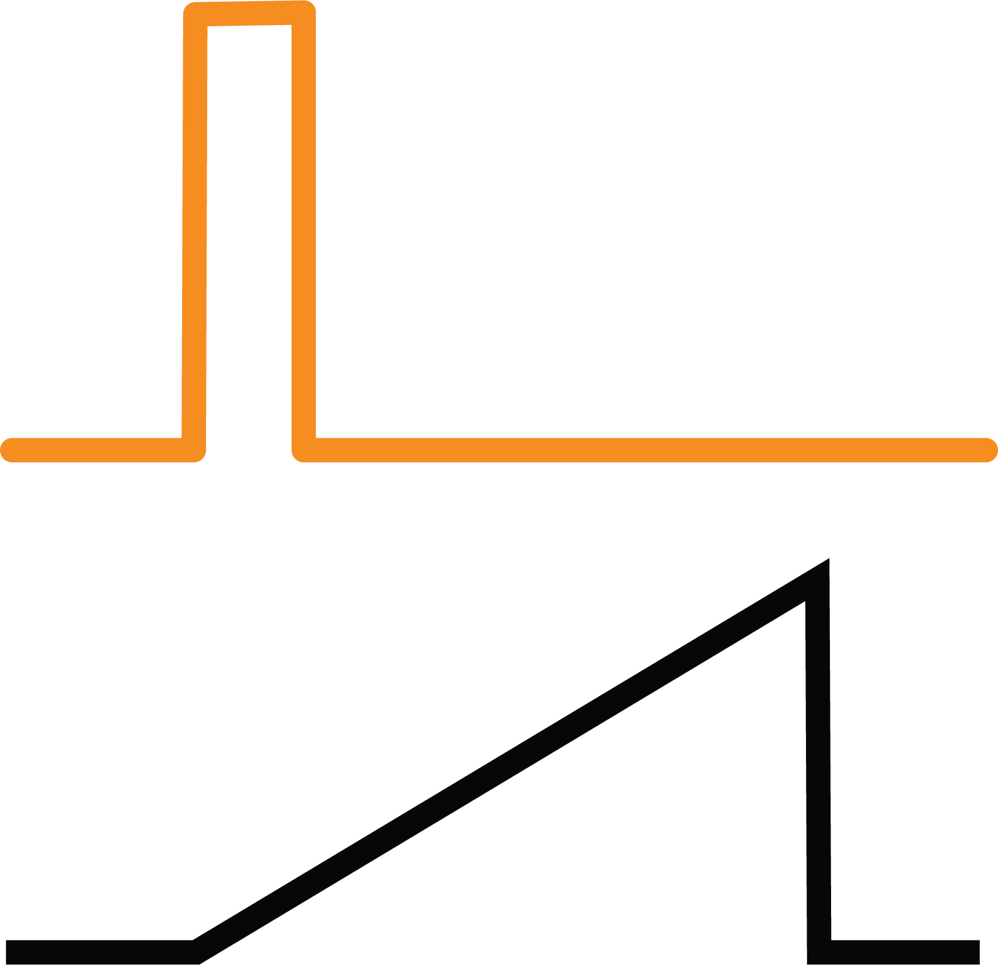

Short-term Memory in rodents: a delayed-response 2AFC
winner-take-all
Population activity
Population Rate r_{R}
I_{L}
I_{R}
Exc. Input I_{ext}
Unspecific excitatory input I_{ext}
Input I_{ext}
Inagaki et al. Nature, 2019

