Slide 1
A circuit model explaining the mechanisms underlying behavior during the multi-choice delayed-response task

Slide 2
Objectives
Develop a population rate model that :
Can be individually fitted to choice behavior in the Multi-choice delayed-response task (MCDR).
Describe neural recordings from frontal cortex in behaving mice.
Incorporate activity-dependent plasticity that captures the adaptability of choice behavior to the statistics of the stimulus.
Describes the impact of choice-ensemble photo-suppression experiments.

Slide 3
Project’s rationale
Over the last years, Balma Serrano (4th year PhD student in the lab) has developed a multi-choice delayed-response new task in mice (MCDR) from which she has gathered a lot of behavioural data. She has performed electrophysiological recordings as well as optogenetic experiments. Moreover, she has performed a lot of statistical analyses finely characterizing different aspects of the behaviour. We are still lacking, however, a more mechanistic model that can reproduce and “explain” some of the results we have observed in the data.
The first goal of this project would be to take existing circuit models of decision making in two-choice tasks [1-2, 4] and adapt them to the three-choice task that we have used with the mice. Moreover, in the MCDR the timing of the stimulus (i.e. onset and offset) relative to the decision time also varies compared with other tasks (slide 7). These different trials conditions create non-trivial dependencies on stimulus and delay durations that have not been explored with previous models but our that we aim to reproduce. We aim to have both a population rate description of the network model (slides 8 and 12) as well as a low dimensional description (Refs. 2-4; slide 15) that could allow us to obtain analytical approximations for the probabilities of making the various choices as a function of the model parameters. We would then use Bayesian methods to fit the model parameters to the individual data of each mouse [7]. With these fits, we will then aim to compare the dynamics of the population rates in the model with the ephys recordings in ALM from mice performing the task.
Having developed a model that can capture the choice probabilities for the different trial conditions (e.g. visually guided, no-stimulus conditions, etc), we would turn into investigating which parameters of the model, can most effectively capture the idiosyncratic choice biases of each mouse. This will be the first step to understand how to introduce activity-dependent plasticity mechanisms that can explain the adaptability of these choice probabilities to the statistics of the stimuli (slide 14; Ref [6]). We have carried out extensive experiments in which the distribution of stimuli has changed in blocks of trials and have observed that mice adapt their choice probabilities to those stimulus statistics. A fine statistical (i.e. not mechanistic) characterization of these plastic changes, has been Javier’s project in the lab in the last four months. During his TFM, we would attempt to propose a mechanistic plasticity rule, that incorporated into the circuit model developed above, can capture the adaptability observed in the mice.
Finally, if time permits, we could also model the optogenetic experiments Balma conducted in which she inhibited “choice engrams” during selected trials (i.e. population of neurons selective to a specific choice).

Slide 4
Bibliography
Modeling decision making: Wong & Wang 2006
Normal form for 2AFC task model: Roxin & Ledberg Plos Comp Bio 2008
Reduction of an N-choice task: Roxin J. Math Neuroscience 2019
Fitting 2AFC attractor model: Prat-Ortega et al Nature Comms 2021
Mice experiments in 2DRT and attractor model: Inagaki et al Nature 2019
Plasticity in delayed response task: Eissa & Kilpatrick. Plos Comp Bio 2023
Fitting double-well model: Ona-Jodar et al BioRxiv 2024.

Slide 5
Multi-choice delayed-response task in mice

Slide 6
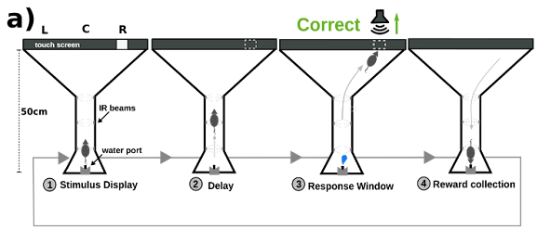

Slide 7
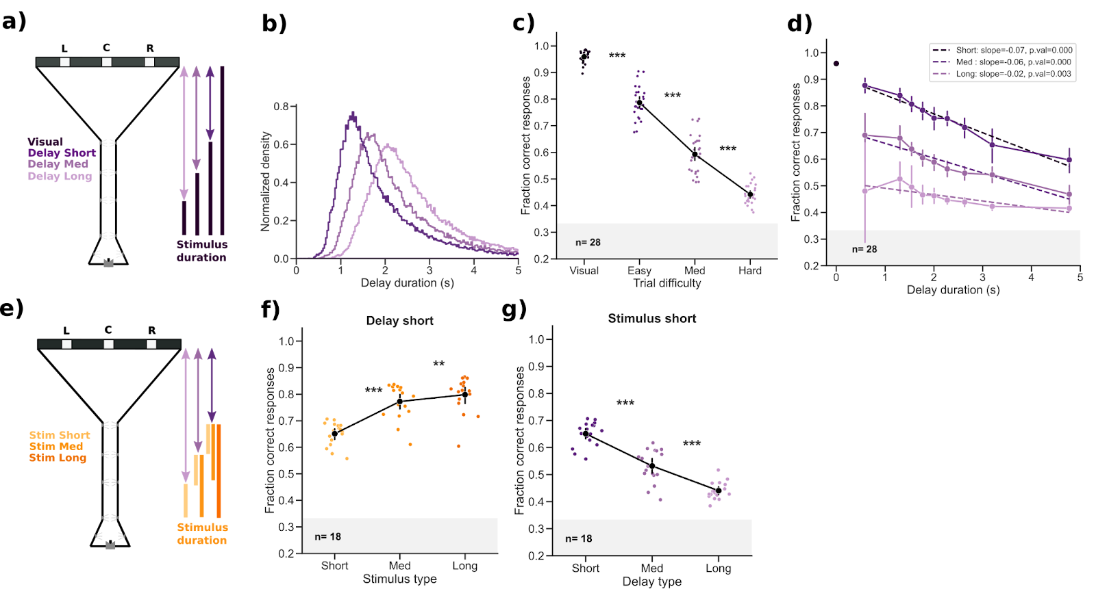

Slide 8
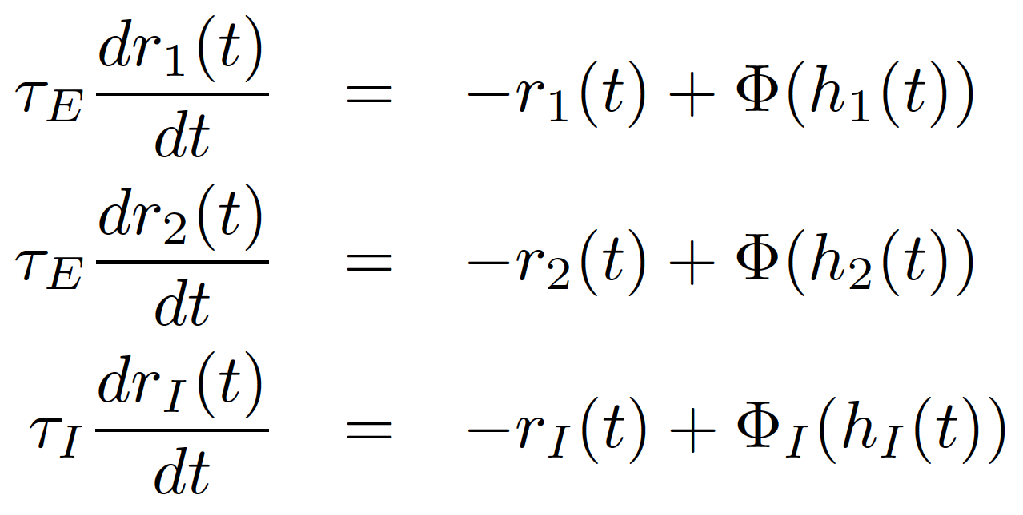
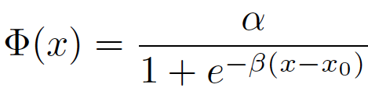
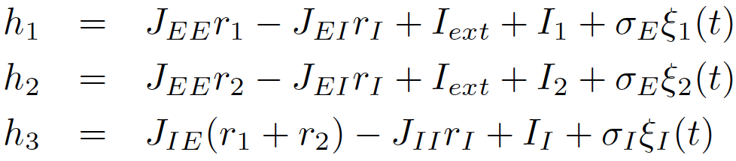
Model for two-alternative choice task

Slide 9
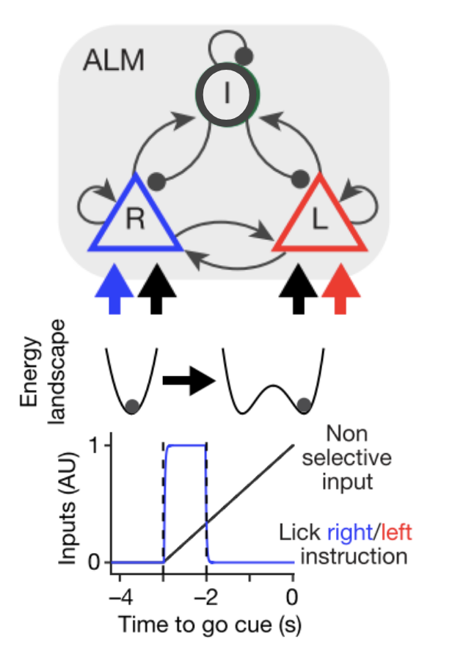
Inagaki et al 2019

Slide 10
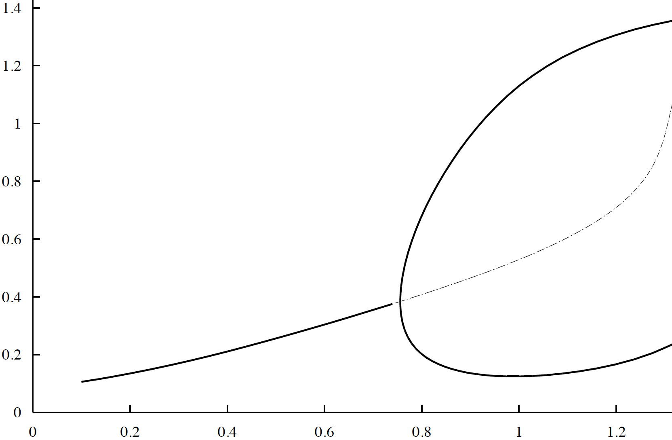
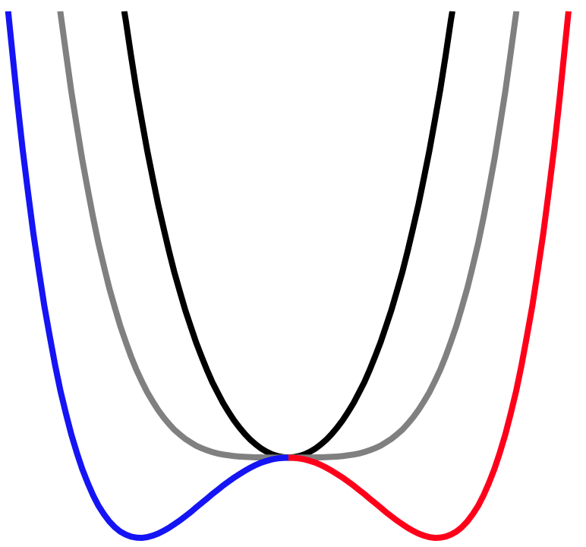
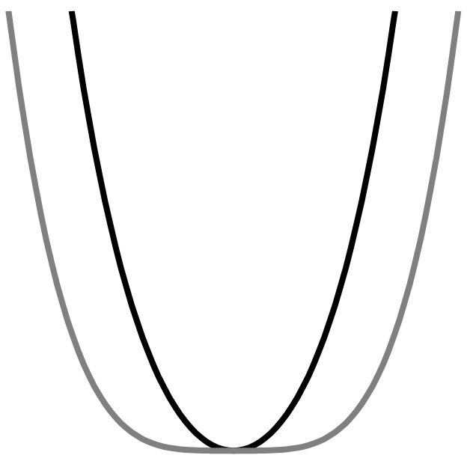

Model stability analysis
Winner Take all regimen
Steady Decision Rates
Internal decision input
External Input I_{ext}
Δr = X
Wong & Wang ‘06; Wong et al ‘07; Roxin & Ledberg ’08; Prat-Ortega et al 2021

Slide 11
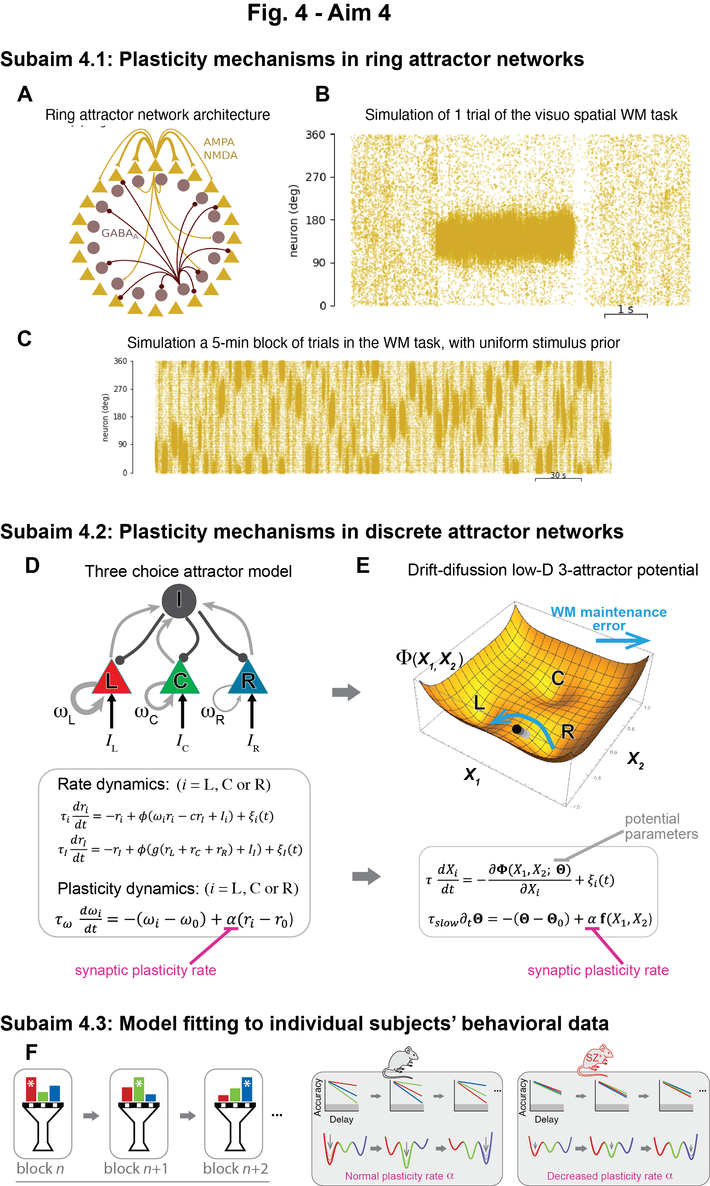
S(t)
U(t)
Internal Decision Input U(t)
External Stimulus Input S(t)

Slide 12
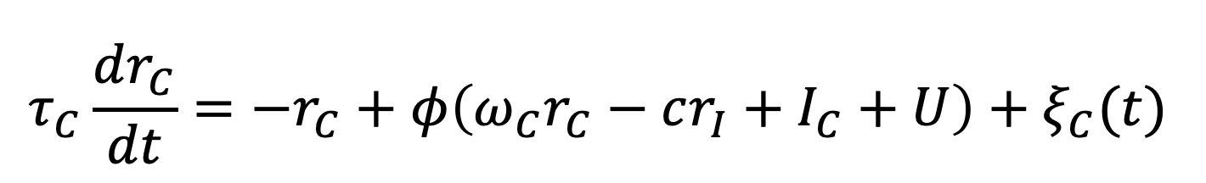
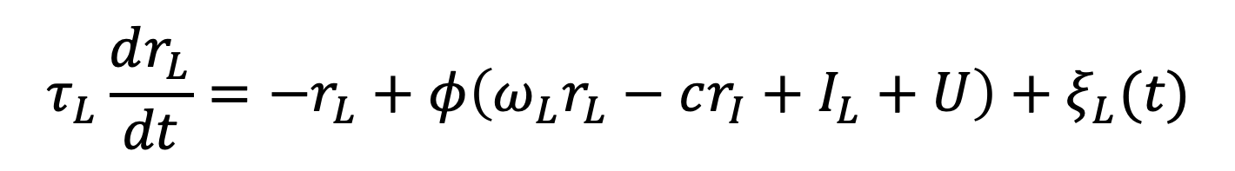
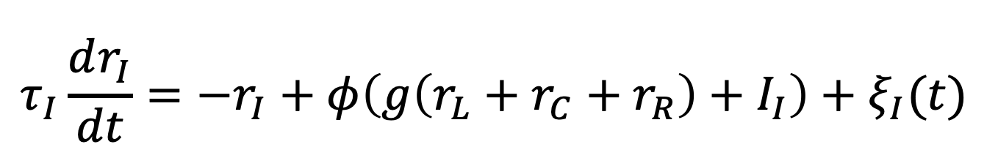
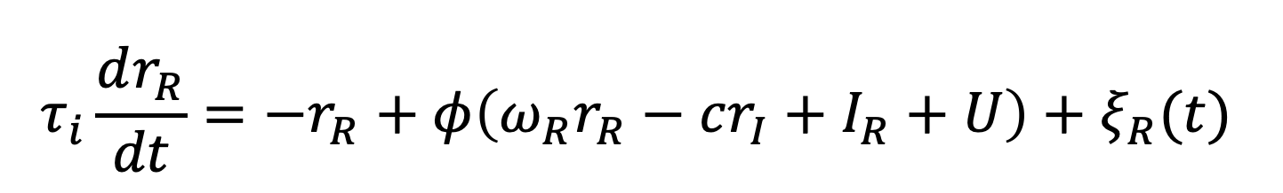
Model equations three-choice task
$$τ_{L}\frac{dr_{L}}{dt}=−r_{L}+φ\left(ω_{L}r_{L}−cr_{I}+I_{L}+U\right)+ξ_{L}(t)$$
$$τ_{C}\frac{dr_{C}}{dt}=−r_{C}+φ\left(ω_{C}r_{C}−cr_{I}+I_{C}+U\right)+ξ_{C}(t)$$
$$τ_{i}\frac{dr_{R}}{dt}=−r_{R}+φ\left(ω_{R}r_{R}−cr_{I}+I_{R}+U\right)+ξ_{R}(t)$$
$$τ_{I}\frac{dr_{I}}{dt}=−r_{I}+φ\left(g\left(r_{L}+r_{C}+r_{R}\right)+I_{I}\right)+ξ_{I}(t)$$

Slide 13
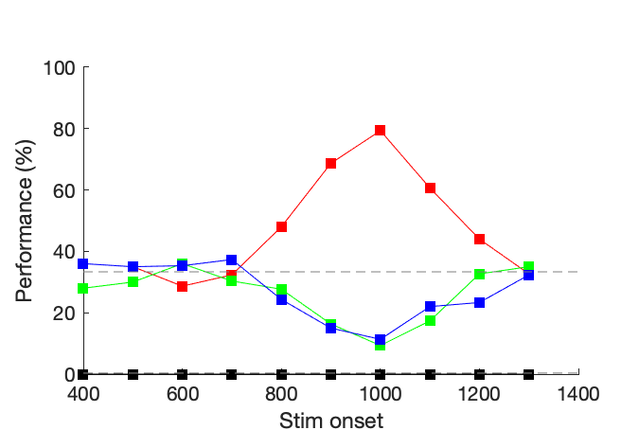
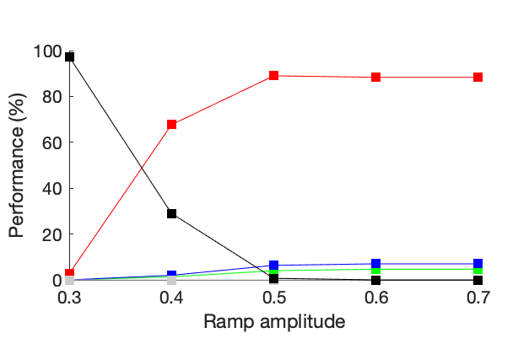
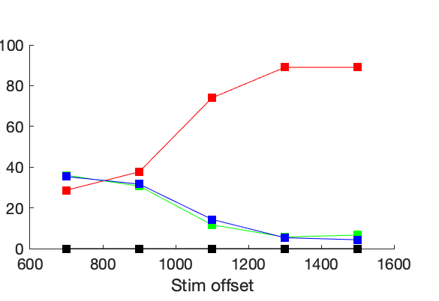
Varying U-amplitude, stim. offset and stim. onset
(prerliminary results simulating the model)
Stim. Onset = 500 ms
Stim. Offset = Stim. Onset + 200 ms
no choice
L choices
C choices
R choices

Slide 15
Synaptic plasticity can explain choice adaptability

