Slide 1
R for Ecology
Javiera rudolph

Slide 2
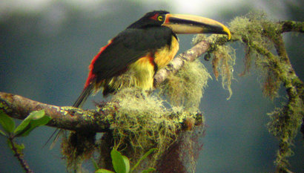

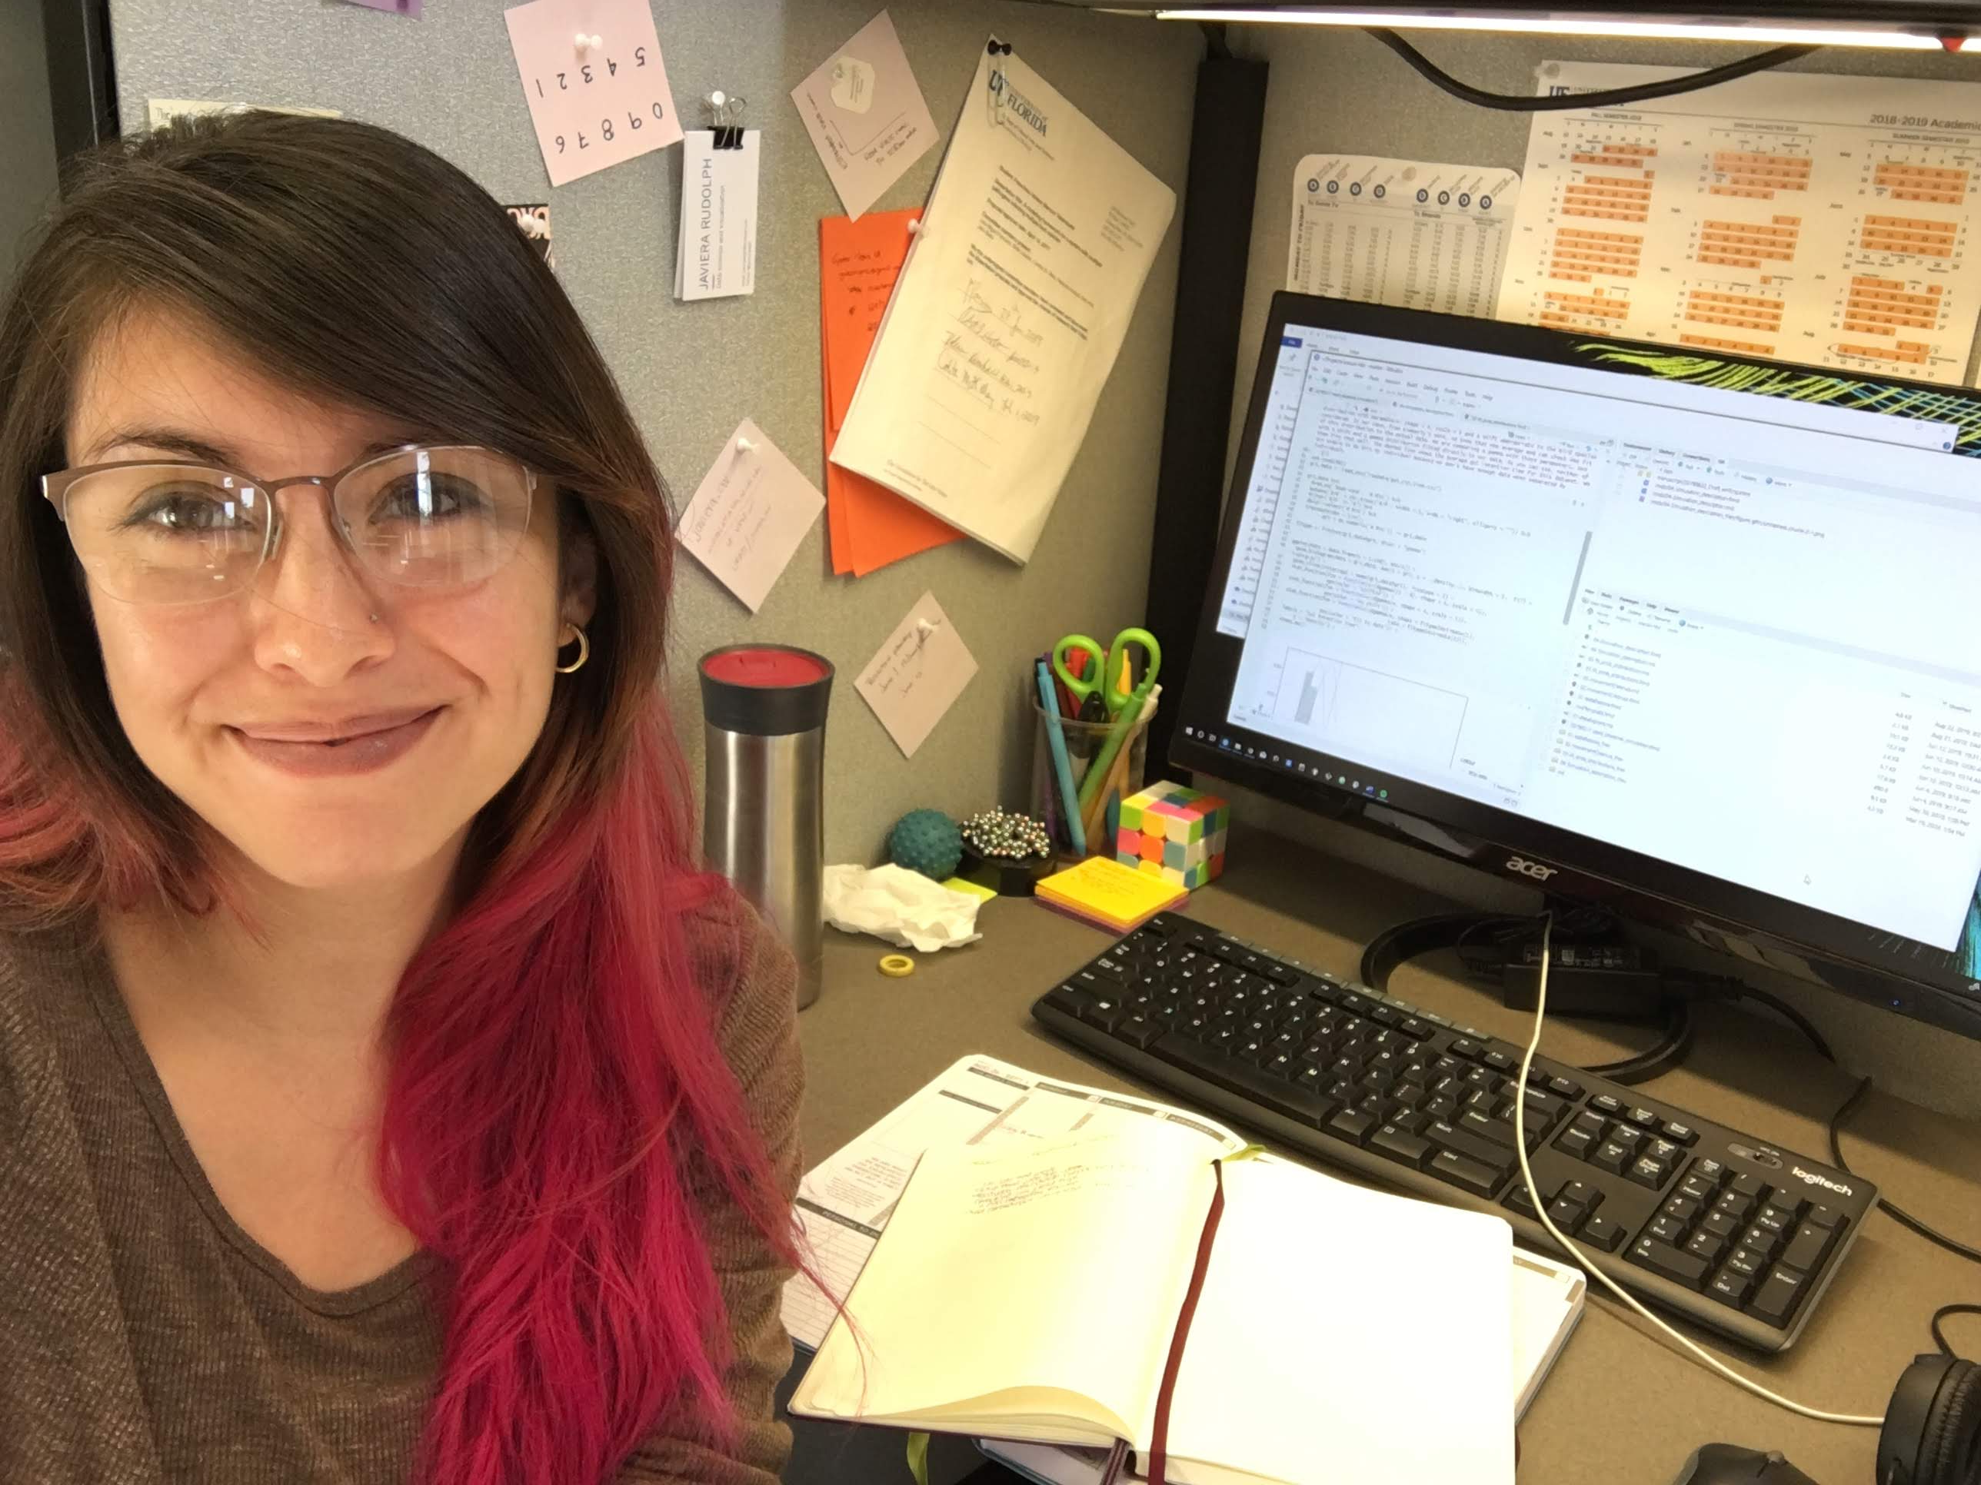
Who am I?
Grad student and quant ecologist
I work with dispersal – simulations
RLadies coorganizer
This Photo by Unknown Author is licensed under CC BY-NC

Slide 3
What is R?
Resource link: https://www.r-project.org/about.html
Notes:
Think combination of Microsoft tools
Statistical software: spss, sas, matlab
Visualization tool: publication quality figures
Show examples online: https://github.com/javirudolph/aracari-ldd/blob/master/rmds/01-dataExplora.md

Slide 4
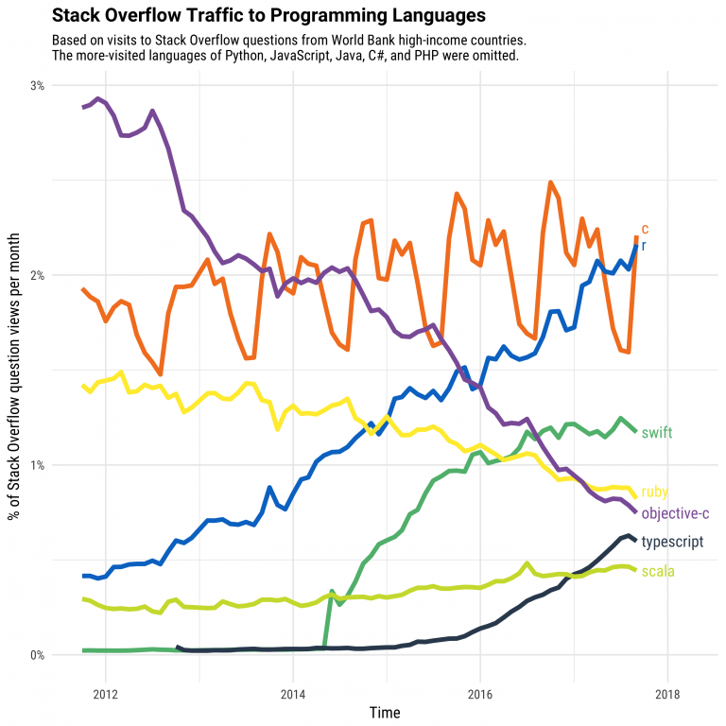
Why learn R?
Growth https://stackoverflow.blog/2017/10/10/impressive-growth-r/
Reproducibility
Keeping up with the field
Communicate with others
Notes:
Emphasize the communication part. You may not become a quantitative ecologist, but it is always helpful to know how to communicate with one.
Also, click the link on the website to show the other figures that show academic as being a big area.

Slide 5
What is r studio?
Notes:
Here, go to demo. Show the different panes.

Slide 6
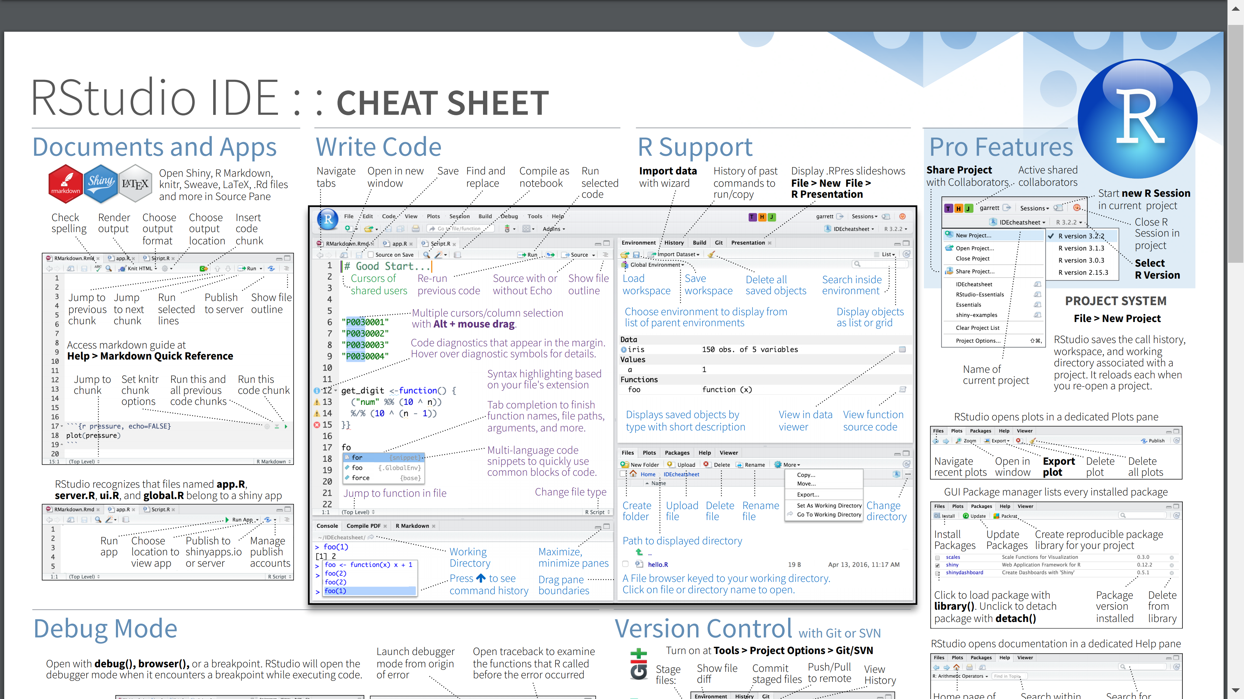

Slide 7
Scalars, vectors, matrices and lists
Scalars: a single number
Vector: a row of numbers
Matrix: two-dimensional array of numbers
Data frame: like a matrix but with names at the top of columns
Lists: a collection of vectors, matrices or dataframes
lists

Slide 8
Useful concepts
What is a script?
Any file that has the extension .R
What is a directory?
A location in your computer’s system of files
What is the working directory?
The folder in your computer where you are currently working and where files will be saved and accessed from.
How do you set your working directory?
Session > Set working directory > choose directory
What is a library? What is a package?
A package is the bundle of functions you can install. You load these packages using the library() function.

Slide 9
Resources:
https://datacarpentry.org/R-ecology-lesson/index.html
https://cran.r-project.org/doc/contrib/Torfs+Brauer-Short-R-Intro.pdf
https://www.rstudio.com/resources/cheatsheets/
https://resources.rstudio.com/webinars
https://datacarpentry.org/
https://stackoverflow.com/questions
https://www.r-bloggers.com/
https://training.it.ufl.edu/linkedin/ UF courses to learn R

