Slide 1
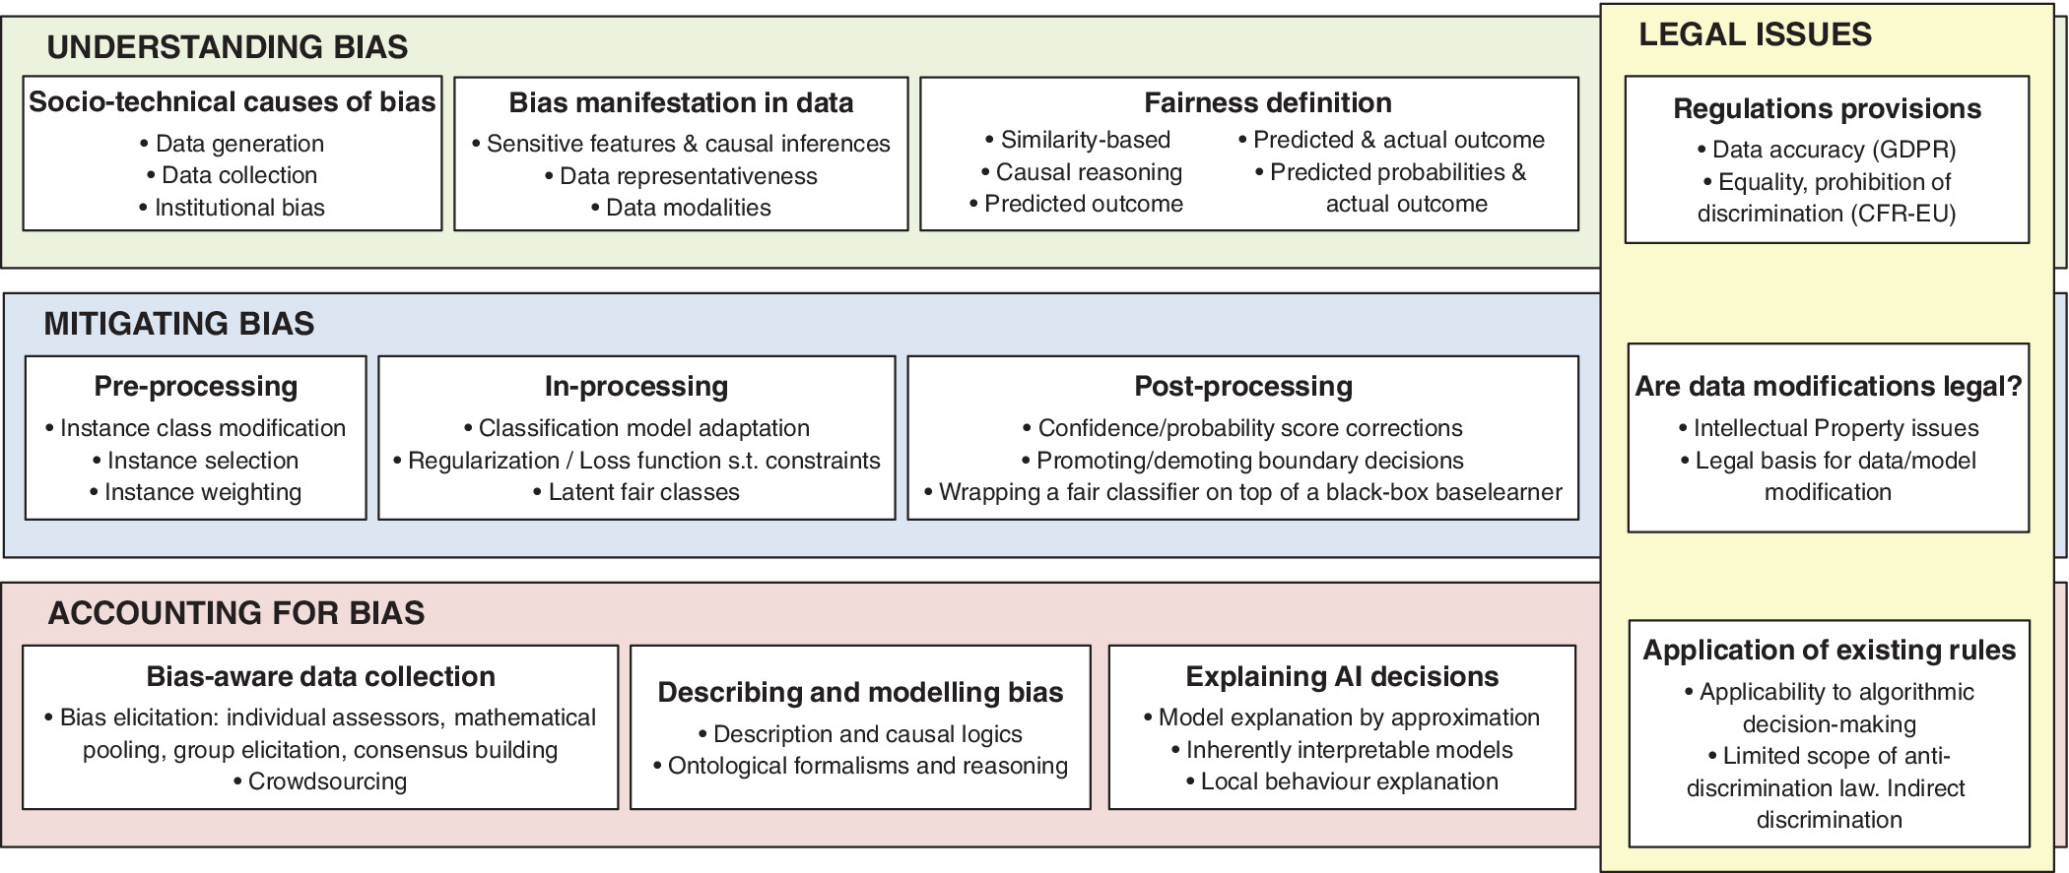
Bias in data‐driven artificial intelligence systems—An introductory survey
WIREs Data Min & Knowl, Volume: 10, Issue: 3, First published: 03 February 2020, DOI: (10.1002/widm.1356)
Notes:
Overview of topics discussed in this survey
IF THIS IMAGE HAS BEEN PROVIDED BY OR IS OWNED BY A THIRD PARTY, AS INDICATED IN THE CAPTION LINE, THEN FURTHER PERMISSION MAY BE NEEDED BEFORE ANY FURTHER USE. PLEASE CONTACT WILEY'S PERMISSIONS DEPARTMENT ON PERMISSIONS@WILEY.COM OR USE THE RIGHTSLINK SERVICE BY CLICKING ON THE 'REQUEST PERMISSIONS' LINK ACCOMPANYING THIS ARTICLE. WILEY OR AUTHOR OWNED IMAGES MAY BE USED FOR NON-COMMERCIAL PURPOSES, SUBJECT TO PROPER CITATION OF THE ARTICLE, AUTHOR, AND PUBLISHER.

