Slide 1
DevSecOps
First steps

Slide 2
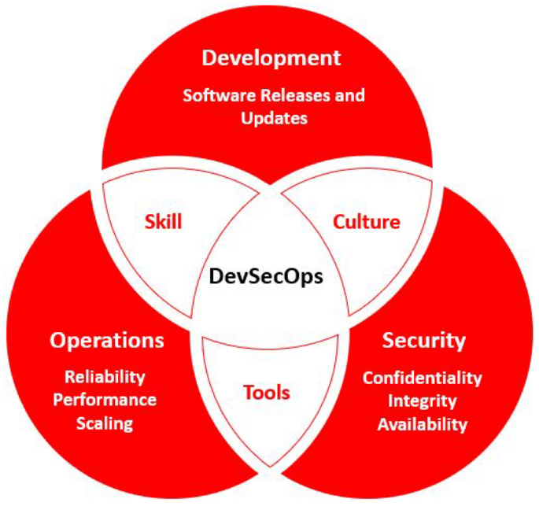
What is DevSecOps?
Integral, secure-by-default approach to DevOps (specially Continuous Delivery).
Everybody is responsible for security (cross skilling).
Security as code
No “one-size-fits-all” solution.

Slide 3
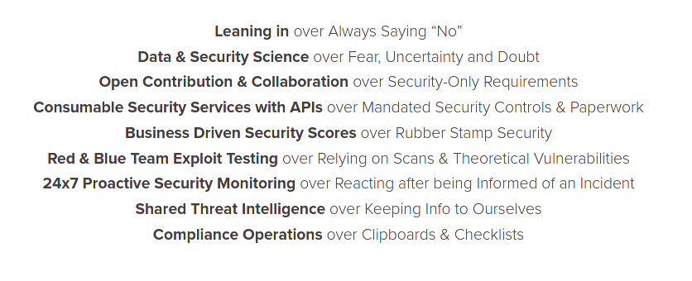
DevSecOps vs. traditional “Sec”
DevSecOps Manifesto ^{[1]}

Slide 4


Why DevSecOps?
Without DevSecOps
CI/CD
Develop
Build
Automated
Tests
Deploy
v1.0
Security
Audit
Several User Stories that look bad on the backlog and breaks momentum of development.
Report for v1.0
50 Critical issues
300 High issues
1200 Medium issues

Slide 5
Why DevSecOps?
With DevSecOps
CI/CD
Develop
Code
Analysis
Build
Automated
Tests
Dynamic
Analysis
Deploy
Infrastr.
Tests
v1.0
Report for v1.0
Easy to fix,
probably already
addressed.
Security
Audit
12 Medium issues
Shifting left saves cost and time in the long run.
(No longer a
bottleneck)

Slide 6
How?
Pre-commit hooks
Penetration tests
CI/CD
Develop
Code
Analysis
Build
Automated
Tests
Dynamic
Analysis
Deploy
Infrastr.
Tests
Static code analysis
Vulnerability assessment
Dependency analysis
Alerting & Monitoring

Slide 7
Pre-commit hooks
Prevent leak of credentials into git history.
Can be installed on each developer’s PC.
Developers may choose not to use them, but they spot issues early:
  Linters
  Code scanners
  Scripts/snippets to filter sensitive data.

Slide 8



Secrets Management
Never store credentials on SCM!
Create separate set of credentials for each stage.
Prefer tokens to passwords or keys.

Slide 9
Static code analysis
Automated white-box code scanners.
Avoid regressions and common/known mistakes (SQLi, XSS, insecure functions, …).
Always configure them to suit your project: default configurations give a lot of false positives.

Slide 10
Dependency Analysis
a.k.a Software Composition Analysis
Most of the software consists on 3rd party components.
… and repositories (pip, npm, gradle, apt, …)
They can also be vulnerable.

Slide 11
Dynamic Analysis
Black-box pentesting with automated tools.
Code analyzers cannot catch runtime errors.
Combine with Code analyzers to narrow down issues.

Slide 12
Infrastructure Tests
Infrastructure as Code (IaC) keeps the infra documented and under version control.
Automated Vulnerability scanners to assess issues on running infra.
Alerts & Monitoring to spot anomalies early.
Monitors (dashboards) should concentrate the report of the other tools of the pipeline.

Slide 13
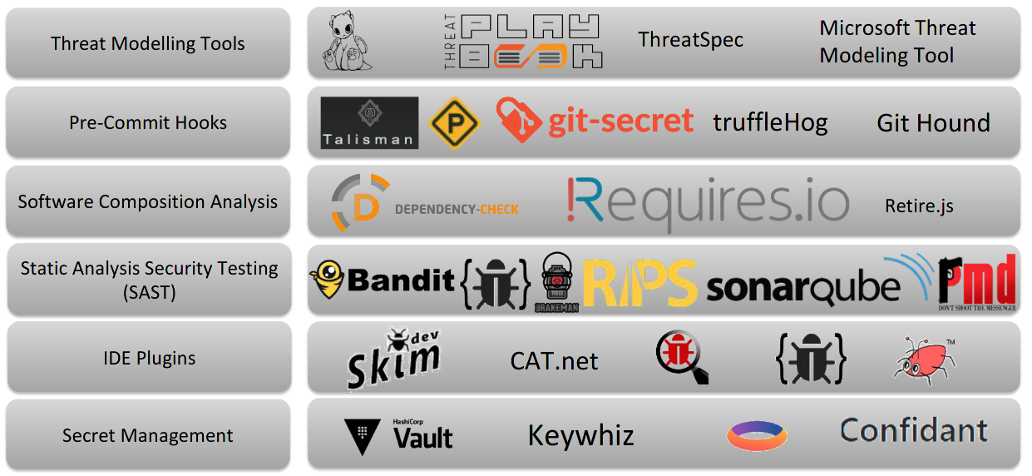
Tools

Slide 14
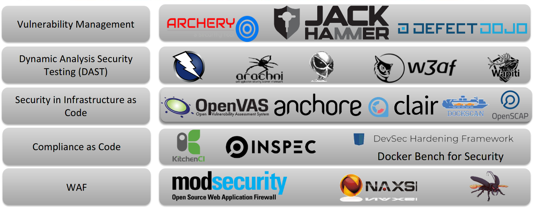
Tools

Slide 15
Culture changes
Encourage security mindset:
  Cultivate/identify common goals.
  Designate “security champions” in teams.
    Bridge between Dev, Sec,and Ops Teams
Focus on collaboration, not on finger-pointing.
  Provide similar cross-skilling opportunities.

Slide 16
Culture changes
How to get the skills?
  Bug bounties
  Events:
    Capture the Flag
    Hack the Box
    Wargames (e.g. OverTheWire ^{[2]})
  Drills: exercise the worst probable scenario.
    On a schedule
    Without notice (more fun).

Slide 17
References
[1] https://www.devsecops.org/
[2] https://overthewire.org/wargames/
https://www.blackhat.com/us-19/briefings/schedule/#devsecops--what-why-and-how-17058

