Slide 1
FOROCOCHES
Penguins
Dancing
Dramatically
Late
PDDL Edition

Slide 2
FAST-DOWNWARD
(rápido y pa’ abajo)

Slide 3
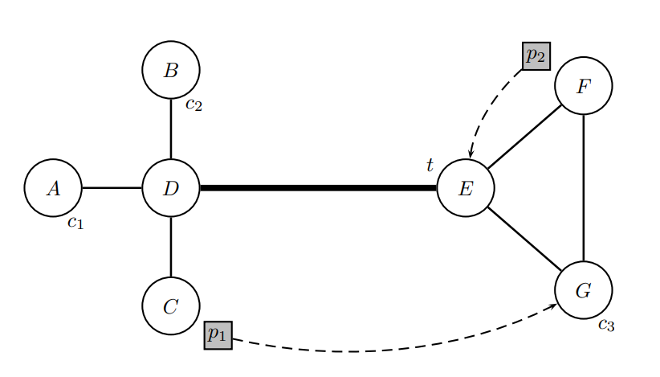
Paquete de C hacia G

Slide 4
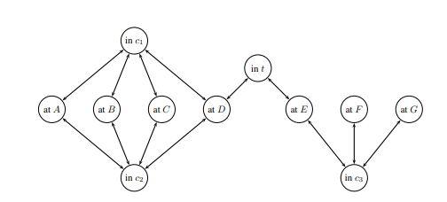
Domain Transition Graph

Slide 5
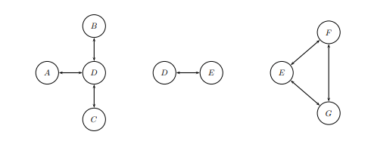
Domain Transition Graph
Domain T-Specific Graph

Slide 6
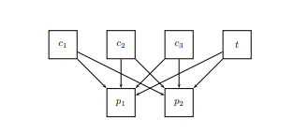
Domain Transition Graph
Domain T-Specific Graph
Causal Graph

Slide 7
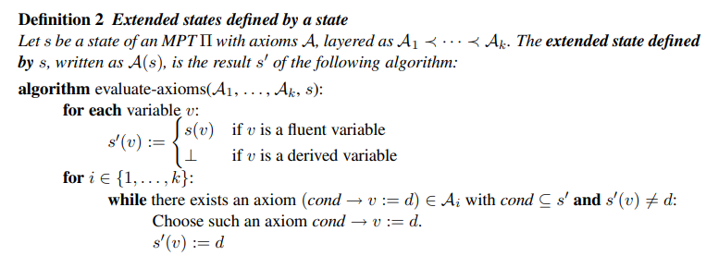
Domain Transition Graph
Multivalued States
Domain T-Specific Graph
Causal Graph

Slide 8
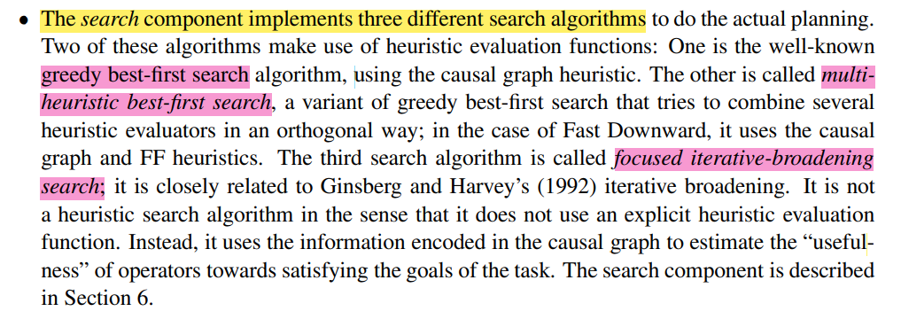
Domain Transition Graph
Multivalued States
Domain T-Specific Graph
3-Algorithms
Causal Graph

Slide 9
MOVIDAS CHUNGAS
(Que nos vamos a saltar)

Slide 11
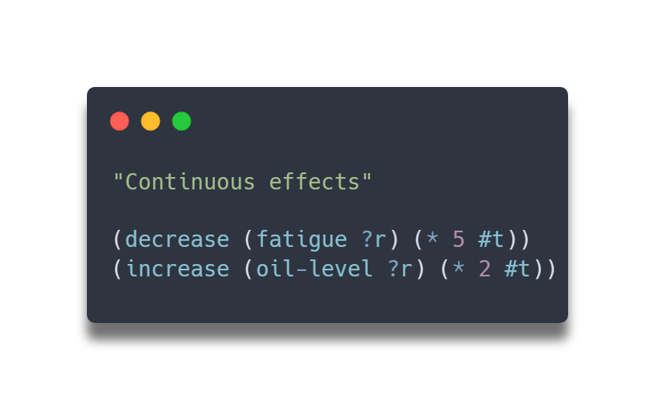
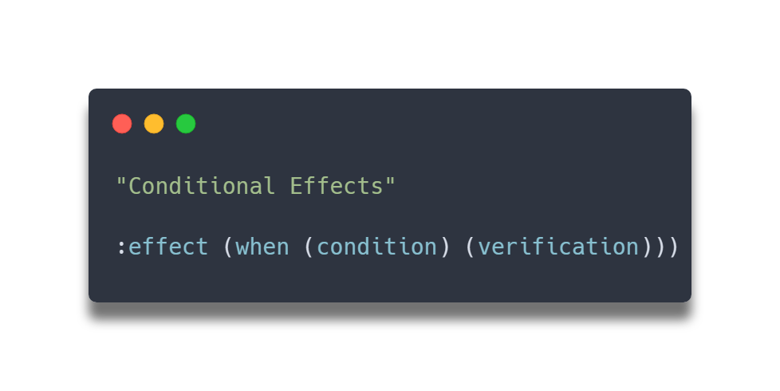

Slide 12
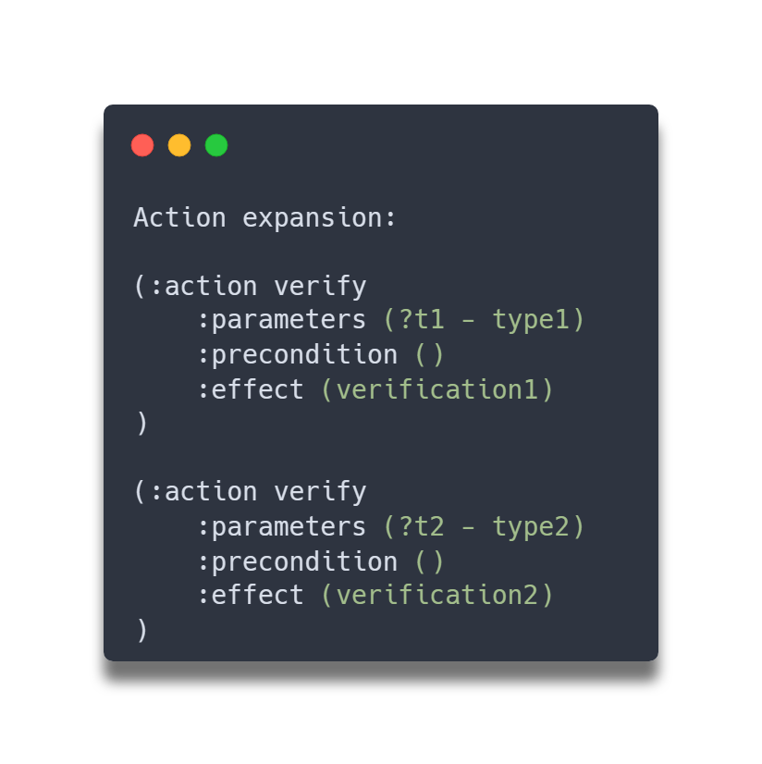
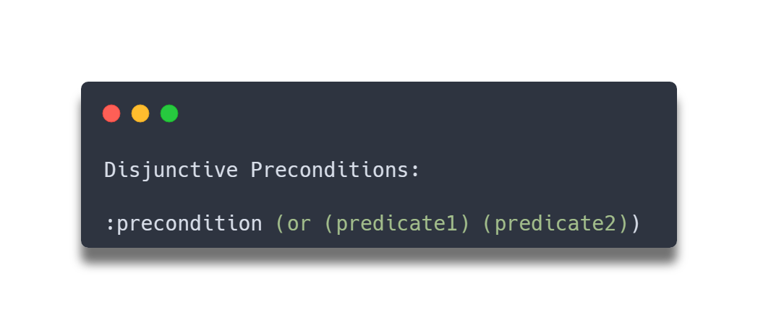
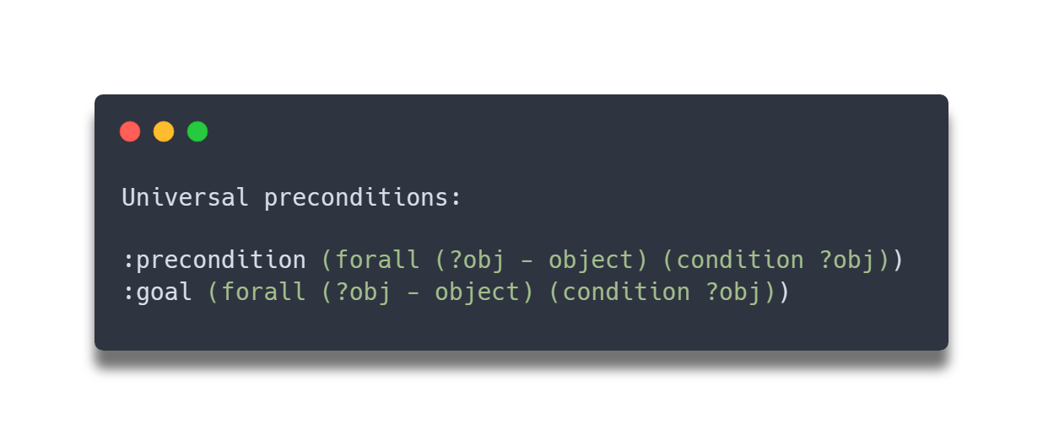
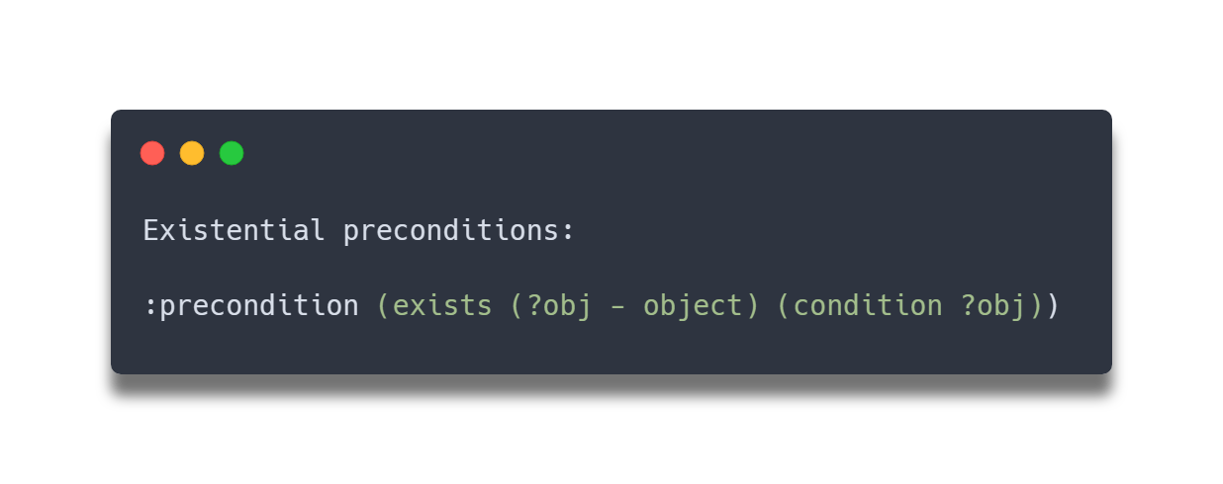

Slide 13
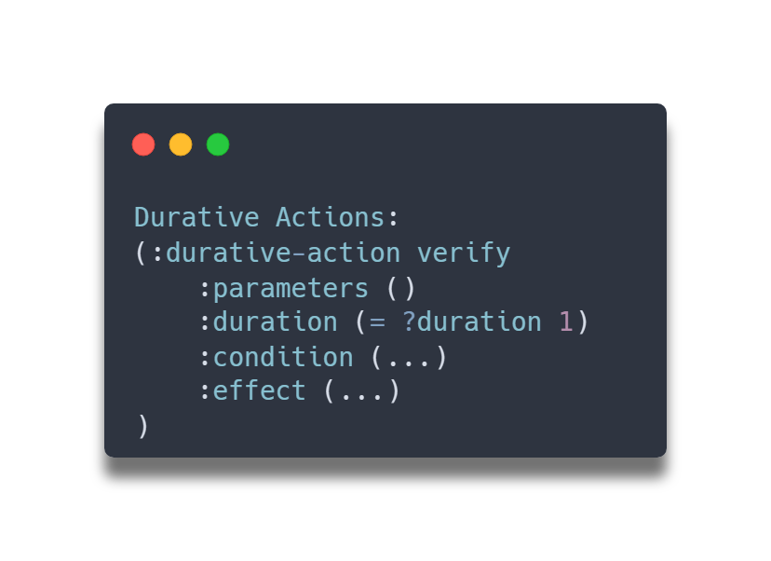
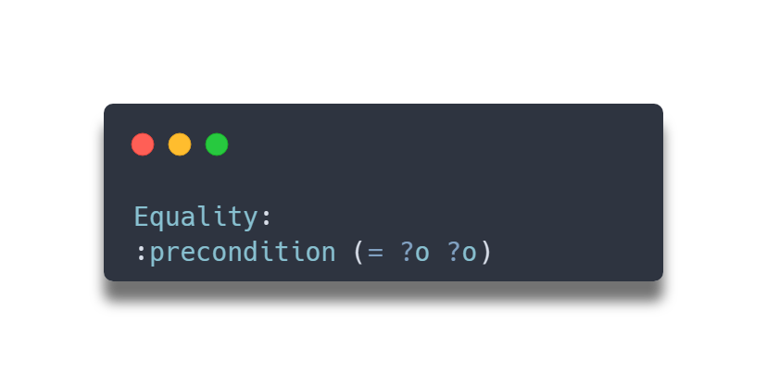
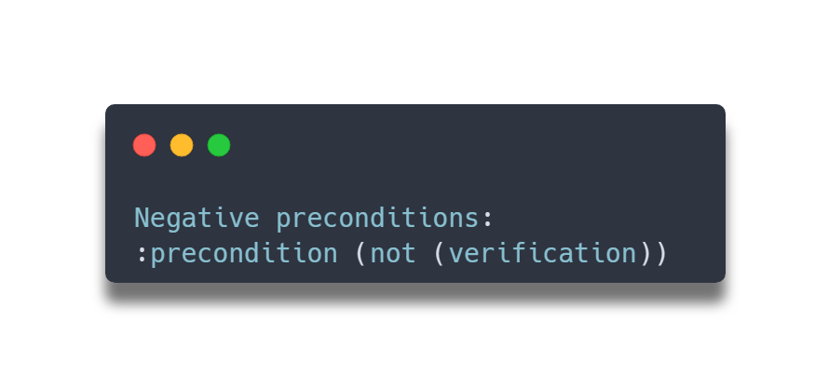

Slide 14
