Slide 1
Labor Force Exits of SLE Patients

Slide 2
Objectives
Study characteristics of workers in the various end states
2) Identify risk factors of workers leaving the labor force
3) Flag high risk patients for early prediction

Slide 3
Objectives
Study characteristics of workers in the various end states
- Descriptive and summary statistics
2) Identify risk factors of workers leaving the labor force
- Competing risk analysis
3) Flag high risk patients for early prediction
- Recurring Neural Network

Slide 4
Characteristics of workers in the various exit routes

Slide 5
Sample
1,051 initially employed people SLE patients
Classified their final employment into end states:
End State | Disability Benefit | Early Retirement | Economically Inactive | Employed | Unemployed | Employed (Died)
N (% of Cohort) | 129 (12.6%) | 27 (2.6%) | 35 (3.4%) | 762 (74.3%) | 45 (4.4%) | 27 (2.6%)
*Employed (Died) includes all deaths that occurred while the patient was employed.
There were only seven deaths of employed people caused by SLE and it was only the primary cause of death in four of them

Slide 6
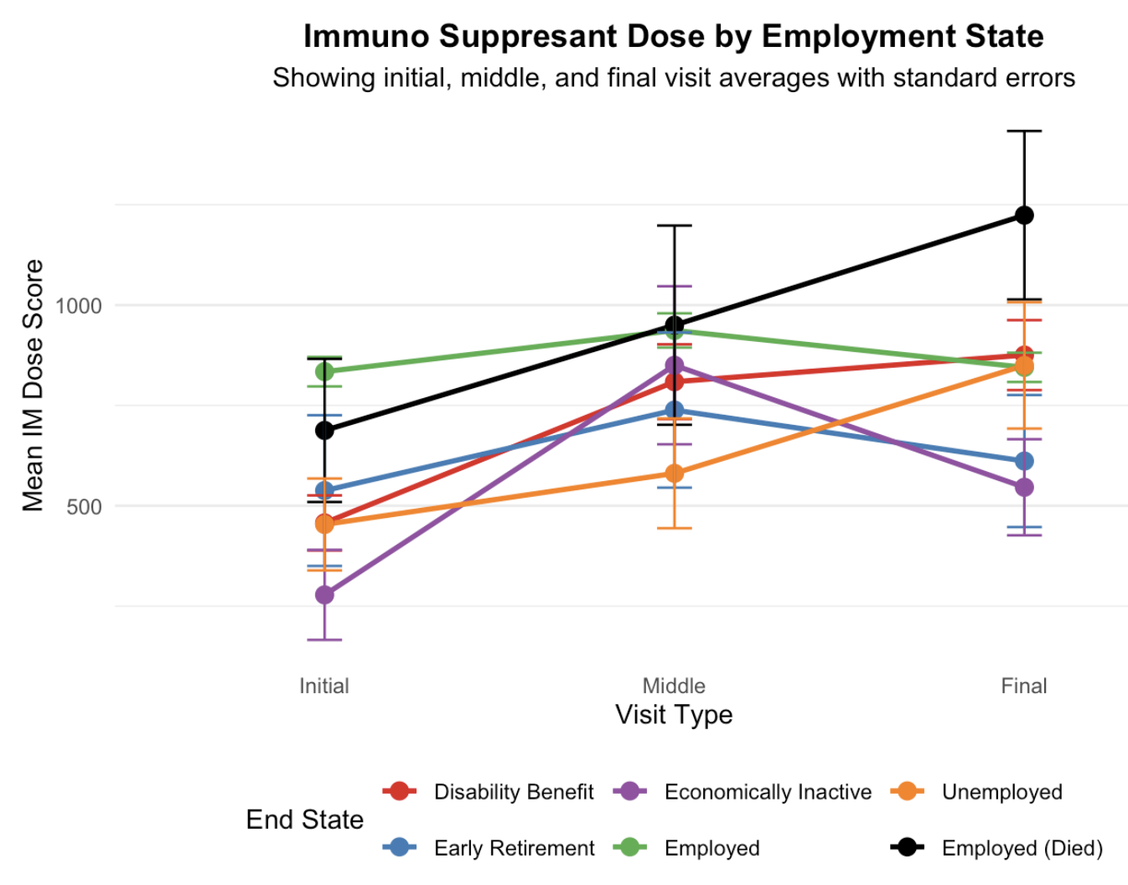
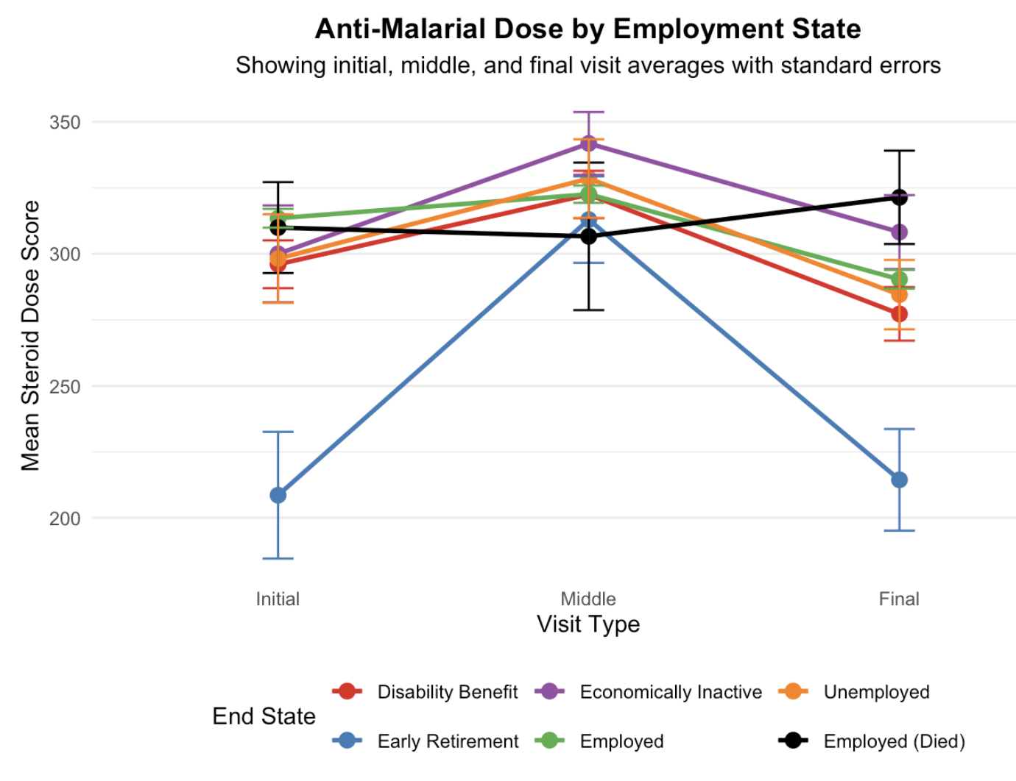
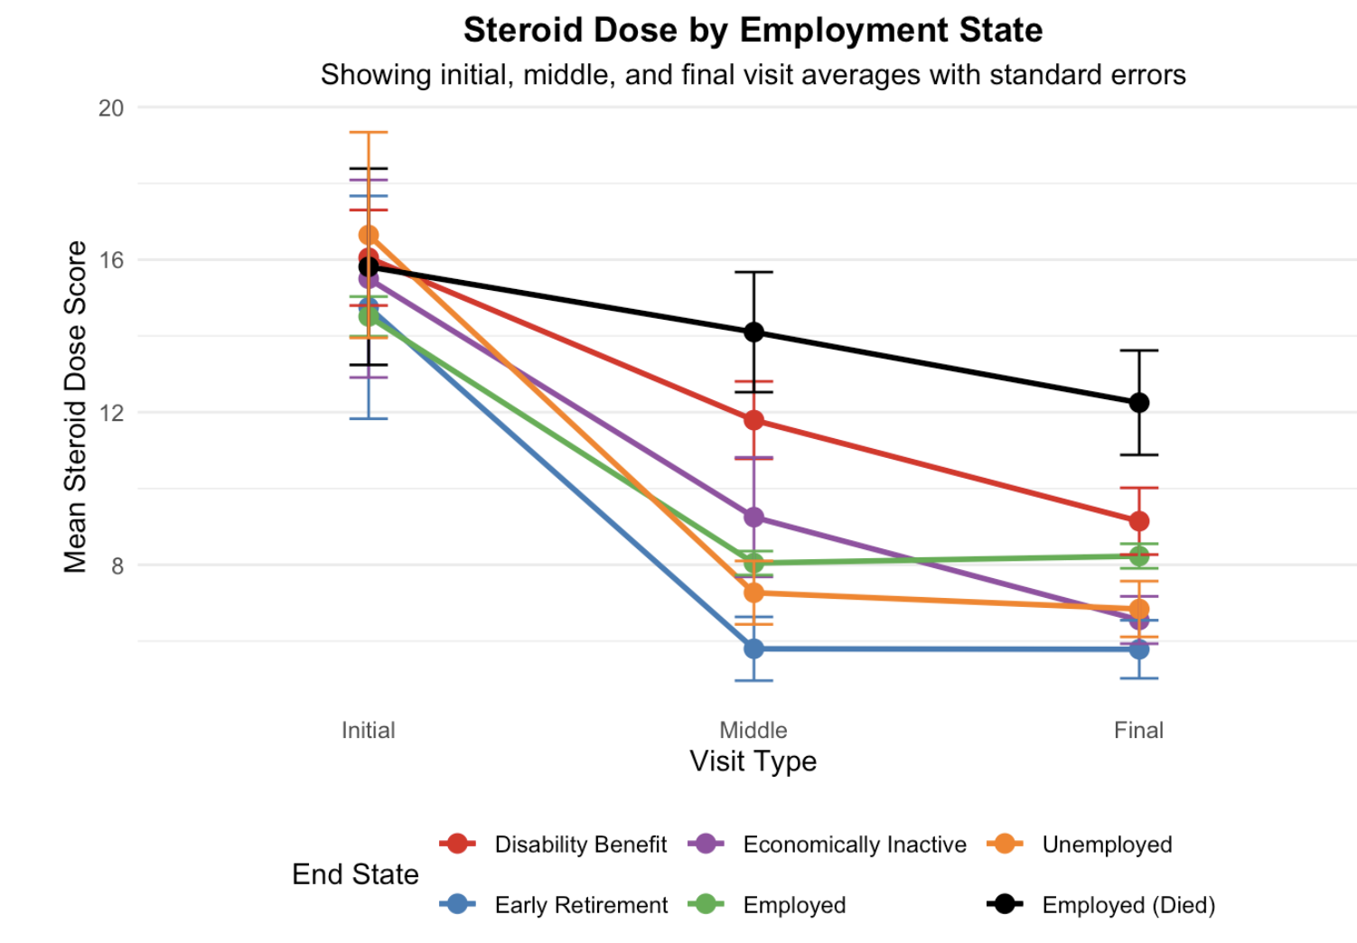
Treatment Trajectory by End State
We can consistently see how people that died while employed had the highest doses at the end and employed people, the lowest
People on disability benefit had the second highest steroid dose at the end

Slide 7
Maximum Dose and type of treatment
People who died while employed had significantly higher maximum doses of steroids or immunosuppressants than the other categories
End State | Patients (n) | Low Steroid Dose | Medium Steroid Dose | High Steroid Dose | Any Immunosuppressant | Immunosuppressant >100mg | Any Antimalarial
Disability Benefit | 129 | 13.3% | 39.1% | 47.6% | 81.5% | 61.2% | 92.6%
Early Retirement | 27 | 40.5% | 44.2% | 15.2% | 57.7% | 39.9% | 73.5%
Economically Inactive | 35 | 16.9% | 28.5% | 54.6% | 75.4% | 69.7% | 93.2%
Employed | 762 | 31.3% | 38.5% | 30.2% | 72.2% | 52.0% | 92.7%
Employed (Died) | 27 | 4.0% | 32.1% | 63.8% | 94.3% | 90.1% | 82.2%
Unemployed | 45 | 24.2% | 17.6% | 58.2% | 73.5% | 54.2% | 90.5%
Note. Steroid doses look at maximum dose throughout treatment. Low steroid dose is <7.5mg; medium, 7.5-30mg; high, >30mg. Mild flares are defined as a change in SLEDAI between 3 and 10 and severe are changes of more than 10 units.

Slide 8
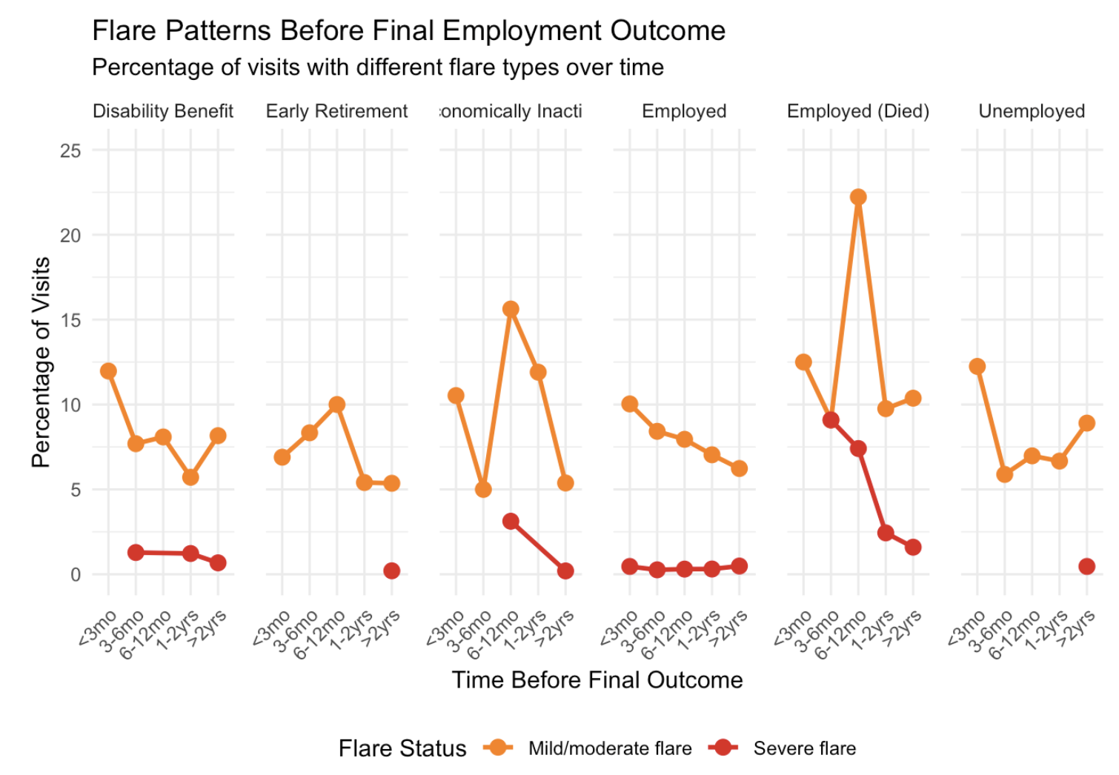
Flares by End State
Moderate flare: SLEDAI increase from 3 to 10
Severe flare: SLEDAI increase of more than 10

Slide 9
Identify risk factors
-Multinomial model for SDI and SLEDAI components
-Competing risk regression

Slide 10
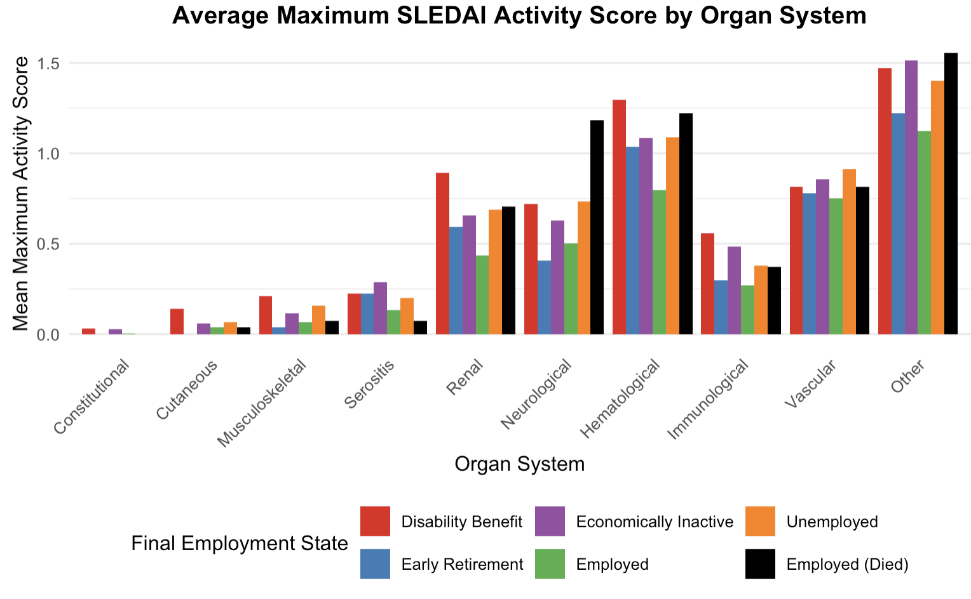
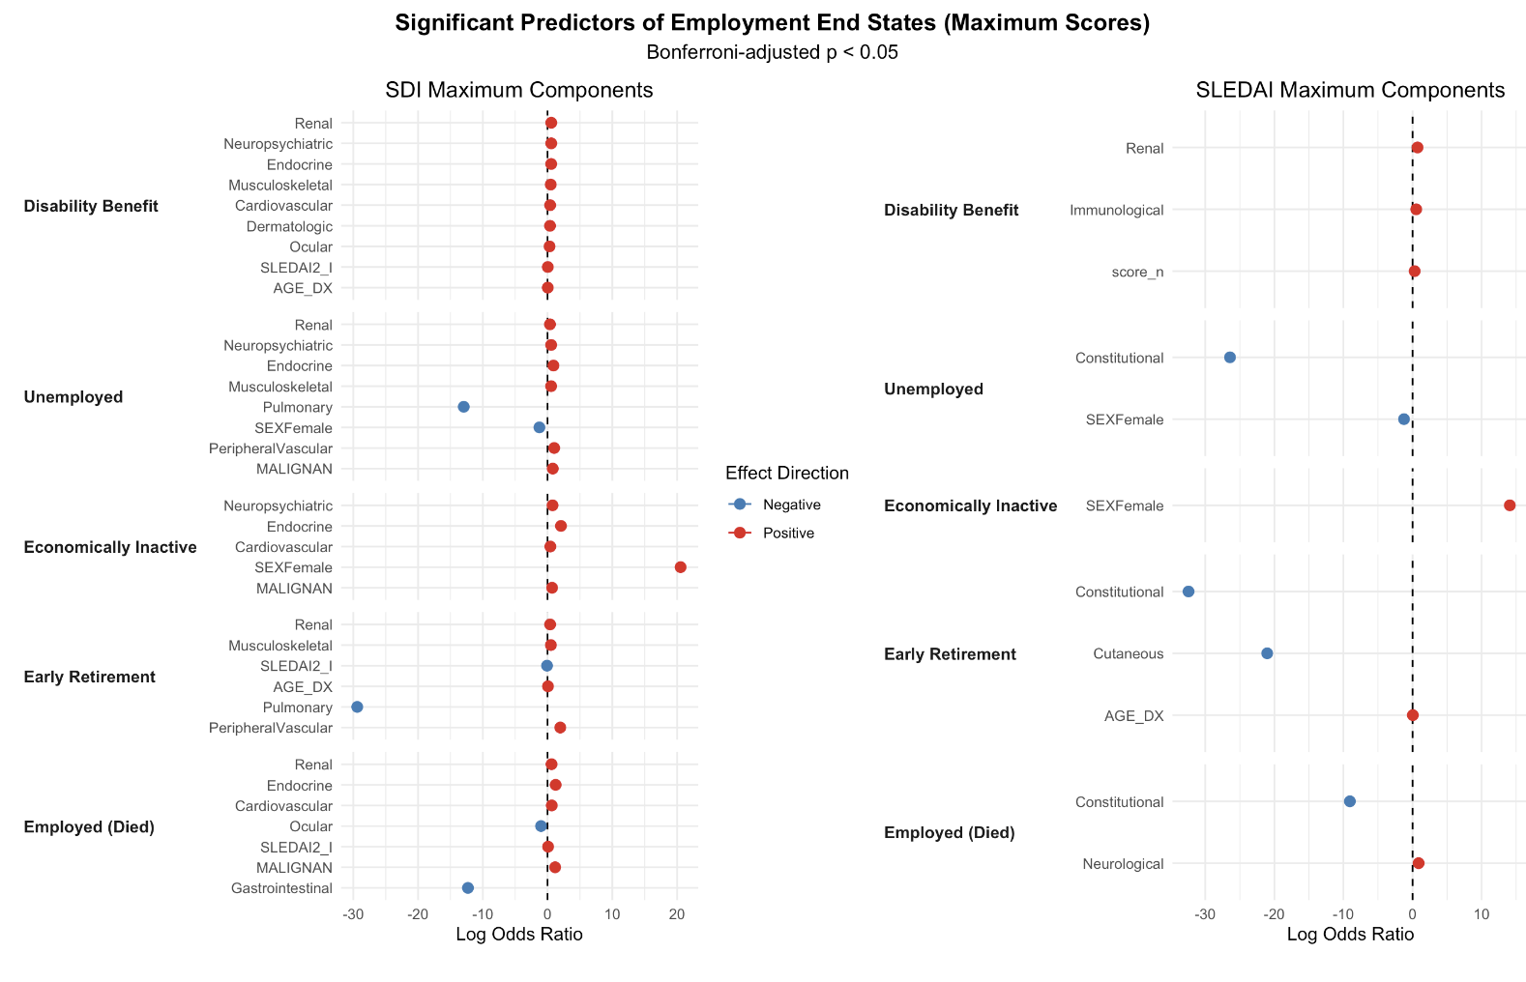
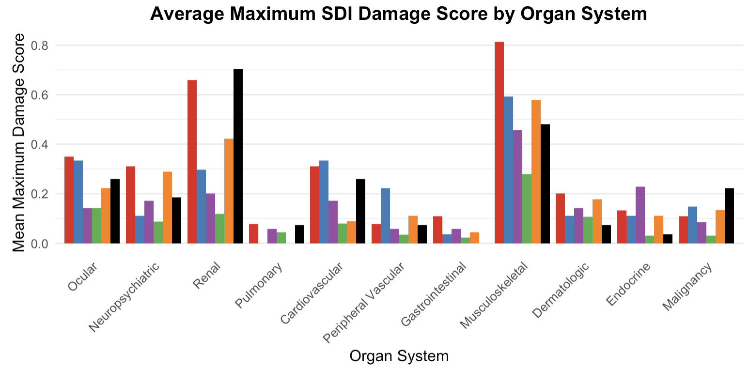
Multinomial Models for Components of SDI and SLEDAI
Creating two models using Employed as reference group for significant components of SLEDAI and SDI respectively, adjusting for multiple testing, controlling for Age at diagnosis

Slide 11
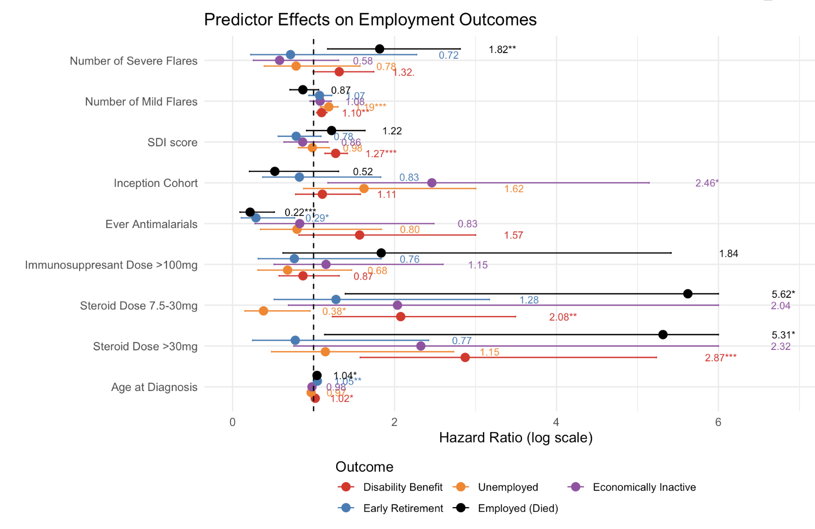
Competing Risk Regression
Using employed individuals as reference category:
Number of severe flares significantly higher for dead and number of mild flares significantly higher for disabled and unemployed
Higher steroid doses significantly higher for both disabled and dead and lower for unemployed

Slide 12
Flag high risk patients for early prediction
-Classify patients into their end state, using only data before transitioning
-Identifying patients at risk of leaving the labor force
-Viewing their risk score trajectory with clinical outcomes

Slide 13
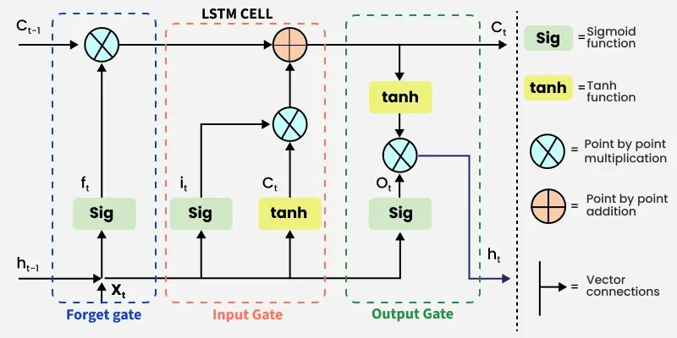
Long Short-Term Memory Model
Recurrent Neural Network for sequential data (patient visits)
LSTM networks are designed to remember information over long sequences.
Each unit includes gates (input, forget, output) that control the flow of information, enabling the model to retain or discard data as needed

Slide 14
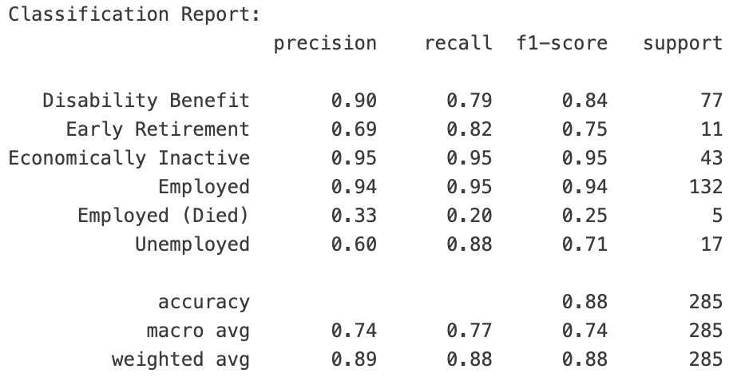
Predicting the final state of patients
Training LSTM model with cross-validation and including Random Forest into prediction (0.7xLSTM prediction + 0.3xRF prediction)
Look at each visit to see:
Treatment data: Steroid and antimalarial dose
Clinical data: Severe/mild flare, SDI score at that visit
Patient data: Inception cohort? Time since first visit and since last visit, number of visits and age at the visit
Results:
Balanced accuracy 0.766
(since classes are very unbalanced)

Slide 15
Flagging High Risk Patients Accuracy
Flagging Performance Report
Overall Flagging Accuracy
Total flagged: 208
Still employed when flagged: 40 (19.2%)
Median months before exit: 10.0
Early warnings (>12 months): 55
Imminent warnings (≤12 months): 153 (Includes people who had already transitioned)
- Total patients: 1025
Should have been flagged (not employed at end): 243
Correctly flagged (true positives): 179
False positives: 23
False negatives: 64
Sensitivity (recall): 73.7%
Precision: 89.9%
Specificity: 97.4%
Flagging rate: 73.7%
False positive rate: 2.6%
Notes:
=== Flagging Performance Report === Flagged Patients Summary: - Total flagged: 208 - Still employed when flagged: 92 (44.2%) - Median months before exit: 7.0 - Early warnings (>12 months): 55 - Imminent warnings (≤12 months): 153 Overall Flagging Accuracy: - Total patients: 1025 - Should have been flagged (not employed at end): 243 - Correctly flagged (true positives): 208 - False positives: 23 - False negatives: 35 - Sensitivity (recall): 85.6% - Precision: 90.0% - Specificity: 97.1% - Flagging rate: 85.6% - False positive rate: 2.9%

Slide 16
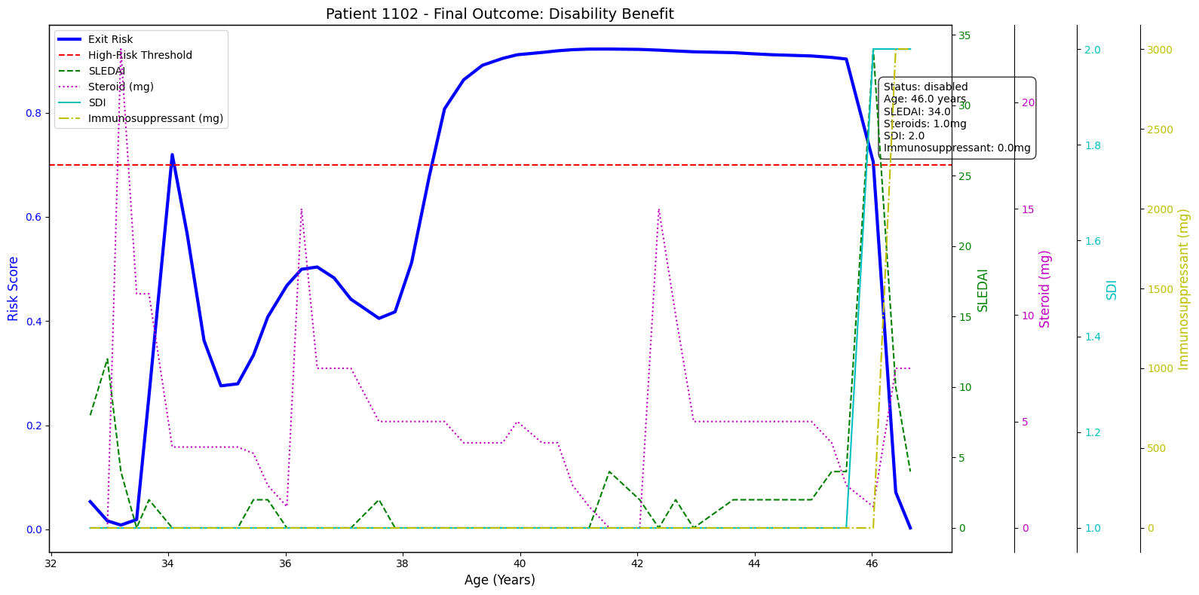
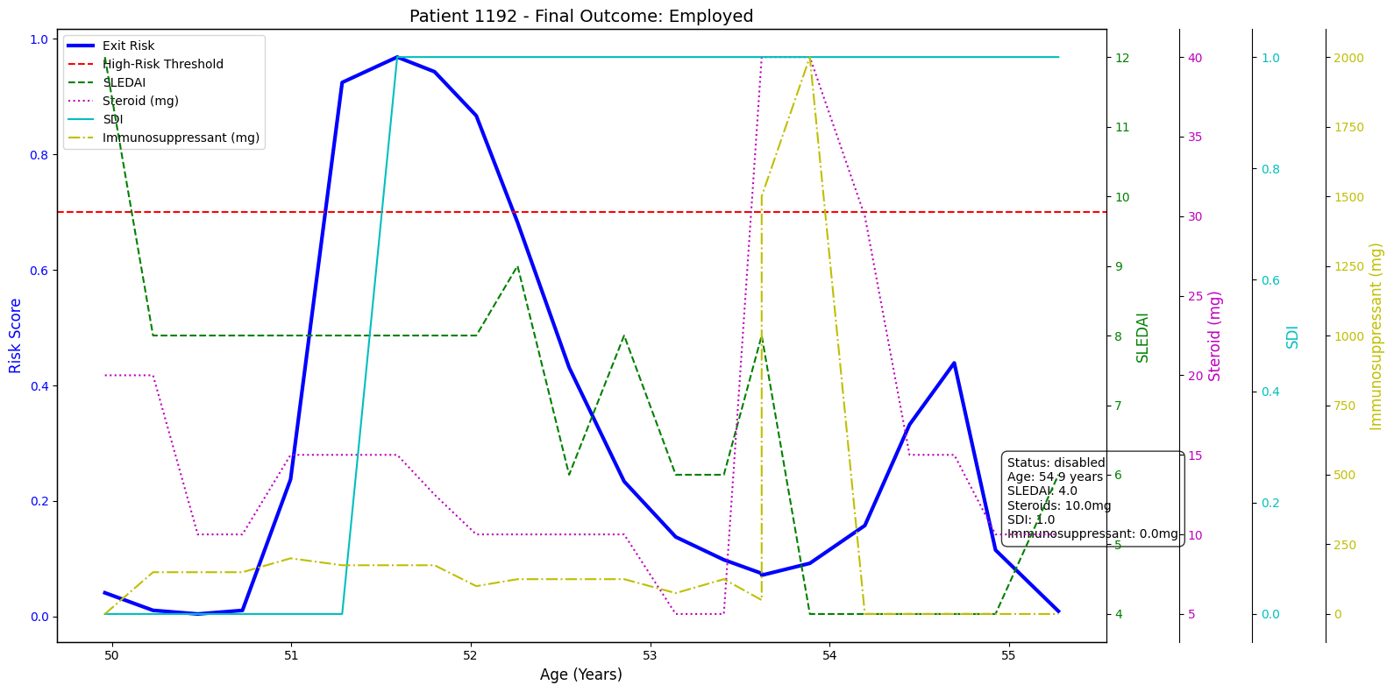
Sample High Risk Patient Trajectory
LSTM model assigns an exit risk probability (blue) to each patient using sequential clinical data

