Slide 1


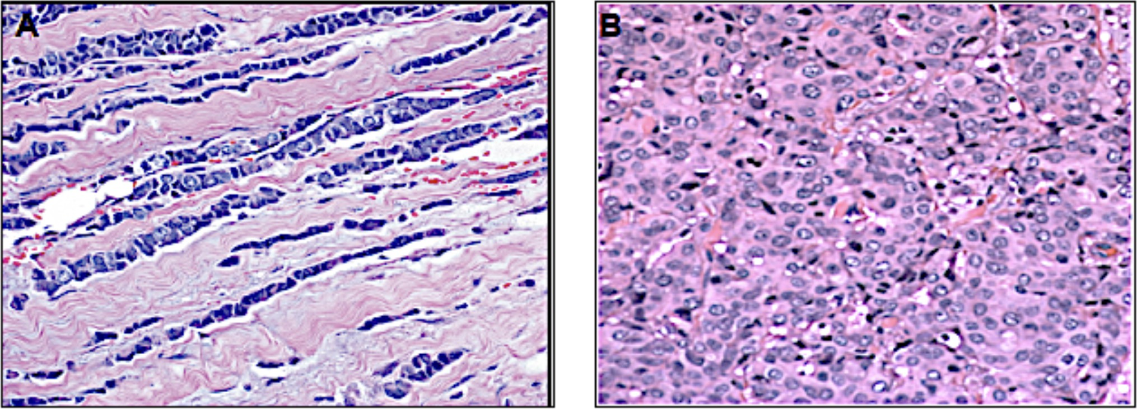
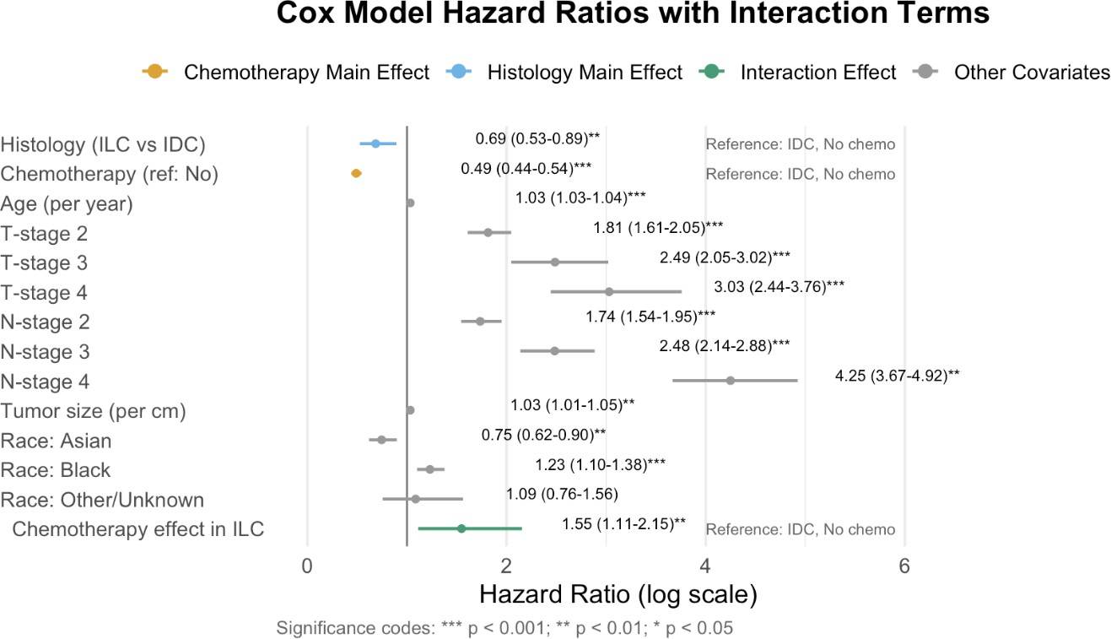
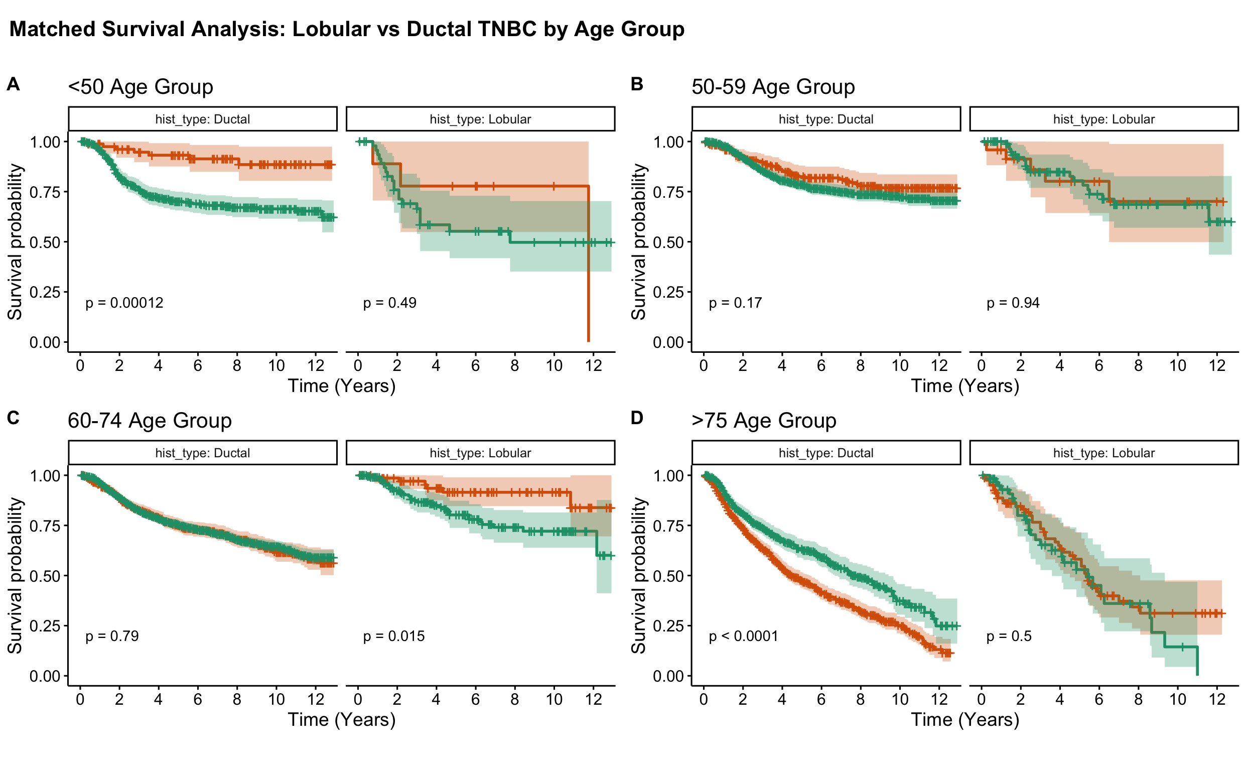
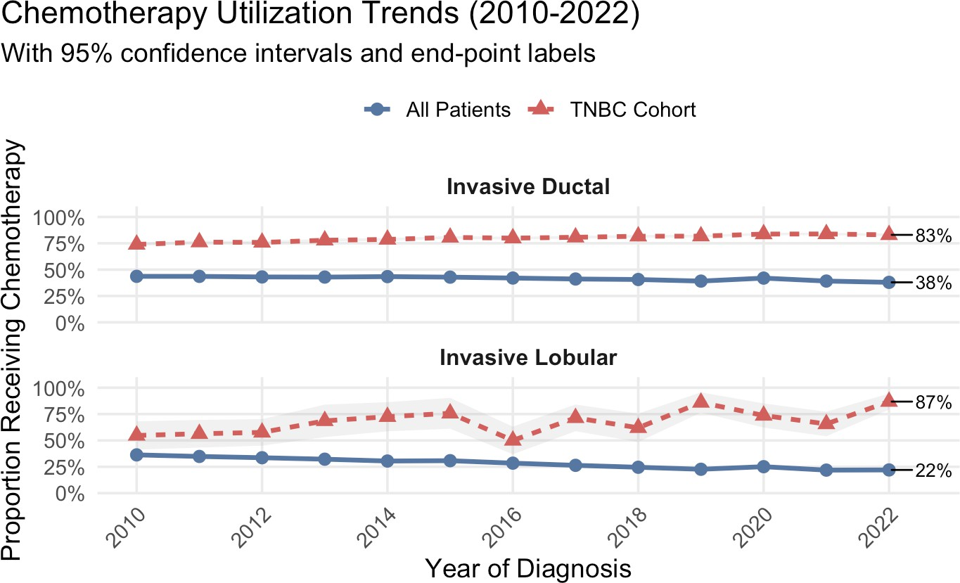
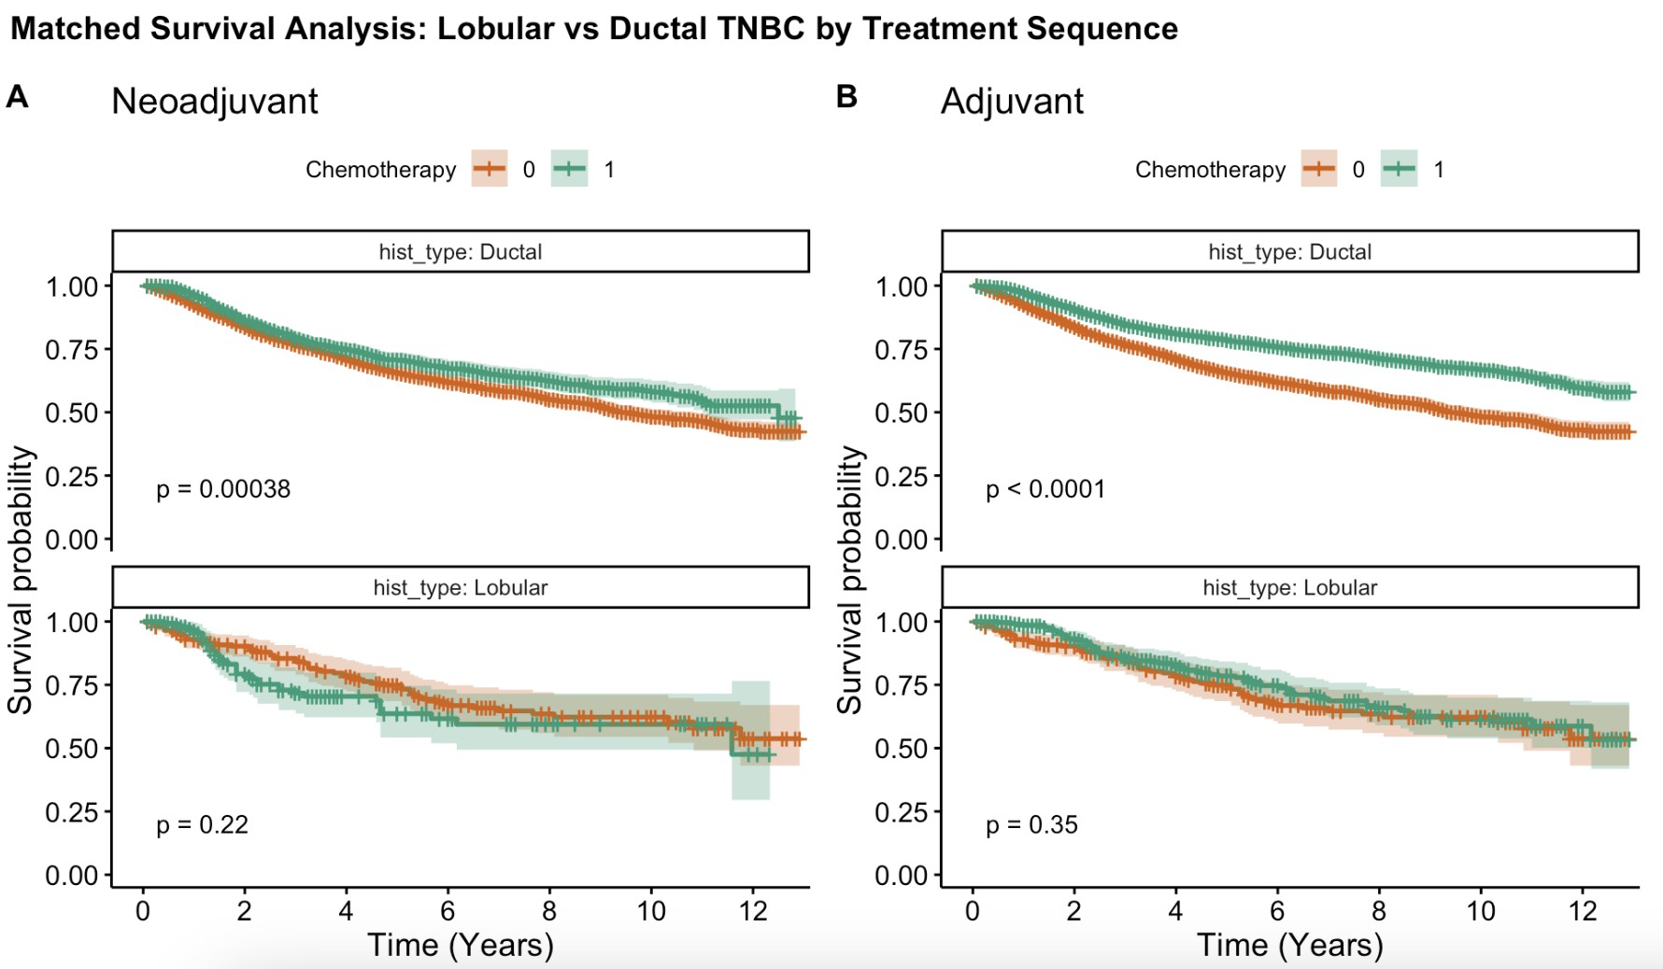
Differential Chemotherapy Benefit in Triple-Negative Breast Cancer: Invasive Lobular vs. Ductal Carcinoma
Javier Mencia Ledo¹; David Lim PhD, MD^{1,2}
¹ University of Toronto, ² Women’s College Hospital
Background
Key Findings
Racial Disparities
Triple-negative breast cancer (TNBC) lacks ER, PR, and HER2 receptors, making chemotherapy the cornerstone treatment. However:
TN-ILC tumors compared to TN-IDC tumors were more frequently:
Low-grade (70.4% vs 16.0% Grade I/II)
Larger (mean 2.7cm vs 2.1cm)
Higher nodal involvement (20.4% vs 7.9% N2/N3)
Overall Chemotherapy benefit:
TN-IDC: 51% mortality reduction (HR=0.49,p<0.001)
TN-ILC: No significant benefit (HR=1.14,p>0.05)
White Asian Black
Invasive lobular carcinoma (ILC) and ductal carcinoma (IDC) have distinct biological behaviors
TN-IDC chemo benefit (HR) 0.76*** 0.69* 0.87
TN-ILC chemo benefit (HR) 1.03. 2.07 2.19
Table 1. Chemotherapy effects by race (HR <1 favors chemo)
Coefficients from unadjusted hazards ratio model. ***: p<0.001; **: p<0.01; *: p<0.05
Results
Age-Specific Results
Figure 1. Pathologies of ILC (A) and IDC (B)
Methods
Data Source: SEER database (2010-2022)
50,922 TNBC patients (677 ILC, 50,245 IDC)
1:10 propensity matching (age, cancer stage, size, nodal status)
Analysis:
Cox models for breast cancer-specific survival
Interaction terms for histology × chemotherapy
Subgroup analyses by treatment sequence, race, age
Figure 3. Forest Plot of Overall Cox Regression Model
By Treatment Sequence
Figure 5. Survival By Age Groups
Younger TN-IDC (<50) showed smaller chemo benefit TN-ILC showed no benefit in any age group
Elderly TN-ILC (≥ 60) had worse outcomes with chemo (HR>1, p<0.05)
Implications & Next Steps
Clinical Implications:
Need for histology-specific TNBC treatment approaches
Consider alternative strategies for TN-ILC (immunotherapy, ADCs) Racial disparities warrant equitable access to novel therapies
Figure 4. Survival by Treatment Sequence
Neoadjuvant includes any case with neoadjuvant therapy, whereas adjuvant only is exclusively adjuvant therapy.
TN-IDC showed benefit across all sequences (all p<0.05 except combined) TN-ILC showed no benefit for any sequence (all p>0.05)
Neoadjuvant includes either just neoadjuvant or a combination of neoadjuvant and adjuvant
Future Directions:
Figure 2. Chemotherapy Usage of TNBC vs All ILC and IDC (2010-2022)
Investigate molecular mechanisms of chemo resistance in TN-ILC Explore targeted therapies for this distinct population
SURP Research Day 2025
j.mencialedo@mail.utoronto.ca

