Slide 1







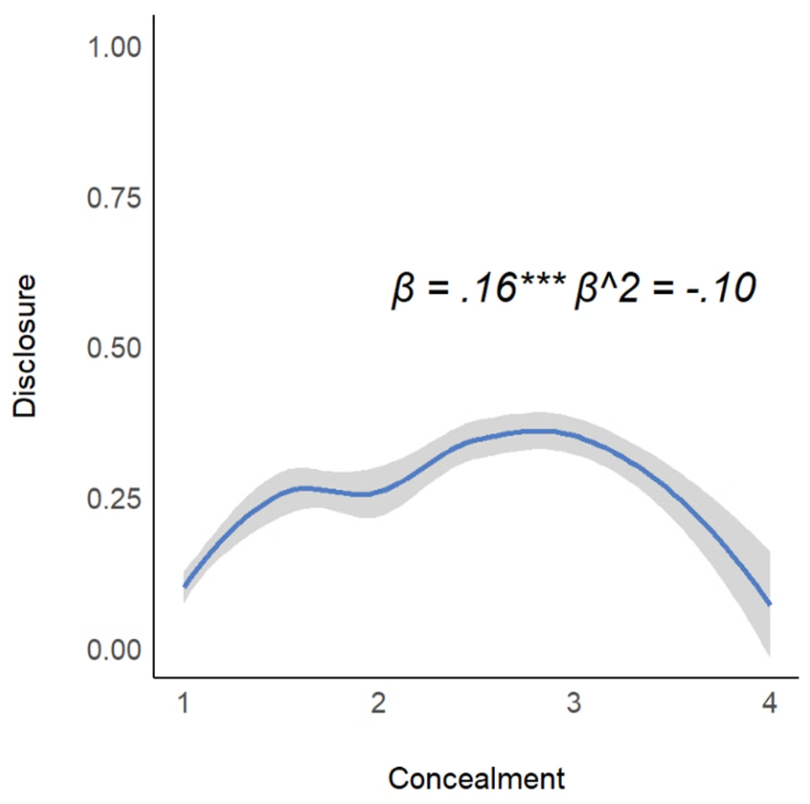
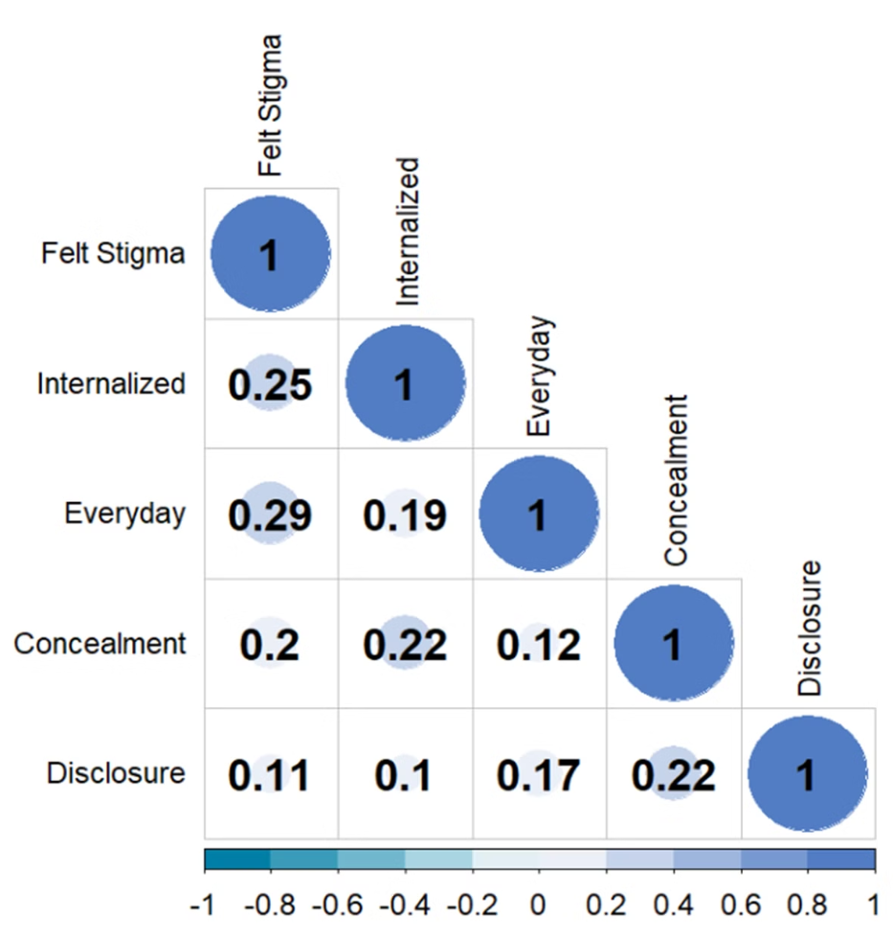
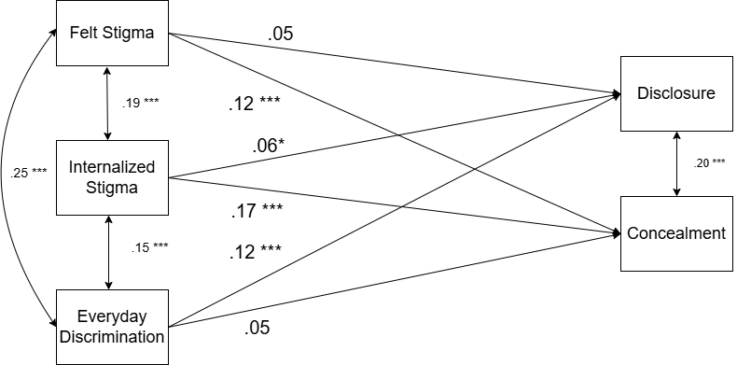
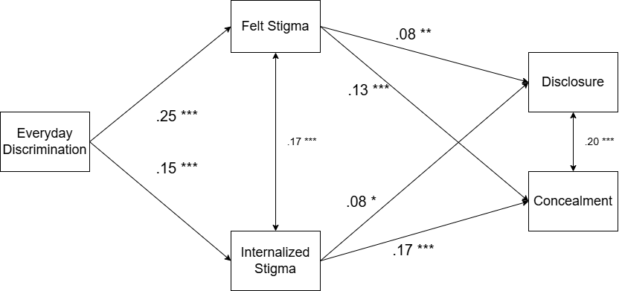
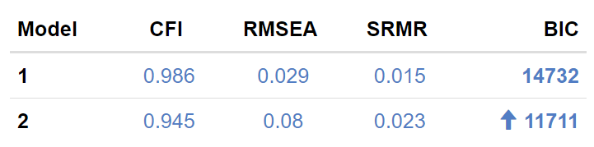

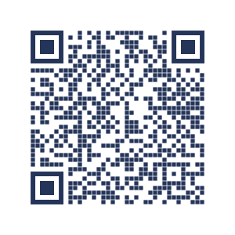
Should I tell him...
To Conceal or Disclose? The Differential Role of Minority Stress in LGB Identity Concealment and Disclosure
K. Colin Li, Javier Mencia Ledo, Rebecca Neel
Introduction
Results
Additional Results
Sexual minorities face unique stressors, including internalized stigma, felt stigma, and everyday discrimination (Meyer, 2003)
While research explored how minority stress relates to concealment and disclosure, the role of each stressor was often examined independently (Jackson & Mohr, 2016; Ryan et al., 2017)
This work explores whether and how different minority stressors relate differently to sexual orientation disclosure and concealment
Model 1: Minority Stressors Predicting Disclosure and Concealment
Method
Discussion
Participants
N = 944 LGB adults (1,491 observations) from an open-source dataset in Generations, a U.S. representative, longitudinal study (Meyer, 2023)
Mage = 38.5, 58% gay/lesbian, 48% men
Model 2: Indirect Effects of Everyday Discrimination via Internalized and Felt Stigma
Everyday discrimination plays a more important role in disclosure, whereas felt stigma and internalized stigma are more important to concealment
Everyday discrimination can also influence disclosure and concealment indirectly through felt stigma and internalized stigma
This may be the first work that considers how different minority stressors jointly affect sexual orientation disclosure and concealment
Limitation: Participants may be more “out”; only in the U.S. context; outcome measurement
Next Step: Examine other contextual barriers to concealment and disclosure
Measures | Item n (α/ρ) | Sample Item
Felt Stigma (Herek, 2009) | 3 (.74) | Most people where I live think less of a person who is LGB. (1 = strongly disagree, 5 = strongly agree)
Internalized Stigma (Herek, 2009) | 5 (.78) | I wish I were not LGB. (1 = strongly disagree, 5 = strongly agree)
Everyday Discrimination (Williams et al., 1997) | 9 (.91) | You were threatened or harassed. (1 = never, 4 = often)
Concealment (Meyer, 2023) | 2 (.59) | Are you out to all, most, some, or out to none of your straight friends/family. (1 = all, 4 = none)
Disclosure (Meyer, 2023) | 2 (.34) | You told a straight friend/family that you are LGB for the first time. (0 = no, 1 = yes)
Disclosure via Felt Stigma: β = .02, p = .012
Disclosure via Internalized Stigma: β = . 01, p = .027
Concealment via Felt Stgima: β = .03, p < .001
Concealment via Internalized Stigma: β = .03, p < .001

