Slide 1

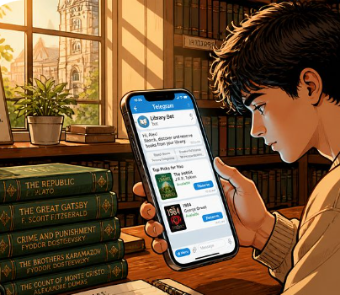

LibCloud
AI
Reinventing the School Library
with AI
LibCloud AI is a smart library operating system that unites readers, librarians, and school administrators in one Telegram ecosystem.
“Find me an adventure book
for a 14-year-old.”
1 BOT
10× FASTER DIGITIZATION
From “Where is the book?” to “Which book is right for me?”
AI recommends real books available in the school collection.
10K+
6M+
1
schools
students
pilot region

Slide 2



LibCloud
AI
PROBLEM
The library exists. But the system does not work.
Today’s processes waste time, push readers away, and leave administrators without reliable data.
01
02
03
Slow and outdated
Inconvenient for readers
Management without visibility
Paper logs, manual search, lost archives. Every operation takes unnecessary time.
Students must physically visit the library just to find out whether a book is available.
There is no single real-time view of inventory, loans, and overdue borrowers.
Result:
fewer books read • more manual work • decisions based on guesswork
THE PROBLEM IS NOT TECHNOLOGY — IT IS THE EXPERIENCE

Slide 3



LibCloud
AI
SOLUTION
LibCloud: every process in one Telegram ecosystem
No extra app, complex server setup, or programming knowledge required.
Admin
1 284
books in database
Excel import
LibCloud Core
Telegram Web App
Automation
Today's loans
Thousands of books
in a single upload
A separate secure database
for every school
Search, reserve,
profile, and history
Automatic reminders
for due dates and overdue loans
Real-time
analytics
1 second
1–2 minutes
24/7
Excel import
to learn
auto-reminders
This is the core platform. The next leap: AI.

Slide 4






LibCloud
AI
AI TRANSFORMATION
From automation to an intelligent ecosystem
AI is not a separate chatbot — it is a decision layer built on top of the catalog, loans, and student behavior.
TODAY
LibCloud Core
Reader AI
Librarian AI
Analytics AI
Catalog
For readers
For librarians
For administrators
Reservations & loans
Semantic search
AI cataloging
Demand analysis
Reminders
Personalized recommendations
Natural-language management
Purchase recommendations
Analytics
Reading path
Automated reports
Trend forecasting
AI does not recommend a random book from the internet — it recommends books actually available in the school collection.

Slide 5





LibCloud
AI
READER
A personal smart librarian for every student
Students do not need to know the book title. They describe their goal — AI finds the right book.
Semantic search
Reader outcomes
Understands natural requests such as “an easy book about Amir Temur.”
LibCloud AI
Find books faster
A shorter path from search to reservation
Find me an adventure book
for a 14-year-old.
Personalized recommendations
Suggests books based on previous loans, age, and interests.
Read more
Relevant content encourages students to return
I found 3 suitable books:
Reading path
Digital habit
1. The Mysterious Island
2. The Adventures of Tom Sawyer
3. Riding the Yellow Giant
A step-by-step book sequence from beginner to advanced for any topic.
A familiar, simple experience inside Telegram
Type your question…
EXPECTED KPI: SEARCH → RESERVATION CONVERSION

Slide 6
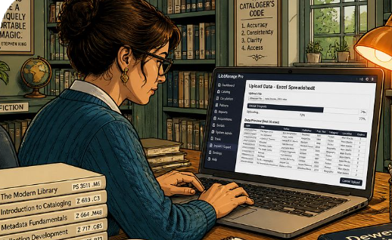



LibCloud
AI
LIBRARIAN
Not an operator — a decision-maker
AI reduces manual work while keeping the librarian in control.
Import
AI enrichment
Approval
Catalog
title / author / ISBN
genre / age / tags
human-in-the-loop
ready for search
Natural-language management
“Show books due for return today.”
“List the 10 most-read books in Grade 8-A.”
AI CATALOG
Excel / ISBN → category → keywords → description
The librarian only reviews and approves.
Every data change requires approval and leaves an audit trail.

Slide 7


LibCloud
AI
ADMINISTRATION
From data to decision — in 30 seconds
The AI dashboard does more than show numbers — it tells you what action to take.
Library status • Demo
Last 90 days
AI insight
1 240
loans
42
inactive books
18
overdue
Demand for programming books is high in Grades 7–9, but their share of the collection is low.
Most-read genres
Loan dynamics
Adventure
Purchase recommendation
Expand the programming category
Fantasy
History
Collection optimization
Identify books not borrowed in the last 6 months
Programming
Engagement
“Most Active Reader” campaign
EXPECTED KPI: REDUCE OVERDUE LOANS

Slide 8





LibCloud
AI
TECHNOLOGY
Safe, explainable AI built for schools
Every answer is grounded in a source; every action remains under control.
Question / action
AI Orchestrator
School RAG
Safety Layer
Response / action
reader or staff member
understands intent
catalog + loans + policy
age / role / approval
explainable and auditable
Multi-tenancy
No writes without approval
Audit log
Grounded answers
Each school’s data is strictly isolated.
AI never changes the database silently.
Who asked what, and when, is recorded.
Answers are based on the real collection and authorized data.
Technical advantage:
local language + Telegram UX + school-specific data + human-in-the-loop
AI GOAL: A TRUSTED ASSISTANT

Slide 9
LibCloud
AI
MARKET
Large market, simple monetization
AI increases platform value and creates a new premium layer.
01
School subscription
UZS 3–5M / academic year
Uzbekistan market opportunity
Unlimited use with administrative control.
10K+
6M+
general education schools
potential students
02
Student micro-payment
UZS 5–10K / year
For schools without a centralized budget.
Starting point
Jizzakh — pilot region
03
AI Pro & partnerships
Premium module / B2B advertising
Pilot → regional partnerships → nationwide scale
Additional ARR from recommendations, analytics, and partnerships.
B2B CORE
B2C FLEX
AI UPSIDE
Diversification = resilience

Slide 10

LibCloud
AI
ADVANTAGE
Why LibCloud AI wins
Fast deployment, local UX, and a data flywheel that gets stronger with usage.
Criteria
Paper log
Complex local system
LibCloud AI
Deployment
weeks
days / specialist
minutes
Via smartphone
no
limited
yes
School-specific AI
no
no
yes
Real-time analytics
no
partial
yes
Scaling
low
expensive
cloud-native
Local UX
Data flywheel
Distribution moat
Cloud-native
Natural-language search in Uzbek and a familiar experience inside Telegram.
More usage → better recommendations → more engagement.
B2B market-entry strategy through regional education departments.
Manage hundreds of schools separately from one platform.

Slide 11


LibCloud
AI
EXECUTION
From pilot to nationwide scale in 12 months
Each phase ends with user value and measurable KPIs.
Q1
AI MVP
Q2
Jizzakh pilot
Q3
Analytics Pro
Q4
Multi-region scale
Semantic search
AI cataloging
Grounded chat
School onboarding
Feedback loop
Reader AI
Purchase recommendations
District dashboard
Sales playbook
Cloud hardening
Partnerships
Nationwide rollout
Onboarding time
Books digitized
Search → reservation
Overdue loans
Active readers
LIBCLOUD AI • TECH AWARD PITCH

Slide 12




LibCloud
AI
We are not digitizing the library.
We are bringing young people back to books.
Innovation
Social impact
Scalability
Sustainable model
An AI librarian built on local school data.
Makes books easier to find and strengthens reading habits.
Hundreds of schools on one platform through multi-tenant SaaS.
Diversified through B2B, B2C, and premium AI layers.
Tech Award support will take LibCloud AI from the Jizzakh pilot to nationwide scale.
@libcloud_bot
Demo • Partnership • Pilot
Digital infrastructure that brings young people back to books.
LIBCLOUD AI

