Slide 1

!
Javolution C++
They call him Ginger!
« It looks like Java, it tastes likes Java… but it is C++ »
October 20, 2012

Slide 2
What is the problem?
  More and more hybrid C++/Java projects
    Developer expertise required in both Java and C++
  C++ total cost is significantly higher
    But cost of migrating existing C++ components to Java is prohibitive.
  Standardized and well established software practices exist in the Java world
    C++ developers are on their own (multiple solutions to address the same problems lead to additional complexity)
  Many Open-Source implementations of Software Standards exist only in Java
    OSGi, GeoAPI, UnitsOfMeasure, etc.

Slide 3
Many causes of variability.
  Developers expertise varies considerably.
  Testing performed at the end (integration) due to component inter-dependencies.
  Insufficient documentation.
  “Not Invented Here” Syndrome.
  Proprietary solutions not maintained which later become legacy burden.
  It is very beneficial to follow well-established standard specification.
    “Doing the right thing is difficult, but doing it right is easier.”

Slide 4
Javo(So)lution.
  Uniformization of C++/Java development through the use of a common framework (Javolution) based on Java standard library specification.
  Facilitating the migration of Java OSS code to C++
  Promote the “Service Oriented Approach” by providing an OSGi framework for both Java and C++
  Reduce documentation by having the same specification/design for our Java and C++ components.
  Unification of code building for Java and C++ (maven used for both).

Slide 5

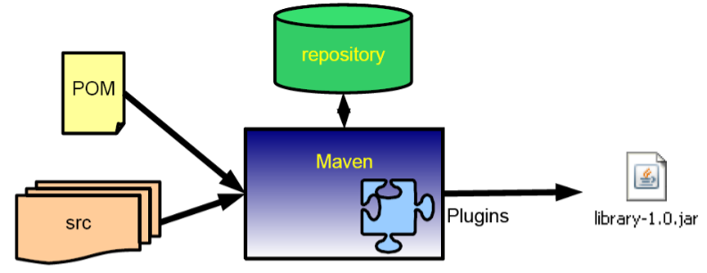
Maven Build
  Apache Maven (maven native plugin) is used to produce artifacts (dynamic libraries, static libraries, executable) and to perform unit tests.
  Profiles and packaging classifiers are used to address platform variability (windows, linux, etc.)

Slide 6
What is Javolution C++ ?
  A mirrored C++ library sharing the same specifications, documentation and unit testing as its Java pendant.
  A “behind-the-scenes” C++ infrastructure based on smart pointers (real-time garbage collection through reference counting).
  Integrated memory cache making small, short lived objects (e.g. value types) very efficient.
  C++ packages/classes derived from standard Java (e.g. java::lang::Thread, java::lang::* collections)
  A C++ dynamic execution and testing framework (OSGi & JUnit) identical to Java.

Slide 7
C++ Class Definition
  The general pattern for class/interface is as follow:
#include "javolution/lang/Object.hpp"
namespace com { namespace bar {
class Foo_API;
typedef Type::Handle<Foo_API> Foo; // Object reference.
}}
class com::bar::Foo_API : public virtual javolution::lang::Object_API {
private:
Param param;
protected:
Foo_API(Param param) { // Constructor visible to sub-classes.
this->param = param;
}
public:
static Foo newInstance(Param param) {
return Foo(new Foo_API(param));
};
virtual void fooMethod () { ... };
}

Slide 8
C++ Parameterization – Better than Java!
  Unlike Java, C++ class parameterization is not syntactic sugar but efficient use of C++ templates!
  All javolution.util collections are parameterized.
    List<String> list = FastTable_API<String>::newInstance();
    list->add(L"First");
    list->add(Type::Null);
    list->add(L"Second");
  Also used for Java-Like Enums

Slide 9
Synchronization
  Supported through a macro: synchronized(Object) mimicking the Java synchronized keyword.
  Can be performed on any instances of Javolution collections and Class (for static synchronization).
  synchronized (trackedServices) {// trackedServices instance of FastMap
  for (int i = 0; i < serviceReferences.length; i++) {
  Object service
  = actualCustomizer->addingService(serviceReferences[i]);
  trackedServices->put(serviceReferences[i], service);
  }
  trackingCount = 0;
  }

Slide 10
Miscellaneous
  Limited reflection support through RTT
  Auto-boxing of primitive types (boolean, integer, float, wide strings).
    Integer32 i = 23;
    Float64 f = 3.56;
    Boolean b = true;
    String s = L"xx“
  All variables are initialized to Type::Null (NullPointerException if not set before use).
  Wide-String (literal) concatenation supported.
    throw RuntimeException_API::newInstance(
    L"Bundle " + symbolicName + L" not in a resolved state");
  Dynamic length array Type::Array<type>
    Type::Array<ServiceReference> serviceReferences
    = context->getServiceReferences(serviceName, Type::Null);
    if (serviceReferences.length == 0) return;

Slide 11
Minor differences with Java
  Generalized use of static factory methods (such as newInstance(), valueOf()) instead of constructor.
  No ‘finally’ keyword in C++ (but try…catch same as Java).
  Static methods are called using the name of the class with the suffix ‘_API’
  Synchronization not supported on every object but only on those whose class implements the Object_API::getMutex() virtual methods

Slide 12
What next?
  More ports of Java Open source libraries (e.g. units of measurement, geo transforms)
  Math routines with GPU Acceleration.
  More standard Java library conversion (from OpenSDK source code ?)

