Slide 1
Chapter 3 - Void methods
(Lecture Slides – Week02)

Slide 2
3.1 Floating-point Numbers
The foating-point type is called double, which is short for “double-precision”
An example to create a foating-point variable and assign value to it:
double pi;
pi = 3.14159;
It is also legal to declare a variable and assign a value to it at the same time (called initialization):
int x = 1;
string empty = "";
double pi = 3.14159;

Slide 3
3.2 Converting from double to int
C# distinguishes the integer value 1 from the foating-point value 1.0
ints are converted (implicitly) into doubles automatically if necessary
Typecast is used to convert (explicitly) a foating-point value to an integer, and converting to an integer always rounds down
What are the values in variables x, y, z, m, n, p and q?
int x = 1.1; double y = 1; double z = 1 / 3; double m = 1.0 / 3.0; double n = 1 / 3.0; | Typecast examples: double pi = 3.14159; int p = (int) pi; double q = (int) pi * 20.0;
Typecasting takes precedence over arithmetic operations
https://docs.microsoft.com/en-us/dotnet/csharp/language-reference/builtin-types/numeric-conversions

Slide 4
Integral Numeric Types
The integral numeric types represent integer numbers. C# supports the following predefined integral types:
Type | Range | Size | .NET type
sbyte | -128 to 127 | Signed 8-bit integer | System.SByte
byte | 0 to 255 | Unsigned 8-bit integer | System.Byte
short | -32,768 to 32,767 | Signed 16-bit integer | System.Int16
ushort | 0 to 65,535 | Unsigned 16-bit integer | System.UInt16
int | -2,147,483,648 to 2,147,483,647 | Signed 32-bit integer | System.Int32
uint | 0 to 4,294,967,295 | Unsigned 32-bit integer | System.UInt32
long | -9,223,372,036,854,775,808 to 9,223,372,036,854,775,807 | Signed 64-bit integer | System.Int64
ulong | 0 to 18,446,744,073,709,551,615 | Unsigned 64-bit integer | System.UInt64
https://docs.microsoft.com/en-us/dotnet/csharp/language-reference/builtin-types/integral-numeric-types

Slide 5
Floating-point Numeric Types
The floating-point numeric types represent real numbers. C# supports the following predefined floating-point types:
There is only one implicit conversion between floating-point numeric types: from float to double.
Type | Approximate range | Precision | Size | .NET type
float | ±1.5 x 10−45 to ±3.4 x 1038 | ~6-9 digits | 4 bytes | System.Single
double | ±5.0 × 10−324 to ±1.7 × 10308 | ~15-17 digits | 8 bytes | System.Double
decimal | ±1.0 x 10-28 to ±7.9228 x 1028 | 28-29 digits | 16 bytes | System.Decimal
double a = 1.0;
double b = 0.42e2;
decimal c = 2.1m;
decimal myMoney = 3_000.5m;
https://docs.microsoft.com/en-us/dotnet/csharp/language-reference/builtin-types/floating-point-numeric-types

Slide 6
3.3 Math Methods
C# provides functions (called methods) that perform the most common mathematical operations.
The math methods are invoked using a syntax that is similar to the Write statements:
double root = Math.Sqrt(17.0);
double angle = 1.5;
double height = Math.Sin(angle);
C# assumes that the values you use with sin and the other trigonometric functions (cos, tan) are in radians.
To convert from degrees to radians, use the formula below:
double rad = degrees * 2 * Math.PI / 360.0;
// good to know the formula above but not required!

Slide 7
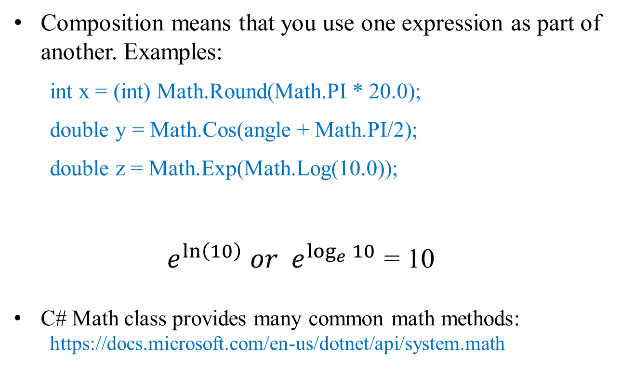
3.4 Composition
Composition means that you use one expression as part of another. Examples:
int x = (int) Math.Round(Math.PI * 20.0);
double y = Math.Cos(angle + Math.PI/2);
double z = Math.Exp(Math.Log(10.0));
${ e}^{\ln\left(10\right)} or { ⅇ}^{\log_{e}{10}}$ = 10
C# Math class provides many common math methods:
https://docs.microsoft.com/en-us/dotnet/api/system.math
Good to know it
but NOT required!

Slide 8
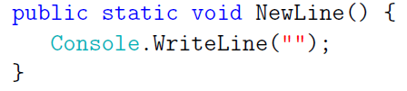
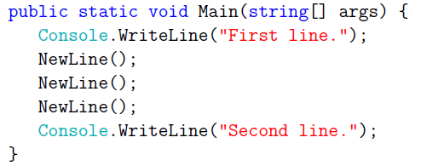
3.5 Adding New Methods
We can create/add new methods, the syntax is similar to that for the special Main method:
public static void <name> (<list of parameters>) {
<statements>
} // If a compound name is used, use Pascal style like “PascalCase”
A method can have no parameters, for example:
Sample program:

Slide 9
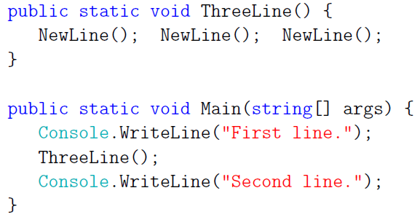
More code
Several observations:
You can invoke the same procedure more than once
You can have one method invoke another method
Short statements can be on the same line
Some benefits to create new methods:
Creating a new method gives you an opportunity to give a name to a group of statements
Creating a new method can make a program smaller by eliminating repetitive code

Slide 10
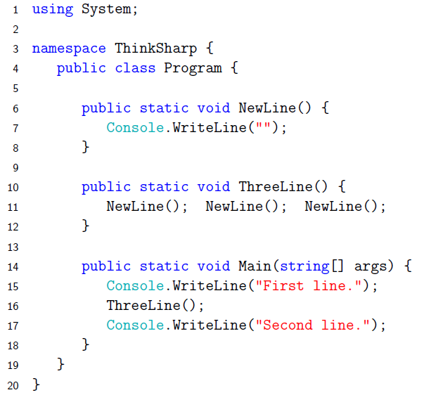
3.6 Classes and methods
A class definition may look like this

Slide 11
Methods in C#
A method is a code block that contains a series of statements
A program causes the statements to be executed by calling the method
In C#, every executed instruction is performed in the context of a method
The Main method is the entry point for every C# application and it is called by the common language runtime (CLR) when the program is started
Why use methods? Code reuse by defining the code once and using it many times

Slide 12
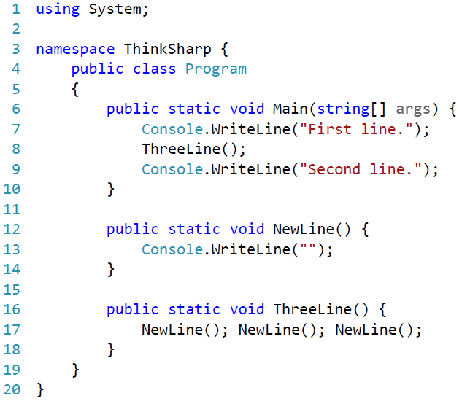
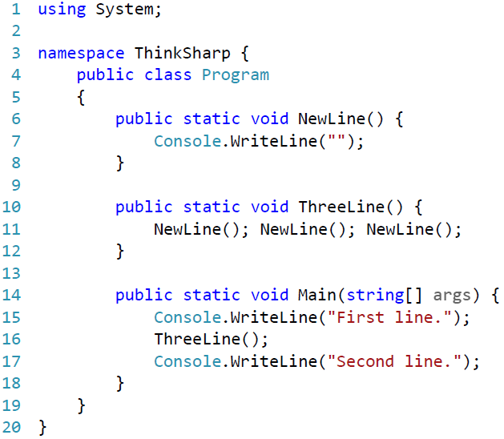
3.7 Programs with Multiple Methods
What is the difference between A and B? Will they have the same output?
The flow of execution for both A and B:
Main() => WriteLine() => ThreeLine() => NewLine() =>WriteLine() => NewLine() => WriteLine() => NewLine() => WriteLine() => WriteLine()
(A)
(B)

Slide 13


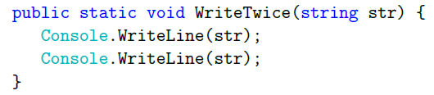
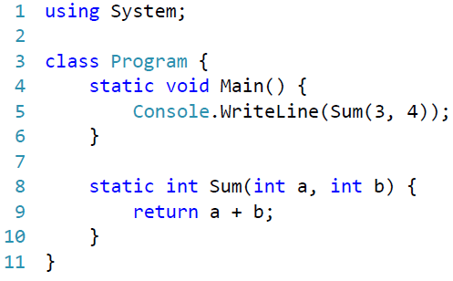

3.8 Method Parameters and Arguments
Some C# methods do not require arguments (values that you provide when you invoke the method). For example:
Some C# methods require one or more arguments:
Function definition:
(Pass-by-value)
Function invocation:

Slide 14
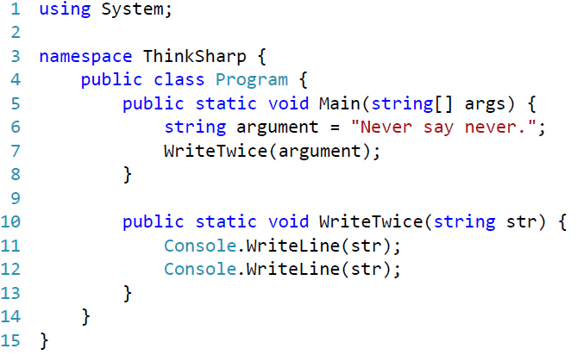
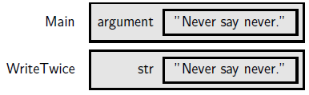
3.9 Stack diagrams
Parameters and other variables only exist inside their own methods
One way to keep track of where each variable is defined is with a stack diagram
The stack diagram for the previous example looks like this:
For each method there is a gray box called a frame that contains the method's parameters and variables. The name of the method appears outside the frame. As usual, the value of each variable is drawn inside a box with the name of the variable beside it.

Slide 15
Methods Definition and Invocation
The syntax for defining methods:
<Access specifier> <Return type> <Method name> (Parameter list) {
Method body
}
Access specifier: determines the visibility of a variable or a method from another class
Return type: the data type of the value the method returns, or void if no return value
Method name: unique identifier (PascalCase style is recommended)
Parameter list: the parameters are used to pass and receive data from a method, and they are optional; the parameter list refers to the type, order, and number of the parameters of a method
Method body: a set of statements
The syntax for calling methods:
<Method name> (Argument list) or <Method name> ()

Slide 16
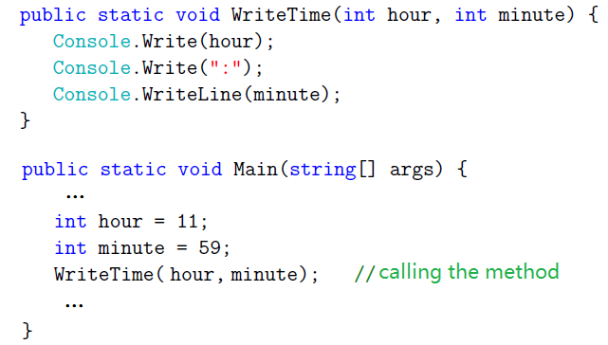
3.10 Methods with Multiple Parameters
An example for a method with two parameters:
Exercise: modify the code to print out a time like: “10:50:28”

Slide 17
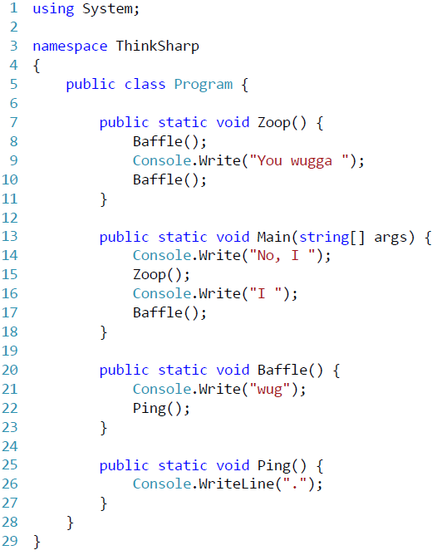
Exercise 3.2
The point of this exercise is to practice reading code and to make sure that you understand the flow of execution through a program with multiple methods. Read the code and write down your output, compare it to the program output when you run the code.

Slide 18
Chapter 4 - Conditionals and Recursion
(Lecture Slides – Week02)

Slide 19
4.1 The Modulus Operator (%)
The modulus operator (%) works on integers (and integer expressions) and yields the remainder
Modulus operator (%) vs. division operator (/):
int quotient = 7 / 3;
int remainder = 7 % 3;
relationship between % and /: a % b = a - (a / b) * b
% is very useful, can be used to:
check whether one number is divisible by another
extract a digit or digits from a number
check if a number is even or odd

Slide 20
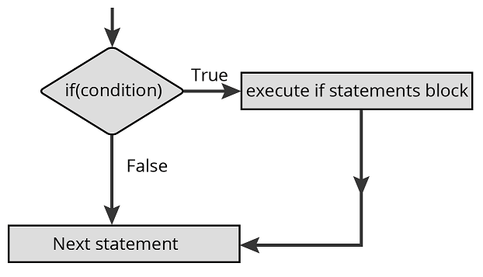
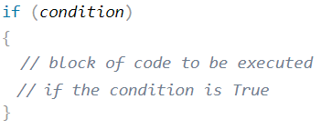

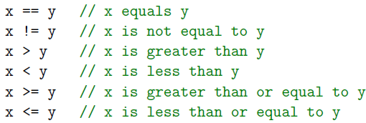
4.2 Conditional Execution
if statement
An examples:
Relational Operators
assignment operator =
is not same as ==

Slide 21
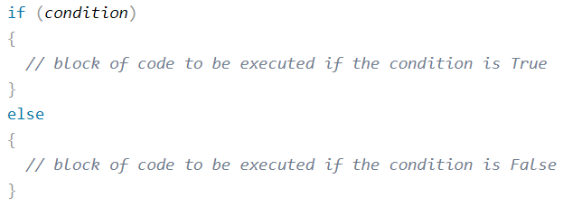
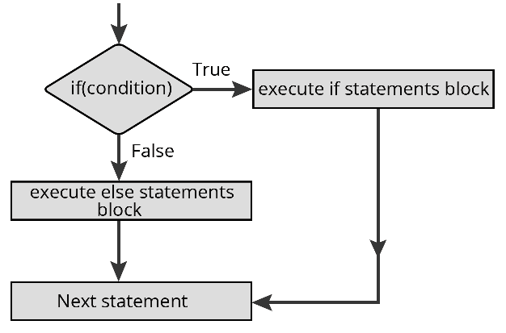
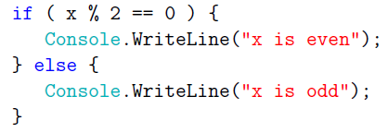
4.3 Alternative execution: if-else
Syntax
Example

Slide 22
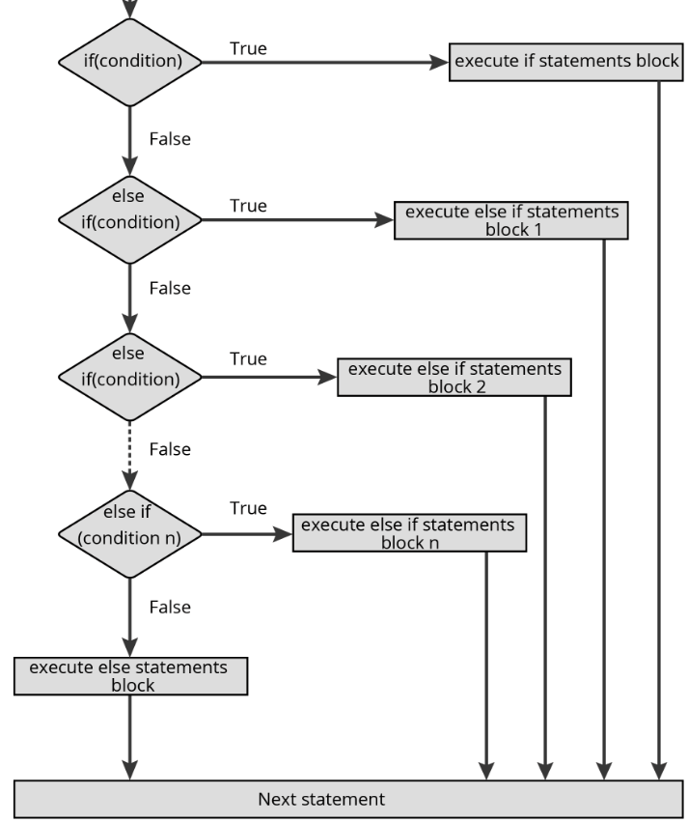
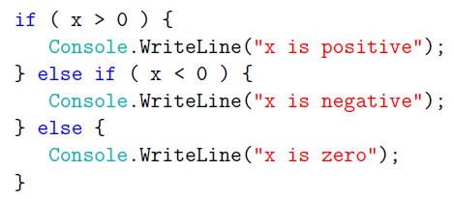
4.4 Chained Conditionals - if..else … if...else
Example
These chains can be as long as you want but long chains makes code hard to read. Always try to avoid long chains!

Slide 23
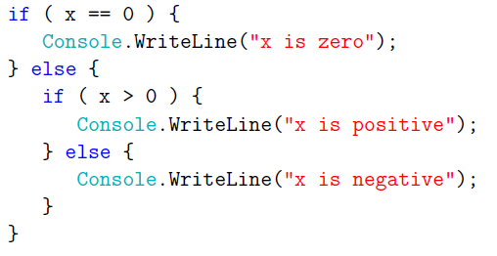
4.5 Nested conditionals
In addition to chaining, you can also nest one conditional within another. We could have written the previous example as:
Can you draw the flow chart for the example above?
Always try to avoid nested conditionals!

Slide 24
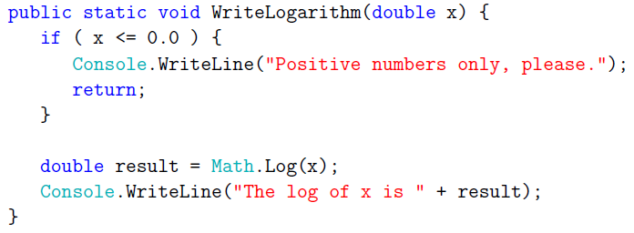
4.6 The Return Statement
The return statement allows you to terminate the execution of a method before you reach the end. One reason to use it is if you detect an error condition:
This method takes a double named x as a parameter. It checks whether x is less than or equal to zero, in which case it prints an error message and then uses return to exit the method without executing the remaining lines.

Slide 25
Factorial Function
Mathematical definition:
$$n!= \left\{\begin{aligned}1 if n=0 \\ n∙\left(n−1\right)∙\left(n−2\right)∙∙∙3∙2∙1 if n≥1\end{aligned}\right.$$
Examples:
$$0!=1, 1!=1, 5!=5∗4∗3∗2∗1=120$$
Factorial function:
$$Fact (n)= \left\{\begin{aligned}1 if n=0 \\ n∙Fact\left(n−1\right) if n≥1\end{aligned}\right.$$

Slide 26

Factorial Function
Return 4×6 = 24, the final value
Fact(4)
int Fact(int n){
if(n==0)
return 1;
else
return n * Fact(n-1);
}
//n=4
call
Return 3×2 = 6
Fact(3)
call
Return 2×1 = 2
Fact(2)
call
Return 1×1 = 1
Fact(1)
call
Return 1
Fact(0)

Slide 27
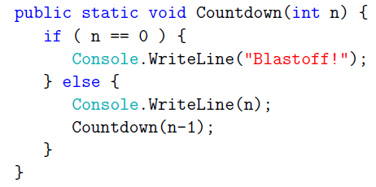
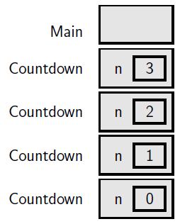
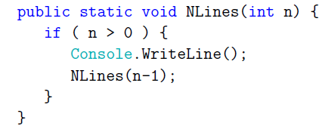
4.8 Recursion
When a method invokes itself, that's called recursion. An interesting recursion method – Countdown()
Another interesting recursion method – NLines()
n=3
Stack Diagrams

