Slide 1
Chapter 5 - Value Methods
(Lecture Slides – Week03)

Slide 2



5.1 Return Values
Remember the method syntax?
<Access specifier> <Return type> <Method name> (Parameter list) {
Method body }
Access specifier: public, private, etc. (note that default is private)
Return type: the data type of the value the method returns, or void if no return value
Method name: legal C# identifier
Parameter list: is used to pass and receive data from a method, can be none, 1 or more
Method body: a return statement must be included if method return type is not void
The syntax for calling methods:
<Method name> (Argument list) or <Method name> ()
Examples:
Remember these functions:

Slide 3
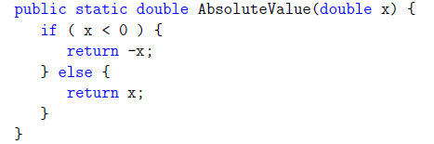
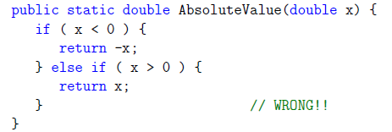
5.1 Return Values
A method can have multiple return statements but only one will be executed
If you put return statements inside a conditional, then you have to guarantee that every possible path through the program hits a return statement.
What coding practice can help you avoid the potential error above?

Slide 4

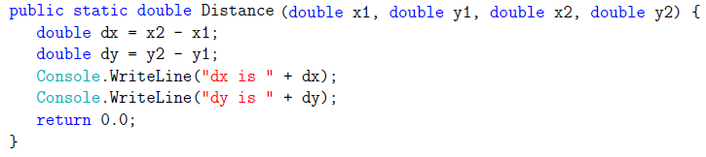
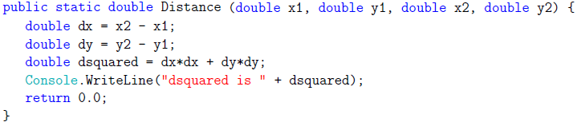
5.2 Program Development
A step-by-step incremental development way to compute the distance between two points, given by the coordinates (x1; y1) and (x2; y2)
Math formula

Slide 5
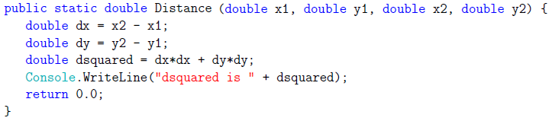
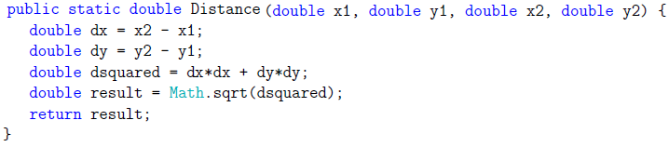
5.2 Program Development
Continued:
Summary of incremental development:
Start with a working program and make small, incremental changes. At any point, if there is an error, you will know exactly where it is.
Use temporary variables to hold intermediate values so you can write and check them.
Once the program is working, you can remove scaffolding and consolidate multiple statements into compound expressions.

Slide 6

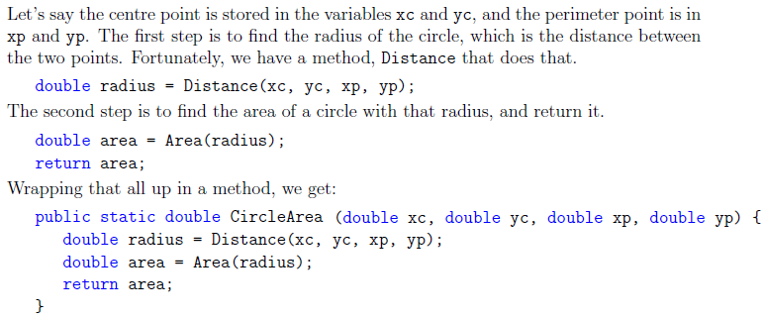
5.3 Composition
Once you define a new method, you can use it as part of an expression, and you can build new methods using existing methods.

Slide 7
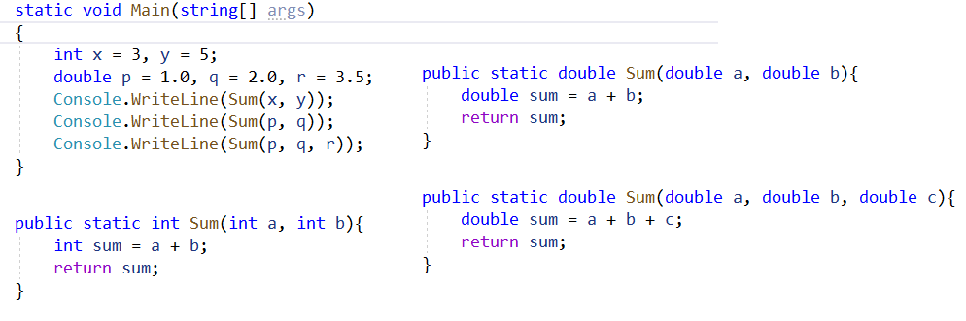
5.4 Overloading
Having multiple methods with the same name but different parameters is called method overloading. Method overloading can be done by changing:
The number of parameters in two methods
The data types of the parameters of methods
The order of the parameters of methods

Slide 8
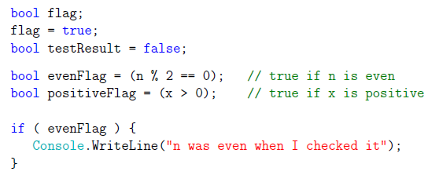
5.5 Boolean Expressions
A Boolean type is declared with the bool keyword and can only take the values true or false
A Boolean expression is a C# expression that returns a Boolean value
Expressions with relational operators (>, <, ==, !=, >=, <=) return Boolean values
Examples:

Slide 9
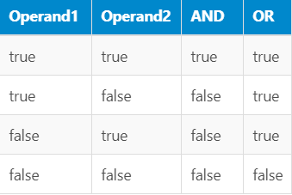
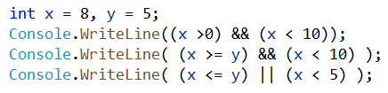
5.6 Logical Operators
There are three logical operators: AND, OR and NOT, which are denoted by the symbols &&, || and !
Binary && (conditional logical AND) and || (conditional logical OR) operators evaluate the right-hand operand only if it's necessary
The unary prefix ! operator computes logical negation of its operand
Operator precedence: ! > && > ||. When in doubt, use parenthesis

Slide 10
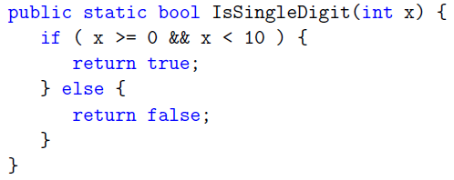


5.7 Boolean Methods
Boolean methods can return Boolean values, true or false. Example:
Can be simplified to:
Invocation:

Slide 11
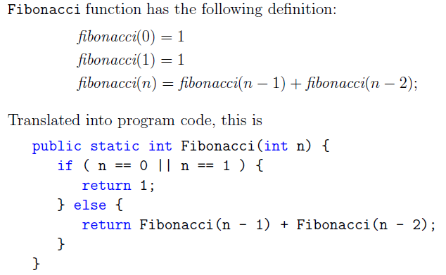
5.10 More Recursion Example

Slide 12
Chapter 6 - Iteration and Loops
(Lecture Slides – Week03)

Slide 13
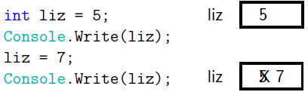
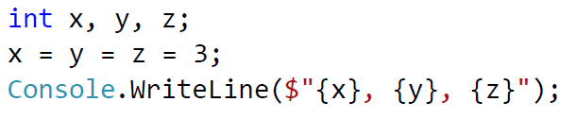

6.1 Multiple Assignment
After the declaration of a variable, we can make more than one assignment to the same variable; the effect is to replace the old value with the new:
A value can be assigned to multiple variables in a single statement:
Assignment statement examples:

Slide 14
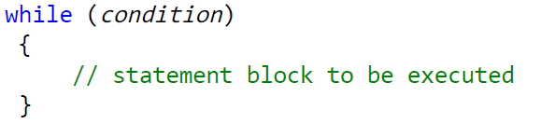
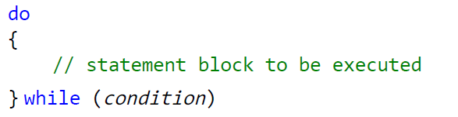
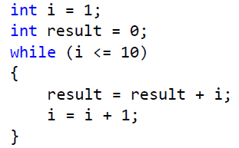
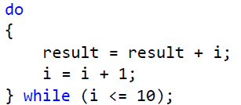
6.2 The while Statement
The while statement (or loop) executes a block of statements while a specified Boolean expression evaluates to true:
A do-while loop is similar except that it executes a block of statements first, check the condition afterward:
Examples:

Slide 15
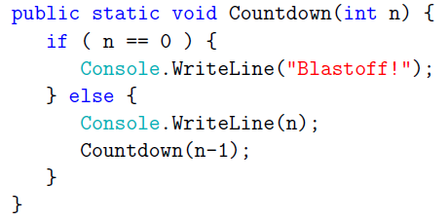
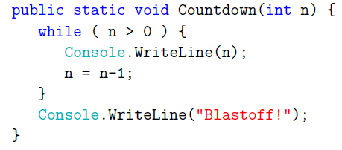
Iteration vs. Recursion
The recursion-version Countdown method:
Use a while loop we can rewrite Countdown:

Slide 16
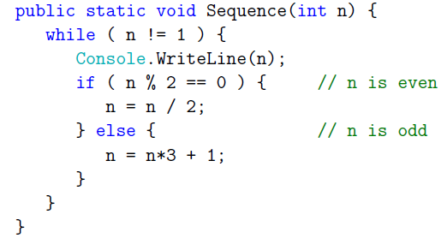
Collatz Conjecture Using While Loop
The Collatz conjecture is a conjecture in mathematic that performs the following operation on an arbitrary positive integer:
If the number is even, divide it by two
If the number is odd, triple it and add one
Let’s play some numbers: 3, 7, 16, 97 …
See more:
https://en.wikipedia.org/wiki/Collatz_conjecture

Slide 17
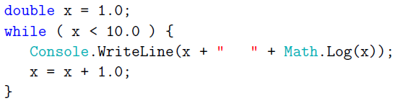

6.3 Tables
(print tables using while loops)
Loops are good for is generating and printing tabular data. Example:
The following formula can be used to compute logarithms with respect to base 2:
A base-2 table:

Slide 18
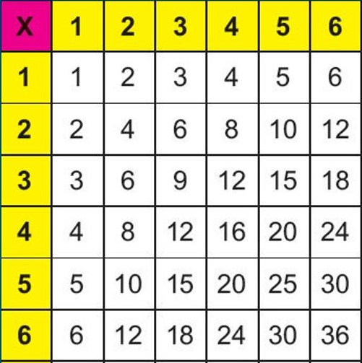
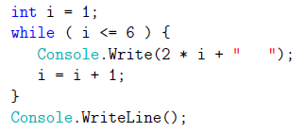
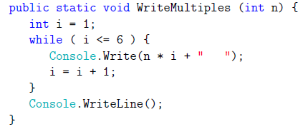
6.4 Two-dimensional Multiplication Tables
(An application of while loops)
Let's use while loops to print a multiplication table for the values from 1 to 6. First, let’s start with just one row:
Let’s generalize above for any number:
`

Slide 19
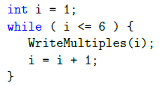
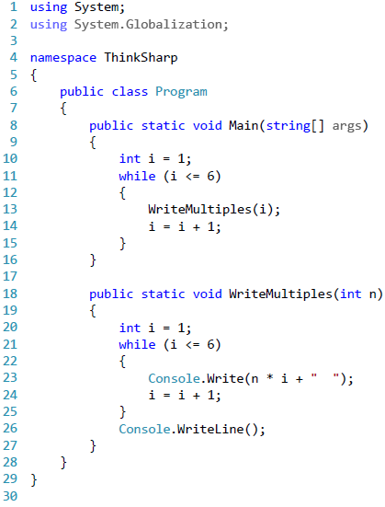
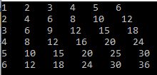
Now we can print the 2-D table:
The complete program:
The result:
(a)
Can we wrap this portion of the program in a method?

Slide 20
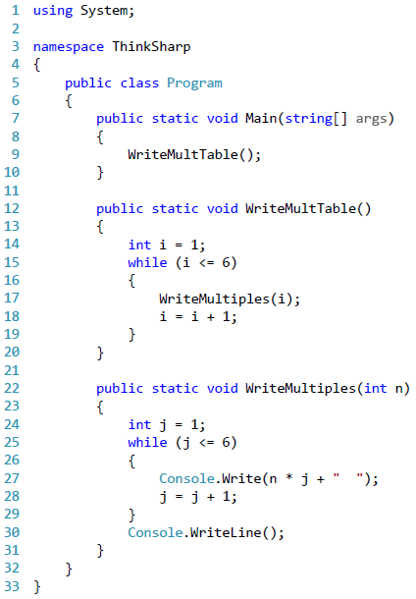
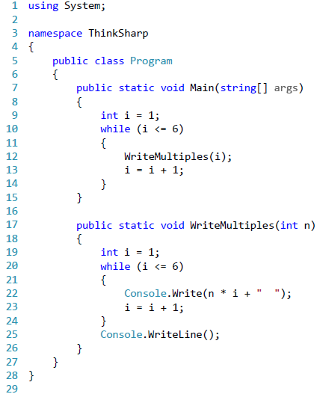
Now we can print the 2-D table:
The complete program:
(b)
(a)

Slide 21
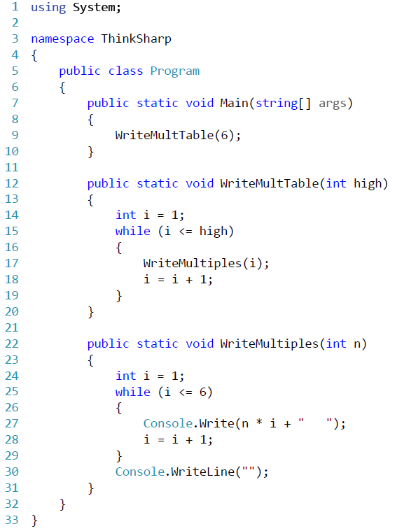
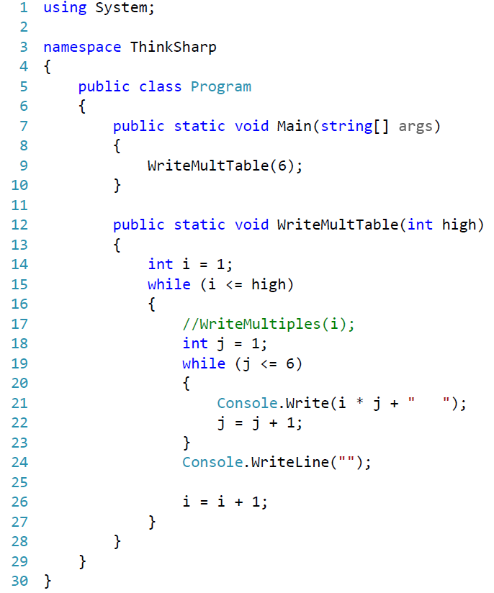
Let’s slightly revise (b) to (c), the merge the two methods in (b) into one method in (d):
(c)
(d)
Can we modify here to generalize it to any number?

Slide 22
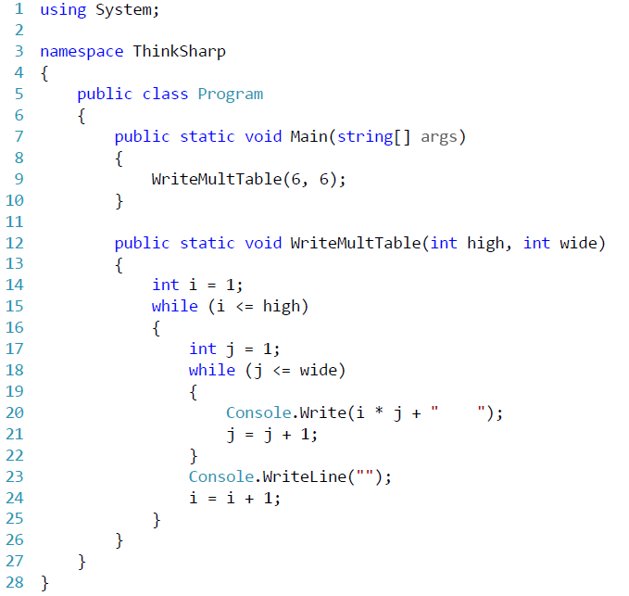
The final program!
(e)
Nested
loops

Slide 23
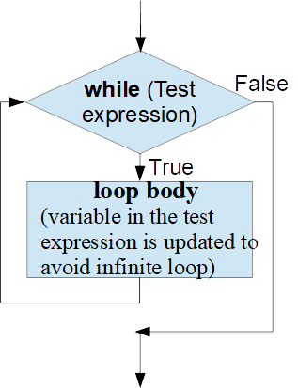
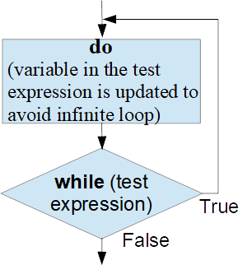
Summary of Loops
while loop
It repeats a statement or a group of statements while a given condition is true. It tests the condition before executing the loop body.
do...while loop
Similar to a while statement, except that it tests the condition at the end of loop body
for loop
If you know the number of repetition, for loop is a better choice.

Slide 24

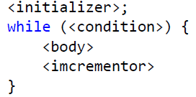
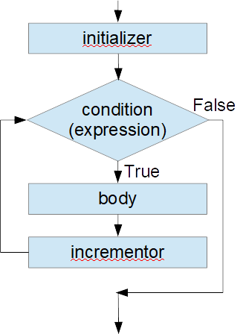
for Loop
A for loop is a repetition control structure that allows you to efficiently write a loop that needs to execute a specific number of times. Syntax:
which is equivalent to:
Step 1: the initializer is executed first, and only once. You can declare and initialize any loop control variables, or leave it empty.
Step 2: the condition is evaluated. If it is true, the body of the loop is executed. If false, skip the body of the loop and the for loop terminates.
Step 3: After the execution of loop body, the flow of control jumps back up to the incrementor statement. This statement allows you to update any loop control variables. This can be left empty if you already updated the control variable in the loop body. After the incrementor, the control goes back to step 2 to repeat.

Slide 25
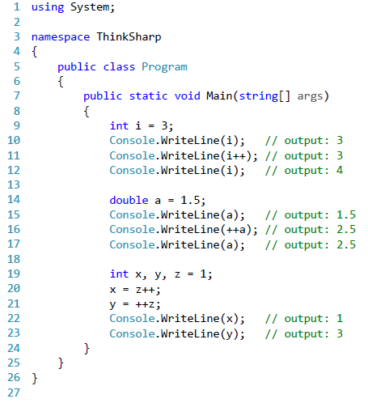
Increment Operator ++
The unary increment operator ++ increments its operand by 1. The increment operator is supported in two forms: the postfix increment operator, x++, and the prefix increment operator, ++x.
There is also a corresponding decrement operator -- that behaves similarly.

Slide 26
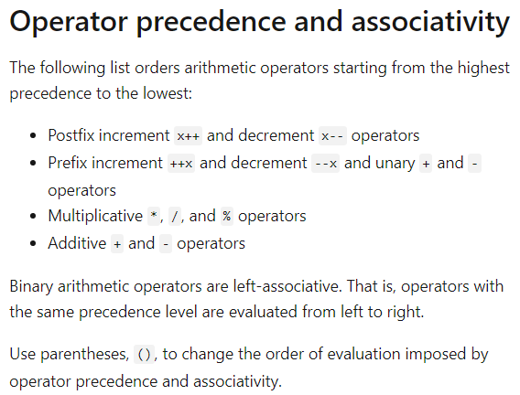
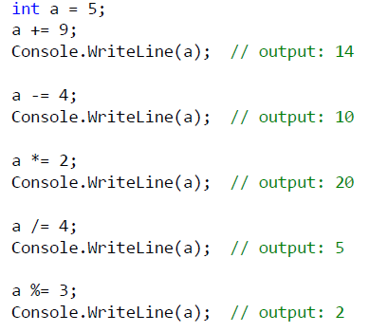
Compound Assignment
For a binary operator op, a compound assignment expression of the form x op = y is equivalent to x = x op y
Examples:
https://docs.microsoft.com/en-us/dotnet/csharp/language-reference/operators/arithmetic-operators

Slide 27
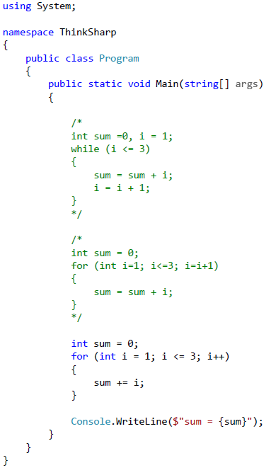
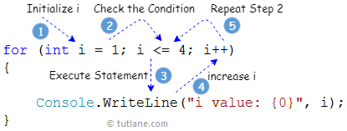
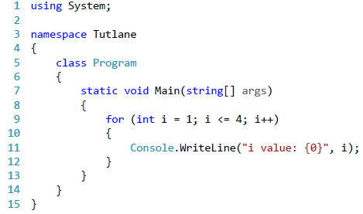
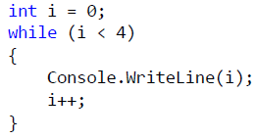
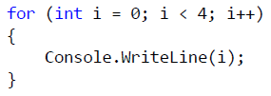
Examples
https://www.tutlane.com/tutorial/csharp/csharp-for-loop-with-examples

