Slide 1
Chapter 7 – Strings and More
(Lecture Slides – Week 4)

Slide 2
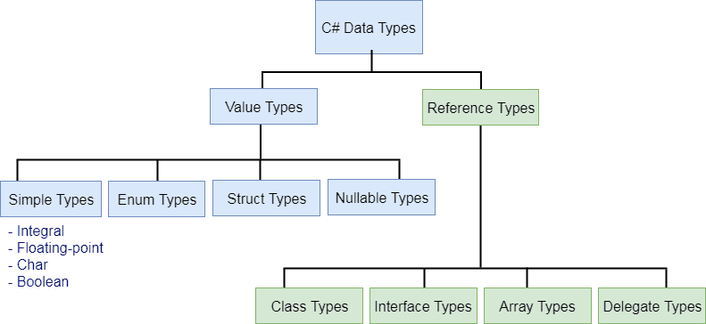
C# - Data Types
C# is a strongly-typed language. It means we must declare the type of a variable before using it. C# mainly categorized data types in two types: Value types and Reference types.
https://www.tutorialsteacher.com/csharp/csharp-data-types

Slide 3
7.1 Characters
ASCII vs. Unicode
The char type represents a Unicode UTF-16 character; the default value \0, that is, U+0000; the char type is implicitly convertible to the following integral types: ushort, int, uint, long, and ulong.
A character literal can be represented by one of the following:
‘k’
‘\u007A’
‘\x007A’
(char)107
On the surface, the string in C# is just a collection of characters (of char type).

Slide 4
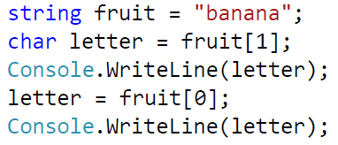
7.1 Characters
In Object-Oriented Programming (OOP), classes and objects are used to represent real-life entities.
A class is a user-defined blueprint or prototype from which objects are created. A class combines the fields (data) and methods (actions) into a single unit.
Strings in C# are objects, this means that a string has data (characters) and methods.
Individual character in a string can be accessed using the [] operator. For example:
b
a
n
a
n
a
Index: 0 1 2 3 4 5

Slide 5
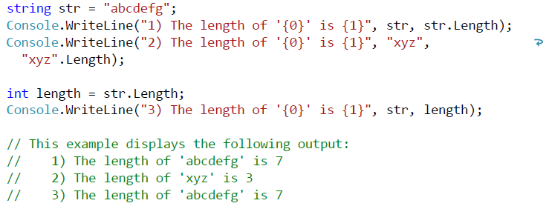
7.2 Length
The length of a string, the number of characters in the string, is an attribute of a string. For example:
int Length = fruit.Length;
char last = fruit[length - 1];
More examples:
https://docs.microsoft.com/en-us/dotnet/api/system.string.length?view=netcore-3.1

Slide 6
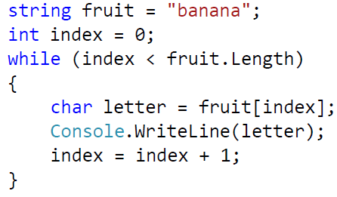
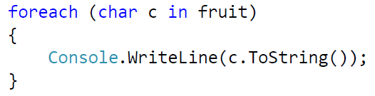
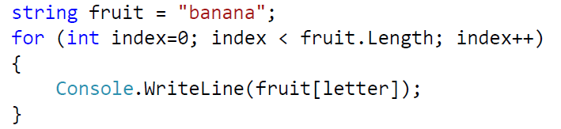
7.3 Traversal
A common thing to do with a string is start at the beginning, select each character in turn, do some computation with it, and continue until the end. This pattern of processing is called a traversal. An example:
Another example using for loop:
Another quick and easy way to iterate over the string but less flexible. Let’s just forget it for now (you’re welcome to test it)

Slide 7
String Methods
Some examples of C# string methods:
string s = "Visual C#";
System.Console.WriteLine(s.Substring(7, 2));
// Output: "C#"
System.Console.WriteLine(s.Replace("C#", "Basic"));
// Output: "Visual Basic Express"
System.Console.WriteLine(s.ToUpper());
// Output: "VISUAL C#"
System.Console.WriteLine(s.Contains("C#"));
//Output: True
System.Console.WriteLine(s.Insert(0, "I like "));
//Output: I like Visual C#

Slide 8
Format Strings
A format string is a string whose contents are determined dynamically at runtime.
Format strings are created by embedding interpolated expressions or placeholders inside of braces within a string.
Everything inside the braces ({...}) will be resolved to a value and output as a formatted string at runtime.
String interpolation (available in C# 6.0 and later):
string name = "John";
int age = 23;
Console.WriteLine($"The age of {name} is {age}.");
Composite formatting:
string name = "John";
int age = 23;
Console.WriteLine("The age of {0} is {1}.", name, age);

Slide 9
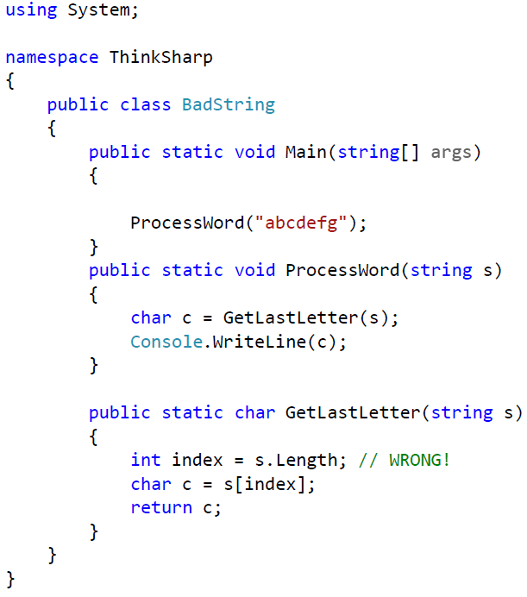
7.4 Run-time Errors
A runtime error is an application error that occurs during program execution. Compile time error occurs during the compilation phase.
Run-time errors don't appear until a program has started running, they are called exceptions.
When it happens, an error message with the type of exception and a stack trace that shows the methods that were running when the exception occurred.

Slide 10
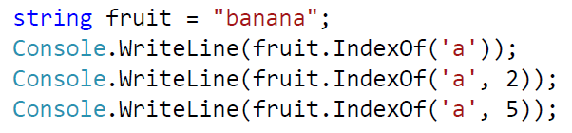
7.5 The IndexOf Method
The [] operator takes an index and returns the character at that index; it fails if the index is out of range and throws an exception.
IndexOf is the inverse of the [] operator, it takes a character and returns the index where that character appears. It fails if the character does not appear in the string and returns the value -1.
Examples:
What will happen if we use fruit.IndexOf('a', 6) ?

Slide 11
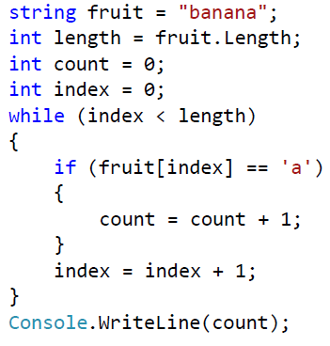
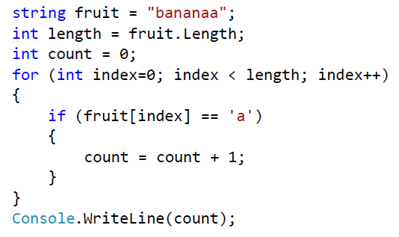
7.7 Looping and Counting
The following program counts the number of times the letter 'a' appears in a string. The variable count is initialized to zero and then incremented each time we found an 'a’.
Another version using for loop
Note that we should use increment operator (++) to make code compact and easy to read

Slide 12
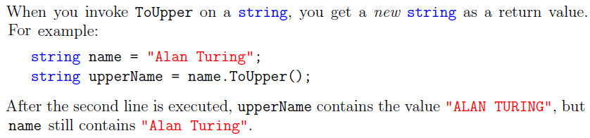
7.9 Strings Are Immutable
String objects are immutable: they cannot be changed after they have been created.
All of the String methods and C# operators that appear to modify a string actually return the results in a new string object.
An example of ToUpper() method to show string immutability:

Slide 13
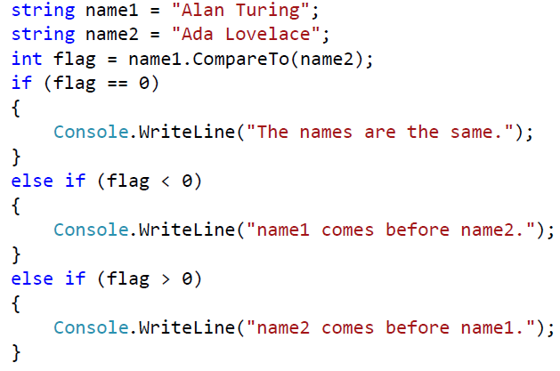
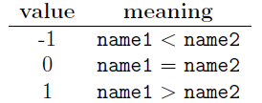
7.10 Strings Are Incomparable
We can use the equality operator (==) to compare if two string are the same.
However, we can not use the < or > operators to see which comes first in alphabetical order.
To compare strings, we have to use the CompareTo method. For example:
Return values:

Slide 14
Appendix B - Input & Output
(Lecture Slides – Week 4)

Slide 15
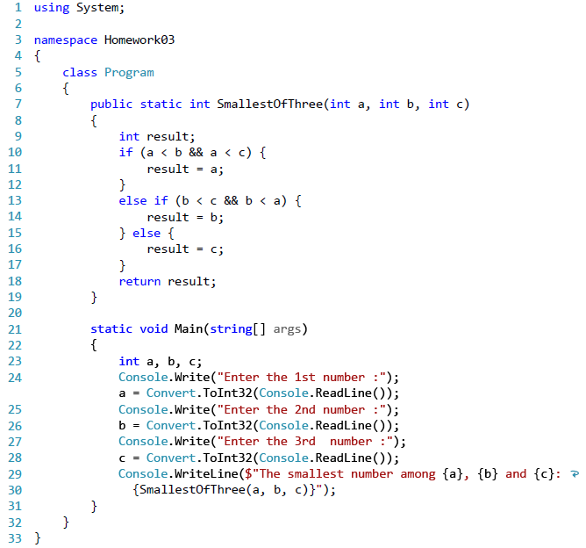
Find the Smallest of Three Numbers

Slide 16
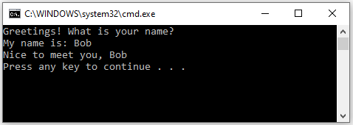
B.1 System Objects
A console is an operating system window through which a user can communicate with the operating system.
The Console class provides methods and objects that get input from the keyboard, output text on the screen. When you invoke Write and WriteLine, ReadKey, ReadLine, etc., you invoke them on Console.
The FileStream class from the System.IO library does the same for file input and output (I/O).

Slide 17
B.2 Keyboard input
Console has methods to get input from the keyboard. There are three methods of interest:
ReadKey() This will wait for the user to press a key, but will return as they have pressed it. Unfortunately it does not return a char, but a ConsoleKeyInfo object.
ReadLine() This will read a line of text from the keyboard. It will only return when the user presses the Enter or Return keys. The text they have typed is returned in a string. Note that the string could be empty if they only pressed the Enter/Return key.
Read() Reads the next character from the standard input stream, it returns the next character (ASCII code) from the input stream, or negative one (-1) if there are currently no more characters to be read. The Read method blocks its return while you type input characters; it terminates when you press the Enter key.
The ReadLine method and ReadKey method are preferable to using the Read method (unrealiable, avoid it).

Slide 18
Console.ReadLine() Method in C#
ReadLine method is used to read the next line of characters from the standard input stream. It comes under the Console class(System Namespace).
If the standard input device is the keyboard (default), the ReadLine method blocks until the user presses the Enter key. If standard input is redirected to a file, then this method reads a line of text from a file.
Syntax: public static string ReadLine();
Return value: It returns the next line of characters of string type from the input stream, or null if no more lines are available.
Can we use ReadLine to take an integer from user input?

Slide 19
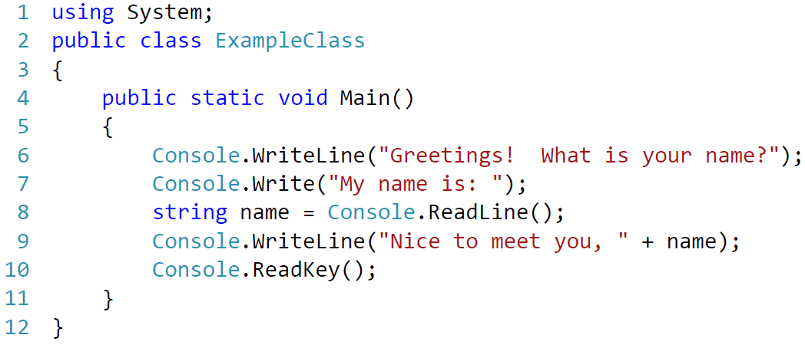
ReadLine() Example
Input can be gathered in a similar method to outputing data using the Read() and ReadLine methods of that same System.Console class. Below is a simple example:

Slide 20
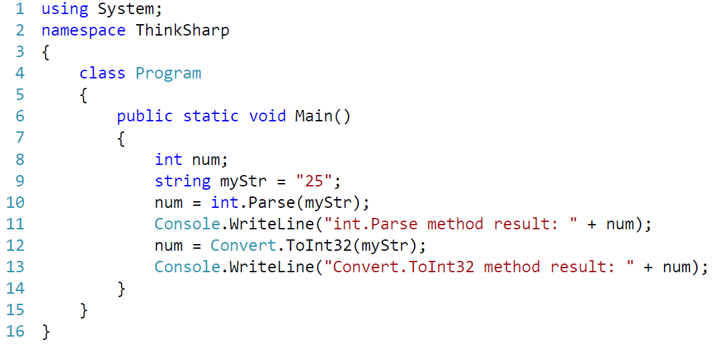
Convert String to Integer
There are three ways to convert it and they are as follows:
Using the Parse method
Using the Convert class from (System.Convert class)
Using the TryParse method (recommended, but we skip it for now)
Examples:

Slide 21
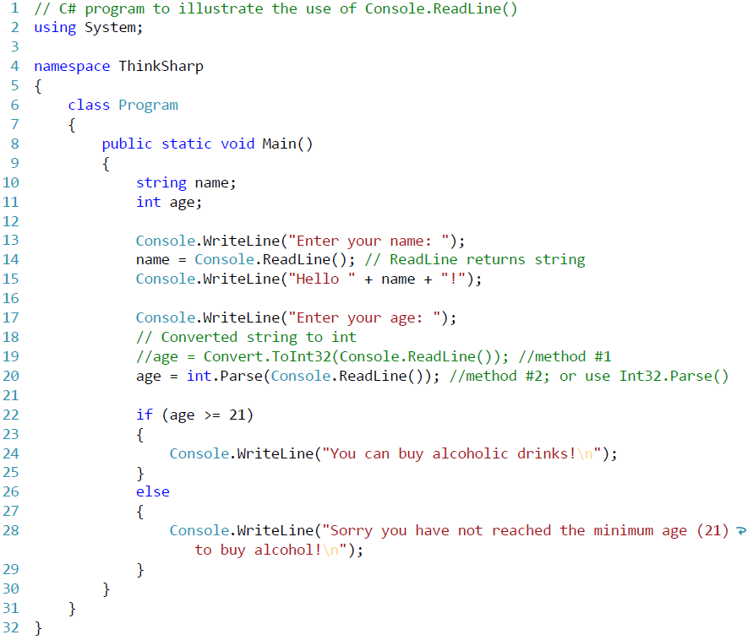
ReadLine() Example

Slide 22
B.3 File Input
All of the file Input and Output (I/O) operations are provided by the System.IO namespace. First you must tell the compiler to use the name space:
using System.IO;
All file I/O is done using data streams. The next thing you need to do is open a data stream reader as a text reader:
TextReader reader = new StreamReader("filename");
Finally, you can invoke ReadLine on reader, to take input from the file and convert it to a string or null if you have reached the end of the file.

Slide 23
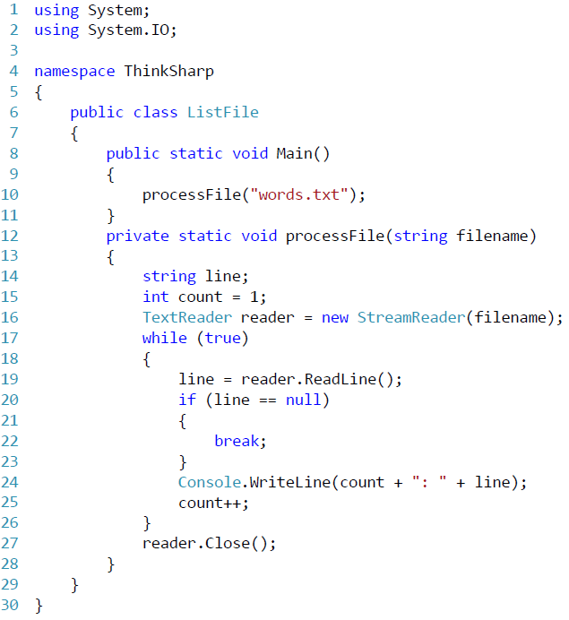
B.3 File input

Slide 24
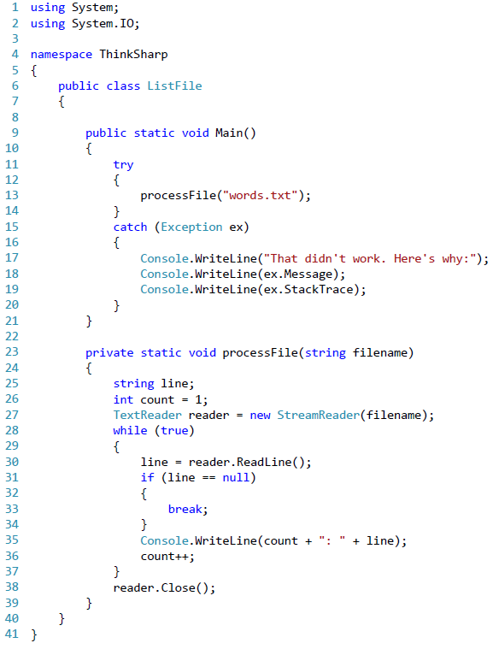
B.4 Catching Exceptions
In the previous example, processFile can throw a FileNotFoundException. And since Main calls processFile, we could catch the exceptions with a try-catch statement. Here's an example:
The structure is similar to an if statement. If the first “branch” runs without causing an Exception, the second branch is skipped.
If the first branch causes an Exception, the flow of execution jumps to the second branch, which tries to deal with the exceptional condition (by saying “error” in a polite way). In this case it prints an error message and the stack trace.

