Slide 1
Week 6
Object-oriented programming (OOP)
Inheritance in C#
Abstraction
Encapsulation
Polymorphism
Chapter 13 - Object-oriented programming
13.7 inheritance
13.8 class hierarchy
Chapter 10 - Arrays

Slide 2
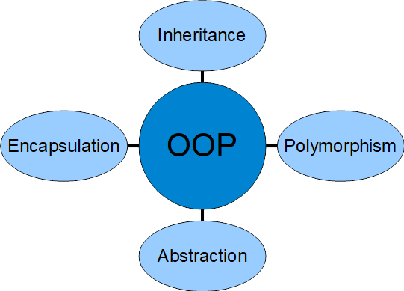
Principles of OOP

Slide 3
Building Blocks of OOP
Classes
Blueprints
Instances
Behaviors
Data
Objects
Methods
Attributes

Slide 4

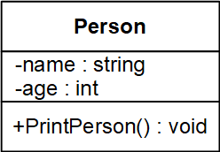
Class & Object – An Example
Let’s make a class called Person:
Class Declaration Syntax:
modifier class <ClassName>
{
// data members (attributes)
// methods (functions)
// others …
}
UML Class Diagram
For more about UML, here are some useful links:
https://www.youtube.com/watch?v=UI6lqHOVHic
(10 minutes video)
https://www.visual-paradigm.com/guide/uml-unified-modeling-language/uml-class-diagram-tutorial/

Slide 5
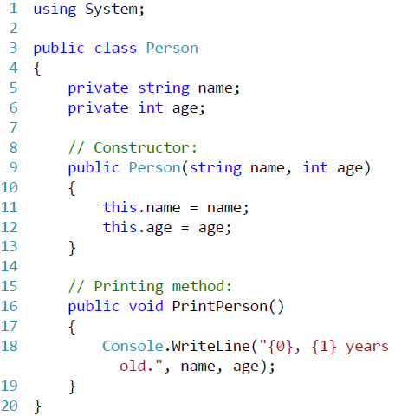
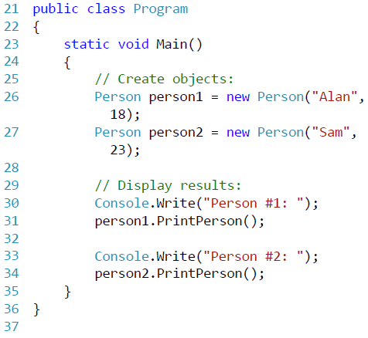
Class & Object – An Example

Slide 6
Class & Object – An Example

Slide 7
Class & Object – An Example

Slide 8
Inheritance in C#
Inheritance is one of the core concepts/features of object-oriented programming (OOP)
It allows you to define a child class that reuses (inherits), extends, or modifies the behavior of a parent class
The class whose members are inherited is called the base class (parent class)
The class that inherits the members of the base class is called the derived class (child class)

Slide 9


What do they have in common?

Slide 10


Slide 11
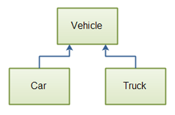

Slide 12
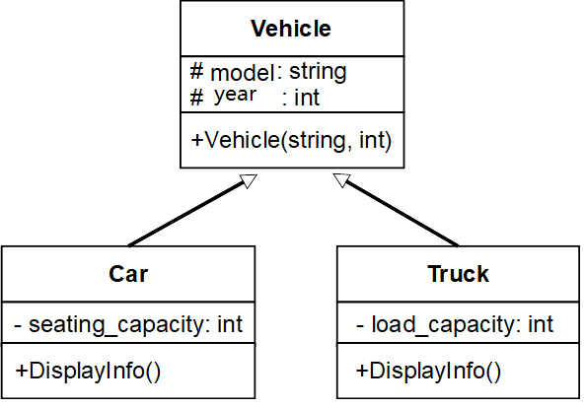
UML Diagram for Vehicle, Car & Truck

Slide 13
public class Vehicle // base class
{
public string model;
public int year;
public Vehicle(string model, int year)
{
this.model = model;
this.year = year;
}
}
public class Car : Vehicle
{
private int seating_capacity;
public Car(string model, int year, int capacity) : base(model, year)
{
seating_capacity = capacity;
}
public void DisplayInfo()
{
Console.WriteLine($"model: {model}, year: {year}, seating capacity: {seating_capacity}");
}
}
public class Truck : Vehicle
{
private int load_capacity;
public Truck(string model, int year, int capacity) : base(model, year)
{
load_capacity = capacity;
}
public void DisplayInfo()
{
Console.WriteLine($"model: {model}, year: {model}, load capacity: {load_capacity} tons");
}
}
public class Program
{
static void Main(string[] args)
{
var car = new Car("Honda Accord", 2019, 5);
var truck = new Truck("kenworth W990", 2020, 50);
car.DisplayInfo();
truck.DisplayInfo();
}
}

Slide 14
Class Inheritance Example
public class Program
{
static void Main(string[] args)
{
Person person = new Person();
person.name = "Allan";
person.age = 21;
Teacher teacher = new Teacher();
teacher.name = "Tom";
teacher.age = 55;
teacher.subject = "Computer Science";
teacher.DisplayNameAge();
Student student = new Student();
student.name = "Sara";
student.age = 19;
student.studentId = 02018001;
student.DisplayNameAge();
}
}
public class Person
{
public string name;
public int age;
public void DisplayNameAge()
{
Console.WriteLine($"{name} is {age} years old.");
}
}
class Teacher : Person // Child class
{
public string subject;
}
class Student : Person // Child class
{
public int studentId;
}

Slide 15
// version 2
using System;
namespace Week14
{ public class Program
{ static void Main(string[] args)
{ Person person = new Person("Allan", 21);
Teacher teacher = new Teacher("Tom", 55, "Computer Science");
teacher.DisplayNameAge();
Student student = new Student("Sara", 19, 02018001);
student.DisplayNameAge();
}
}
class Person // Parent class
{ public string name;
public int age;
public Person(string name, int age)
{ this.name = name;
this.age = age;
}
public void DisplayNameAge()
{ Console.WriteLine($"{name} is {age} years old."); }
}
class Teacher : Person // Child class
{ public string subject;
public Teacher(string name, int age, string subject) : base(name, age)
{ this.subject = subject; }
}
class Student : Person // Child class
{
public int studentId;
public Student(string name, int age, int studentId) : base(name, age)
{ this.studentId = studentId; }
}
}
Version #2 w/ constructors

Slide 16
// version 3
using System;
namespace Week14
{ public class Program
{ static void Main(string[] args)
{ Person person = new Person("Allan", 21);
Teacher teacher = new Teacher("Tom", 55, "Computer Science");
teacher.DisplayNameAge();
Student student = new Student("Sara", 19, 02018001);
student.DisplayNameAge();
}
}
abstract class Person // Parent class
{ public string name;
public int age;
public Person(string name, int age)
{ this.name = name;
this.age = age;
}
public void DisplayNameAge()
{ Console.WriteLine($"{name} is {age} years old."); }
}
class Teacher : Person // Child class
{ public string subject;
public Teacher(string name, int age, string subject) : base(name, age)
{ this.subject = subject; }
}
class Student : Person // Child class
{
public int studentId;
public Student(string name, int age, int studentId) : base(name, age)
{ this.studentId = studentId; }
}
}
Version #3 w/ abstract class

Slide 17
// version 4
using System;
namespace Week14
{ public class Program
{ static void Main(string[] args)
{ Teacher teacher = new Teacher("Tom", 55, "Computer Science");
teacher.DisplayTeacher();
Student student = new Student("Sara", 19, 02018001);
student.DisplayStudent();
}
}
abstract class Person // Parent class
{ public string name;
public int age;
public Person(string name, int age)
{ this.name = name; this.age = age; }
public void DisplayNameAge()
{ Console.WriteLine($"Name：{name}, Age: {age}"); }
}
class Teacher : Person // Child class
{ public string subject;
public Teacher(string name, int age, string subject) : base(name, age)
{ this.subject = subject; }
public void DisplayTeacher()
{ this.DisplayNameAge();
Console.WriteLine($"Teaches {subject}\n");
}
}
class Student : Person // Child class
{ public int studentId;
public Student(string name, int age, int studentId) : base(name, age)
{ this.studentId = studentId; }
public void DisplayStudent()
{ this.DisplayNameAge();
Console.WriteLine($"Student ID: {studentId}");
}
}
}
Version #4 w/ more methods

Slide 18
// version 5
using System;
namespace Week14
{ public class Program
{ static void Main(string[] args)
{ Teacher teacher = new Teacher("Tom", 55, "Computer Science");
teacher.DisplayTeacher();
Student student = new Student("Sara", 19, 02018001);
student.DisplayStudent();
}
}
abstract class Person // Parent class
{ private string name;
private int age;
public Person(string name, int age)
{ this.name = name; this.age = age; }
public void DisplayNameAge()
{ Console.WriteLine($"Name：{name}, Age: {age}"); }
}
class Teacher : Person // Child class
{ private string subject;
public Teacher(string name, int age, string subject) : base(name, age)
{ this.subject = subject; }
public void DisplayTeacher()
{ this.DisplayNameAge();
Console.WriteLine($"Teaches {subject}\n");
}
}
class Student : Person // Child class
{ private int studentId;
public Student(string name, int age, int studentId) : base(name, age)
{ this.studentId = studentId; }
public void DisplayStudent()
{ this.DisplayNameAge();
Console.WriteLine($"Student ID: {studentId}");
}
}
}
Version #5 w/ a bit encapsulation

Slide 19
// version 6 - polymorphism
using System;
namespace Week14
{ public class Program
{ static void Main(string[] args)
{ Teacher teacher = new Teacher("Tom", 55, "Computer Science");
teacher.DisplayInfo();
Student student = new Student("Sara", 19, 02018001);
student.DisplayInfo();
}
}
abstract class Person // Parent class
{ private string name;
private int age;
public Person(string name, int age)
{ this.name = name; this.age = age; }
public virtual void DisplayInfo()
{ Console.WriteLine($"Name：{name}, Age: {age}"); }
}
class Teacher : Person // Child class
{ private string subject;
public Teacher(string name, int age, string subject) : base(name, age)
{ this.subject = subject; }
public override void DisplayInfo()
{ base.DisplayInfo();
Console.WriteLine($"Teaches {subject}\n");
}
}
class Student : Person // Child class
{ private int studentId;
public Student(string name, int age, int studentId) : base(name, age)
{ this.studentId = studentId; }
public override void DisplayInfo()
{ base.DisplayInfo();
Console.WriteLine($"Student ID: {studentId}");
}
}
}
Version #6 w/ polymorphism

Slide 20
// version 7 – more encapsulation thru Properties
using System;
namespace Week14
{ public class Program
{ static void Main(string[] args)
{ Teacher teacher = new Teacher("Tom", 55, "Computer Science");
teacher.DisplayInfo();
Student student = new Student("Sara", 19, 02018001);
student.DisplayInfo();
student.StudentId = 52018001;
student.DisplayInfo();
}
}
abstract class Person // Parent class
{ private string name; private int age;
public Person(string name, int age)
{ this.name = name; this.age = age; }
public virtual void DisplayInfo()
{ Console.WriteLine($"Name：{name}, Age: {age}"); }
}
class Teacher : Person // Child class
{ private string subject;
public Teacher(string name, int age, string subject) : base(name, age)
{ this.subject = subject; }
public override void DisplayInfo()
{ base.DisplayInfo(); Console.WriteLine($"Teaches {subject}\n"); }
}
class Student : Person // Child class
{ private int studentId;
public int StudentId { get { return studentId; } set { studentId = value; } } // Property
public Student(string name, int age, int studentId) : base(name, age)
{ this.studentId = studentId; }
public override void DisplayInfo()
{ base.DisplayInfo();
Console.WriteLine($"Student ID: {studentId}");
}
}
}
Version #7 w/ more encapsulation thru Properties

Slide 21
//textbook page 153-154
using System;
namespace Week14
{ public class Time
{ public int Hour, Minute;
public double Second;
public Time()
{ this.Hour = 0; this.Minute = 0; this.Second = 0.0; }
public Time(int hour, int minute, double second)
{ this.Hour = hour; this.Minute = minute;
this.Second = second;
}
public Time(double seconds)
{ Hour = (int)(seconds / 3600.0);
seconds -= Hour * 3600.0;
Minute = (int)(seconds / 60.0);
Second = seconds - (Minute * 60.0);
}
public double ToSeconds()
{ int minutes = Hour * 60 + Minute;
return minutes * 60 + Second;
}
public string ToString()
{ return String.Format("{0:D2}:{1:D2}:{2:D2}",
Hour, Minute, (int)Second);
}
public bool IsAfter(Time time)
{ return ToSeconds() > time.ToSeconds(); }
public void AddTime(Time time)
{ Hour += time.Hour;
Minute += time.Minute;
Second += time.Second;
adjustForOverflow();
}
public void Increment(double seconds)
{ Second += seconds; adjustForOverflow(); }
private void adjustForOverflow()
{ while (Second >= 60.0)
{ Second -= 60.0; Minute += 1; }
while (Minute > 59)
{ Minute -= 60; Hour += 1; }
}
} // end of class Time
13.7 Example
public class Program
{
static void Main(string[] args)
{
Time t = new Time();
Console.WriteLine(t.ToString());
var dt1 = new DateAndTime();
var dt2 = new DateAndTime(20, 4, 2014, 12, 0, 0);
Console.WriteLine(dt1.ToString());
Console.WriteLine($"{dt2.Year}, {dt2.Month}, {dt2.Day}, {dt2.Hour}, {dt2.Minute}, {dt2.Second}");
}
}
public class DateAndTime : Time
{
public int Day, Month, Year;
public DateAndTime() : base()
{ Day = 0; Month = 0; Year = 0; }
public DateAndTime(int day, int month, int year,
int hour, int minute, double second)
: base(hour, minute, second)
{ Day = day;
Month = month;
Year = year;
}
public void Increment(double seconds)
{
base.Increment(seconds);
adjustForOverflow();
}
private void adjustForOverflow()
{ while (Hour > 23)
{ Hour -= 24;
Day += 1;
}
// TODO: Day overflows into Month
// TODO: Month overflows into Year
}
}

Slide 22
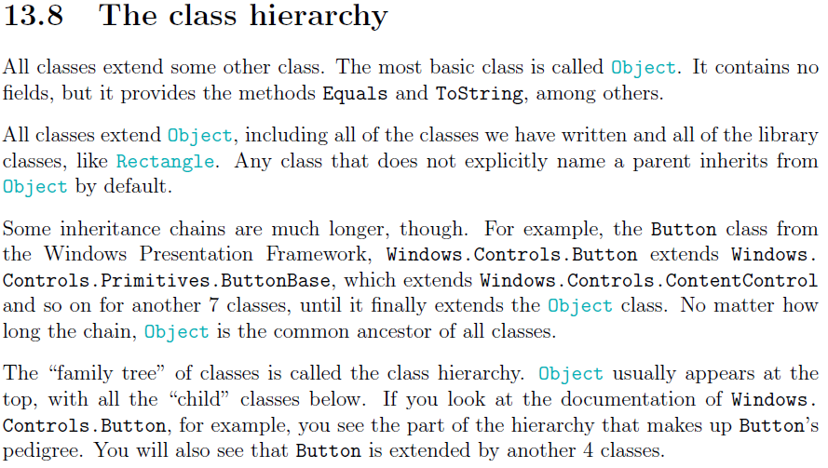
13.8 The class hierarchy

Slide 23
Local, Instance & Static Variables
Local variables
A variable defined within a block or method or constructor is called local variable.
These variable are created when the block is entered or the function is called and destroyed after exiting from the block or when the call returns from the function.
The scope of these variables exists only within the block in which the variable is declared. i.e. we can access these variables only within that block.
Instance variables or Non – Static Variables
Instance variables are non-static variables and are declared in a class but outside any method, constructor or block.
As instance variables are declared in a class, these variables are created when an object of the class is created and destroyed when the object is destroyed. Unlike local variables, we may use access specifiers for instance variables.
Static Variables or Class Variables
These variables are declared using the static keyword within a class outside any method constructor or block.
Unlike instance variables, we can only have one copy of a static variable per class irrespective of how many objects we create.
Static variables are created at the start of program execution and destroyed automatically when execution ends.

Slide 24

Introduction of Array
An array is a set of values where each value is identified by an index.
All the values in an array have to have the same type, ints, doubles, or any other type
Syntactically, array types look like other types except they are followed by [] . Array variables are declared as following and they are set to null:
int[] count;
double[] values;
Use new to create the array
count = new int[4];
values = new double[size];

Slide 25
Create Arrays
// Declare a single-dimensional array of 5 integers.
int[] array1 = new int[5];
// Declare and set array element values.
int[] array2 = new int[] { 1, 3, 5, 7, 9 };
// Alternative syntax.
int[] array3 = { 1, 2, 3, 4, 5, 6 };
// Declare a two dimensional array.
int[,] multiDimensionalArray1 = new int[2, 3];
// Declare and set array element values.
int[,] multiDimensionalArray2 = { { 1, 2, 3 }, { 4, 5, 6 } };
// Declare a jagged array.
int[][] jaggedArray = new int[6][];
// Set the values of the first array in the jagged array structure.
jaggedArray[0] = new int[4] { 1, 2, 3, 4 };
Skip
these

Slide 26

10.1 Accessing Elements
To store values in the array, use the [] operator. For example count[0] refers to the "zeroeth" element of the array, and count[1] refers to the \oneth" element. You can use the [] operator anywhere in an expression:
count[0] = 7;
count[1] = count[0] * 2;
count[2]++;
count[3] -= 60;
You can use any expression as an index, as long as it has type int.
int i = 0;
while (i < 4)
{
Console.WriteLine(count[i]);
i++;
}

Slide 27

10.2 Copying arrays
When you copy an array variable, remember that you are copying a reference to the array. Any changes in either array will be reflected in the other.
double[] a = new double[3];
double[] b = a;
To create a copy of an array, you need something like below:
double[] b = new double[3];
int i = 0;
while (i < 3)
{
b[i] = a[i];
i++;
}

Slide 28
10.3 Arrays and Objects
In many ways, arrays behave like objects:
When you declare an array variable, you get a reference to an array.
You have to use new to create the array itself.
When you pass an array as an argument, you pass a reference, which means that the invoked method can change the contents of the array.
Differences:
The elements of an array are identified by indices, and the elements of an object have names.
Elements of an array have to be the same type. Objects can have fields with different types.

Slide 29
10.4 for loops
for loop vs. while loop:
while (<condition>)
{
<body>
<imcrementor>
}
Example:
int i = 0;
while (i < 4)
{ Console.WriteLine(count[i]);
i++;
}
for (<initializer>; <condition>; <incrementor>)
{
<body>
}
Example:
for (int i = 0; i < 4; i++)
{ Console.WriteLine(count[i]);
}

Slide 30
10.5 foreach loops
A loop statement foreach is used to traverse a collection of items, and the general syntax:
foreach (<type> <variable> in <collection>)
{
<body>
}
An example:
foreach (int item in count)
{
Console.WriteLine(item);
}
The only problem is that the foreach-loop does not guarantee the items will be any particular order. Or even in the same order each time.

Slide 31
10.6 Array length
All arrays have one field named: Length.
Always use this value as the upper bound of a loop, rather than a constant value. That way, if the size of the array changes, you won’t have to go through the program changing all the loops; they will work correctly for any size array.
int[] a = { 1, 2, 3, 4, 5, 6 };
int[] b = new int[6];
for (int i = 0; i < a.Length; i++)
{
b[i] = a[i];
Console.WriteLine(b[i]);
}

Slide 32
Array Properties
An array has the following properties:
Array elements can be of any type, including an array type.
Arrays are zero indexed: an array with n elements is indexed from 0 to n-1.
The default values of numeric array elements are set to zero, and reference elements are set to null.
An array can be Single-Dimensional, Multidimensional or Jagged.
A jagged array is an array of arrays, and therefore its elements are reference types and are initialized to null.
The number of dimensions and the length of each dimension are established when the array instance is created. These values can't be changed during the lifetime of the instance.

Slide 33
10.7 Random Numbers
Random class represents a pseudo-random number generator, which is an algorithm that produces a sequence of numbers that meet certain statistical requirements for randomness. Examples:
The Next() method of System.Random class is used to get a random integer number, and can be overloaded by passing different parameters to it as follows:
Next()
Next(Int32)
Next(Int32, Int32)
// Create a Random object and use it
// to generate some random numbers
Random random = new Random();
int n1 = random.Next();
int n2 = random.Next(101);
int dice = random.Next(1, 7);
// Generate and display 10 random
// integers between 0 and 100
Random rnd = new Random();
for (int i = 0; i <= 10; i++) { Console.WriteLine(rnd.Next(0, 101));
}
// Generate and display 10 random
// floating numbers between 0 and 1.0
Random random = new Random();
for (int i = 0; i < 10; i++)
{
double x = random.NextDouble();
Console.WriteLine(x);
}
// Generate and display 10 random
// floating numbers between 0 and 5.0
Random random = new Random();
for (int i = 0; i < 10; i++)
{
double x = random.NextDouble()*5;
Console.WriteLine(x);
}

Slide 34
using System;
namespace ThinkSharp
{
public class Program
{
public static void Main(string[] args)
{
WriteArray(RandomArray(10));
}
public static int[] RandomArray(int size)
{
Random random = new Random();
int[] array = new int[size];
for (int i = 0; i < array.Length; i++)
{
array[i] = random.Next(0, 100);
}
return array;
}
public static void WriteArray(int[] array)
{
for (int i = 0; i < array.Length; i++)
{
Console.WriteLine(array[i]);
}
}
}
}
10.8 Array of Random Numbers

Slide 35
10.9 Counting
using System;
namespace ThinkSharp
{
public class Program
{
public static void Main(string[] args)
{
int[] scores = RandomArray(20);
WriteArray(scores);
int a = InRange(scores, 90, 100);
int b = InRange(scores, 80, 90);
int c = InRange(scores, 70, 80);
int d = InRange(scores, 60, 70);
int f = InRange(scores, 0, 60);
Console.WriteLine($"{a}, {b}, {c}, { d}, {f}");
}
public static int InRange(int[] array, int low, int high)
{
int count = 0;
foreach (int item in array)
{
if (item >= low && item < high)
{
count++;
}
}
return count;
}
public static int[] RandomArray(int size)
{
Random random = new Random();
int[] array = new int[size];
for (int i = 0; i < array.Length; i++)
{
array[i] = random.Next(0, 100);
}
return array;
}
public static void WriteArray(int[] array)
{
for (int i = 0; i < array.Length; i++)
{
Console.WriteLine(array[i]);
}
}
}
}

Slide 36
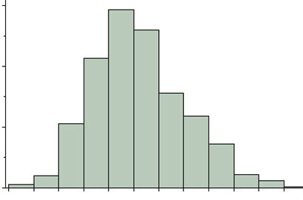
10.10&11 Histogram
using System;
namespace ThinkSharp {
public class Program {
public static void Main(string[] args) {
int[] scores = RandomArray(30);
WriteArray(scores);
int[] counts = new int[100];
for (int i = 0; i < scores.Length; i++) {
int index = scores[i];
counts[index]++;
}
WriteArray(counts);
}
public static int[] RandomArray(int size) {
Random random = new Random();
int[] array = new int[size];
for (int i = 0; i < array.Length; i++) {
array[i] = random.Next(0, 100);
}
return array;
}
public static void WriteArray(int[] array) {
for (int i = 0; i < array.Length; i++) {
Console.WriteLine(array[i]);
}
}
}
}

