Slide 1
Week 8
Data structures
Algorithms and evaluation
Selected topics
Project presentation

Slide 2
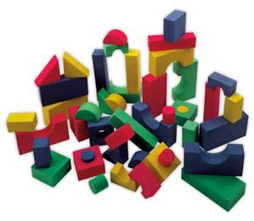
Data Structures
Here are some common data structures:
Arrays
Stacks
Queues
Lists
Hash tables, trees, dictionaries, graphs

Slide 3

Stacks
A stack is a container of objects that are inserted and removed according to the last-in first-out (LIFO) principle.
Objects can be inserted into a stack at any time, but only the most recently inserted (that is, "last") object can be removed at any time.

Slide 4
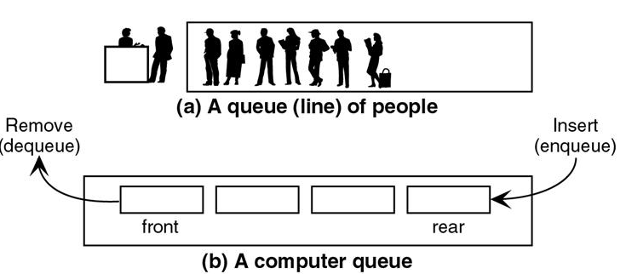
Queues
A queue is a container of elements that are inserted and removed according to the first-in first-out (FIFO) principle. Elements can be inserted in a queue at any time, but only the element that has been in the queue the longest can be removed at any time

Slide 5
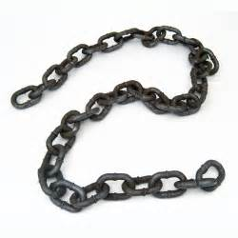

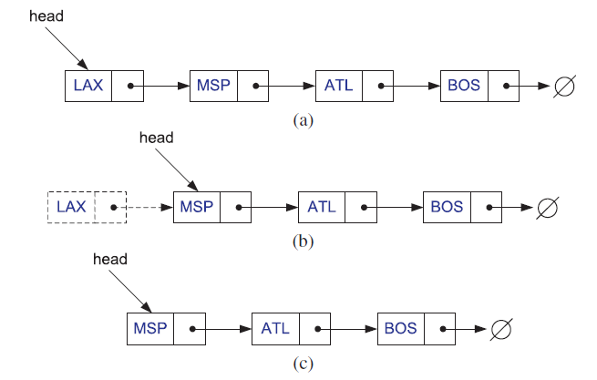
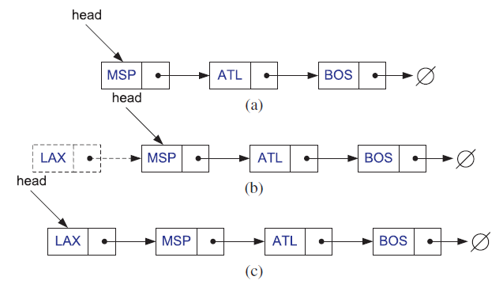
Singly Linked Lists
A linked list, in its simplest form, is a collection of nodes that together form a linear ordering.
Removal from the Front:
Insertion to the Front

Slide 6
public class Node
{
public Node Next;
public object Value;
}
public class LinkedList
{
private Node head;
private Node current;
public int Count;
}
public LinkedList()
{
head = new Node();
current = head;
}
public void InsertToFront(object data)
{
Node newNode = new Node() { Value = data };
newNode.Next = head.Next;//new node points to the previous 1st node
head.Next = newNode;//and now head will refer to new node
Count++;
}
https://www.codeproject.com/Articles/1104980/Linked-List-Implementation-in-Csharp
A simple implementation using class

Slide 7
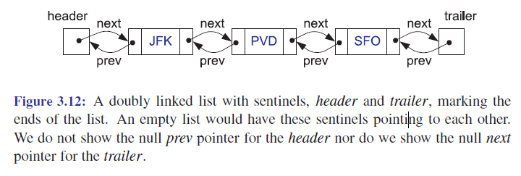
Doubly Linked Lists (DLL)
Doubly linked list allows us to go in both directions—forward
and reverse—, a node in a doubly linked list stores two pointers, a next link and a prev link, which point to the next node in the list and the previous node in the list, respectively:

Slide 8
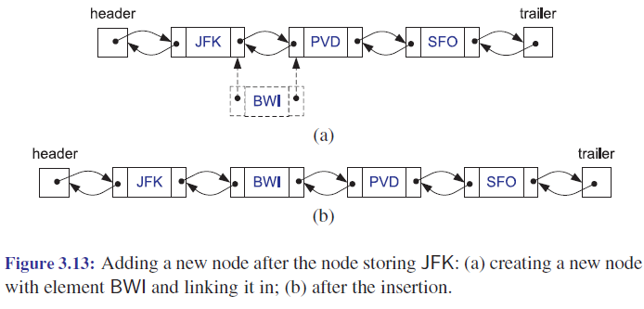
Insertion into a Doubly Linked List

Slide 9
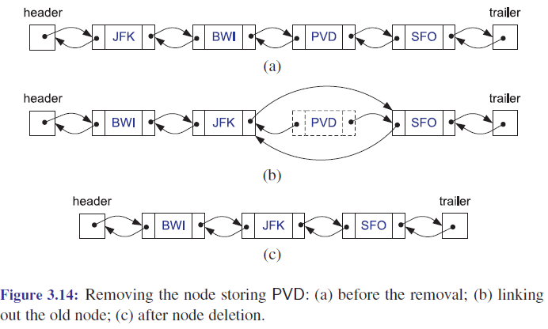
Removal from a Doubly Linked List

Slide 10

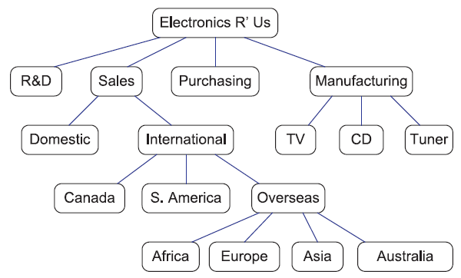
Trees

Slide 11
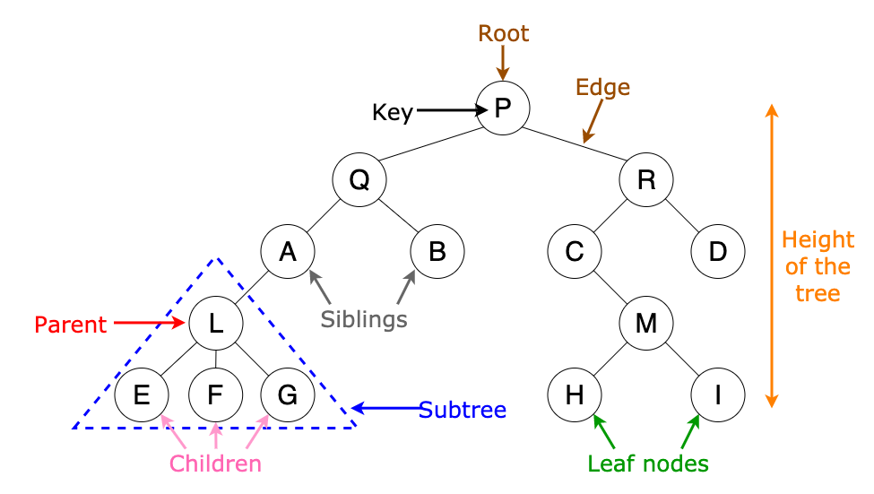
Trees
https://www.c-sharpcorner.com/article/tree-data-structure/

Slide 12
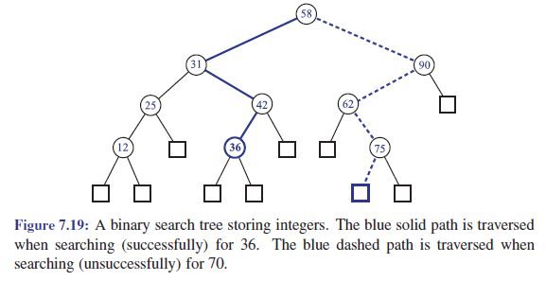
Binary Search Tree (BST)
A binary search tree is a proper binary tree T such that:
Each internal node p of T stores an element of S, denoted with x(p)
Values in left subtree of p <= values in the right subtree of p
The external nodes of T do not store any element

Slide 13

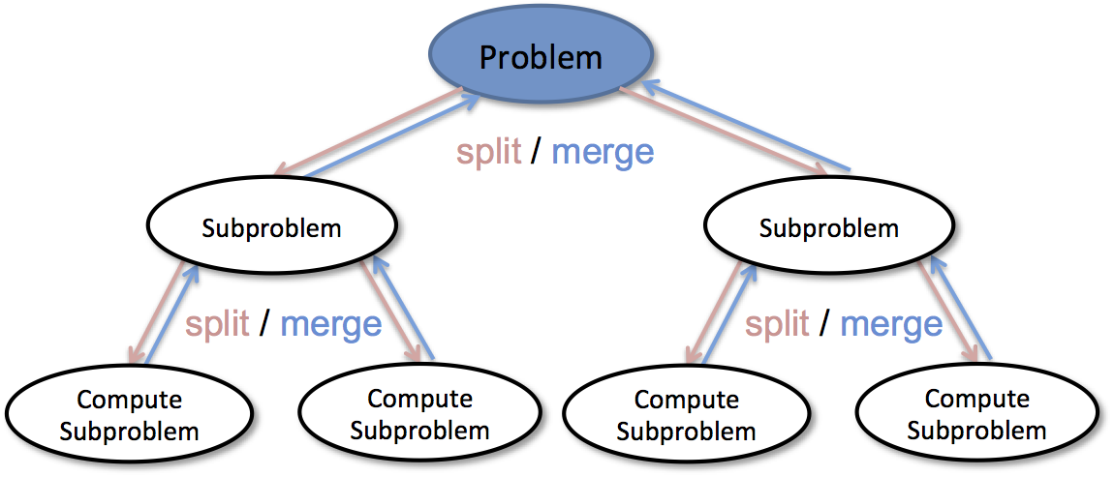
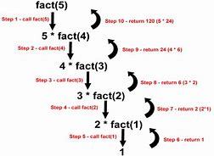

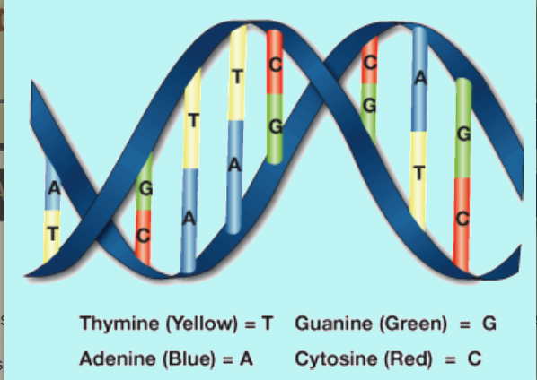
Common Program Design Patterns
Brute Force
Divide-and-Conquer
or Decrease-and-Conquer
Recursion
Greedy Method
Dynamic Programming

Slide 14


How to Evaluate an Algorithm?
There are many criteria for evaluating an algorithm
Time is the most important one!
A computer does its work by computing
Computing time depends on hardware, algorithm, input size etc.
The larger the input size, the more computing time
Others being equal, an algorithm can be evaluated by running time vs. input size
Speed of computing depends on hardware, algorithm, etc.

Slide 15
Mathematical Functions for Analysis of Algorithm
The seven useful math functions are:
Constant Function ━ f(n) = c
Logarithm Function ━ f(n) = log₂n
Linear Function ━ f(n) = n
N-Log-N Function ━ f(n) = n*log₂n
Quadratic Function ━ f(n) = n²
Cubic Function and Other Polynomials
━ f(n) = n³, f(n) = a₀ + a₁n + a₂n² + … + a_{d} n^{d}
Exponential Function ━ f(n) = b^{n}

Slide 16
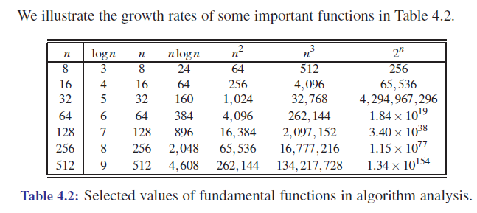
Asymptotic Analysis
Our seven functions are ordered by increasing growth rate in the sequence below:
Good
Bad

Slide 17
Comparing Popular Sorting Algorithms
Name | Performance (best/average/worst)
Bubble sort | n | n² | n²
Insertion sort | n | n² | n²
Selection sort | n² | n² | n²
Heap sort | nlogn | nlogn | nlogn
Merge sort | nlogn | nlogn | nlogn
Quick sort | nlogn | nlogn | n²
Bucket sort | n + N | n + N | n + N

