Slide 1
Project -Pipeline
Umer Ahmed Sajid

Slide 2
Project Description
Using websockets and Alpaca API gathered streaming stock data of APPL, MSFT and TSLA
Using JUPYTER notebook ingested the streaming data into a single node KAFKA cluster by creating a producer in python.
Using scala to create KAFKA consumer to read the incoming data stream and process it.
Using spark to create and transform the consumed data in to required dataframes for further analysis.
Using MONGODB to store the transformed data analysis.

Slide 3
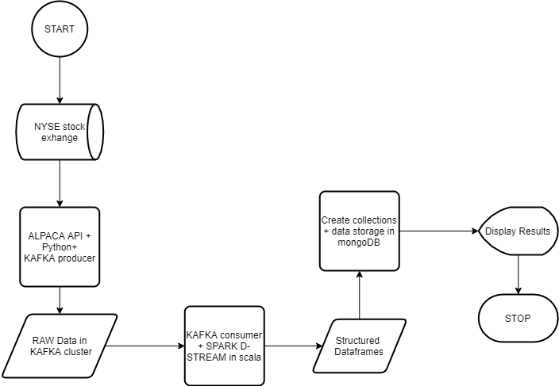
Flow Diagram

Slide 4
Rationale
Python is used for producing data because ALPACA API currently only offer the API in python and not in scala
Scala is used for consuming and processing the data because it is 10 time faster the python due to JVM. Also when working with less number of processor scala performs better with spark as compared to python.
Scala allows developers to write efficient, readable and maintainable services without dangling the program code into an unreadable cobweb of call-backs. Python, to the contrary, does support heavyweight process forking using uwsgi but it does not support true multithreading.
MongoDB is used because it has developed a large and mature platform ecosystem, has a worldwide community of developers and consultants so it is easy to get help and the document data model is a powerful way to store and retrieve data

