Slide 1
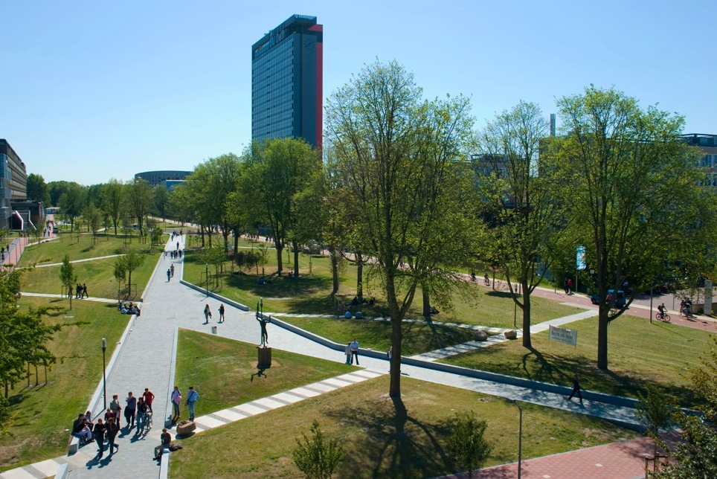
TI3800 Bachelor Project
Jaap van Touw
“A non-centralized approach to Video on Demand on mobile devices.”
“A non-centralized approach to Video on Demand on mobile devices.”
Notes:
30 sec
Introduce jury and yourself

Slide 2
Overview
Introduction
Research Question
Orientation
Design
Implementation
Demo
Conclusion
Notes:
15 sec
Walk them through the outline

Slide 3
Introduction
Bachelor Project
  Proof of concept
  The different stages:
    Plan of Action
    Orientation
    Design
    Implementation
    Final Report
    Presentation
Notes:
30 sec
Tell about how and in what stage Martijn and Jan-Willem helped

Slide 4
Motivation
Mobile Internet traffic increase
Popularity Tablets
Tribler
  Video on Demand
Notes:
Mobile vs desktop 2017.
In response to this growth and to meet the increasing demands of the market, the development of
a mobile version of Tribler would be of great value.

Slide 5
“How can we make Video on Demand available on mobile devices using a non-centralized approach?”
Notes:
20 sec

Slide 6
Orientation
Non-Centralization
Mobile Devices
Video on Demand
  Video decoding
Notes:
30 sec
outline

Slide 7
Non-Centralization vs Central Servers
Peer-to-Peer (P2P) | Client-server
Community driven | Server Owner
Low-cost | Maintenance costs
Reliable | If server fails...
Complex | Relatively Simple
Hard to take down | Prone to attacks
Notes:
2 min
Interesting part, audience will not know much about this, so be clear

Slide 8
The News
Internet Kill Switches
  May 2013, New York Times: “Syria Loses Access to the Internet”
Internet Censorship...
Notes:
2 min
Hot topic

Slide 9
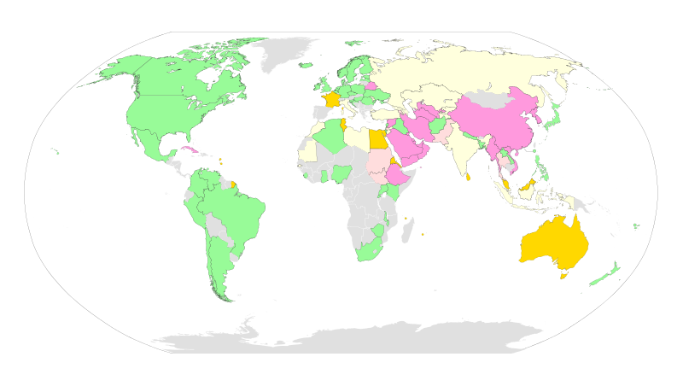
Internet Censorship
Notes:
1 min
Explain important stuff only

Slide 10
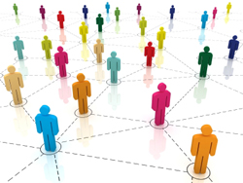
P2P Communication
Torrents
  Descriptor files
  How do they work
    Bittorrent, Libtorrent
    Collecting different pieces of a file
Notes:
3 min
Go Fish → white-board
Torrents contain meta-data with information about the files, folder structure and how to get the files themselves (trackers)

Slide 11
The market share of different mobile platforms
Source: Strategy Analytics, August 2013
Notes:
30 sec
Non-centralization, done, now on to part 2 of the research question

Slide 12



Video on Demand
Notes:
1 min
Video on demand, what kind of experience

Slide 13
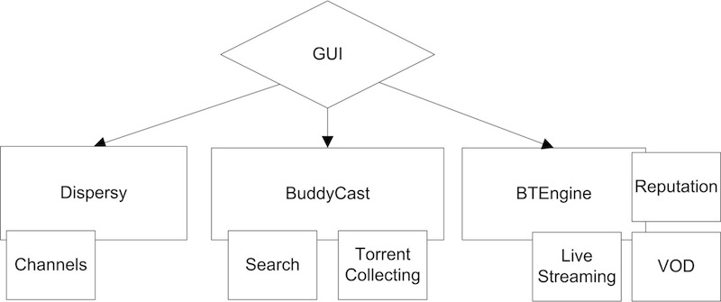
Tribler Architecture and Features
Notes:
1 min
What makes Tribler special outside of the standard client stuff, only explain
VOD
LibTorrent
Desktop environment

Slide 14
Share of supported multimedia file formats.
For source, see final report page 36
Notes:
30 sec
Tell about overlay,
Dolphin has all codecs that stagefright has, VLC has all codecs that Dolphin and stagefright have

Slide 15
Design of the prototype
Tribler Streaming
VLC
Libtorrent
Android
Network
Graphics
Notes:
1 min
Simplified design, tell what we made and what we got/modified to our needs

Slide 16
Implementation Challenges
Libtorrent
  Boost
  RuTracker
VLC and Streaming
Notes:
4 min,
Tell that you are going deeper and be specific about the challenges

Slide 17
Demo
Notes:
7 min
Show use case
Download torrent, and play
Different (already downloaded) torrent (only last played video stays live)

Slide 18
Conclusion
Answer to the Research Question
Contributions
  An open source streaming application on Android which can hardly be taken down.
Limitations
  No support for video's divided over different files.
  No play-list support.
  The torrent has to be downloaded externally.
  Download speed dependent on external factors
Notes:
3 min
(ISP's Download Speed, number of seeders, Wi-Fi connection quality, etc).

Slide 19
Future Work
Polish for release
Play-list support, support for multiple files
Magnet links
Search Functionality
Anonymous Tunneling
Port to other mobile platforms
...
Notes:
1.5 min

Slide 20
Questions?

