Slide 1
Lending Club Case Study
Javvaji Gokul
Krishnendra Nandi

Slide 2
Data Cleansing and Filtering
Removed all behavioral columns as was given by facilitators as people who are applying the loans wont have that data
Removed columns having all rows as null
Unique data keys (id, member_id, url) have no bearing on analysis
Emp_title & Title have no role in analysis
Zip code is of no significance
Removed all columns having null values at least 70%
Removed all singleton value columns ( columns having just 1 value)

Slide 3
Data Assumptions
Emp length not mentioned has been considered as -1 for visualization purposes
Since we are considering defaulted loans , hence we didn’t consider “Current” as Loan status in our analysis
Home ownership had “None” which was just very insignificant count (count=3) , hence removed it
Removed outliers from Annual Income by considering 95 percentile data

Slide 4
Data type Conversions
Interest rate columns converted to numeric for analysis
Term column in months was filtered by removing additional string and then converting to numeric
Derived columns of year and month extracted from issue data
Sub_Grade Column – Since we have grade column we converted the sub_grade column to numerical column for better analysis
We created bins for interest rate and annual income columns

Slide 5
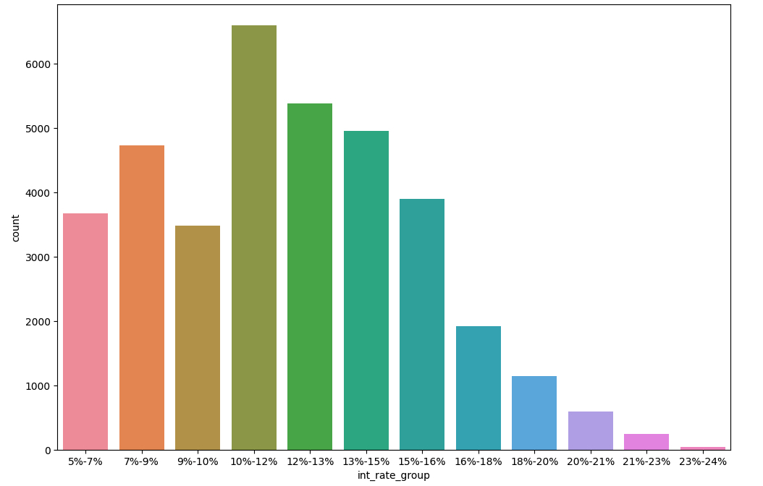
Interest Rate

Slide 6
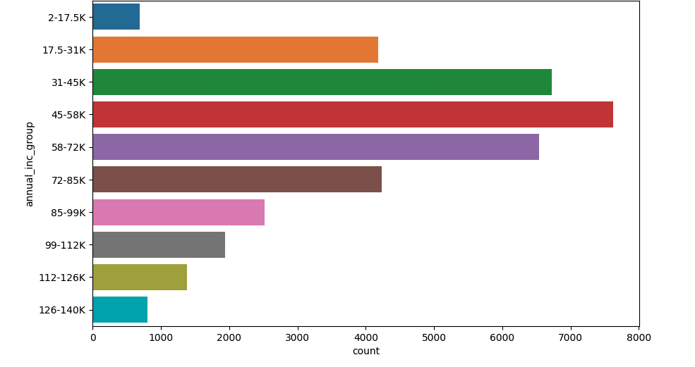
Annual Income Group

Slide 7
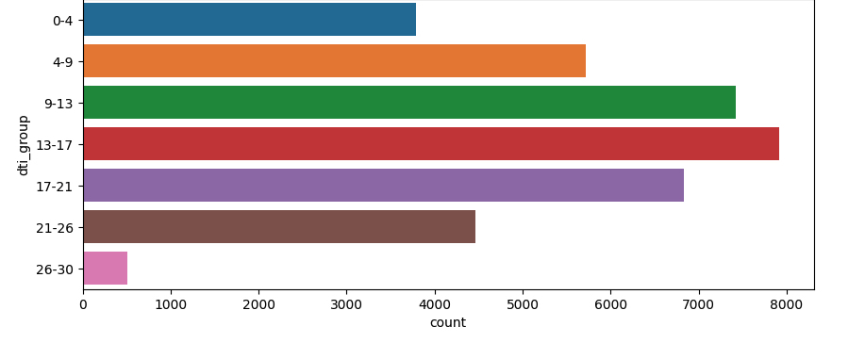
DTI Group

Slide 8
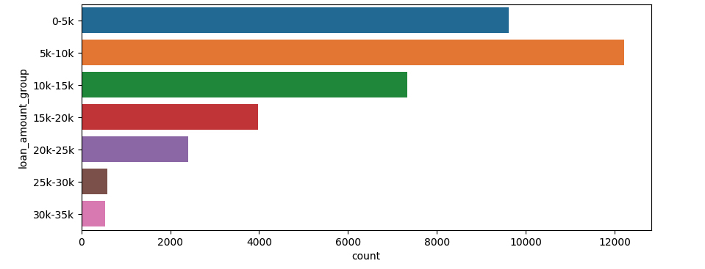
Loan Amount Group

Slide 9
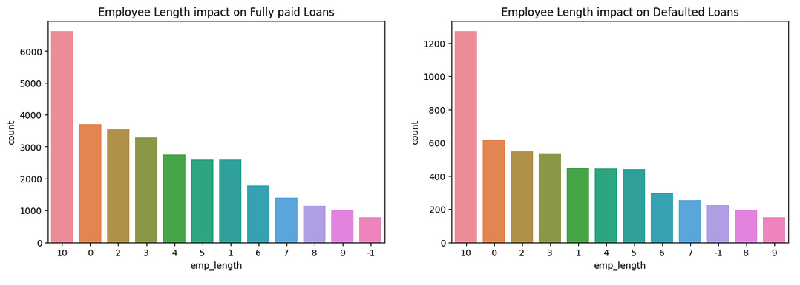
Employee Length Impact

Slide 10
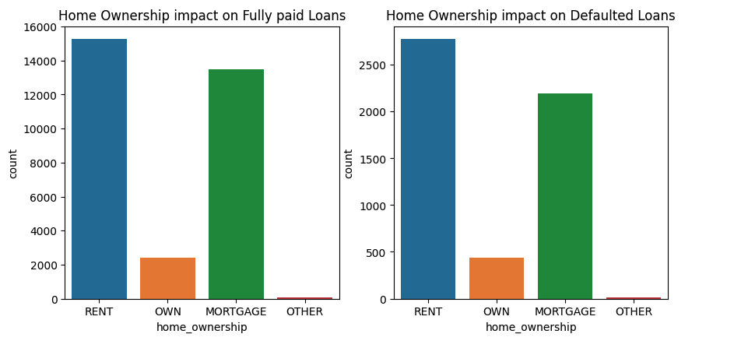
Home Ownership Impact

Slide 11
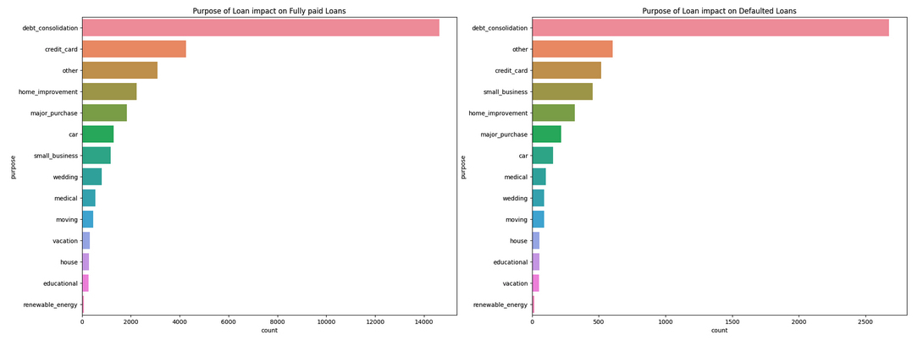
Purpose of Loan Impact

Slide 12
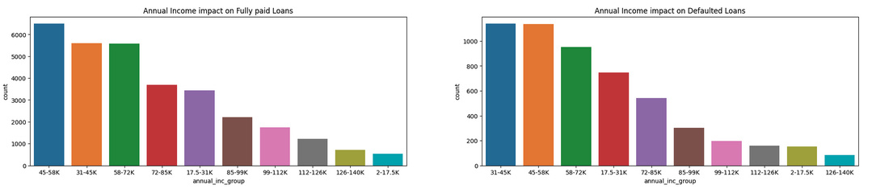
Annual Income Impact

Slide 13
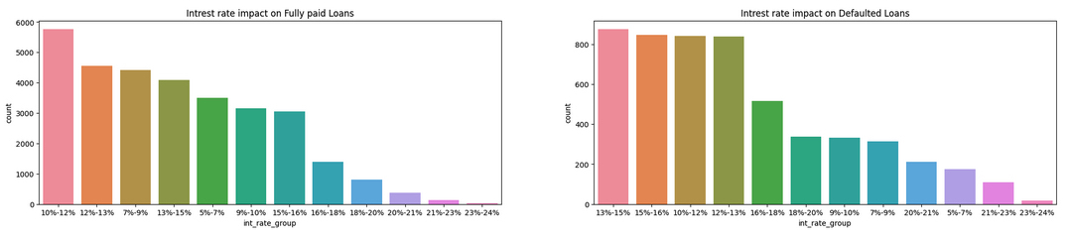
Interest Rate Impact

Slide 14
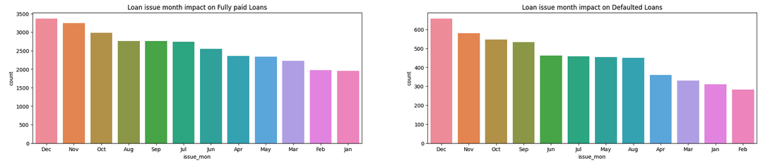
Issue Month Impact

Slide 15
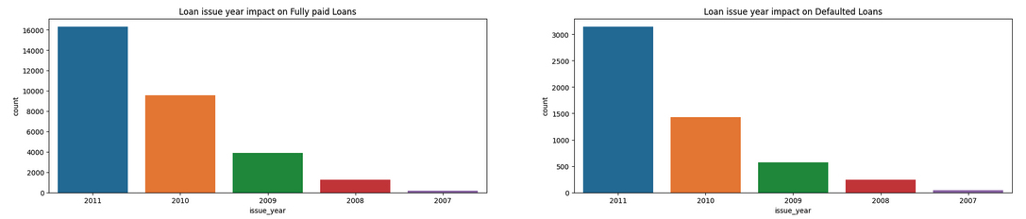
Issue Year Impact

Slide 16
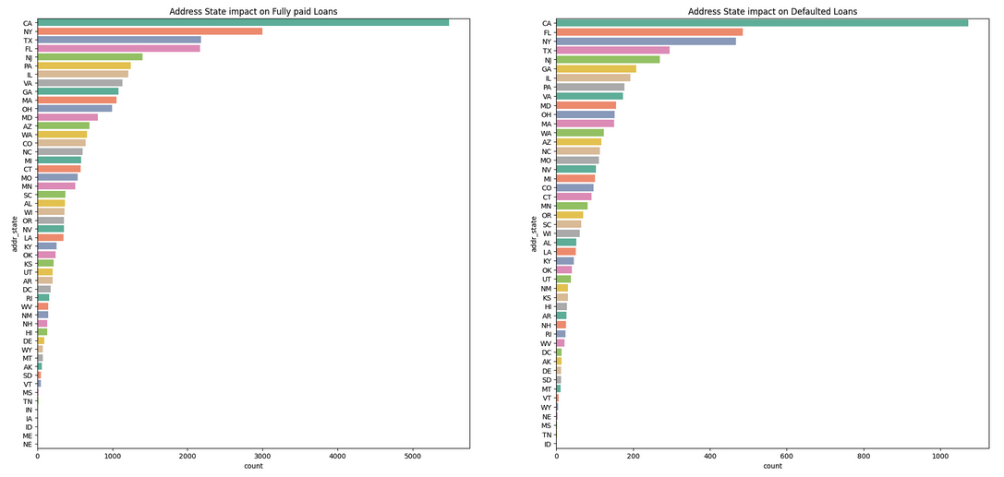
Address State Impact

Slide 17
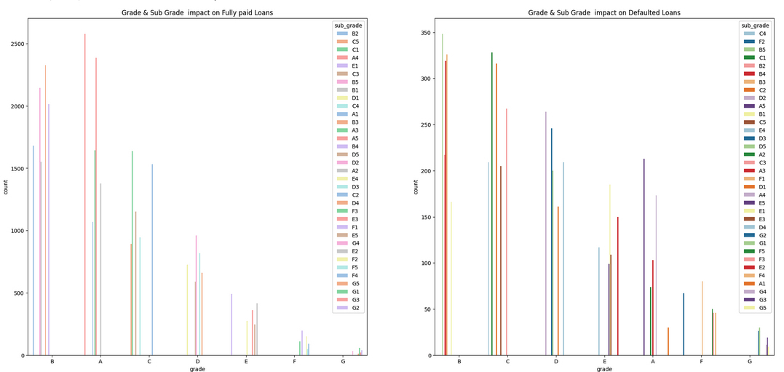
Grade and Sub Grade Impact

Slide 18
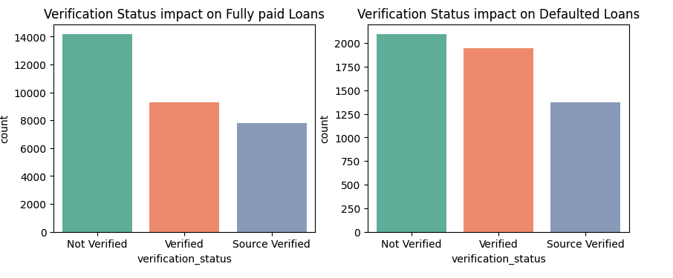
Verification Status Impact

Slide 19
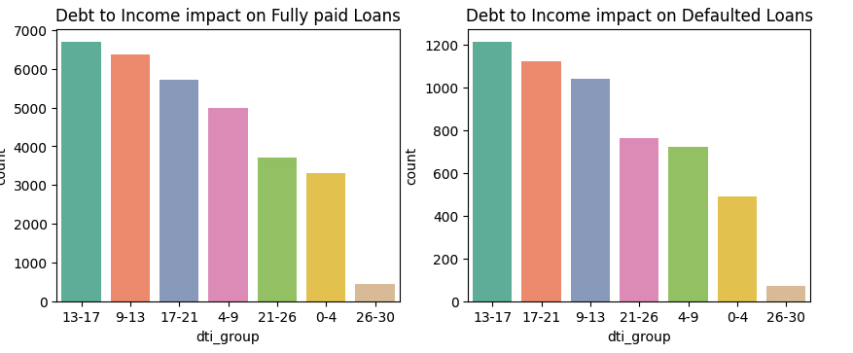
Debt to income Impact

Slide 20
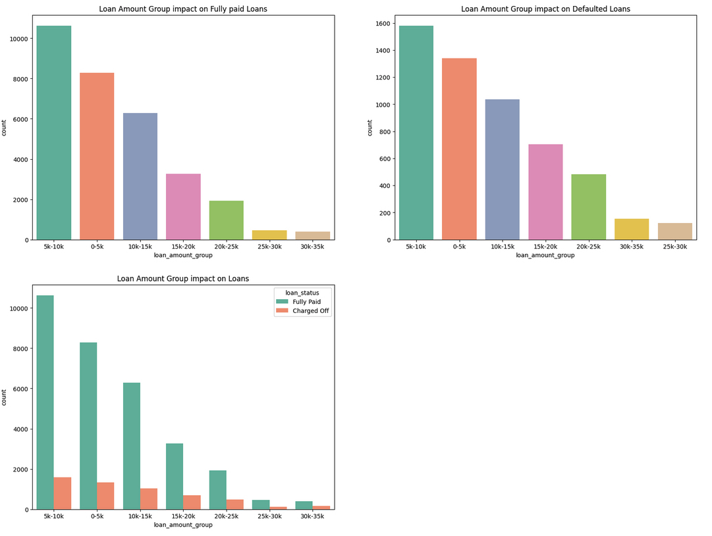
Loan Amount Group Impact

Slide 21
Some Observations so far
10+ , <1 or No work experience Customers have mostly defaulted the loans.
Customers who are on rent house or mortgaged house are more likely to default than who own a house.
Debt consolidation is highest factor for taking loans and then defaulting the loan. So, while giving loan Approver we have to be mindful and check all necessary parameters for approving the loan.
30K-70K(this fig is derived from by analysing 31-45K, 45-58K, 58-72K groups) range annual income customers are more likely to default loan.
13-15% int rate loans are mostly defaulted customers. If we consolidate four buckets(13-15%, 15-16%, 10-12%, 12-13%) we can infer and say 10-16% int rate loans are more likely to default the loan.
Dec Month loans are most defaulted loans, Cusomers who take loan in Sep, Oct, Nov, Dec are more likely to default , may be they are taking loans to pay off other debts as they are nearing to year end.
Loan year pattern suggests us , year on year default loans are increasing and loan applications are increasing. At 2011 year more number of default loans occurred. Financial Crisis / Recission or other global factors might be reason for that.
Though California customers took more no of loans and then defaulted. Florida Customers have defaulted more loans if we consider the ratio of loans taken and defaulted.
B5, C1 grade loans are most defaulted loans.
Unverified loans(non BGV) loans are risky loans and defaulted loans. So, verification about customer helps in reducing the risk.
most of the customers who apply for loan falls in 13-17 dti range and they are also more likely to default the loans.
5-10K loan are most defaulted as well as applied loans.

Slide 22
Some more Observations
Loans can be given to Mid Work Experience customers.
credit card loan purpose customers are mindful about their credit score, so loan issuing to them would reduce risk of loan.
A grade loans can be approved with less risk.

Slide 23
Bivariate Analysis

Slide 24
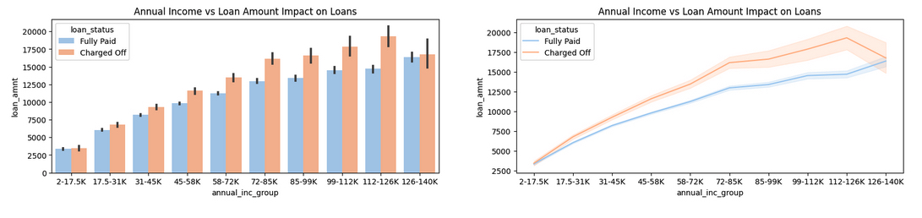
Annual Income vs Loan Amount
Defaulted Loans have highest loan amount across all groups. 2. In case of Defaulted Loans, applied loan amount follows negative trend after 126K income range customers

Slide 25
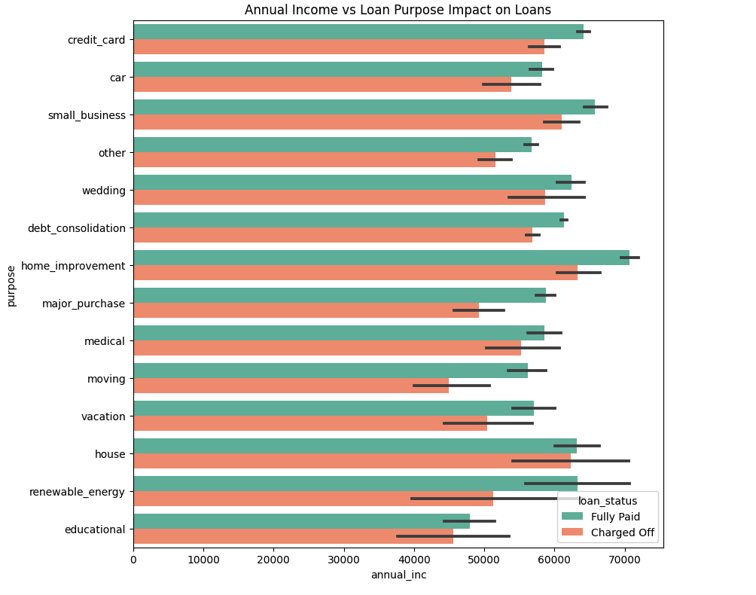
Annual Income vs Purpose
Highest Annual Income Customers take loan on purpose of Home Improvement, house. We see Most defaulted loans also in these categories only

Slide 26
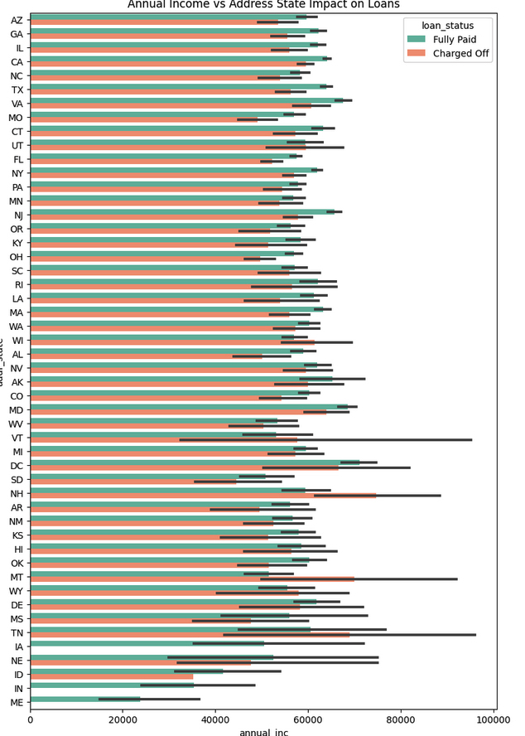
Annual Income vs State
There are no Defaulted Loans in IN, ME States

Slide 27
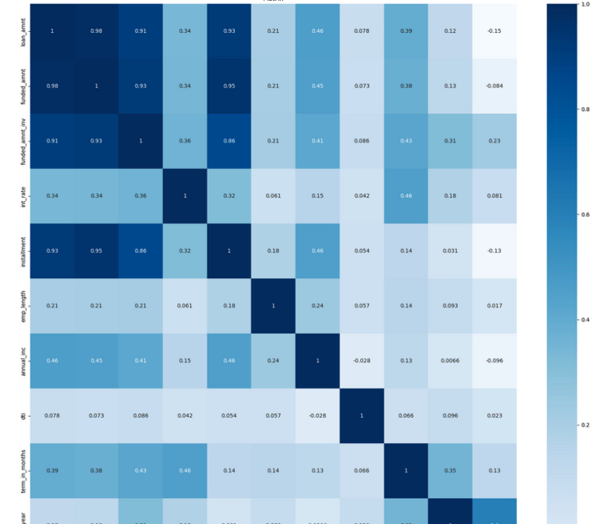
Correlation Heat Map
loan_ratio has positive correlation with issue_year( means a year must have been targetted for growth, or YOY targets have been revised and are upwards

Slide 28
Thanks

