Slide 1

COVID-19 PREDICTION MODEL
Using Regression
Student Name | Roll No. | Mentored By
S Revanth | 160118733041 | Smt. Isha Padhy
Siva Rama Krishna | 160118733048 | Smt. K. Mary Sudha Rani
Yashwanth Javvaji | 160118733060 | Dr. Sangeetha Gupta

Slide 2

The COVID-19 pandemic has affected our lives in many ways with large scale infections and loss of lives, Economies Crashing and many other indirect consequences.

Slide 3
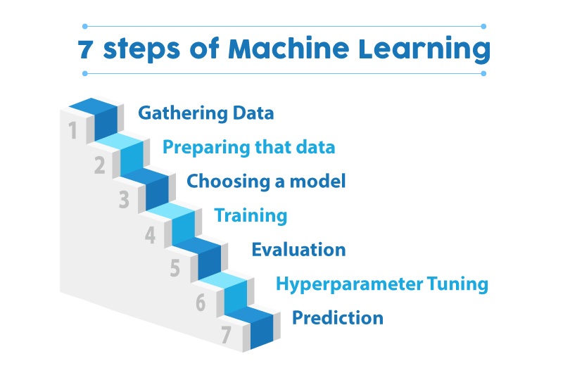

Slide 4
What Is Regression?

Slide 5
Regression analysis is a statistical method to model the relationship between various quantities.
It usually involves two quantities, a dependable variable and one (or more) explanatory response.

Slide 6
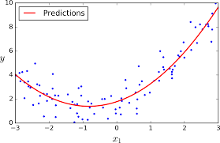
Simple Machine Learning Model

Slide 7
Our Motivation
To develop a
Covid-19 Prediction model using Machine Learning with various features demonstrated in the upcoming slides.

Slide 8
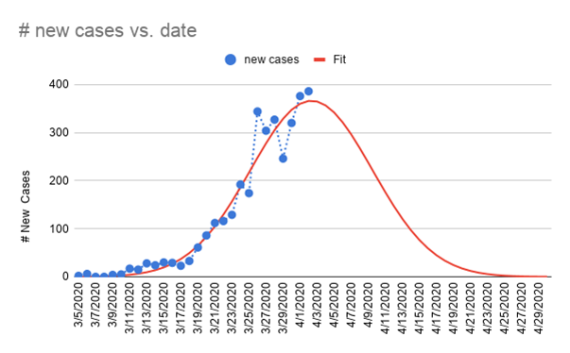
Functionality:
Exploration
This is the most basic functionality where-in we extrapolate the available data to predict the number of cases in the future

Slide 9
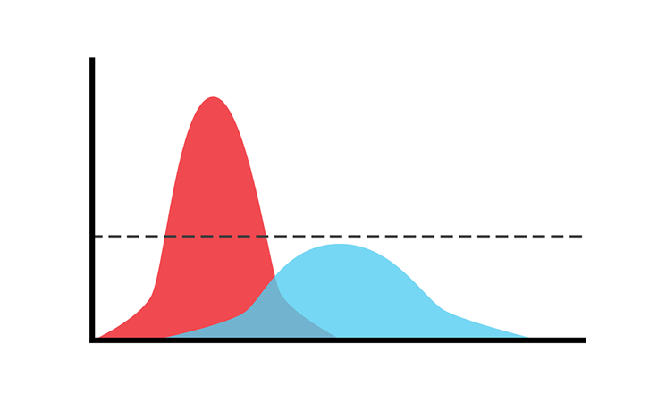
Functionality: Peak Prediction
This is an addition over the previous feature and can be used to predict when the pandemic will end based on the currently available data.

Slide 10
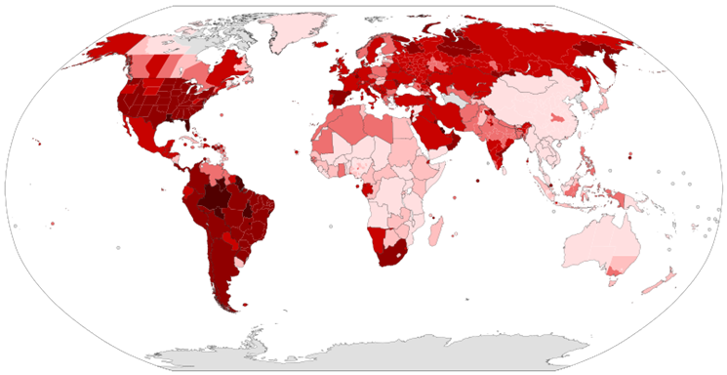
Functionality :Worst Affected Place
This feature can be used by the concerned Health and Administrative Authorities to manage the situation at the particular area.

Slide 11
For the Prediction Model
Scikit Learn as ML Framework.
Numpy and Pandas for Data Analytics.
For Web Development and deploying
HTML
CSS
JS
MATERIALIZE CSS
HEROKU (deployment)
If time permits
TensorFlow/Tableau
Technologies Used

Slide 12
Scikit learn features
Supervised Learning Models
Unsupervised Learning Models
Model Selection and Evaluation
Inspection of Features
Visualizations
Dataset Transformations
Dataset Loading Utilities
Computing

Slide 13
Pandas
NumPy
Pandas is a fast, powerful, flexible and easy to use opensource data analysis and manipulation tool, built on top of the Python programming language.
NumPy brings the computational power of languages like C and Fortran to Python, a language much easier to learn and use. With this power comes simplicity: a solution in NumPy is often clear and elegant.

Slide 14
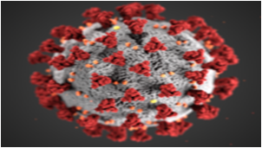
Future of this Model
This model can be used by Health Authorities to understand how diseases spread and can be generalized to other contagious diseases.

Slide 15
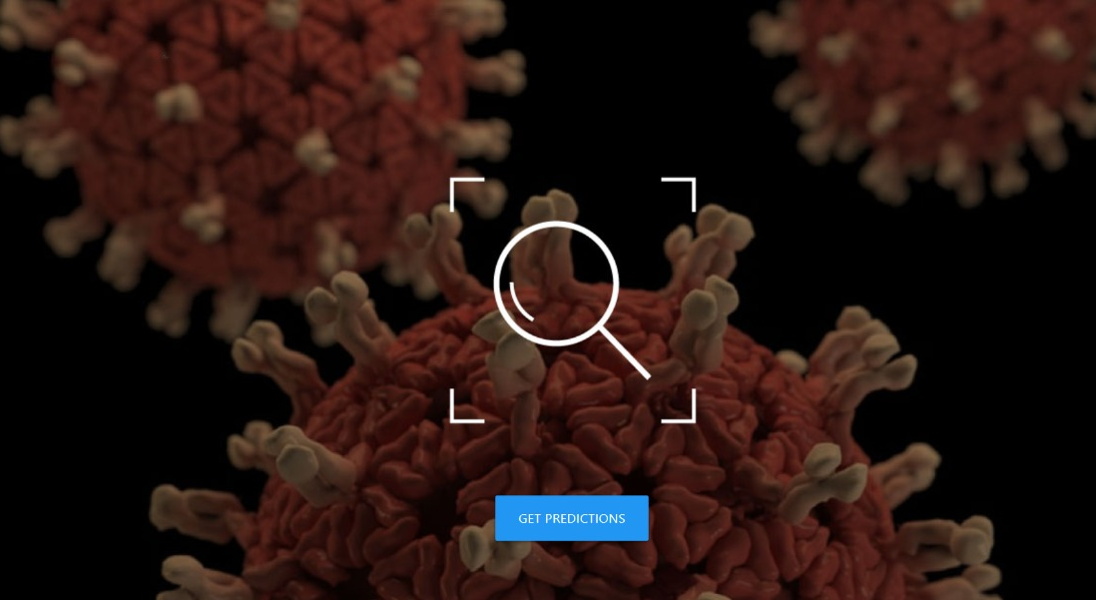

Slide 16
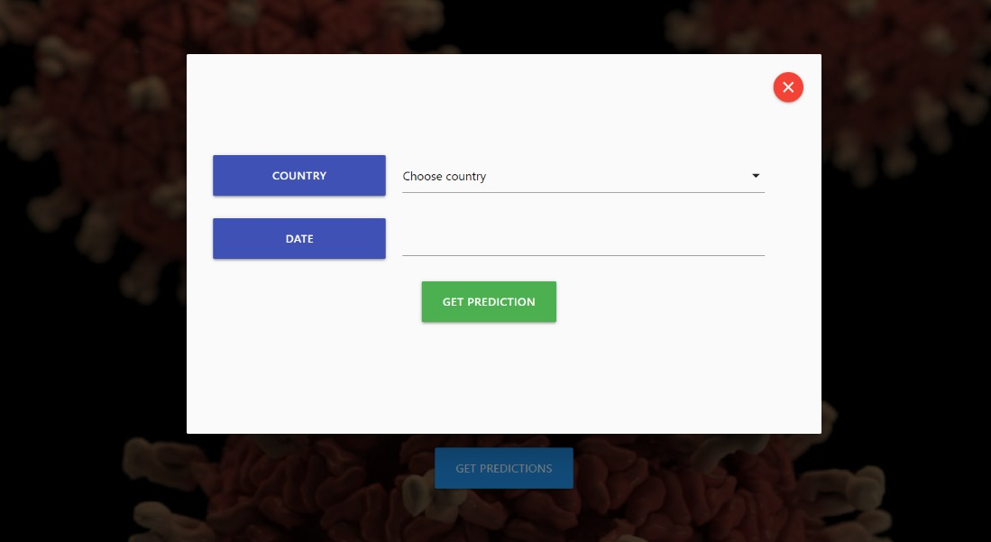

Slide 17
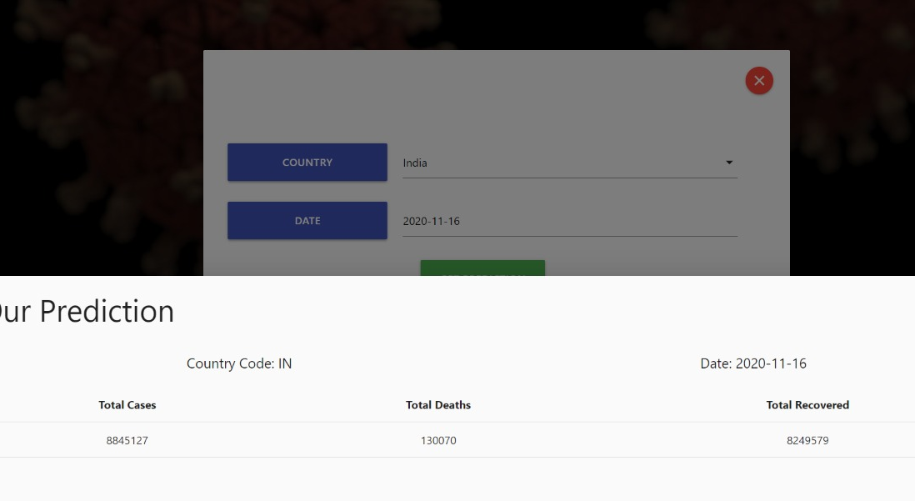

Slide 18


Slide 19
Thank you

